Slide 1








TASKTRACK: An Assignment Tracker App
A Web App for Student Assignment & Deadline Management
Presented by:
Rayen Leigh C. Elecho
Jerriel Aljamz L. Salih

Slide 2

What is TaskTrack?
TaskTrack is a web application designed to help students organize assignments, track due dates, and reduce stress caused by poor time management. ¹

Slide 3
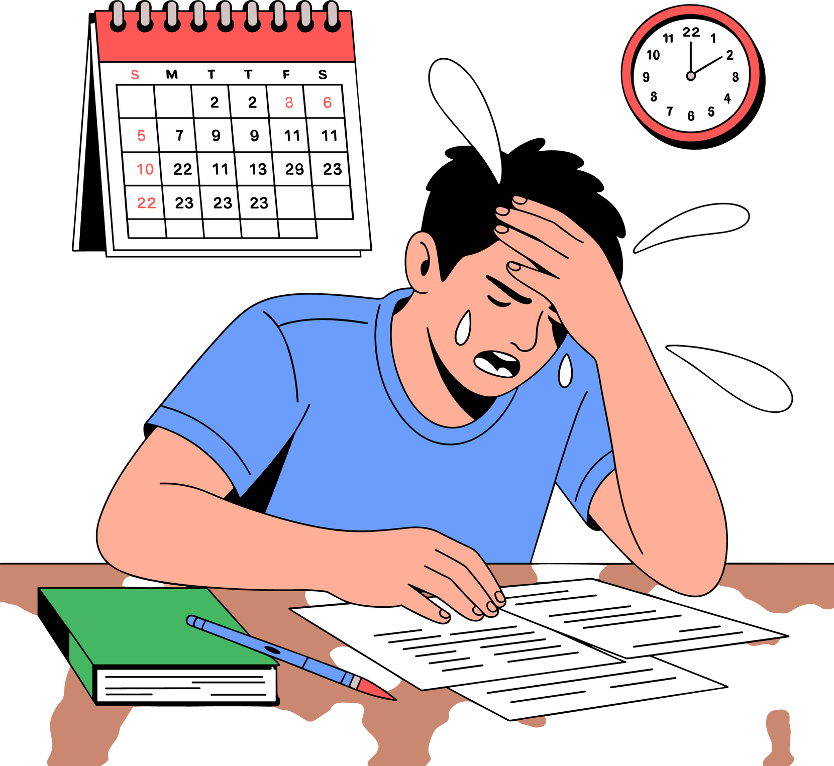
Why Did We Create TaskTrack?
Many students struggle with:
Managing multiple tasks
Forgetting deadlines
Submitting late work
Getting stressed due to disorganization
2
This leads to poor grades, low productivity, and higher stress levels.

Slide 4

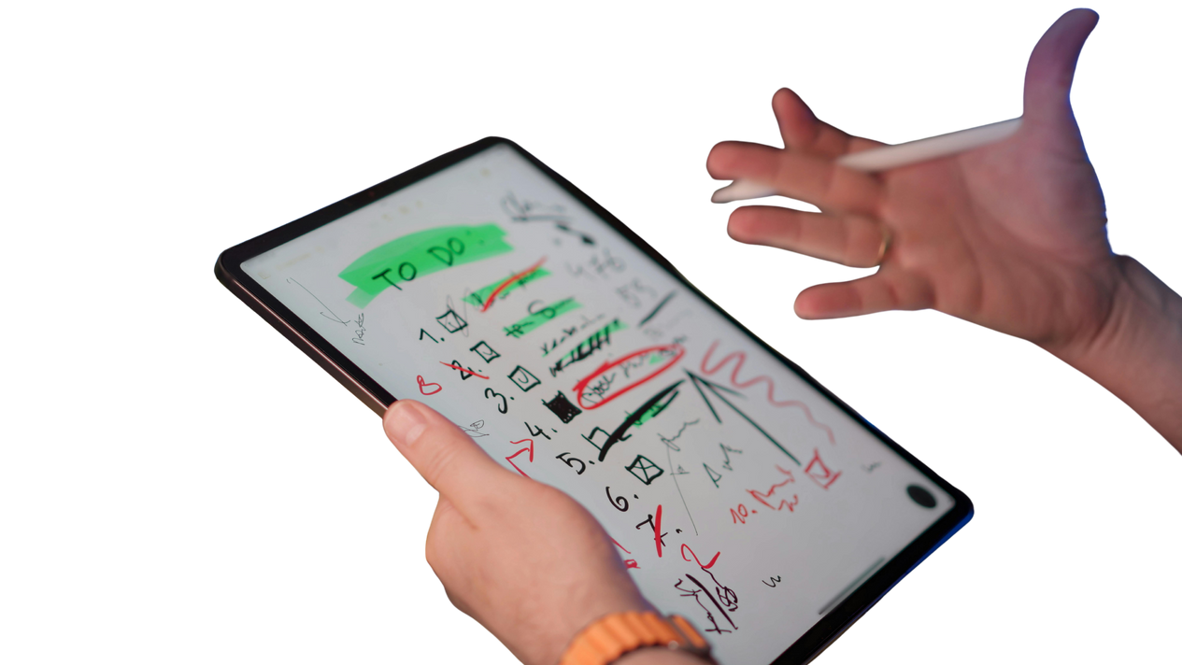


What TaskTrack Aims to Achieve
To allow users to enter and store assignment details such as subject, task, and due date.
To automatically arrange assignments based on their due dates.
To compute and display the number of days left before each assignment is due.
To show reminders for assignments that are due within a set number of days.
To save assignment data locally so it is not lost after closing the program.

Slide 5
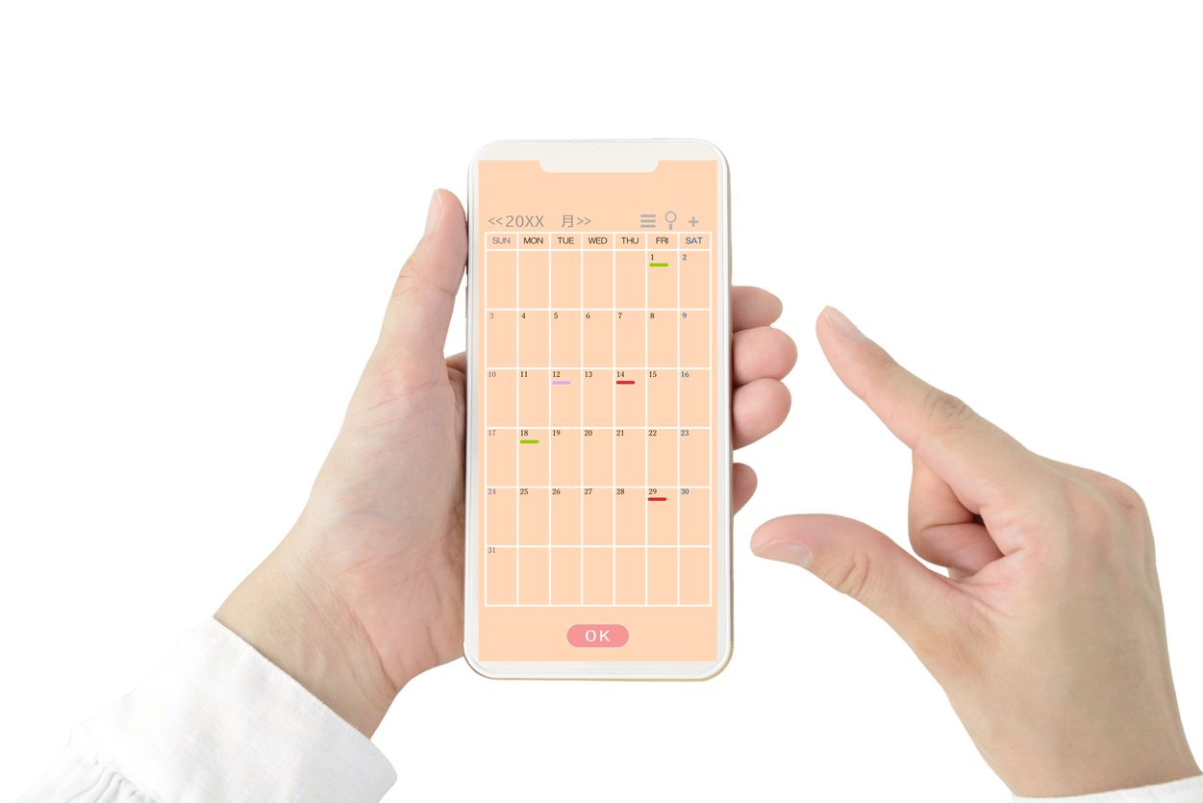






Key Features
Add & Manage
Assignments
Automatic Deadline Sorting
Reminder Notifications
Local Storage
Data saved even after closing
Simple User Interface

Slide 6
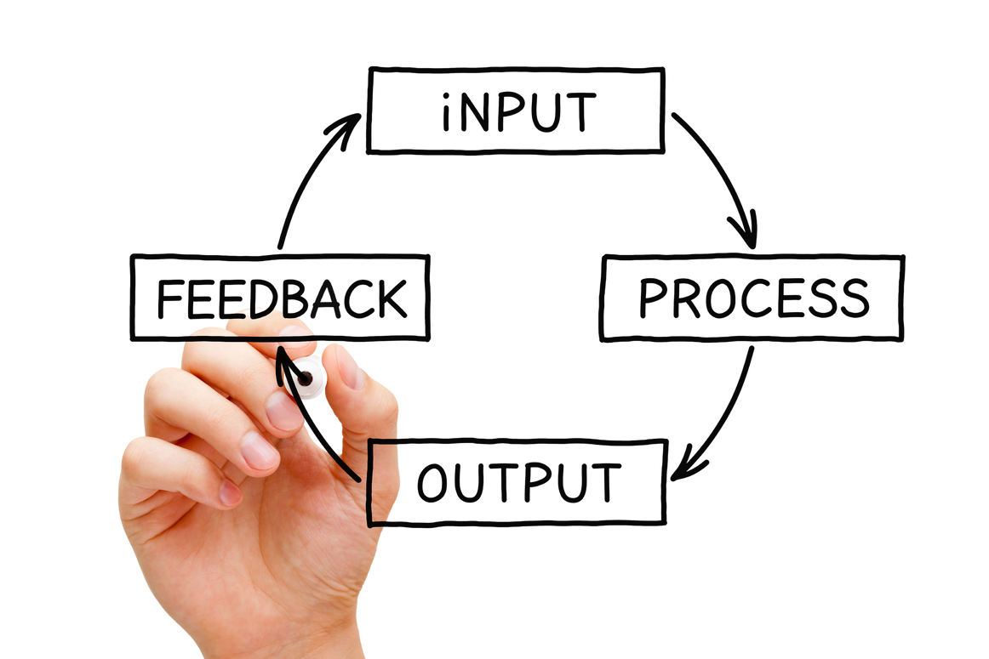
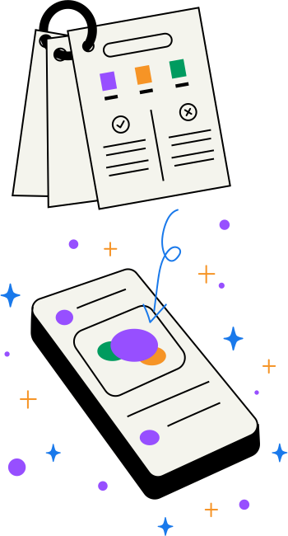


User Inputs & System Outputs
User Inputs
System Outputs
Subject name
Task description
Due date (MM-DD-YYYY)
Sorted task list
Days left until deadlines
Reminder notifications
Example: "CS-2 Project is due in 3 days."

Slide 7

Logic Flow
User adds assignment
System saves to local storage
Tasks auto-sort by due date
Days left are calculated
Reminder appears for near deadlines

Slide 8
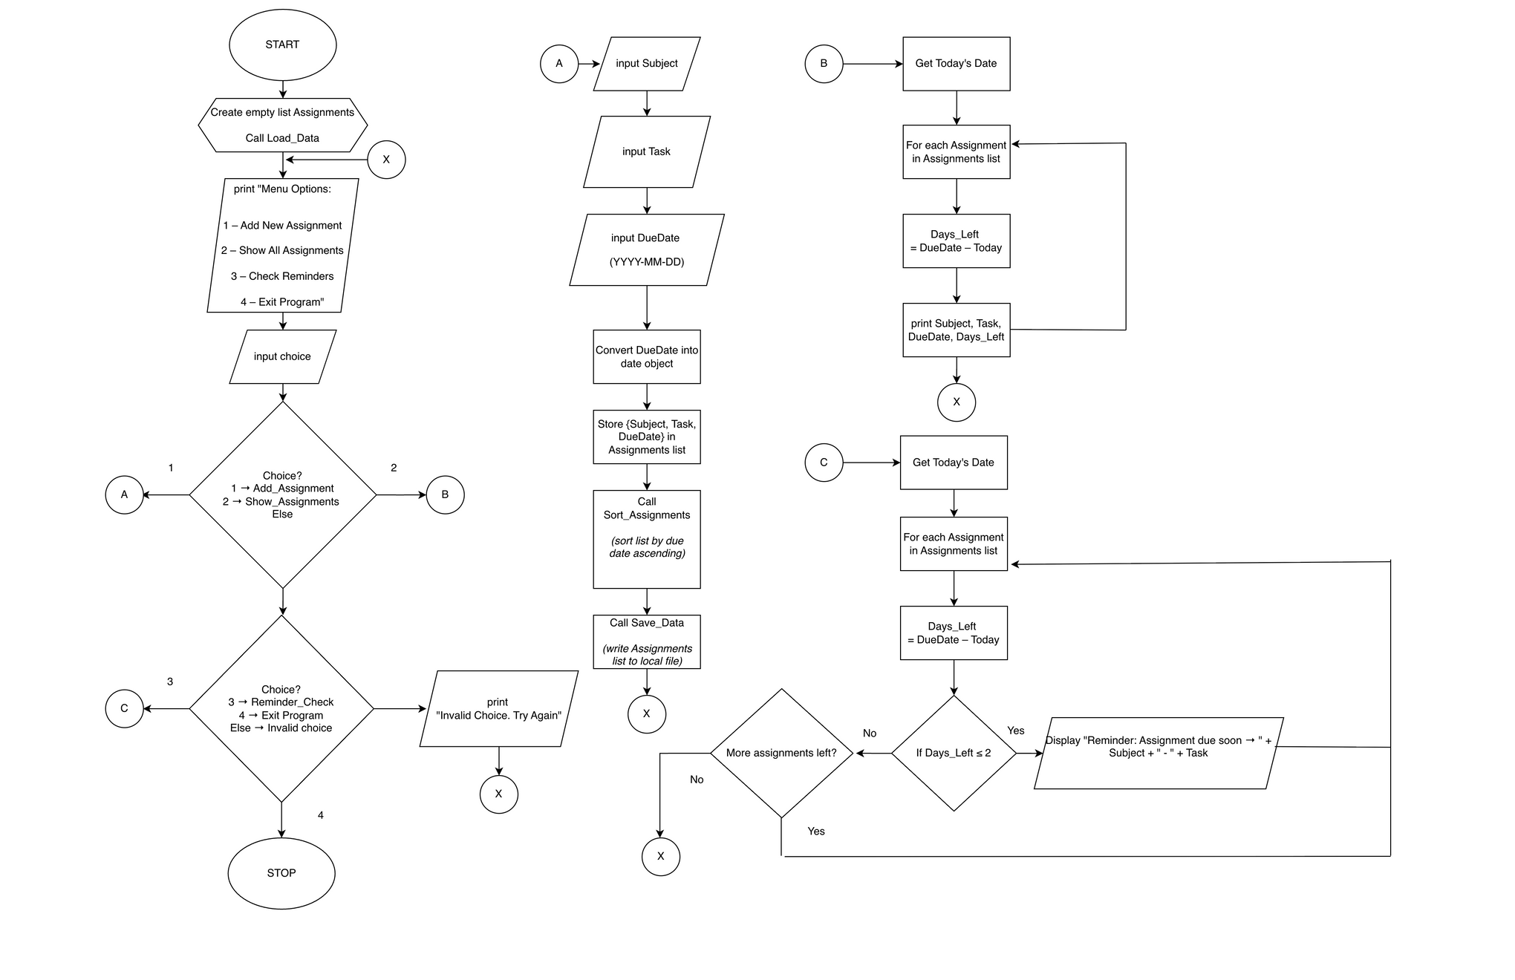



Logic Plan (Flowchart)

Slide 9

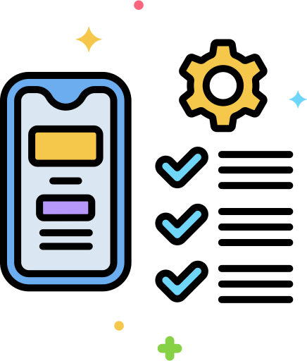

Why Students Will Love TaskTrack
Improves Time Management
Avoids Late Submissions
Reduces Stress
Keeps Workload Visible ³
Easy to Use

Slide 10


Conclusion
TaskTrack is a helpful, simple tool for staying organized, productive, and stress-free.
Future Enhancements
We look forward to expanding TaskTrack with additional features to better serve students in their academic journey.

Slide 11


References:
¹ https://www.frontiersin.org/journals/psychology/articles/10.3389/fpsyg.2022.886344
² https://bmcmededuc.biomedcentral.com/articles/10.1186/s12909-020-02254-1
³ https://psycnet.apa.org/record/2018-20216-001

Slide 12



Presented to: Ma’am Dachel Raagas

