Slide 1

1/501
INF-1

Slide 2
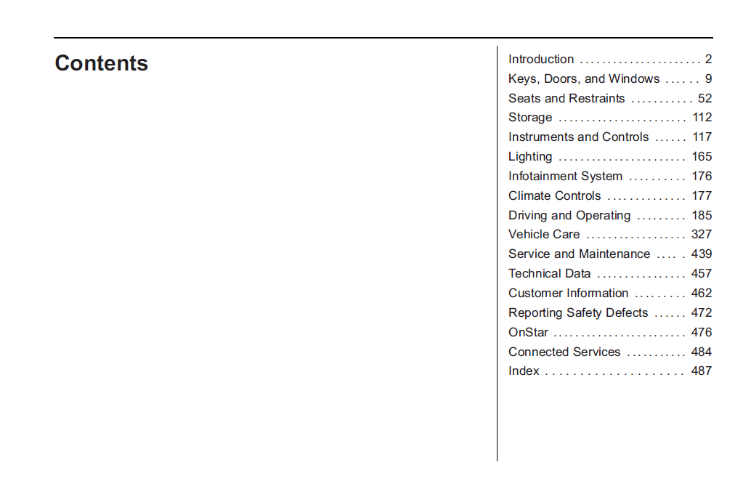
2/501
INF-1 – captured as Chapter List in decomposition table

Slide 3
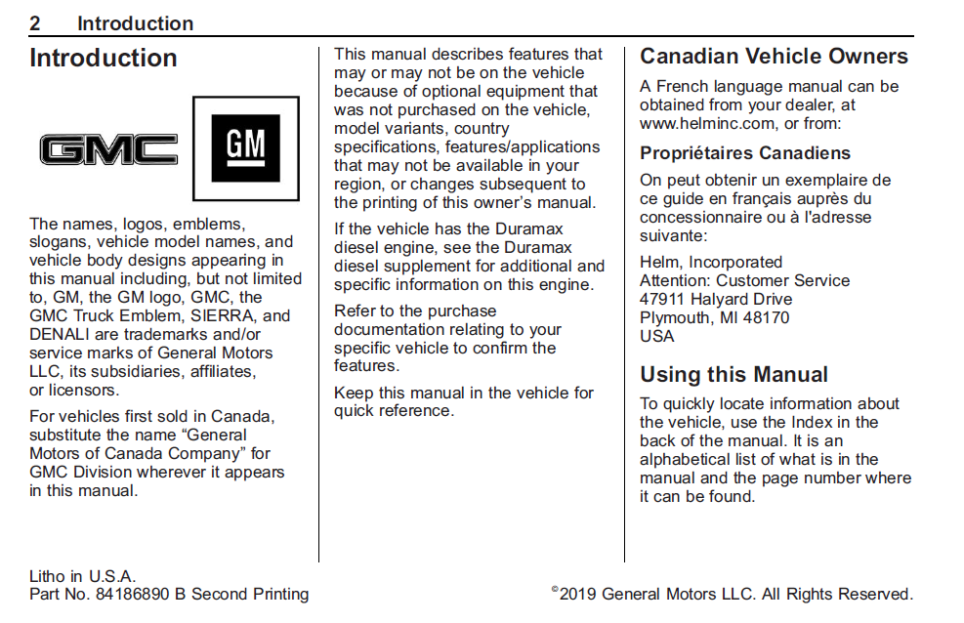
3/501
INF-1
Confidential

Slide 4
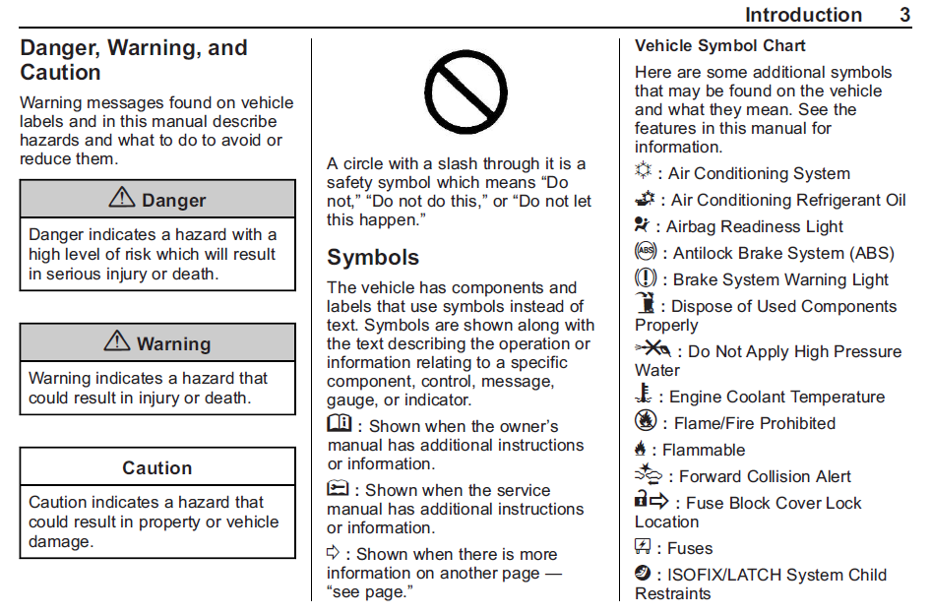
4/501
INF-1
INF-2
EF-1
INF-3
EF-2
EF-3
EF-4
INF-4
PTEF-1
INF-5
EF-5
EF-6
INF-6

Slide 5
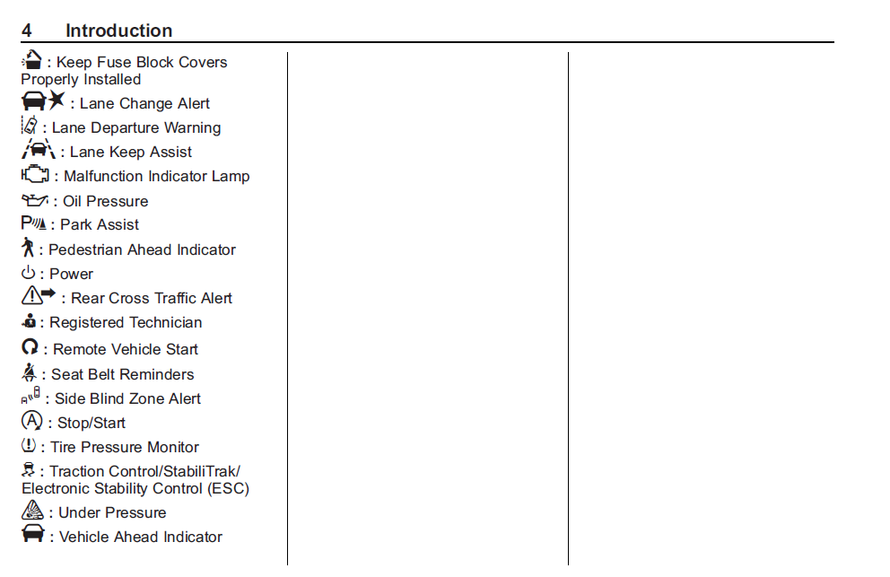
5/501
INF-1
EF-1
EF-2
EF-3
EF-4
EF-5
EF-6
EF-7
EF-8
EF-9
INF-1
EF-10
EF-11
EF-12
EF-13
EF-14
EF-15
EF-16
EF-17

Slide 6
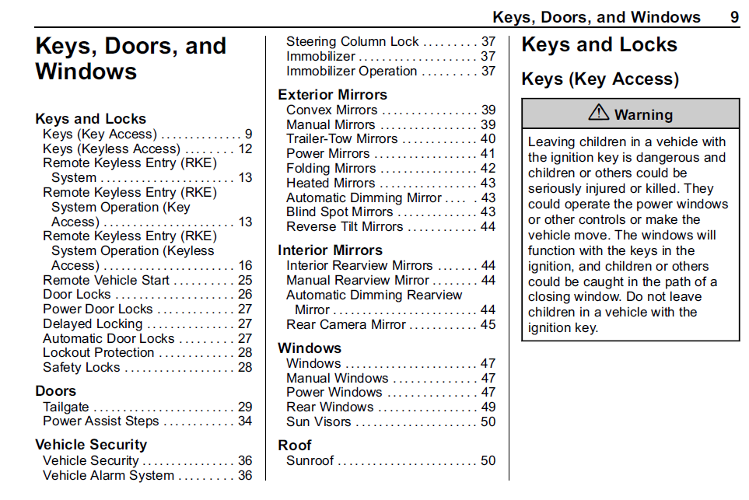
9/501
INF-1 Chapters are covered in chapter list
INF-2

Slide 7
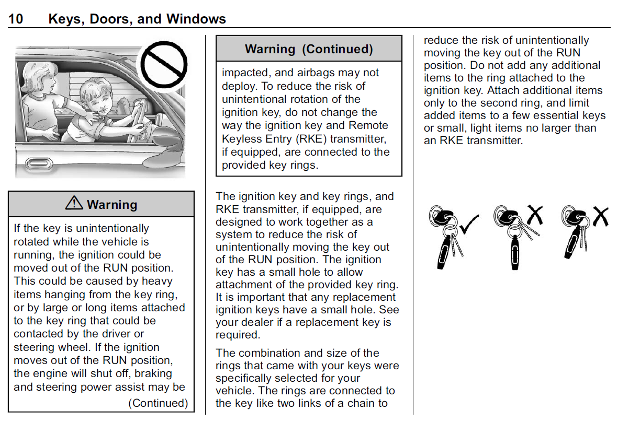
10/501
INF-1

Slide 8
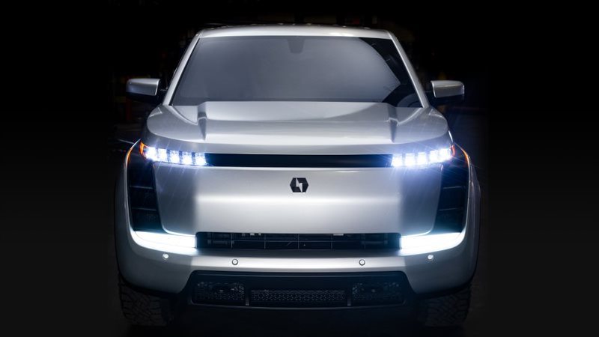
THANK YOU

