Slide 1
RIPv2
Routing Protocols and Concepts – Chapter 7

Slide 2
Objectives
Encounter and describe the limitations of RIPv1’s limitations.
Apply the basic Routing Information Protocol Version 2 (RIPv2) configuration commands and evaluate RIPv2 classless routing updates.
Analyze router output to see RIPv2 support for VLSM and CIDR
Identify RIPv2 verification commands and common RIPv2 issues.
Configure, verify, and troubleshoot RIPv2 in “hands-on” labs

Slide 3
Introduction
Chapter focus
-Difference between RIPv1 & RIPv2
    RIPv1
        -A classful distance vector routing protocol
        -Does not support discontiguous subnets
        -Does not support VLSM
        -Does not send subnet mask in routing update
        -Routing updates are broadcast
    RIPv2
-A classless distance vector routing protocol that is an enhancement of RIPv1’s features.
-Next hop address is included in updates
-Routing updates are multicast
-The use of authentication is an option

Slide 4
Introduction
Similarities between RIPv1 & RIPv2
-Use of timers to prevent routing loops
-Use of split horizon or split horizon with poison reverse
-Use of triggered updates
-Maximum hop count of 15

Slide 5
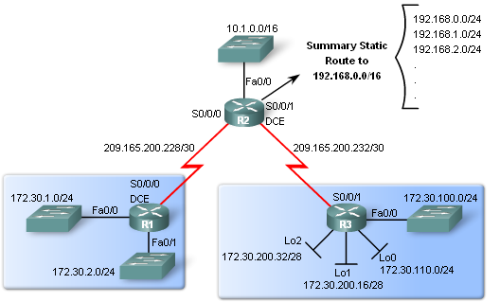
RIPv1 Limitations
Lab Topology
Scenario:
  3 router set up
  Topology is discontiguous
  There exists a static summary route
  Static route information can be injected into routing table updates using redistribution.
  Routers 1 & 3 contain VLSM networks

Slide 6
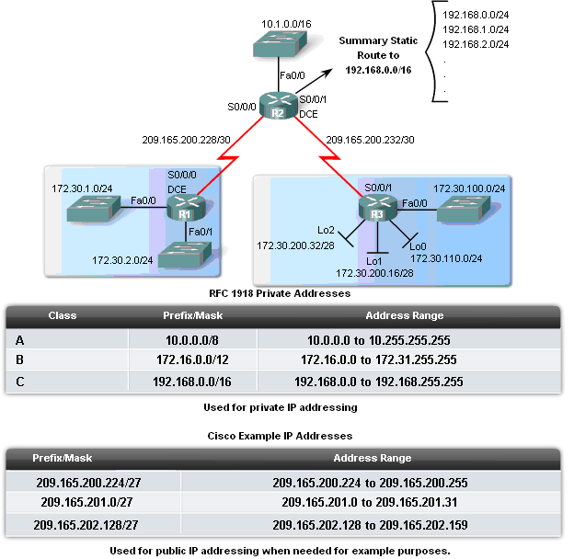
RIPv1 Limitations
Scenario Continued
VLSM
-Recall this is sub netting the subnet
Private IP addresses are on LAN links
Public IP addresses are used on WAN links
Loopback interfaces
-These are virtual interfaces that can be pinged and added to routing table

Slide 7
RIPv1 Limitations
Null Interfaces
  This is a virtual interface that does not need to be created or configured
-Traffic sent to a null interface is discarded
-Null interfaces do not send or receive traffic
Static routes and null interfaces
  null interfaces will serve as the exit interface for static route
  -Example of configuring a static supernet route with a null interface
  -R2(config)#ip route 192.168.0.0 255.255.0.0 Null0

Slide 8
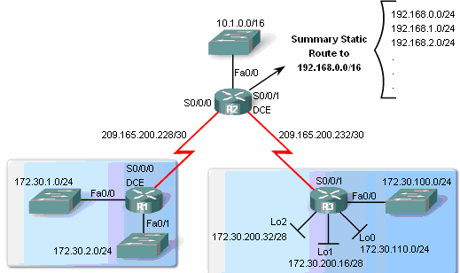
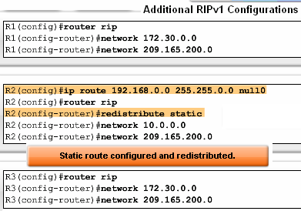
RIPv1 Limitations
Route redistribution
-Redistribution command is way to disseminate a static route from one router to another via a routing protocol
-Example
R2(config-router)#redistribute static

Slide 9
RIPv1 Limitations
Verifying and Testing Connectivity
  Use the following commands:
  show ip interfaces brief
  ping
  traceroute

Slide 10
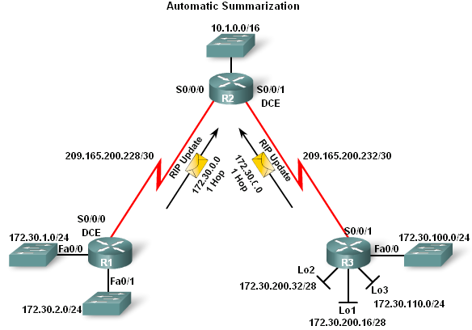
RIPv1 Limitations
RIPv1 – a classful routing protocol
-Subnet mask are not sent in updates
-Summarizes networks at major network boundaries
-if network is discontiguous and RIPv1 configured convergence will not be reached

Slide 11
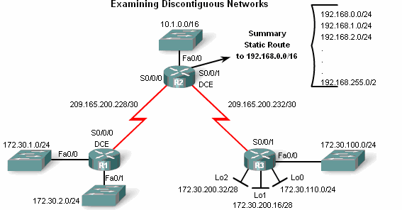
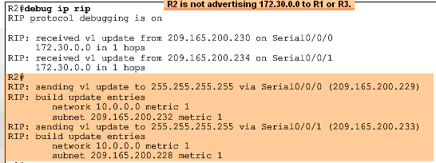
RIPv1 Limitations
  Examining the routing tables
-To examine the contents of routing updates use the
debug ip rip command
-If RIPv1 is configured then
Subnet masks will not be included with the network address

Slide 12
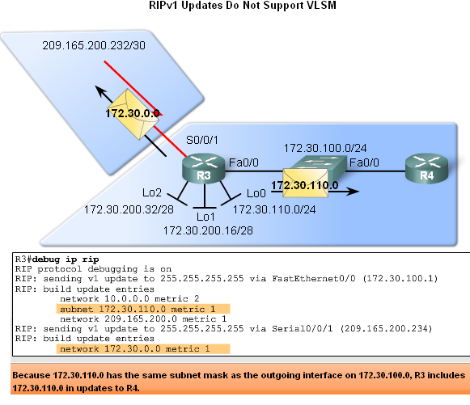
RIPv1 Limitations
RIPv1 does not support VLSM
Reason: RIPv1 does not send subnet mask in routing updates
RIPv1 does summarize routes to the Classful boundary
Or uses the Subnet mask of the outgoing interface to determine which subnets to advertise

Slide 13
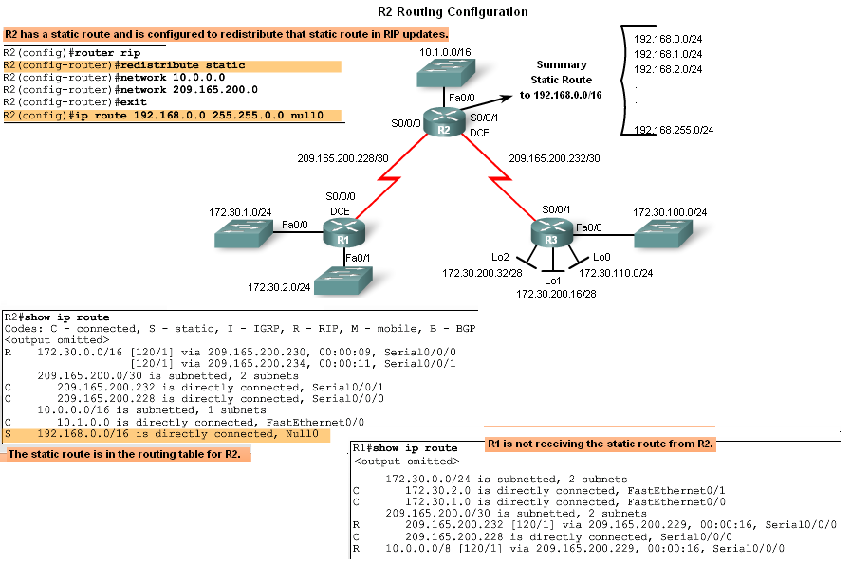
RIPv1 Limitations
No CIDR Support
In the diagram R2 will not include the static route in its update
Reason: Classful routing protocols do not support CIDR routes that are summarized with a smaller mask than the classful subnet mask

Slide 14
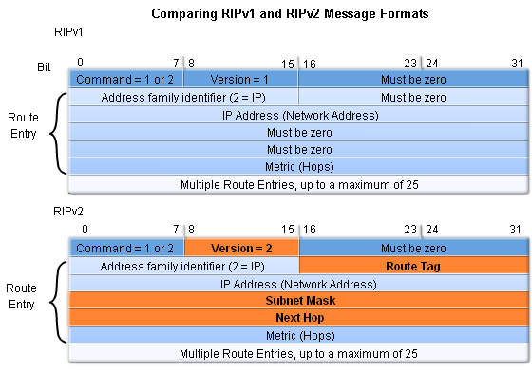
Configuring RIPv2
Comparing RIPv1 & RIPv2 Message Formats
-RIPv2 Message format is similar to RIPv1 but has 2 extensions
      1st extension is the subnet mask field
      2nd extension is the addition of next hop address

Slide 15
Configuring RIPv2
Enabling and Verifying RIPv2
Configuring RIP on a Cisco router
By default it is running RIPv1

Slide 16
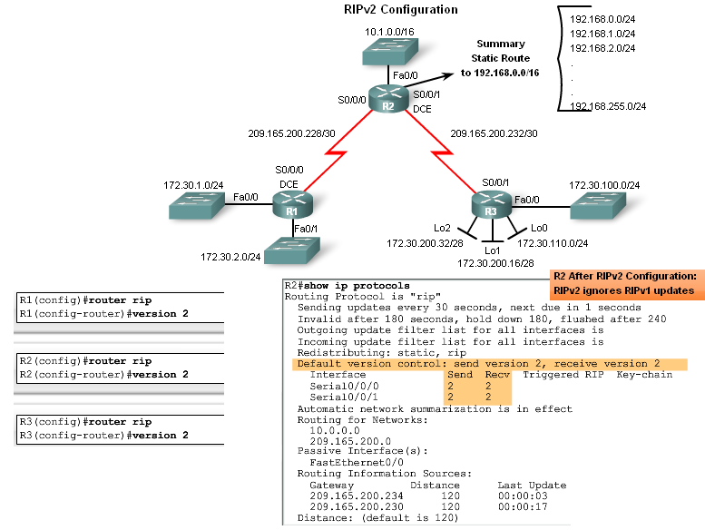
Configuring RIPv2
Configuring RIPv2 on a Cisco router
-Requires using the version 2 command
-RIPv2 ignores RIPv1 updates
To verify RIPv2 is configured use the
show ip protocols command

Slide 17
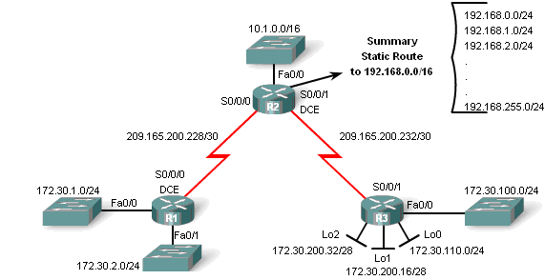
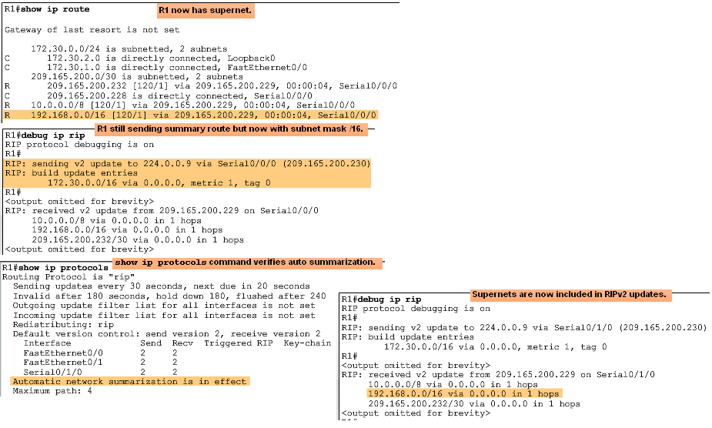
Configuring RIPv2
Auto-Summary & RIPv2
RIPv2 will automatically summarize routes at major network boundaries and can also summarize routes with a subnet mask that is smaller than the classful subnet mask

Slide 18
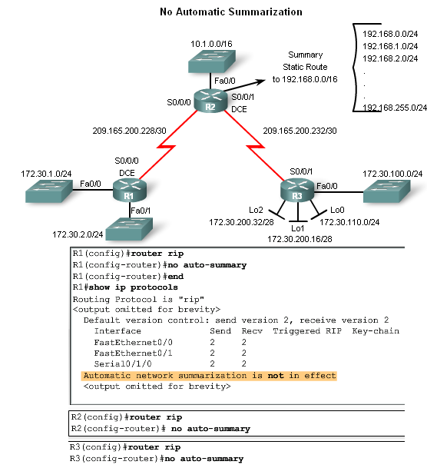
Configuring RIPv2
Disabling Auto-Summary in RIPv2
To disable automatic summarization issue the no auto-summary command

Slide 19
Configuring RIPv2
Verifying RIPv2 Updates
When using RIPv2 with automatic summarization turned off
Each subnet and mask has its own specific entry, along with the exit interface and next-hop address to reach that subnet.
To verify information being sent by RIPv2 use the
debug ip rip command

Slide 20
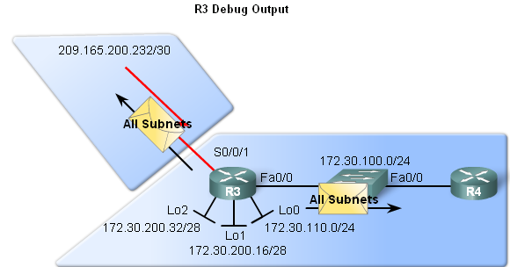
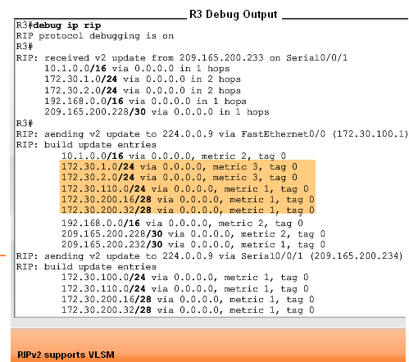
VLSM & CIDR
RIPv2 and VLSM
Networks using a VLSM IP addressing scheme
Use classless routing protocols (i.e. RIPv2) to disseminate network addresses and their subnet masks

Slide 21
VLSM & CIDR
CIDR uses Supernetting
Supernetting is a bunch of contiguous classful networks that is addressed as a single network.

Slide 22
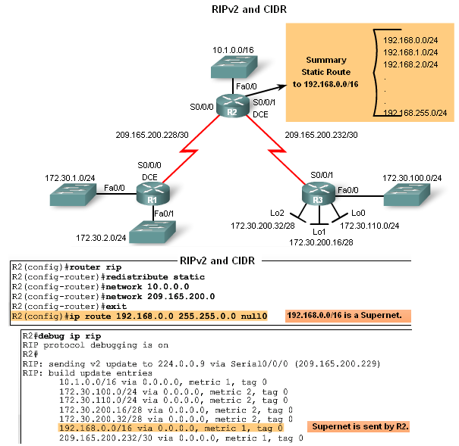
VLSM & CIDR
To verify that supernets are being sent and received use the following commands
-Show ip route
-Debug ip rip

Slide 23
Verifying & Troubleshooting RIPv2
Basic Troubleshooting steps
-Check the status of all links
-Check cabling
-Check IP address & subnet mask configuration
-Remove any unneeded configuration commands
Commands used to verify proper operation of RIPv2
  Show ip interfaces brief
  Show ip protocols
  Debug ip rip
  Show ip route

Slide 24
Verifying & Troubleshooting RIPv2
Common RIPv2 Issues
When trouble shooting RIPv2 examine the following issues:
    Version
Check to make sure you are using version 2
    Network statements
Network statements may be incorrectly typed or missing
    Automatic summarization
If summarized routes are not needed then disable automatic summarization

Slide 25
Verifying & Troubleshooting RIPv2
Reasons why it’s good to authenticate routing information
-Prevent the possibility of accepting invalid routing updates
-Contents of routing updates are encrypted
Types of routing protocols that can use authentication
-RIPv2
-EIGRP
-OSPF
-IS-IS
-BGP

Slide 26
Summary
Routing Protocol | Distance Vector | Classless Routing Protocol | Uses Hold-Down Timers | Use of Split Horizon or Split Horizon w/ Poison Reverse | Max Hop count = 15 | Auto Summary | Support CIDR | Supports VLSM | Uses Authen-tication
RIPv1 | Yes | No | Yes | Yes | Yes | Yes | No | No | No
RIPv2 | Yes | Yes | Yes | Yes | Yes | Yes | Yes | Yes | Yes

