Slide 1
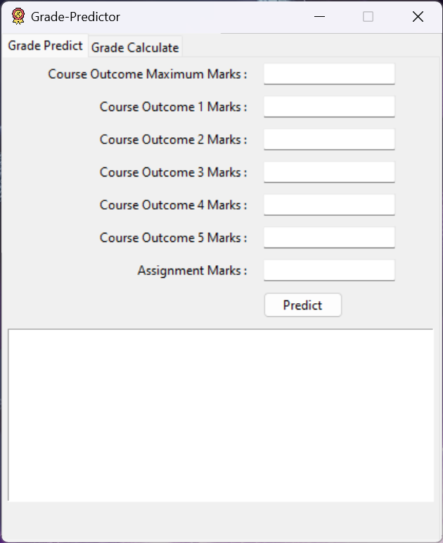
Console to Clicks
Learn how to convert your python programs to GUI programs using Tkinter

Slide 2
What is Tkinter
Tkinter is a useful tool for creating a wide variety of graphical user interfaces, including windows, dialog boxes, and custom widgets. It is particularly well-suited for building desktop applications and adding a GUI to command-line programs.
Full Form of Tkinter: The name “Tkinter” comes from “Tk interface“, referring to the Tk GUI toolkit that Tkinter is based on.

Slide 4
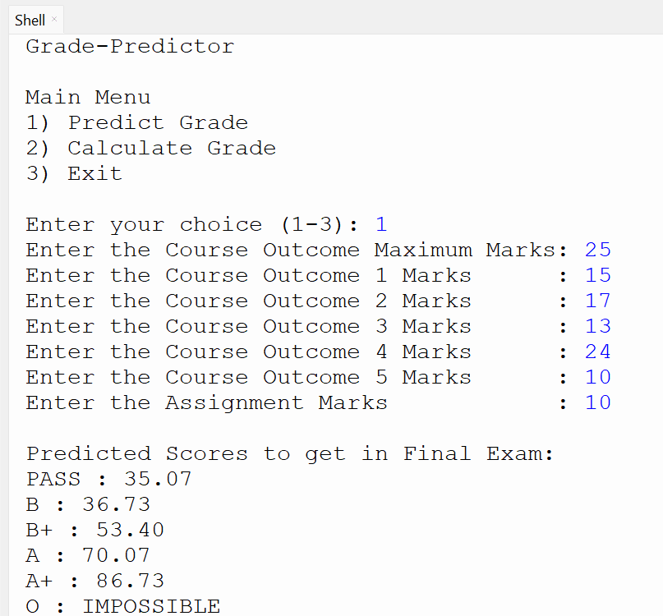
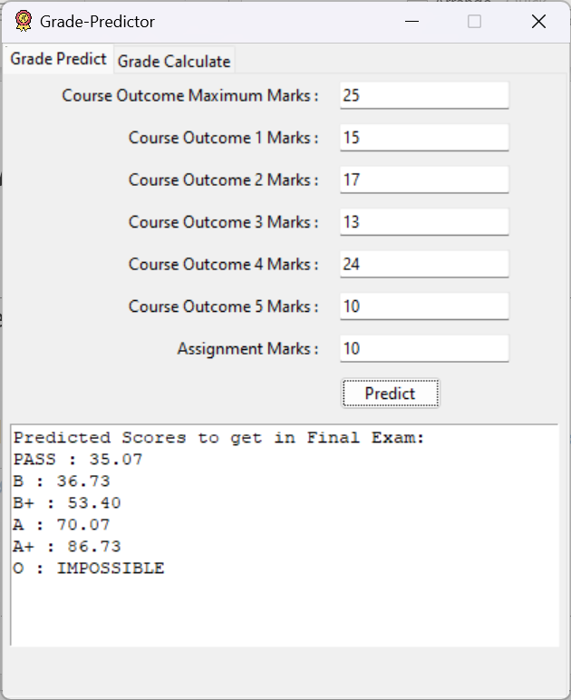
Overview of Conversion
Console Based
GUI Based

