Slide 1
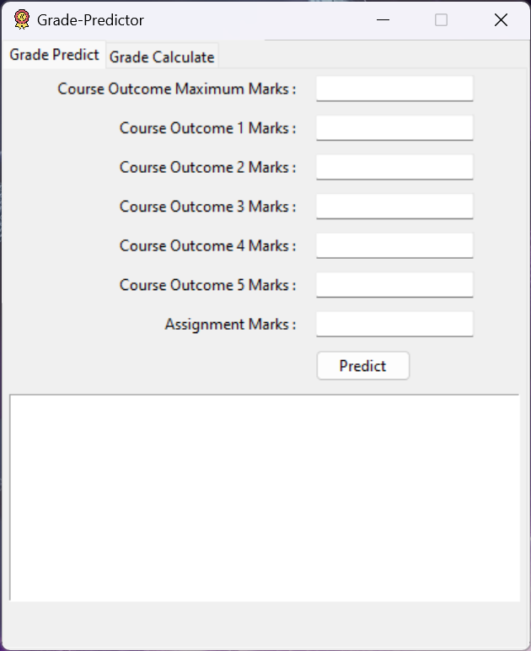
Console to Clicks
Learn how to convert your python programs to GUI programs using Tkinter

Slide 2
What is Tkinter
Tkinter is a useful tool for creating a wide variety of graphical user interfaces, including windows, dialog boxes, and custom widgets. It is particularly well-suited for building desktop applications and adding a GUI to command-line programs.
Full Form of Tkinter: The name “Tkinter” comes from “Tk interface“, referring to the Tk GUI toolkit that Tkinter is based on.

Slide 3
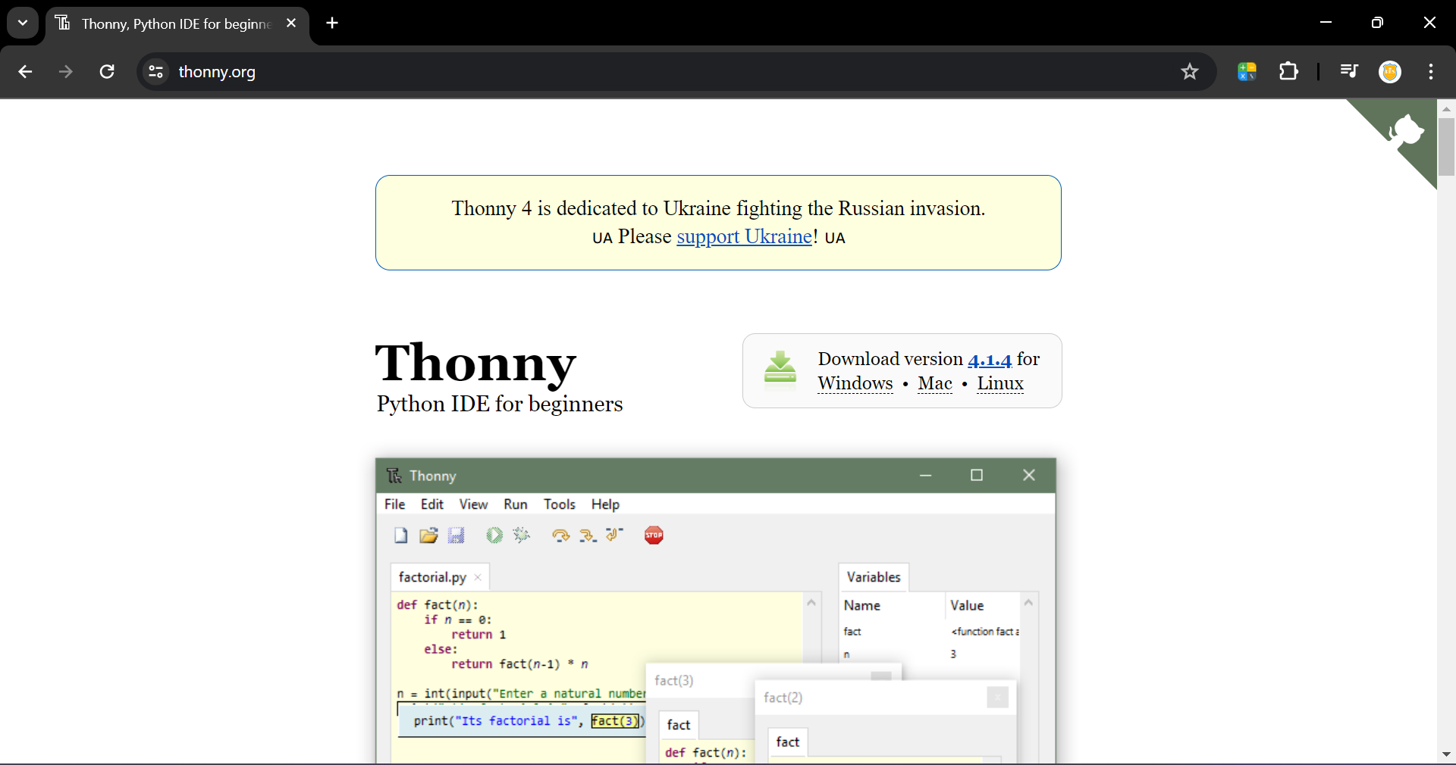
Installing Thonny IDE
Thonny comes with Tkinter pre-configured by default.
So it feels easy to begin with it.
Download from thonny.org and install.

Slide 4
Summary of Existing Program
Explaining main.py

Slide 5
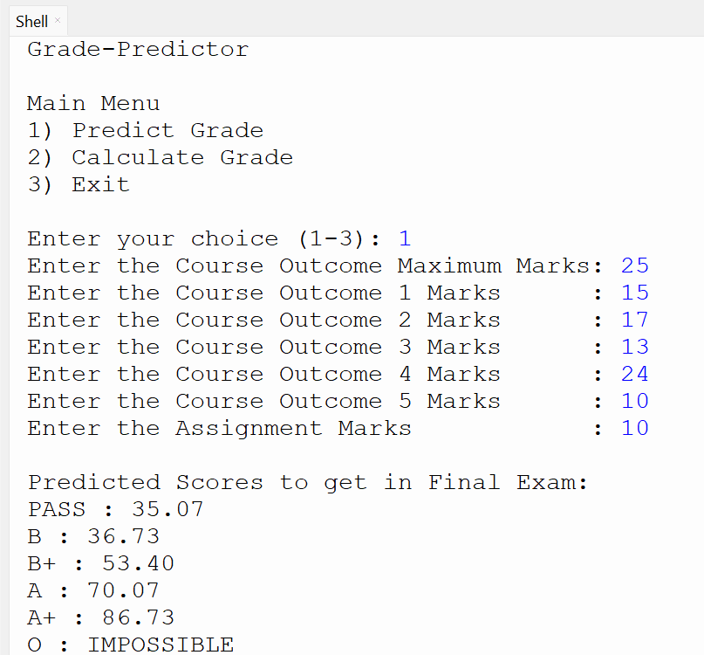
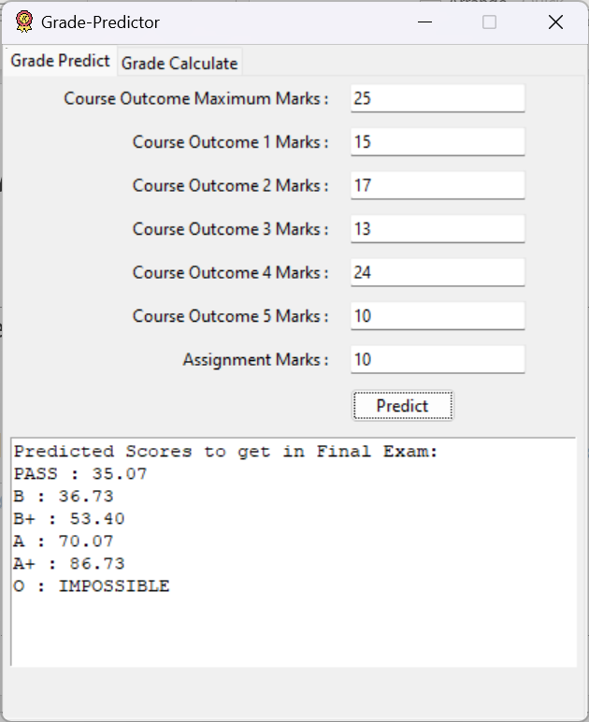
Overview of Conversion
Console Based
GUI Based

Slide 6
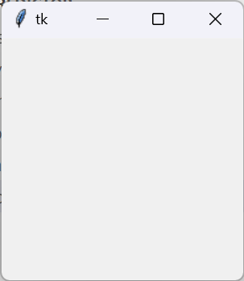
Creating a Blank Window
The journey of GUI development with Tkinter starts with creating a blank window.
import tkinter as tk
root = tk.Tk()
root.mainloop()

Slide 7
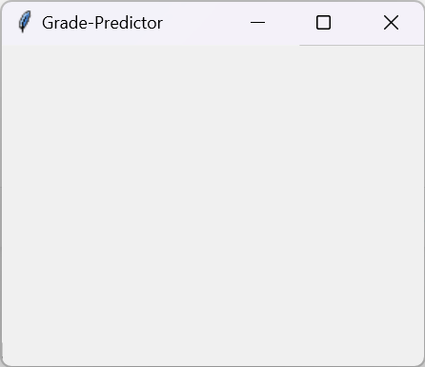
Titles
Console
GUI
In Console Title is just a print statement.
print("\n\nGrade-Predictor")
In GUI we can set a title for the created blank window
root.title("Grade-Predictor")

Slide 8

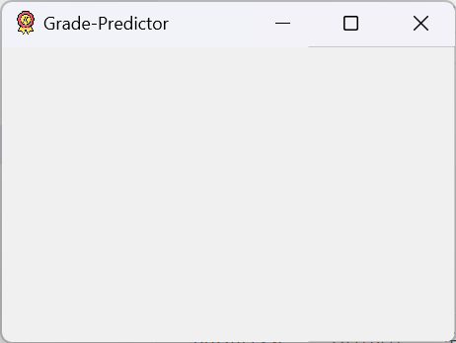
Adding Icon
As you are developing GUI , you can add a PNG or any format of image as a icon in tkinter.
root.iconphoto(False, tk.PhotoImage(file="icon.png"))

Slide 9
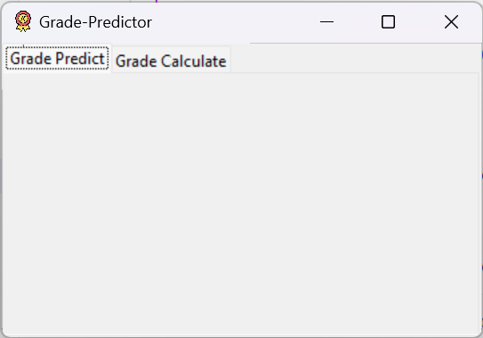
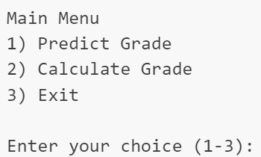
Conversion of Main Menu : Tabs
Console
GUI
In console the main menu is just printing a menu normally with numbered choice as input from user.
In GUI we have many ways to handle this.
In this example I have used tabs as a GUI alternative for main menus.
import tkinter.ttk as ttk
tabs = ttk.Notebook(root)
gp_frame = ttk.Frame(tabs)
gp_frame.pack(padx = 5 , pady = 5)
gc_frame = ttk.Frame(tabs)
gc_frame.pack(padx = 5 , pady = 5)
tabs.add(gp_frame, text = "Grade Predict")
tabs.add(gc_frame, text = "Grade Calculate")
tabs.pack(expand = 1, fill ="both")

Slide 10

Console : Getting an Input
In console to get a input we use just a input() function.
co_max = int(input("Enter the Course Outcome Maximum Marks: "))
We can also write the above code as,
print("Enter the Course Outcome Maximum Marks: ",end="")
co_max = int(input())

Slide 11
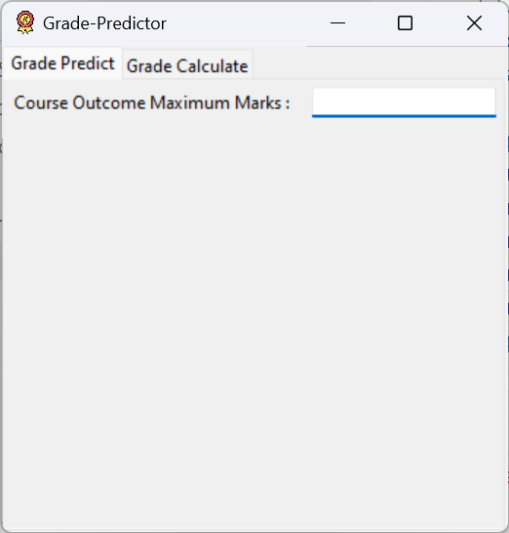
GUI : Creating a Form
Generally in a form there will be a text along with a input area.
From the last slide we can replace the print statement with Label.
pre_co_max_lbl = ttk.Label(gp_frame, text = "Course Outcome Maximum Marks : ")
pre_co_max_lbl.grid(row = 0, column = 0, padx = 5 , pady = 5, sticky = 'e’)
From the last slide we can replace the input statement with Entry.
pre_co_max = tk.StringVar()
pre_co_max_ent = ttk.Entry(gp_frame, textvariable = pre_co_max)
pre_co_max_ent.grid(row = 0, column = 1, padx = 5 , pady = 5, sticky = 'w')

Slide 12
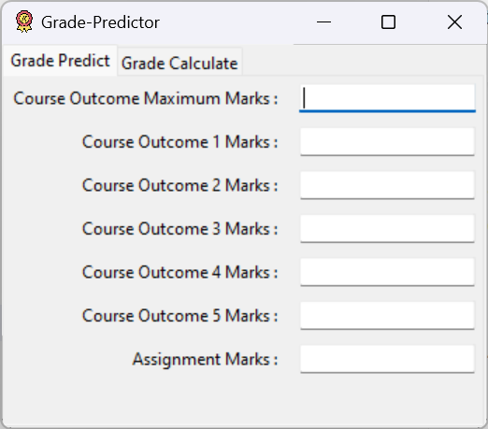
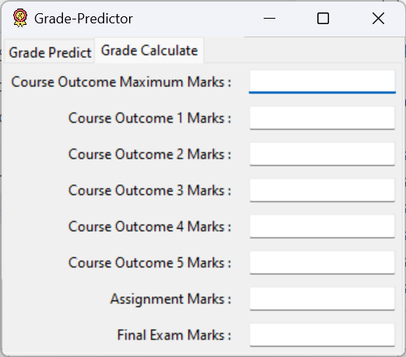
GUI : Creating a Form
Do the last for all needed inputs for both tabs.
Your final output should look like….

Slide 13
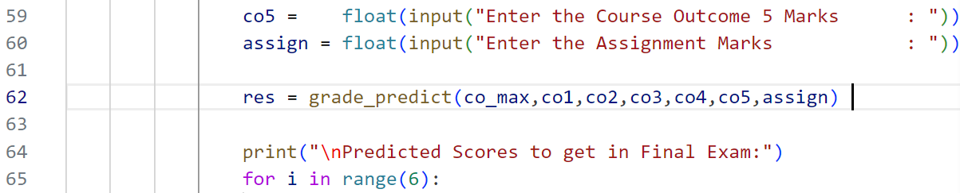
Console : After Getting Input
After getting all inputs, by just pressing Enter the console based programs starts to do next lines of code sequentially. In this case calling appropriate functions.

Slide 14
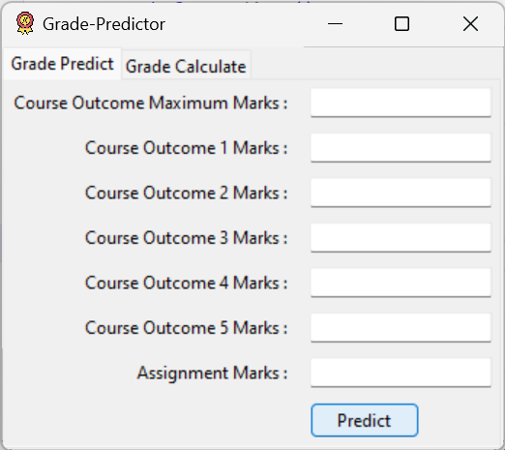
GUI : Buttons
In case of GUI we need a input from user to invoke the functions.
Usually we use Buttons to invoke such functions.
pre_btn = ttk.Button(gp_frame, text='Predict', command = predict)
pre_btn.grid(row = 7, column = 1, padx = 5 , pady = 5, sticky = 'w’)
In the above code we invoke a function called predict passed in the command parameter.
Note we cannot pass parameters in the button function like we do normally

Slide 15
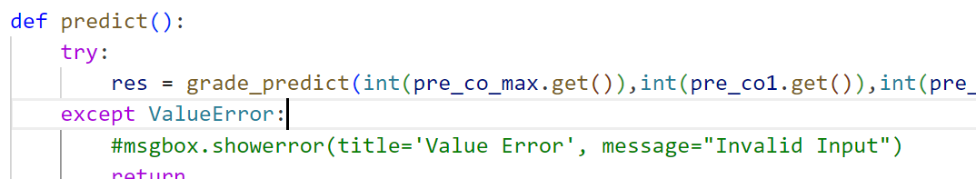
Button Functions
Button function do some process and change the GUI parameters for output.
In this example we make use of the same function from the console program by importing it to GUI program.
from main import *
…
NOTE
We use get() method to get the value from tk.StringVar()
In this case,
pre_co_max.get()c

Slide 16
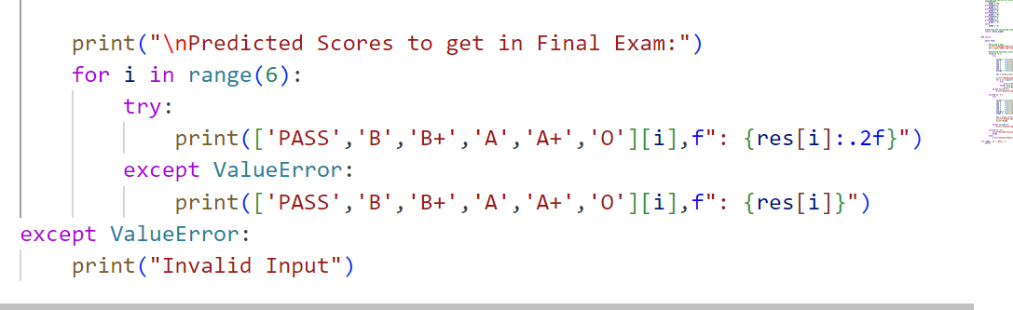
Console : Output
In console we use print statement to display the output.

Slide 17
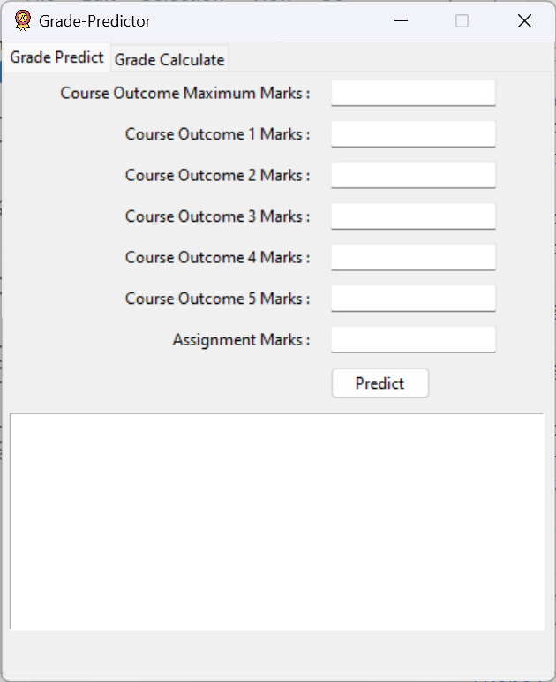
GUI : Output
We can use the same Label widget to display the output.
As our output is quiet long we use Text widget to display.
pre_output = tk.Text(gp_frame, height = 10, width = 50, state = tk.DISABLED)
pre_output.grid(row = 8, column = 0, columnspan=2, padx = 5 , pady = 5)
We use state = tk.DISABLED to disable a widget from user interaction. In this case is done to use the Text widget as output.
NOTE
We use columnspan parameter in grid() method to merge cells in a grid structure.

Slide 18
GUI : Printing Output
NOTE
We use delete() method to clear the contents present in Text widget.
We use insert() method to print text into the Text widget.
We cannot insert text to a disabled Text widget.
So we change to normal state using configure method.
pre_output.configure(state=tk.NORMAL)
pre_output.delete(1.0,tk.END)
pre_output.insert(tk.END, res_txt)
pre_output.configure(state=tk.DISABLED)

Slide 19
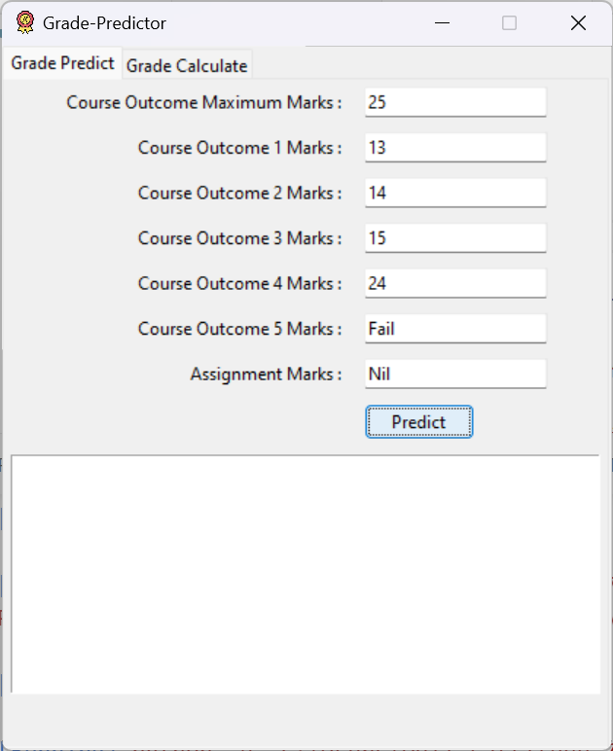
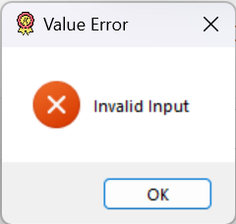
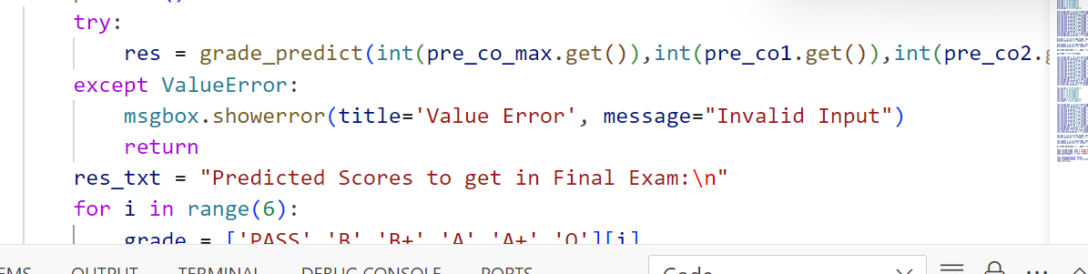
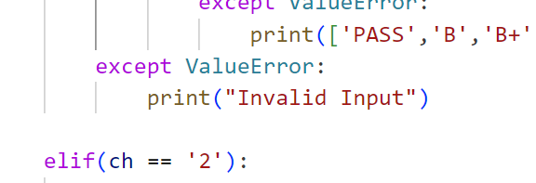
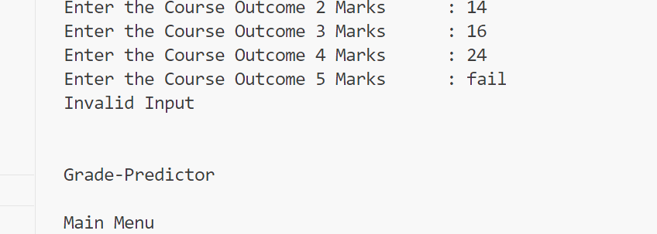
Exceptional Handling
Console
GUI
We print a suitable error message instead of raising error in this example.
We display the error as a popup window using messagebox class.
import tkinter.messagebox as msgbox
msgbox.showerror(title='Value Error', message="Invalid Input")

Slide 20
Summary of the GUI Program
Explaining app.py

Slide 21
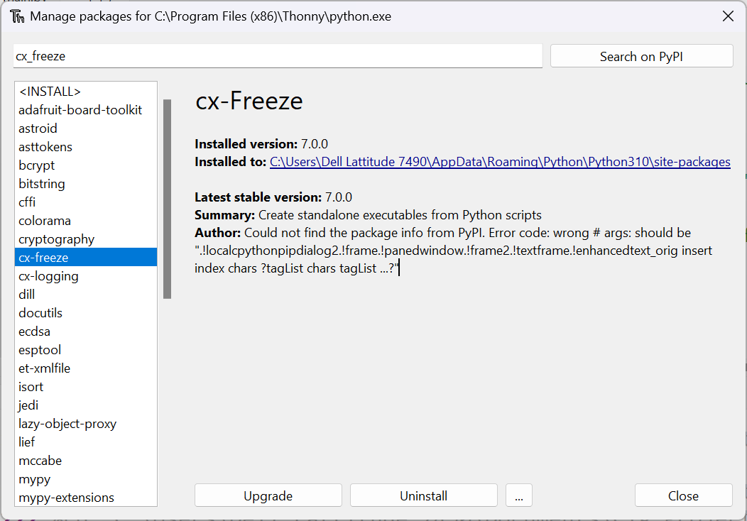
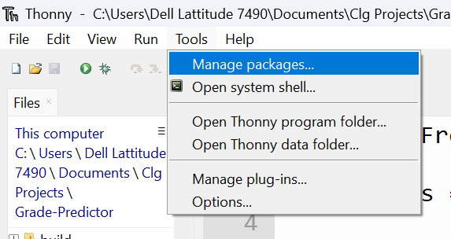
Creating Standalone Executables
Using cx_freeze package we can make our GUI program into a standalone Executable.
pip install cx-Freeze
Use the above command in terminal to install cx_freeze package.
Next we have to create a setup.py…
NOTE
For thonny users you can install packages from manage package window inside tools menu.

Slide 22
Creating setup.py
import cx_Freeze
executables = [cx_Freeze.Executable("app.py", base='gui', icon="icon.png")]
cx_Freeze.setup( name = "Grade-Predictor",
options = {"build_exe": {"packages":["tkinter"],
"include_files":["icon.png","main.py"]}},
version = "2024.1",
description = "Predicting and calculating grades for college courses.",
executables = executables
)

Slide 23
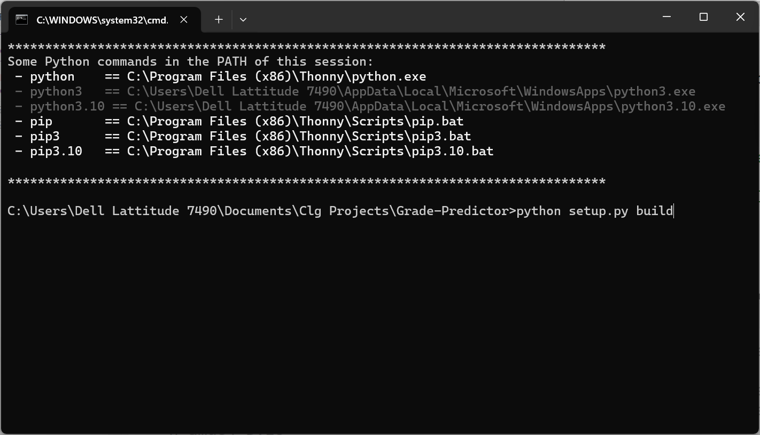
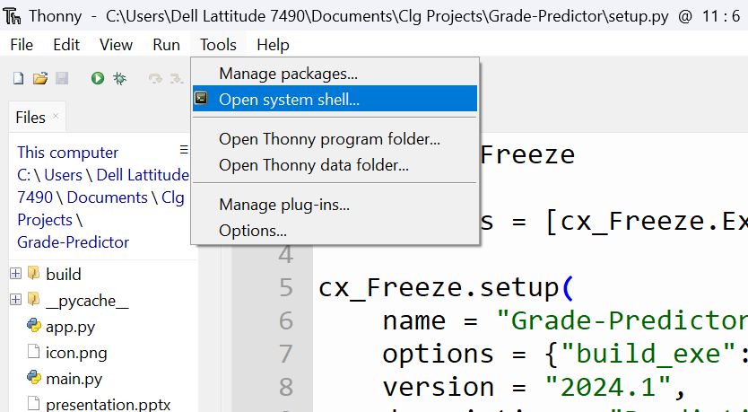
Building Executable
Just run the code in terminal below you will be able to see a folder build created inside which the standalone executable is generated.
python setup.py build
NOTE
For thonny users you can access terminal from open system shell window inside tools menu.

Slide 24
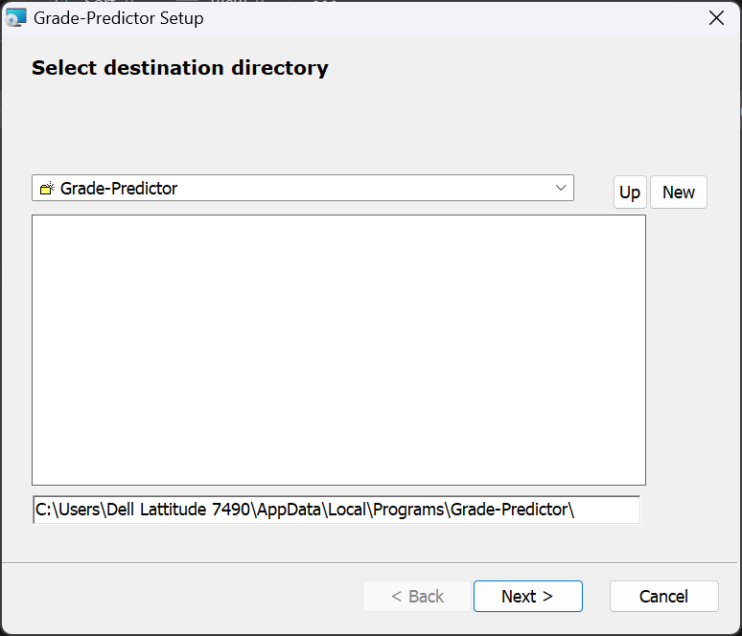
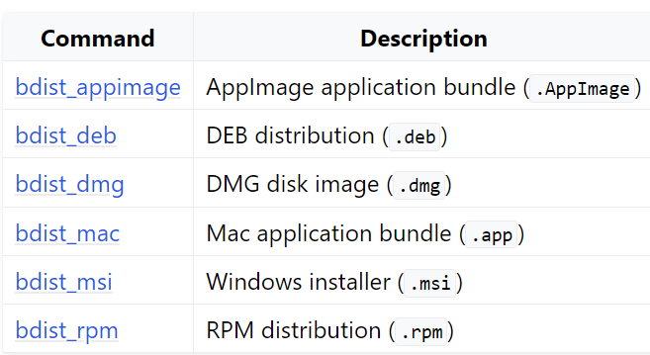
Creating Packages/Installers
Instead of creating the executables directly we can use the below code to create packages or installers for distribution.
It will created under dist folder.
It makes the executable more portable.
python setup.py <command>

Slide 25
Still more …
There are still more widgets like Menubar , RadioButton and ProgressBar that cannot be explained with this example.
You can use websites like geeksforgeeks.org/python-tkinter-tutorial, tutorialspoint.com/python/python_gui_programming.htm to learn and explore more widgets and features of tkinter.

Slide 26
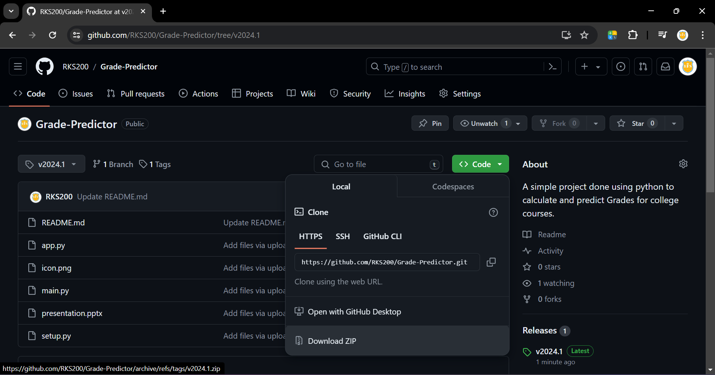
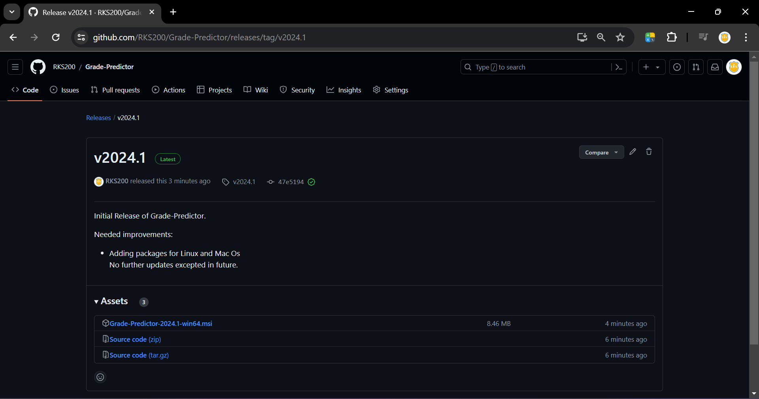
Source Code
Goto github.com/RKS200/Grade-Predictor for downloading the source code.
You can also head to Releases to download the packages / installer of the program.

Slide 27
Thank You

