Slide 1
Demand and Supply Case Study UBER
Airport and City Supply Demand Study, Issues and Resolution.

Slide 2
Business Objectives and Strategy
Business Objective
To explore trip request data and identify root cause for Cancellation and Non-availability of cars.
Recommend ways to improve the situation in turn increasing the revenue and stabilizing demand and supply issue.
Strategy
Explore historical data and identify trend if any.
Hypothesis for the trend.
Prescribe solution.
Constraints
Only trips to and from the airport are being considered.
Hence recommendations are for trips to and from airport.

Slide 3
About Data
Data has been obtained for 5 working days from 11/07/2016(Monday) – 16/07/2015(Friday).
Data covers 300 Uber driver partners.
Data is broadly categorized as per trip status i.e. Cancelled, Trip Completed and No Cars Available.
Data points have a pickup point either Airport or City.

Slide 4
Data Exploration
The data points with cancelled status has a driver id assigned but no drop time.
Data points with status as No Cars Available has neither driver id nor drop time.
From request time day, month, year, hour, minute and second has been extracted.

Slide 5
Data Exploration
From the extracted value an interval derived type has been created indicating the day part i.e. morning, noon , evening etc. so that it can be analyzed which part of the day the issue is most pressing.
Early Morning is between 04:00-07:59
Morning is between 08:00 - 11:59
Noon is between 12:00 - 15:59
Afternoon is between 16:00 -19:59
Evening is between 20:00 - 23:59
Night is between 00:00 - 04:00
In total 2650 records belong to ‘No Cars Available’ status, 2831 records with status ‘Trips Completed’ exists and 1264 records have Cancelled status.

Slide 6
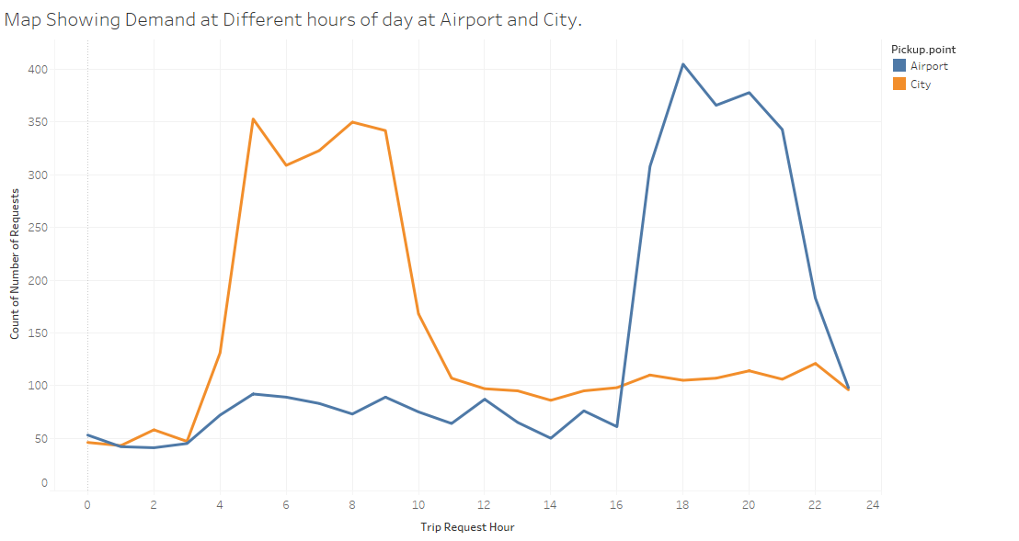
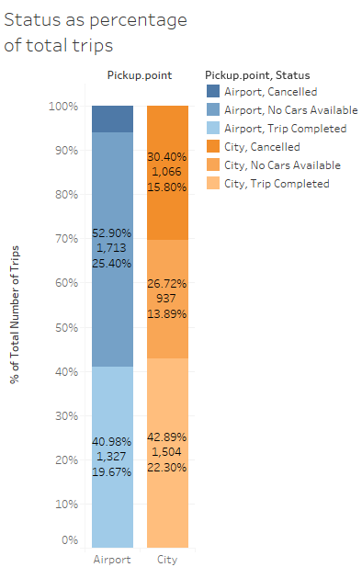
Data Visualization - I

Slide 7
Data Visualization – I Summary
Around 4:00 AM to 11:00 AM there is high demand at City where as around 17:00 to 22:00 there is high demand at Airport.
At Airport major chunk of trips which goes unattended with No Cars Available. But at city major chunk of trips are getting Cancelled, followed by No Cars Available.
Here we assume there are issues at two places one is at Airport where there are not enough cars available for passengers to book and another at City where major requests are getting Cancelled followed by cars not available for airport.

Slide 8
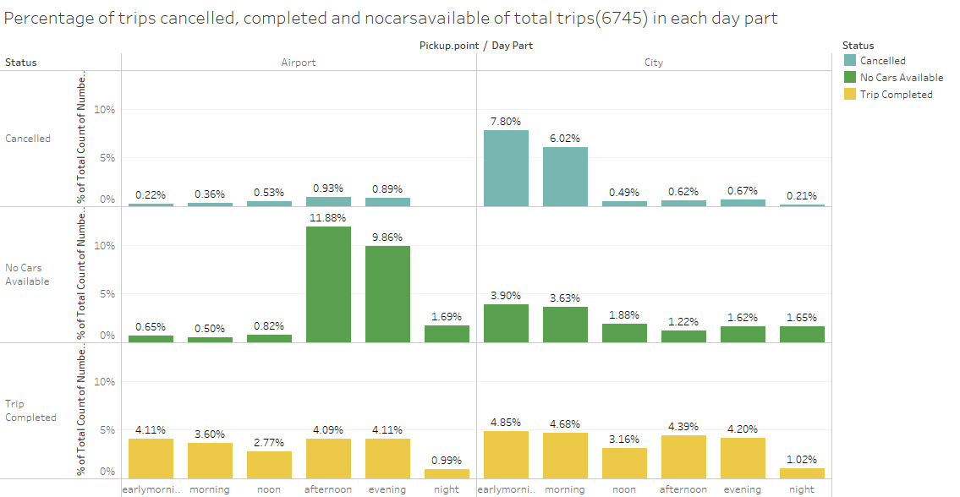
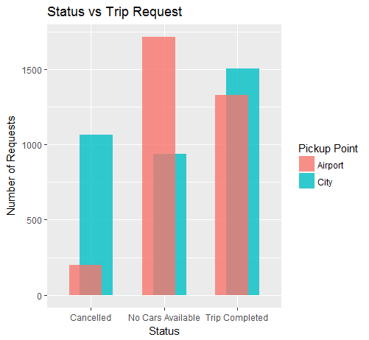
Data Visualization - II
It is considered that Early Morning is : 04:00-07:59, Morning is : 08:00 - 11:59, Noon is : 12:00 - 15:59, Afternoon is :16:00 -19:59, Evening is : 20:00 - 23:59, Night is : 00:00 - 04:00

Slide 9
Data Visualization-II Summary
The above visuals again confirms our assumption that most of the Cancellation is happening at City and most of the time No cars are Available at Airport for passengers to book.
At airport the issue is aggravated during late afternoon and evening time. Where as at City the issue is aggravated during early morning and morning hours.
Also the city situation is worsened by a negative support of non availability of cars as well during early morning and morning time.
At night the rate of trips getting completed is again lesser than demands coming in both at airport and city.
Other times it seems as if the demand is being met both at city and airport.

Slide 10
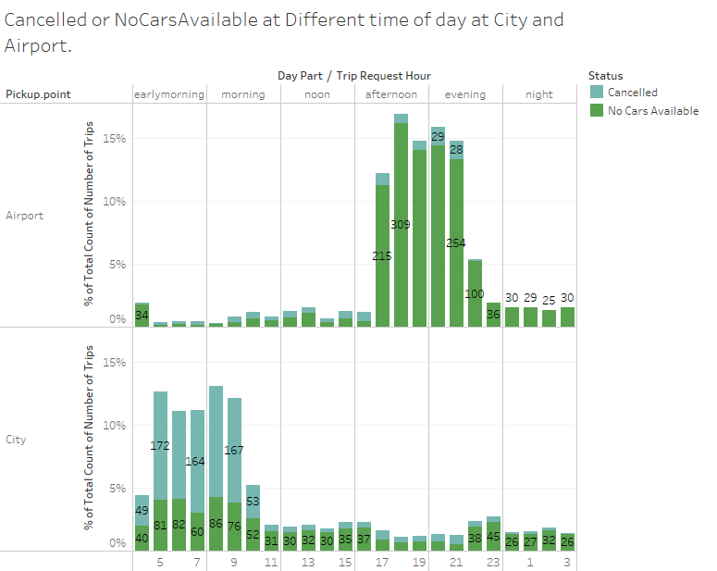
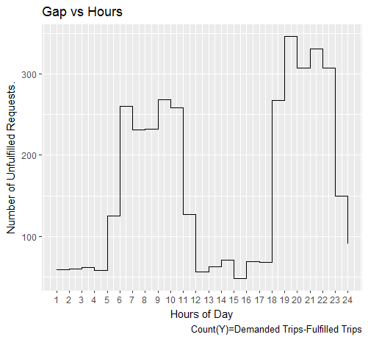
Data Visualization - III

Slide 11
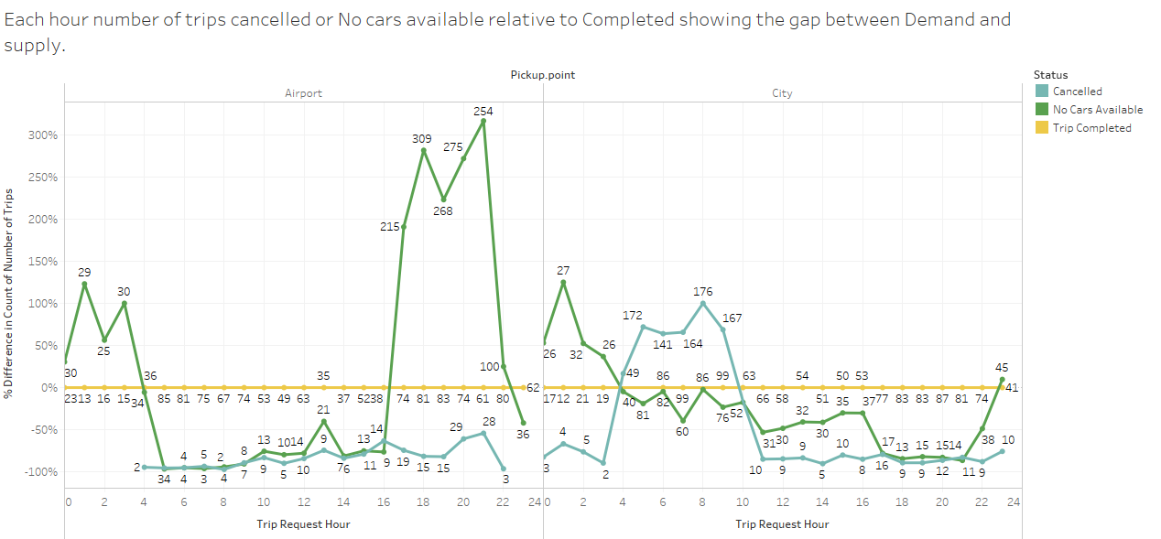

Slide 12
Data Visualization-III Summary
In the above visualization we see how the Non availability of cars and Cancellation of cars are happening throughout the day at more granular level i.e. hourly basis.
Between 4:00 AM to 11:00 AM the issue is high in City. We observed in 1st visualization that the demand at city is higher during this time and from this we can conclude that most of the demands are not getting fulfilled.
Also the same can be told about Airport demand and supply but time is between 17:00 to 22:00.
At night between 12-4 AM at both places and early morning 4-8AM in city the demands are not getting fulfilled by supply. And this graph also gives a glimpse of revenue being made through out the day.

Slide 13
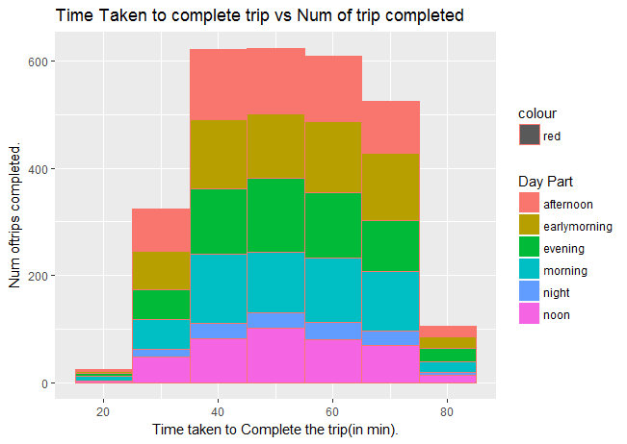
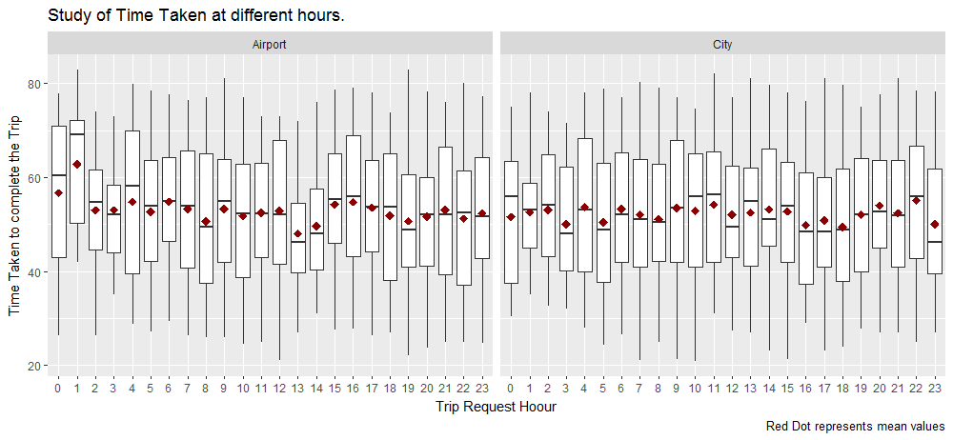
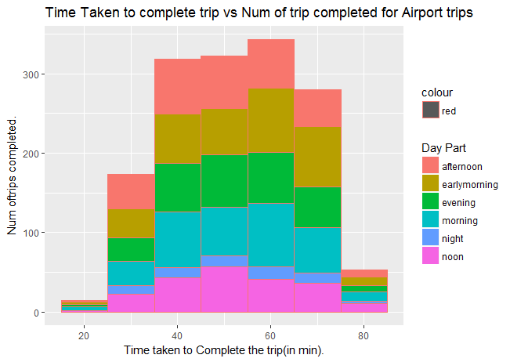
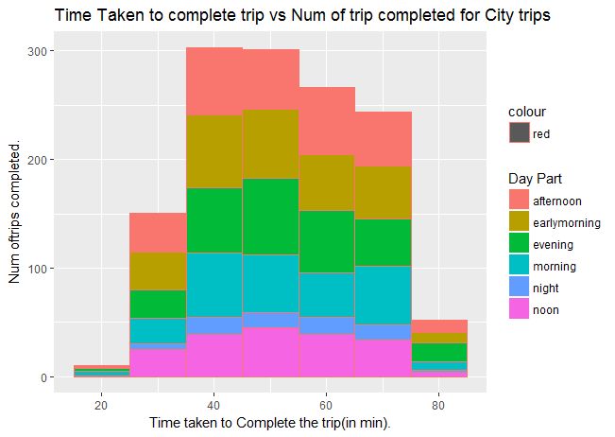
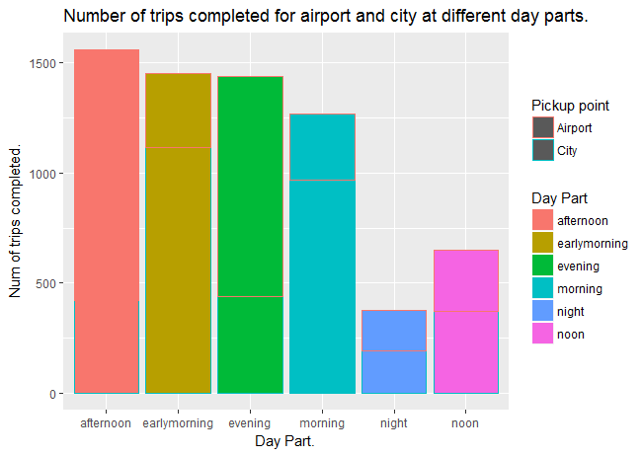
Data Visualization-IV

Slide 14
Data Visualization-IV Summary
From the above plots its clear that most number of trips take time between 40-60 mins to complete the trips from airport to city or city to airport.
If we observe the median and mean for whole day is between this 40-60 range.
Also most number of trips are getting completed during afternoon and then followed by early morning.
At noon most of the airport to city trips are getting completed and early morning most of the city to airport trips are getting completed. But as the demand is too high in early morning supply is not able to compensate the demand.

Slide 15
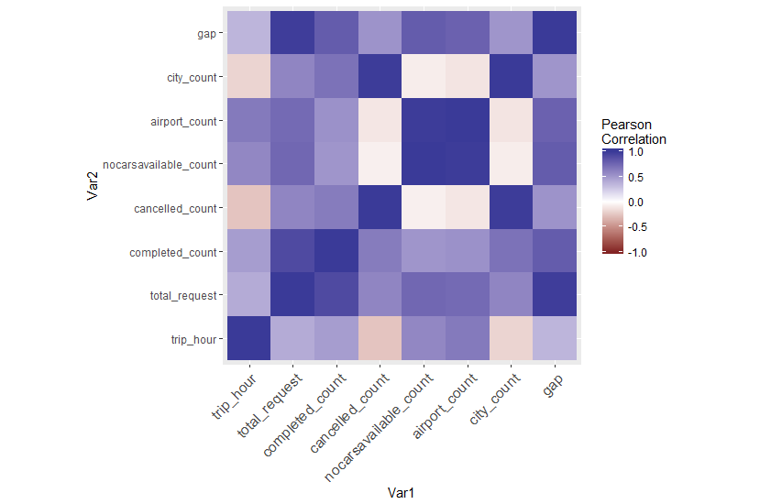
Data Visualization-V Summary
Here for the given data we can see gap is highly correlated with Total Request, Completed trips and No cars Available.
We can also observer that No cars Available is almost not related to Cancelled trips.
Also trip hours are less related to other parameters but positively related except for cancellation.
It should also be observed that the city count is highly correlated with cancelled count and airport count is highly correlated with No Cars Available count, indicating at city and airport cancellation and no cars availability respectively are the major problem.

Slide 16
Issues and Reasons(Hypothesis)
Issues exist at two places one is at Airport where there are not enough cars available for passengers to book mostly during late afternoon and evening time and another at City where major requests are getting Cancelled during early morning and morning hours.
Reason for this behavior at airport could be because driver partners staying near airport might be very less.
Time taken to reach airport from city which is around 52 mins on average and demand at airport after 5 AM is very low till late afternoon. Cabs may have to wait longer to make a return trip with a request. Assuming this is the scenario most driver partners might be cancelling the request at city during 4:00 AM to 11:00 AM.
Also there might not be many other reliable options for people to reach airport early morning.
As most requests are getting cancelled at city the inflow of supply is very less at airport to meet the demand.
Also a sudden spike of demand at airport during morning(small) and evening(huge) could be attributed by high number of the flights coming in at airport during these hours 17:00 to 22:00.
There is spike in demand at city also during early morning and morning hours because of local flights which majorly operates in early hours of the day & in evenings.

Slide 17
Issues and Reasons(Hypothesis)
Also the city situation is worsened by a negative support of non availability of cars as well during early morning and morning time.
This could be because of slow inflow of supply during morning hours as not every driver partner starts the day early morning and at same time and also in city office hours might be taking major chunk of supply creating a shortage for supply to Airport from City.
At night the rate of trips getting completed is again lesser than demands coming in both at airport and city.
This could be because most of driver partners have stopped operating during these hours.

Slide 18
Solution
The issue could be resolved by positioning the driver partners during different part of the day at different location.
The driver partners can be informed by message or app of forecasted demand so that they can position themselves as per the demand.
More driver partners hiring at different high demand regions could be one solution.
Converting part time drivers partners to full time partners makes the cancellation rate go down.
Giving more partners more broken demands in the airport route as the demand period nears by, so that at the pick demand time most of the driver partners will be at the location or near the location.

Slide 19
Presented By: Ramesh Kumar Singh
Thank You

