Slide 1

TEAM(SC2)4_Team No. 1
25th, July, 2025
Al-Powered Fraud Detection In Auto Insurance
Predictive Modellng for Smarter Claims Management

Slide 2

TEAM(SC2)4_Team No. 1
Problem Statement
How we interpret the problem in hand
Auto insurance fraud poses a significant challenge, causing billions in financial losses annually and leading to higher premiums and delayed claim settlements for genuine policyholders. Traditional fraud detection methods rely on manual reviews and static rules, which are often inefficient and unable to adapt to evolving fraud tactics. This project aims to address these limitations by using AI-powered predictive modeling to detect fraudulent patterns in claim data. By identifying anomalies and suspicious behavior early, insurers can reduce fraud-related losses, streamline claims processing, and enhance customer satisfaction. Implementing such a solution promotes operational efficiency, fairness, and trust in the insurance ecosystem.

Slide 3
Detail and explain each product. Our examination of community and market issues increases with additional products/services.
Tech Stack
Models
Internet of Things
Tools and Technologies
Classification Algorithms
Python
Jupyter Notebook
Scikit-learn
Power BI
Logistic Regression
SVM
KNN
Decision Trees
Random Forest
Gradient Boosting
Bagging Algoithms
AdaBoost
XGBoost
Extra Trees
Smart Home Platform

Slide 4
Understanding the problem statement and doing research on Fraud Claims in Auto Insurance
Preprocess the data using Data Processing Procedures
Exploratory Data Analysis
Feature Engineering to find unique and relevant KPIs
Computing the Principal Components using PCA
Model Training and Hyperparameter Tuning
Model Validation and Testing
Power BI Dashboard Representation and Presentation
Our Workflow

Slide 5
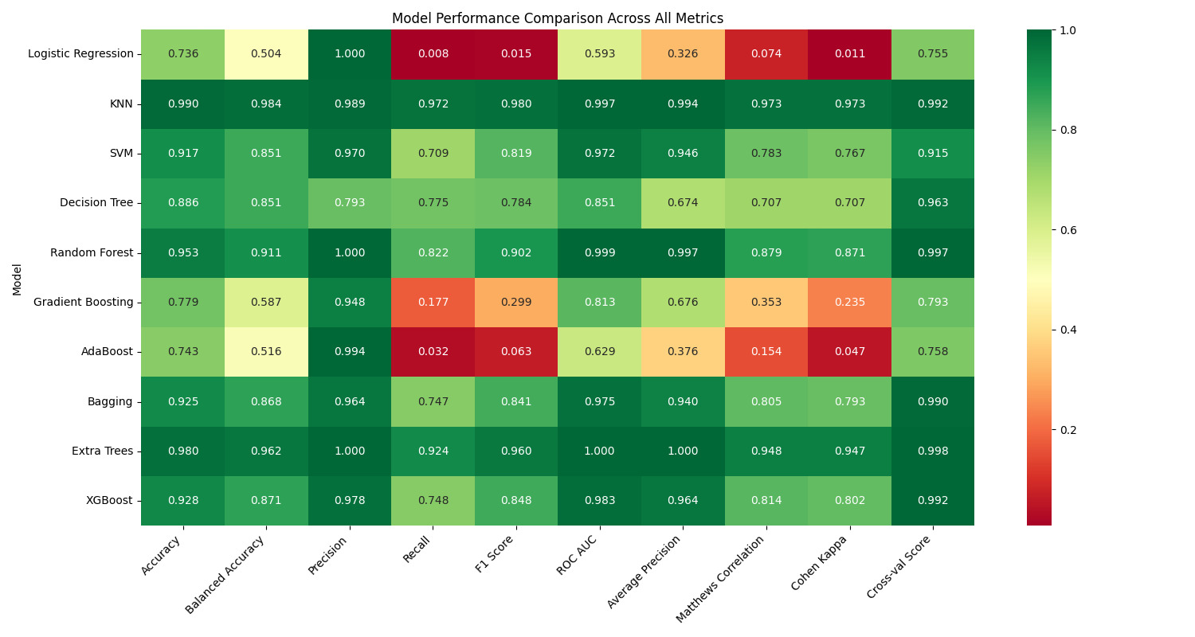

Slide 6
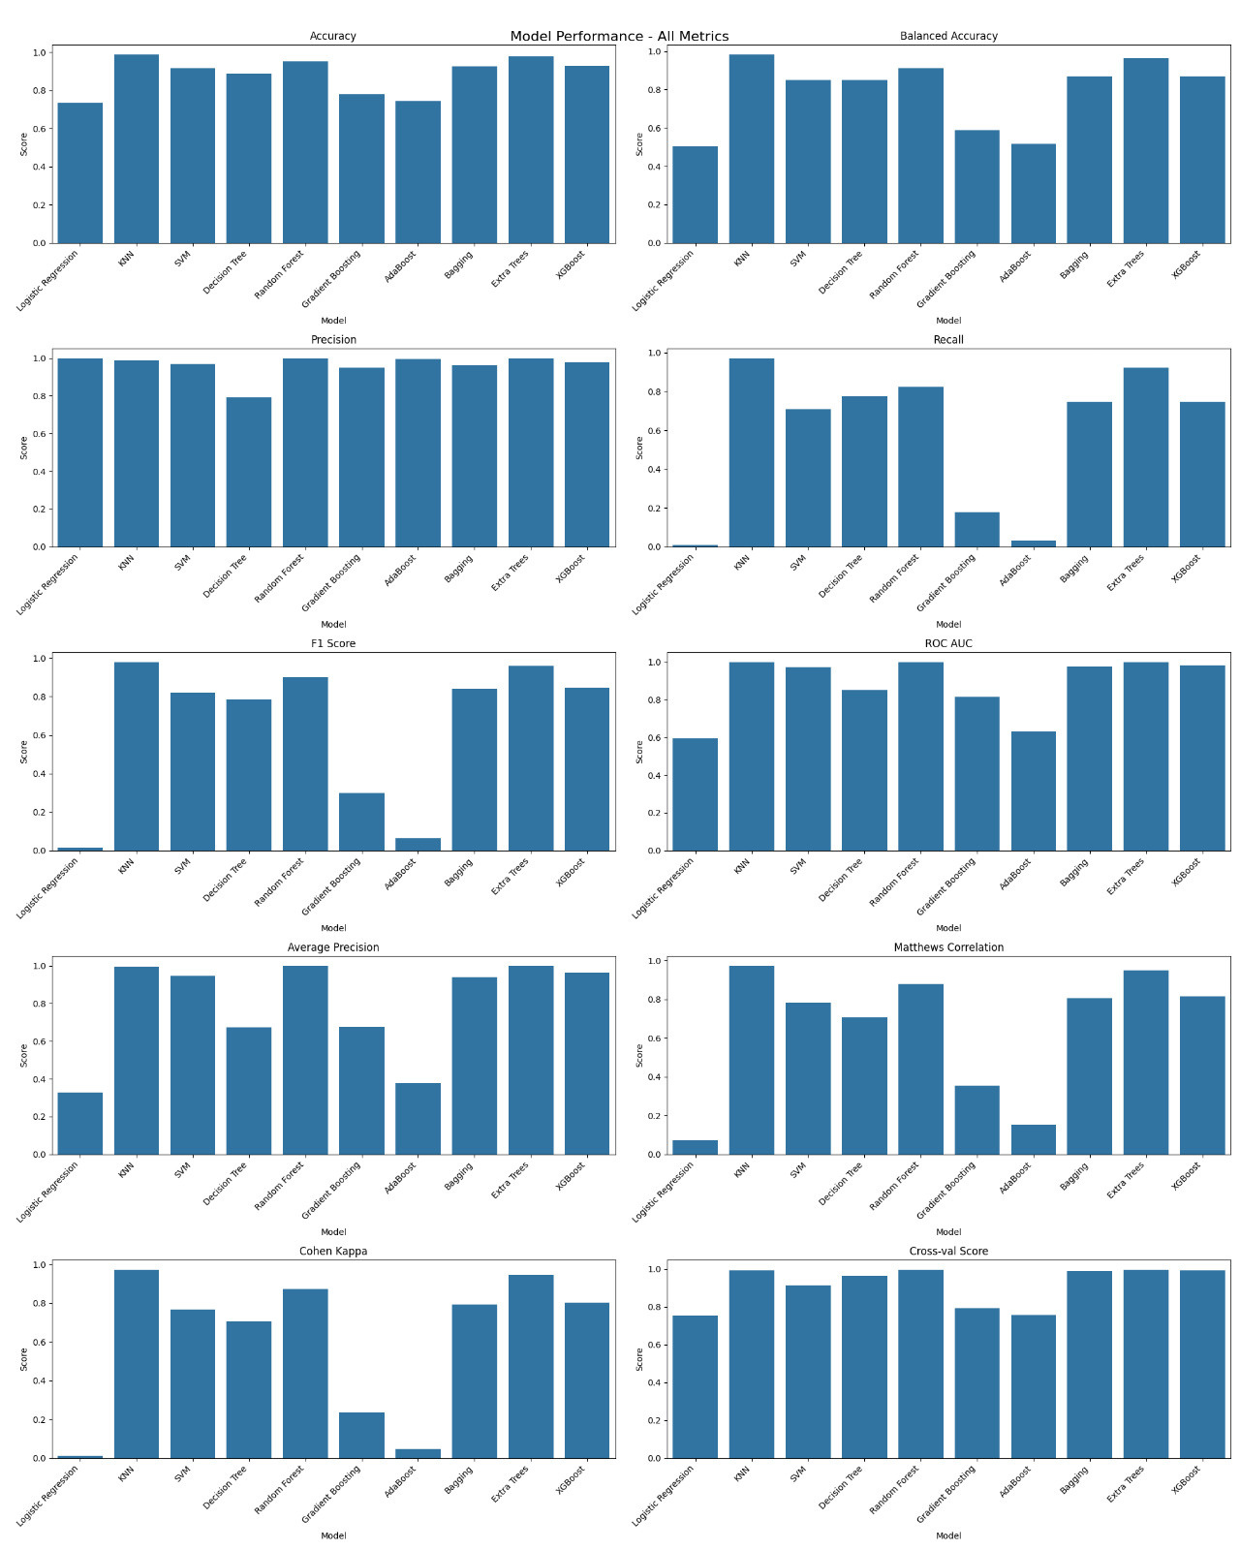

Slide 8

Final Verdict and Evaluation
We found out the 5 KPI as Principal Components based on the features provided. We create 10 models and 10 evaluation metrics to find out which models have more business value.
Highest Accuracy
Highest Precision
ROC-AUC
99.0%
97.8%
98.3%
by KKN Model
by Bagging Models
by XGBoost

Slide 9
Thank You
Team Member:
R. Kiran Kumar Reddy
Vishnu Prasad Korada
A Paritosh
Tusharkanta Behera

