Slide 1
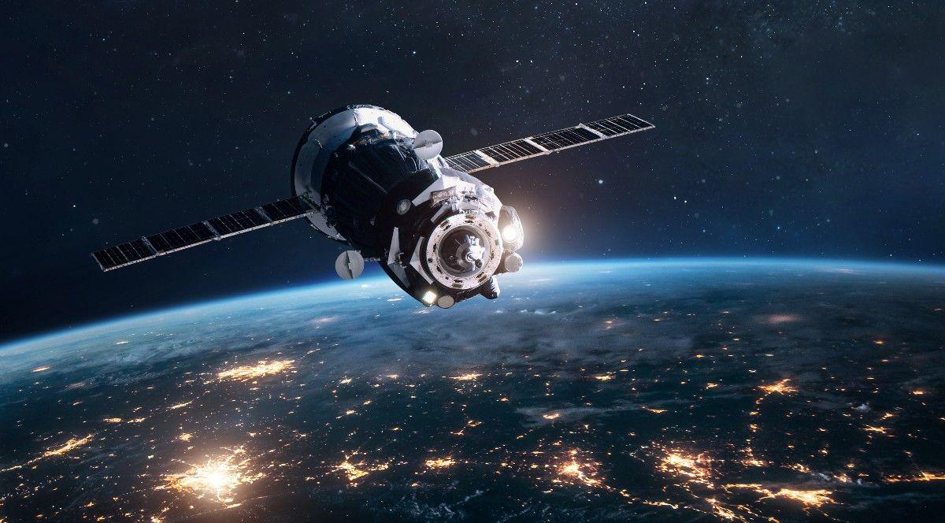
CubeSat Dynamics Simulation
Sprint 02

Slide 2
Prerequisites to use the model
MATLAB and Simulink installed with versions R2023b or later
Aerospace Toolkit and Aerospace Blockset installed.
Geodetic Toolbox and Mapping Toolbox installed.

Slide 3
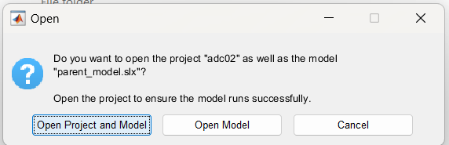
How to use the model
Unzip the cubesat_dynamics_sim file.
Open the folder, and open the parent_model.slx file.
This will open simulink and popup a dialog box, choose “Open Project and Model”

Slide 4
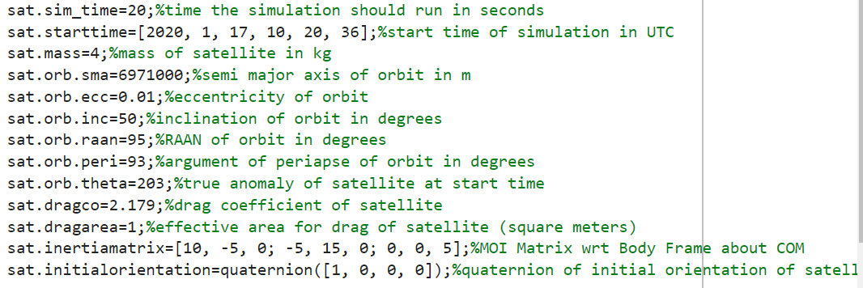
How to use the model
Once the project opens, first set the parameters of the satellite and mission using the ‘setparams.m’ matlab script in the project- follow the instructions given in the comments of the script.
Make sure to run this file irrespective of whether you have made any changes.

Slide 5
How to use the model
The simulation will run from the parent_model.slx file. This has two blocks: ‘configuring_inputs’ and ‘finalsim’
The ‘finalsim’ block is actually running the simulation and takes four inputs. This block does not need to be tuned, edited, etc. by the user of the model who does not want to get into the nitty gritties.
The four inputs, are given to this block by the ‘configuring_inputs’ block. These are the inputs that need to be tuned by the user based on the type of simulation that he/she wants to run, and the user can do so by opening this block. For now random test signals have been given.

Slide 6
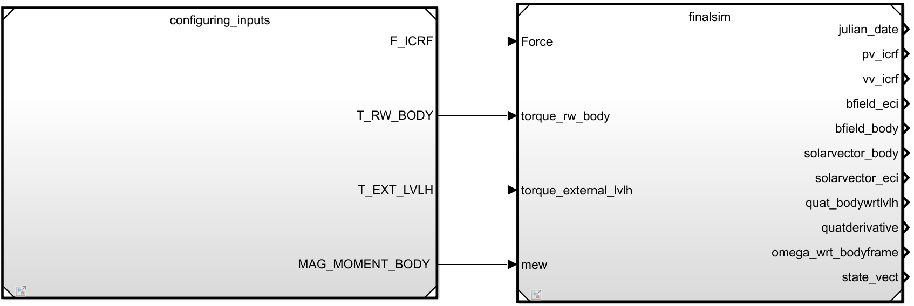
How to use the model

Slide 7
Inputs to configure_inputs Outputs from finalsim
F_ICRF- net external force(with respect to the ICRF/ECI frame) | juliandate - the live juliandate as the sim runs.
T_RW_BODY- signal for the torque of the reaction wheel model with respect to the body frame | pv_icrf - position vector of the satellite wrt ICRF frame
T_EXT_LVLH - external disturbance torque to satellite with respect to LVLH frame | vv_icrf - velocity vector of the satellite wrt ICRF frame
MAG_MOMENT_BODY - magnetic moment vector of the magnetorquers with respect to body frame. | bfield_eci - the earth’s magnetic field as a function of live satellite position in eci frame
 | bfield_body - the earth’s magnetic field as a function of live satellite position in body frame
 | sv_eci - same as b_eci but for solar vector
 | sv_body - same as b_body but for solar vector
Note- ICRF and ECI are two names for one and the same frame | quat_bodywrtlvlh - quaternion of the body frame of the satellite wrt the LVLH frame(orientation of the satellite) quatderivative- derivative of preceding quaternion omega_wrt_bodyframe- angular velocity vector wrt the body frame state _vector - (pv_icrf, vv_icrf, quat_bodywrtlvlh, quatderivative)

Slide 8
How to use the model
Take desired results/signals from output ports.
Run the simulation ‘parent_model.slx’
Ignore warnings if any.

Slide 9
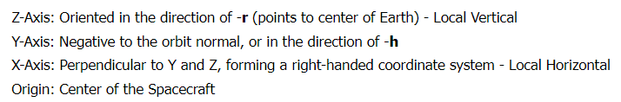
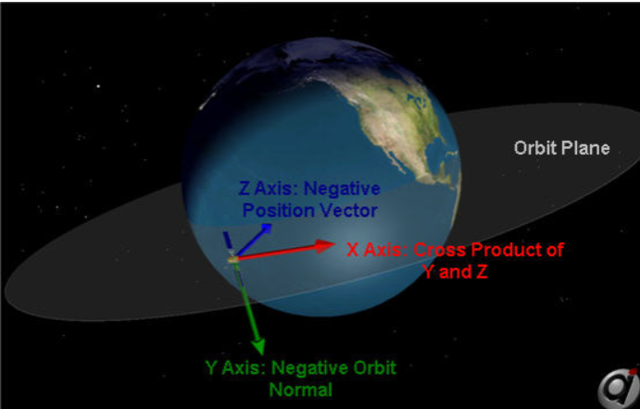
LVLH Frame
Useful to represent attitude because a certain orientation will have the same quaternion wrt this frame irrespective of where the satellite is in orbit

Slide 10
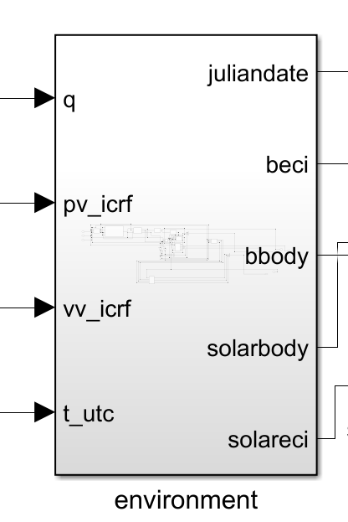
Overview of model blocks
Environment Block
Takes inputs from dynamics blocks and gives output informations regarding the environment of the satellite.

Slide 11
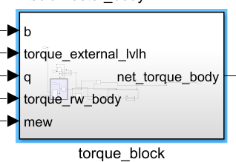
Overview of model blocks
Torque Block
Takes external torque with respect to LVLH frame, reaction wheel torque with respect to body frame and magnetic moment as well as field with respect to body frame, as well as quaternion from dynamics block, and runs scripts and blocks to output net torque with respect to body frame.

Slide 12
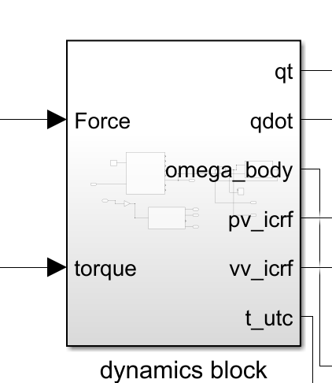
Overview of model blocks
Dynamics Block
Takes net force(other than gravity) wrt ICRF as input and outputs the orbital propagation(pv, vv and time)
Takes net torque with respect to body frame from torque block, and uses 6DOF block from aerospace toolkit to simulate the dynamics of the satellite and output quaternion.

Slide 13
Pendencies
More detailed documentation of each part of the model
Accounting for albedo and shadow in solar vector
Modelling of reaction wheel
Linearised reduced order control model

