Slide 1


Quick guide to
Flash talk
24.10.2024

Slide 2
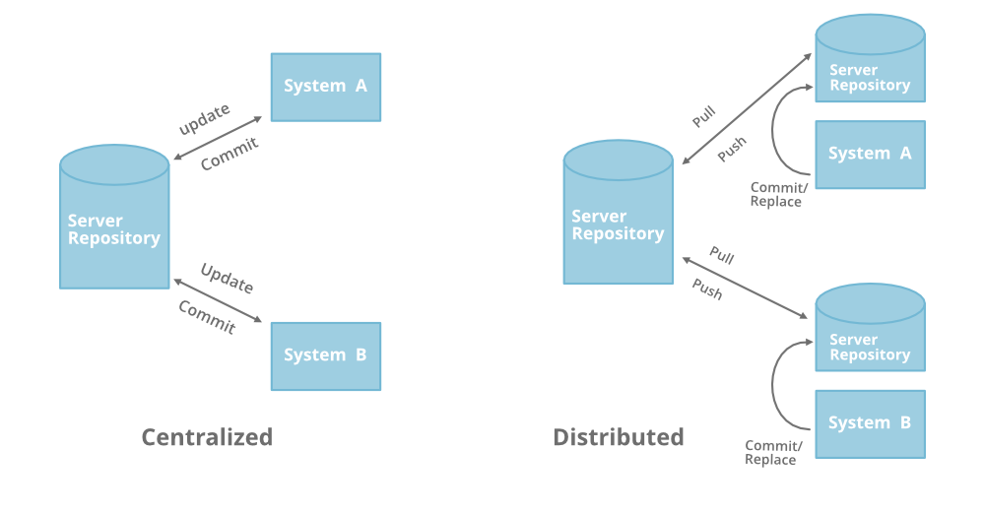
What is Git?
Centralized
distributed version-control system
command line
usually pre-installed (Mac / Linux)
Distributed
What is GitHub?
online application that provides:
visual interface for git
free cloud storage for projects’ code and files
Notes:
Version control is a way to manage files / directories, track changes over time and recall previous versions

Slide 3
Why is GitHub useful?
Version control
No more script, script_v2, script_final, etc…
Can go back to any previous versions
Collaboration
Integrates edits from multiple users
Keeps record of who did what and when
Documentation
All the scripts and files of your project are in a single place
README.md files and Wiki pages
Reproducibility
You and other researchers can recreate and / or modify any script you created
Visibility
Showcase your work to others
Promote your lab’s work and facilitate the use of your pipelines

Slide 4
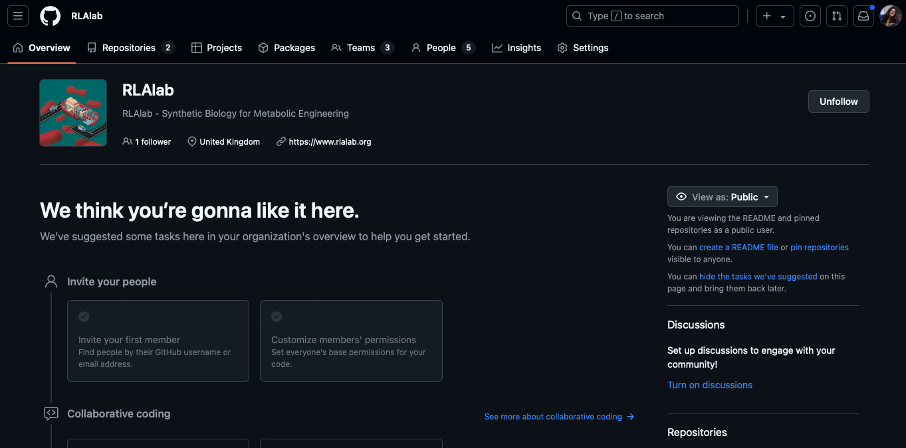
https://github.com/RLAlab

Slide 5
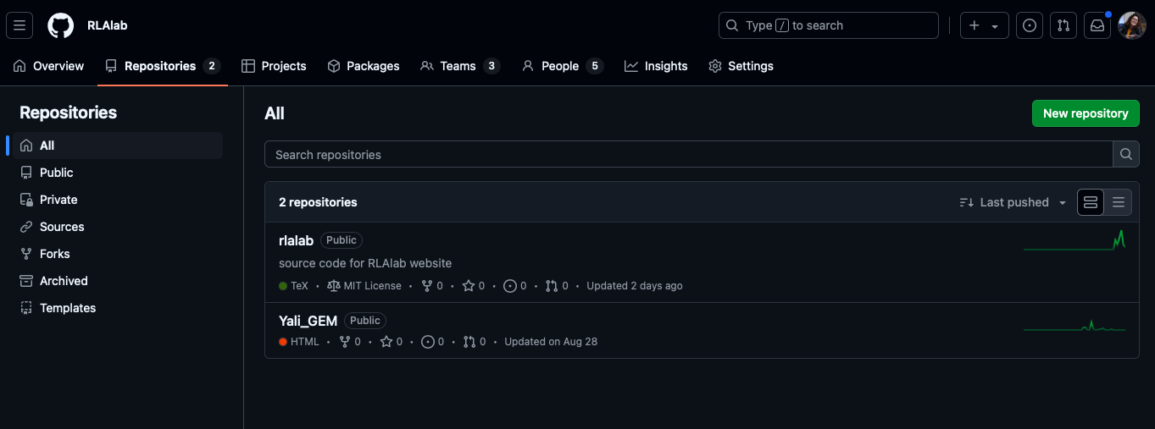

Slide 6
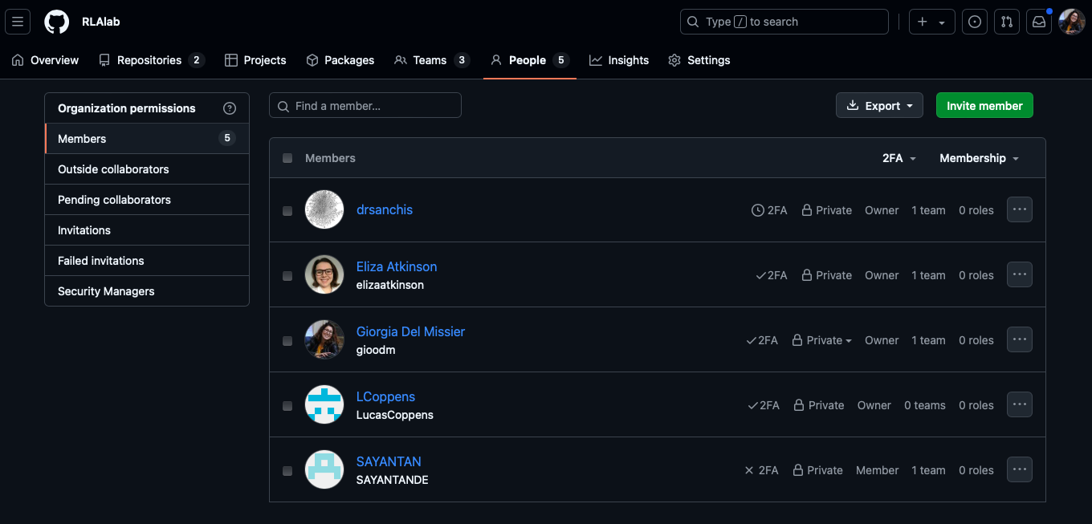
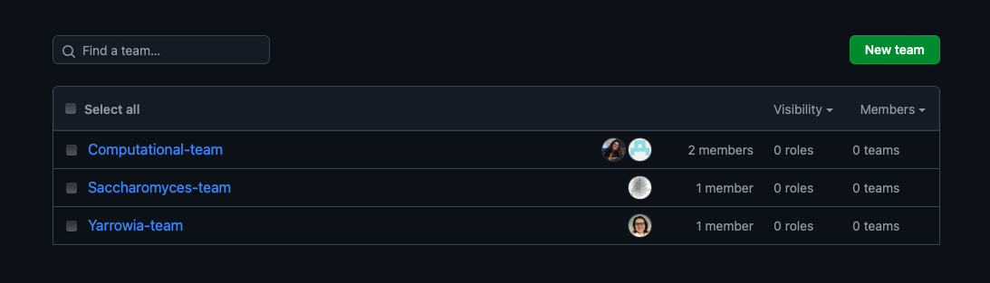

Slide 7
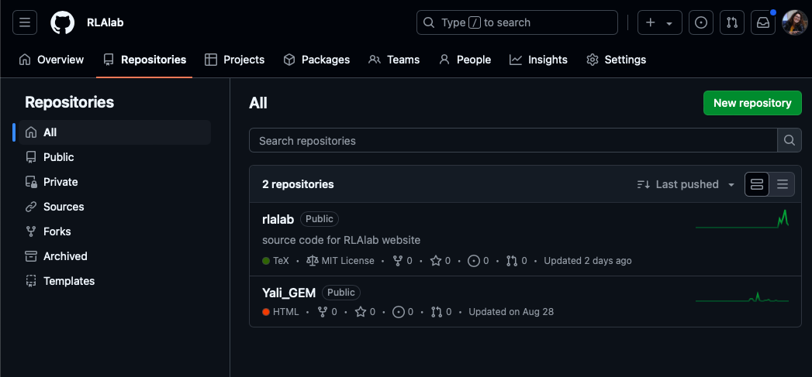
10 most common git terms
1. Repository (repo) a project that contains all your files, history, …

Slide 8
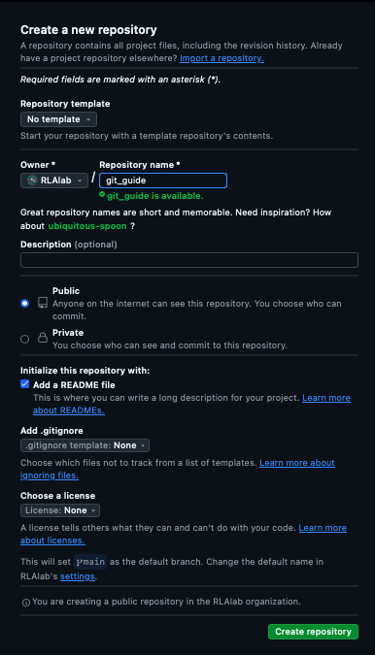
10 most common git terms
1. Repository (repo) a project that contains all your files, history, …

Slide 9
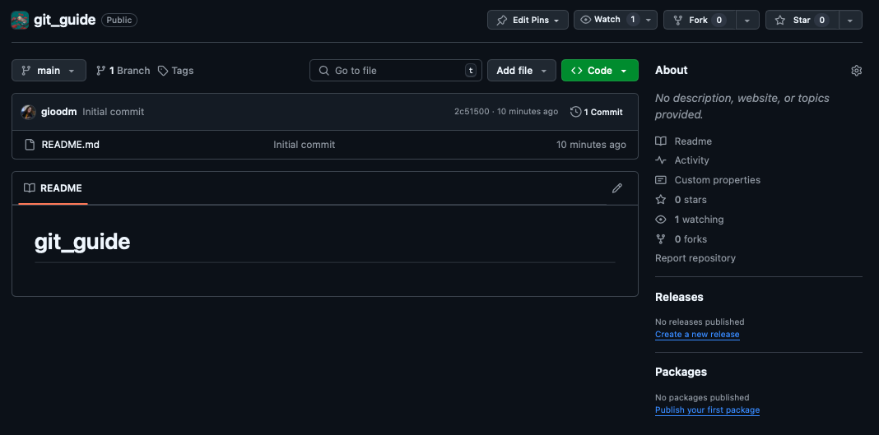
10 most common git terms
1. Repository (repo) a project that contains all your files, history, …
~% mkdir git_guide
~% cd git_guide
~% git init

Slide 10
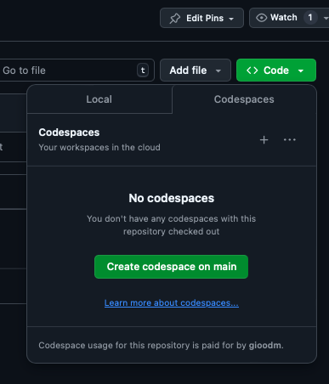
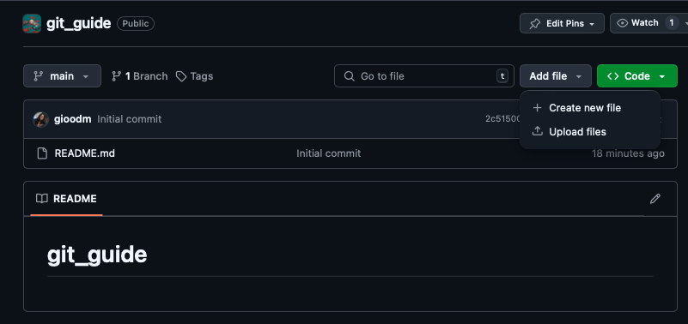
10 most common git terms
2. commit a snapshot of changes in the repository
~% git commit –m ”message”

Slide 11
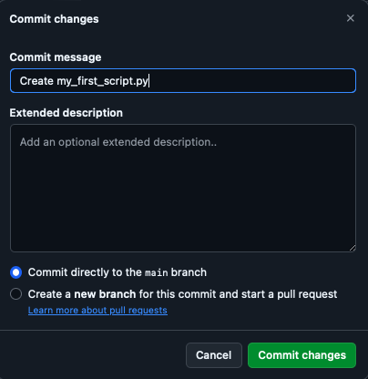
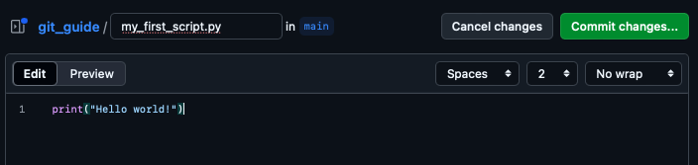
10 most common git terms
2. commit a snapshot of changes in the repository
~% git commit –m ”message”

Slide 12
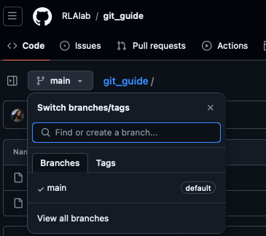

10 most common git terms
3. branch a separate line of development
master / main is the default branch
~% git branch # to list branches
~% git checkout –b branch-name # to create a new branch and switch to it
~% git branch branch-name # creates a branch
~% git checkout branch-name # switch to the new branch

Slide 13
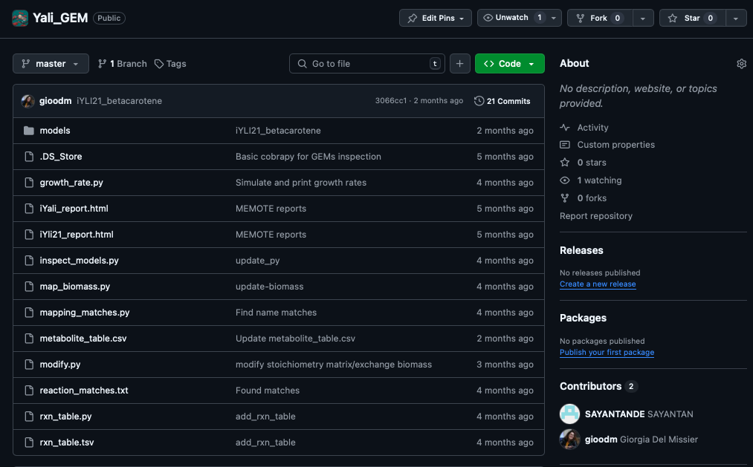
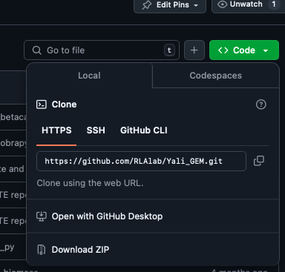
10 most common git terms
4. clone a local copy of a remote repository
~% git clone <url>

Slide 14
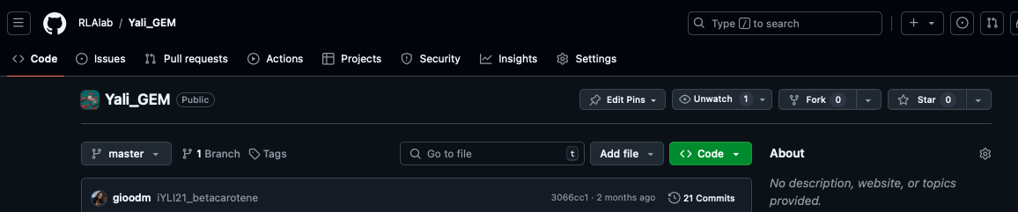
10 most common git terms
5. fork a copy of someone else’s repository on your account

Slide 15
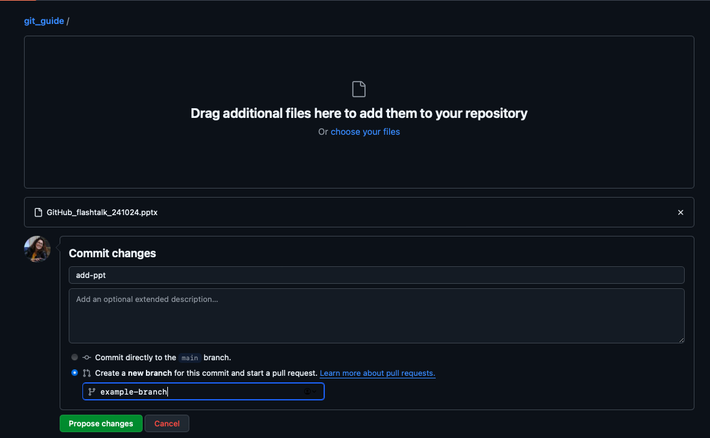
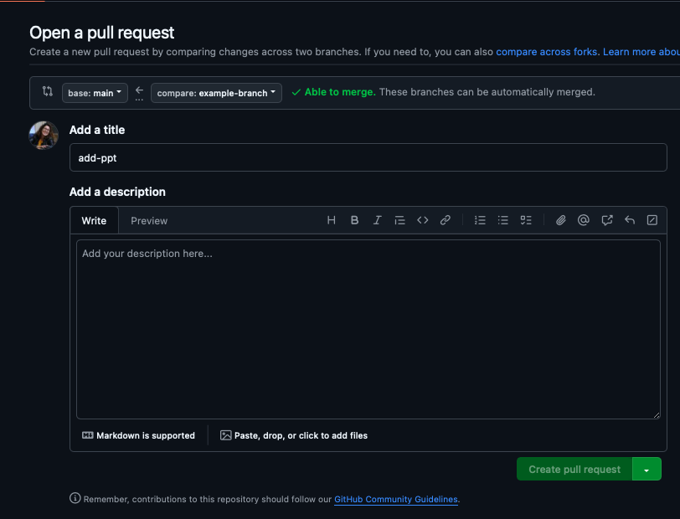
10 most common git terms
6. pull request (PR) a request to merge changes from one branch into another (usually from a feature branch into the main branch)
~% git push origin branch-name

Slide 16
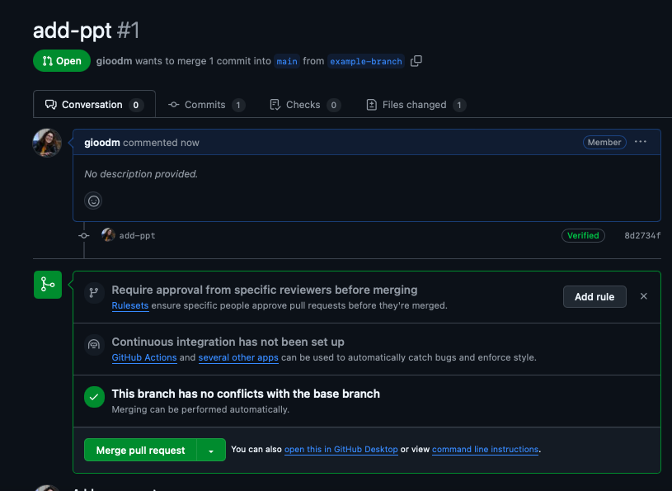
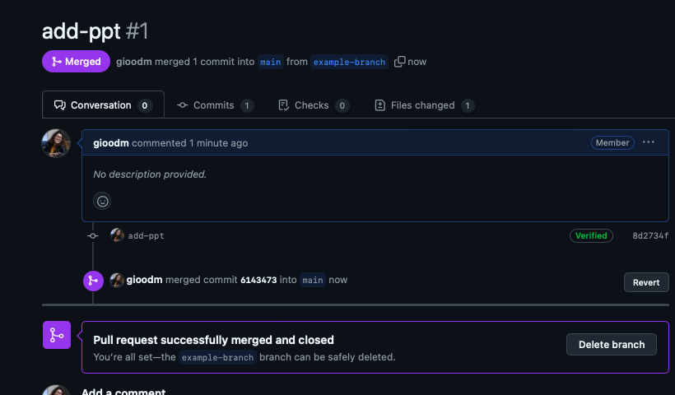
10 most common git terms
7. merge combining changes from one branch into another
~% git merge branch-name

Slide 17
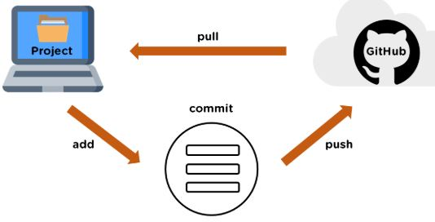
10 most common git terms
8. pull fetch and integrate changes from the remote repository into your local copy
9. staging (area) the area where changes are prepared before committing
10. push sending local commits to the remote repository
~% git pull
~% git add <file>
~% git push origin branch-name

Slide 18
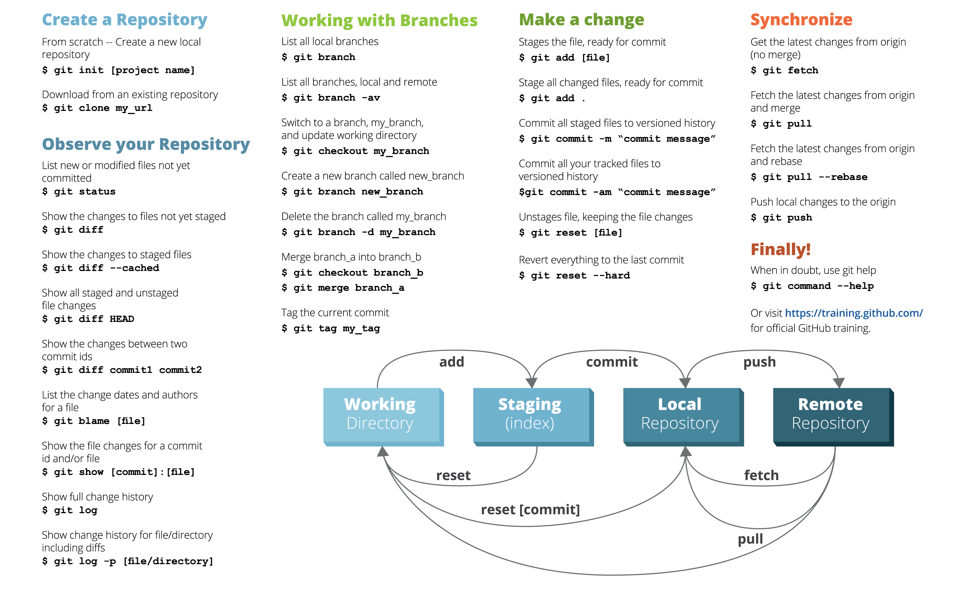
Cheat sheet
https://www.dataschool.io/git-quick-reference-for-beginners/
https://www.dataschool.io/simple-guide-to-forks-in-github-and-git/
https://www.dataschool.io/how-to-contribute-on-github/
https://www.geeksforgeeks.org/ultimate-guide-git-github/
https://medium.com/@sachinsoni600517/complete-tutorial-of-git-and-github-for-basic-to-advanced-1dd34d12b90b

