Slide 1
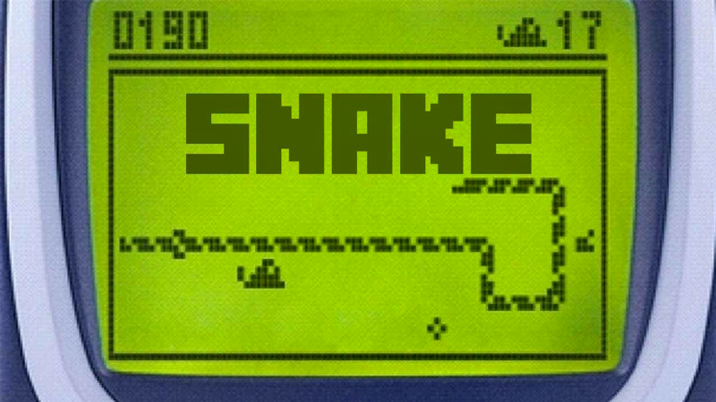
Snake Game Reinforcement Learning
Carolina Badano

Slide 2
The project is composed by 3 main elements
Agent
This code implements the Q-learning-based agent to play the Snake game.
The `SnakeAgent` class manages the agent's interactions with the game environment, utilizing a simple linear neural network for decision-making. The agent learns from experiences, updating both short-term and long-term memory, and get the action. The training loop orchestrates the agent's gameplay, training, and progress monitoring.
Game
This code defines the Snake game and its Pygame-based logic.
The game includes methods for initializing, resetting, playing steps, checking collisions, and updating the user interface. It also moves the snake and update the direction based on the action.
Linear QNet
This code employs PyTorch to define the Q-learning neural network model and its associated trainer.
The neural network predicts Q-values, the Bellman equation computes target Q-values, the loss function measures the discrepancy between them, and backpropagation updates the neural network parameters to minimize this discrepancy, thus improving the Q-values estimate.

Slide 3
Deep Q-Network (DQN)
DQN is a model-free reinforcement learning algorithm that combines deep learning techniques with Q-learning to acquire an approximation of the Q-function.
Components:
Linear_Qnet, it defines the neural network architecture used for the Q-learning.
Qtrainer, it is responsible for training the Q-network.
Optimization, it uses Adam optimizer and Mean Squared Error loss as loss function.
Learning and training, the model learns to approximate the Q-values and training is performed iteratively by sampling experiences from the environment and updating the Q-values to minimize the error between the predicted Q-values and the target Q-values.

Slide 4
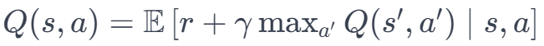
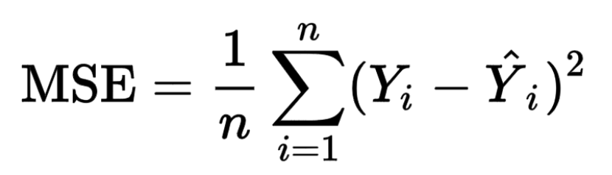
Deep Q-Network (DQN)
Main functions:
Action-value function:
Loss function:

Slide 5
Modifing the hyperparameters
Discount factor
Gamma influences the importance of future rewards in the agent's decision-making. It balances the desire for immediate rewards against the potential for future rewards.
A higher gamma values give more weight to future rewards, encouraging the agent to consider long-term consequences. It can lead to more wise behavior.
A lower gamma values make the agent focus more on immediate rewards, emphasizing short-term gains.
Learning rate
The learning rate determines the size of the steps the Q-learning algorithm takes to adjust its Q-values based on the observed rewards.
A higher learning rate makes the algorithm adapt more quickly to new information, but it may become more prone to overshooting and oscillations.
A lower learning rate makes the algorithm more conservative, taking smaller steps and potentially being more stable, but it might require more time to converge.

Slide 6
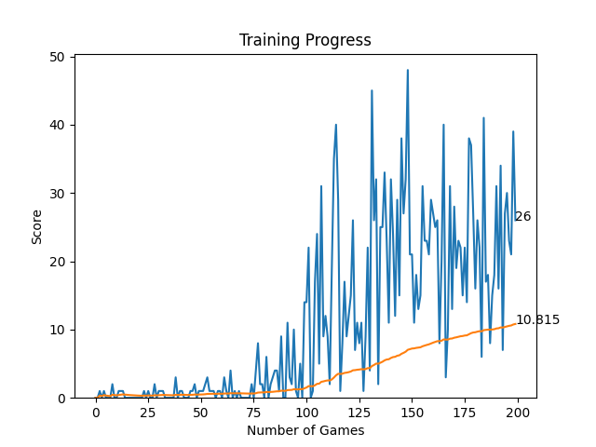
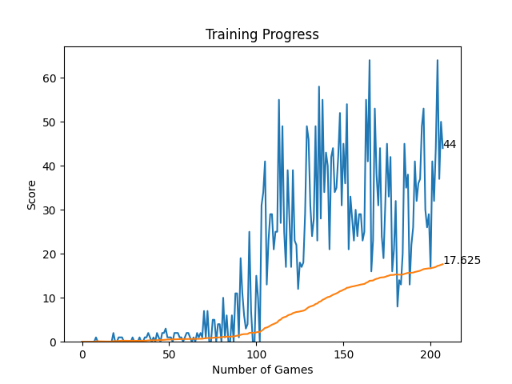
LR=0.001 γ=0.99
LR=0.001 γ=0.95

Slide 7
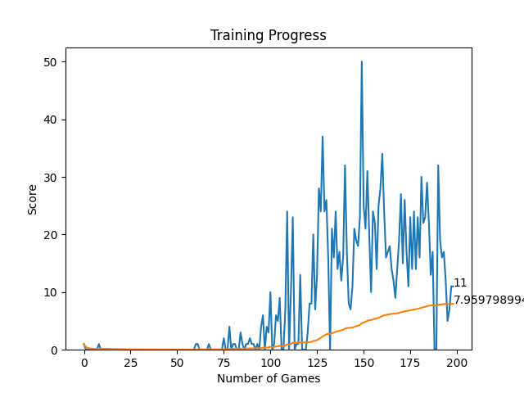
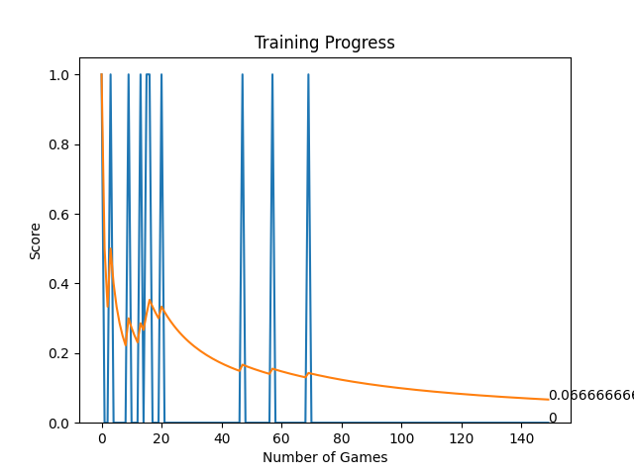
LR=0.0001 γ=0.95
LR=0.01 γ=0.95

Slide 8
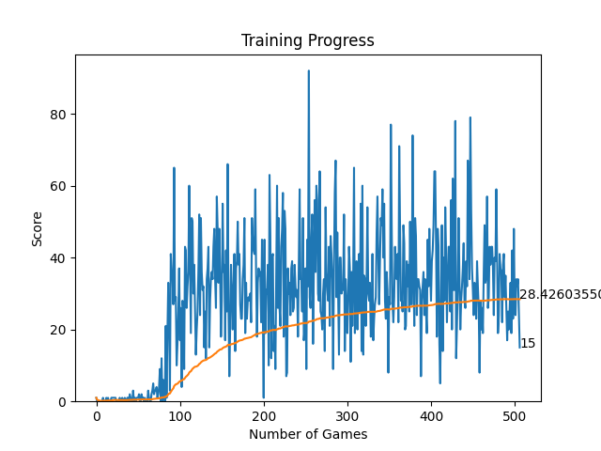
LR=0.001 γ=0.95
500 games
Best score:97

Slide 9
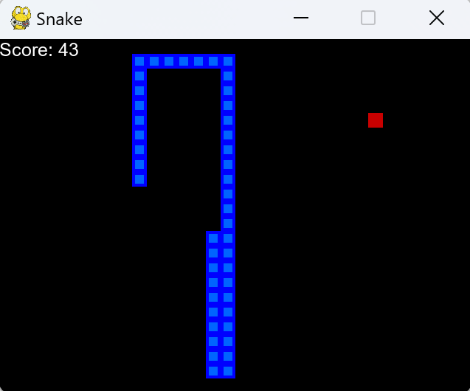
Thanks!

