Slide 1



COVID19
A Global Situational Analysis
Anuja
Bec Ngooi
Rebecca Butcher

Slide 2

Content
What is SARS-CoV-2
Data techniques
Project implementation
Project outcome

Slide 3

Coronavirus (COVID-2019)
February 2020 NSW Health responded to an outbreak of a coronavirus (COVID-2019), first reported in China in December 2019.
On March 11 2020 the World Health Organisation (WHO) declared the novel coronavirus (COVID-19) a worldwide pandemic. This pandemic declaration for COVID-19 is still active.
The project's primary goal is to analyse COVID-19 data and gain insights into the new and cumulative cases and deaths around the world. Which countries are still hotspots for COVID-19 and which countries have gotten the disease under control.

Slide 4

Project 3
Your visualisation must include a Python Flask-powered API, HTML/CSS, JavaScript, and at least one database (SQL, MongoDB, SQLite, etc.).
A combination of web scraping and Leaflet or Plotly

Slide 5
Data Techniques
Python
SQLite
Flask
HTML
CSS
JavaScript
D3

Slide 6

Project implementation
1). WHO-COVID-19-global-data.csv was read into Covid-19ETL.ipynb
Data cleaning was performed and unused columns dropped
Data was grouped by Country
Lat and Long was added to the dataset
Cleaned data was loaded into an SQLite Database
2). app.py
a flask app was developed with the following endpoints:
/ - landing page with rendered index html
(‘/api/covid’) - returns covid data in JSON format

Slide 7
Project implementation cont.
3). index.html - accesses all the libraries being used in the dashboard and displays the page contents
4). logic.js
leaflet to draw a map of the world and hold the cases and deaths data
Click on country to identify the number of cases and deaths per country
drop down menu to select on either cases or deaths
plotly to develop a bar chart of, cumulative cases and deaths
5). style.css - applying style to the html page contents

Slide 8
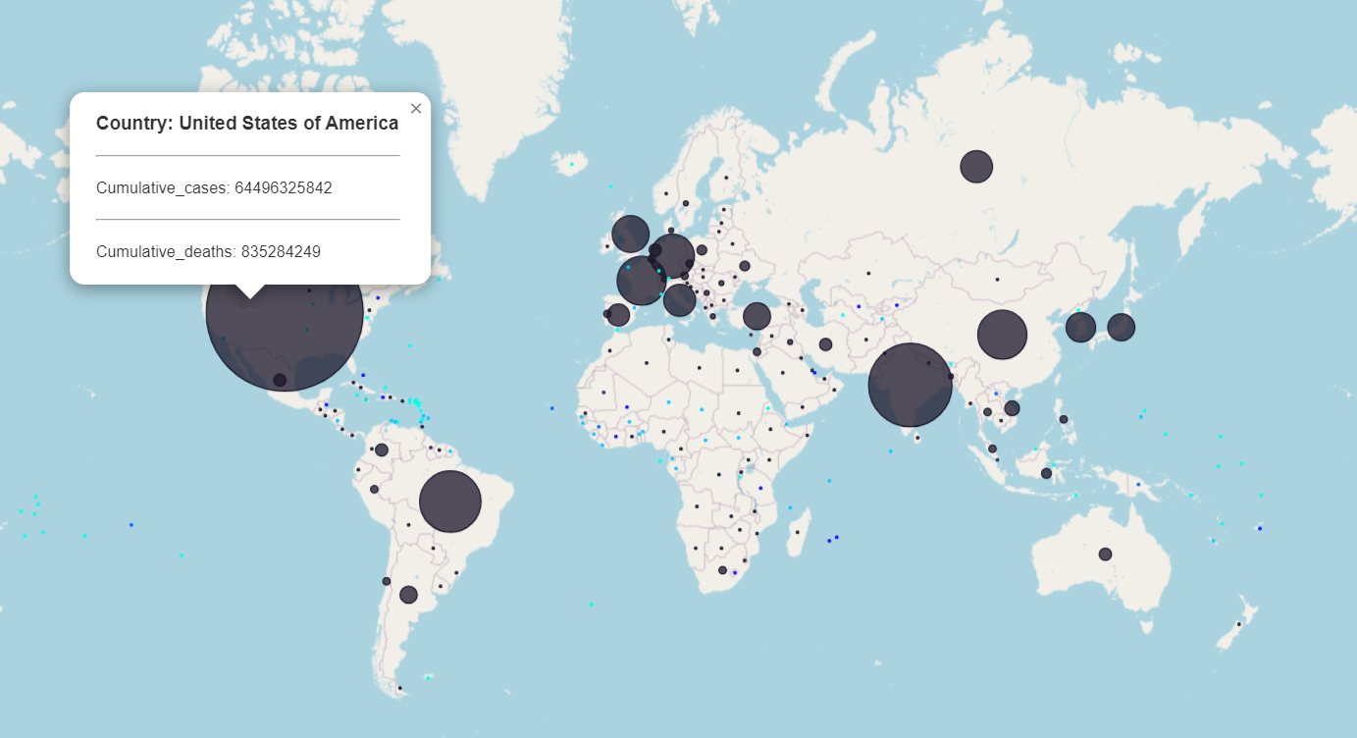

Slide 9
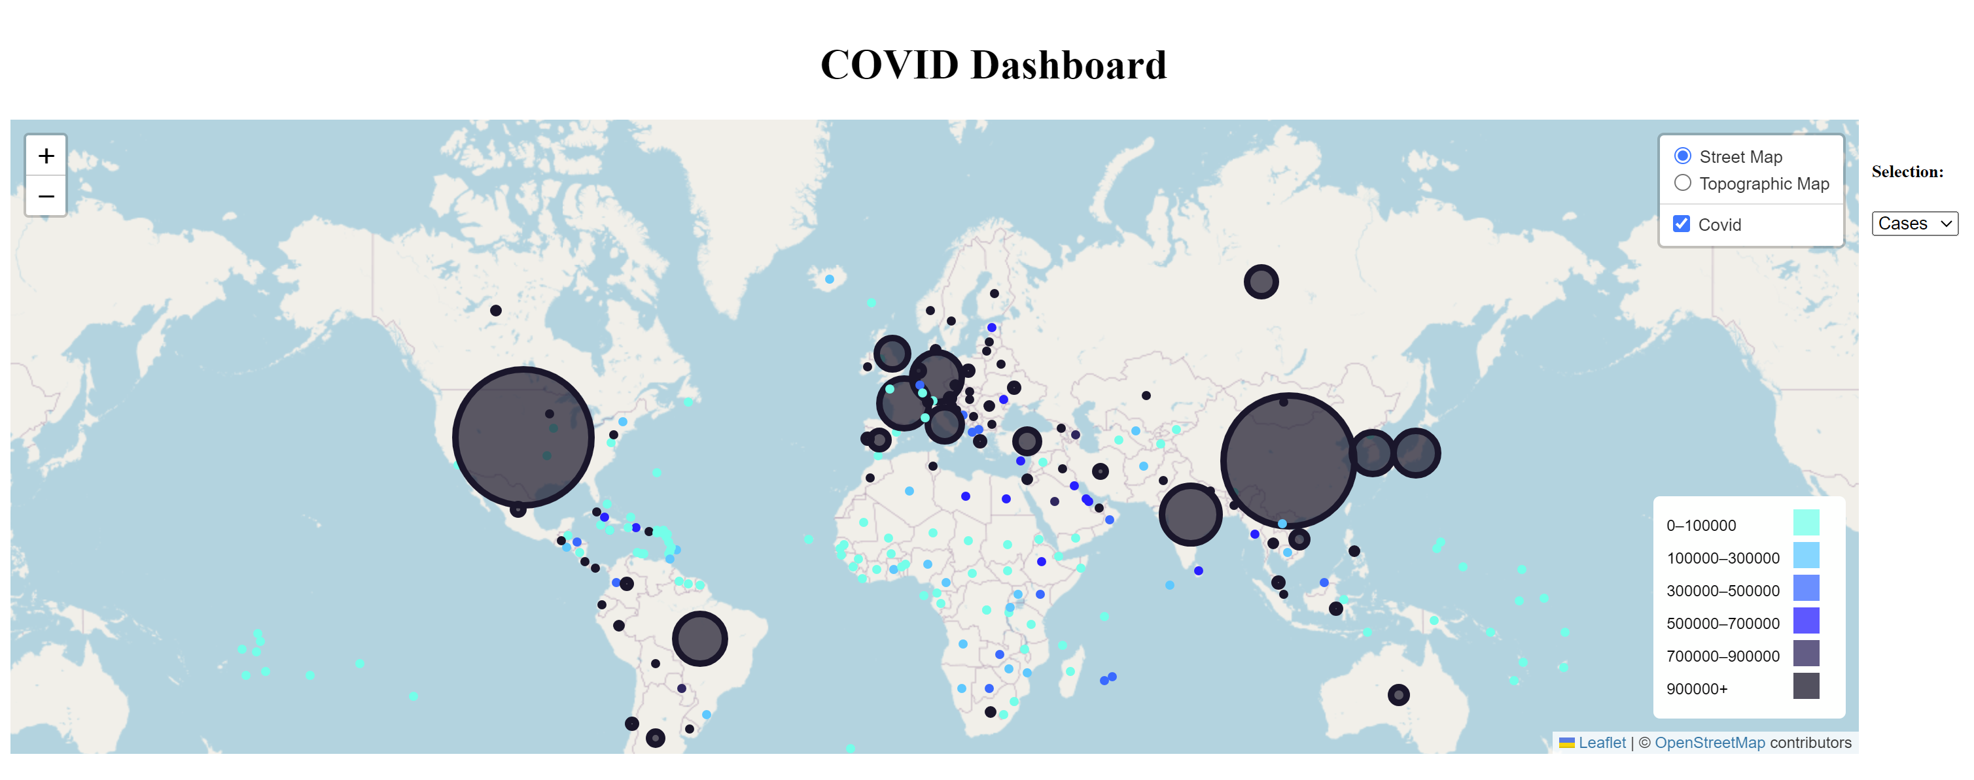

Slide 10
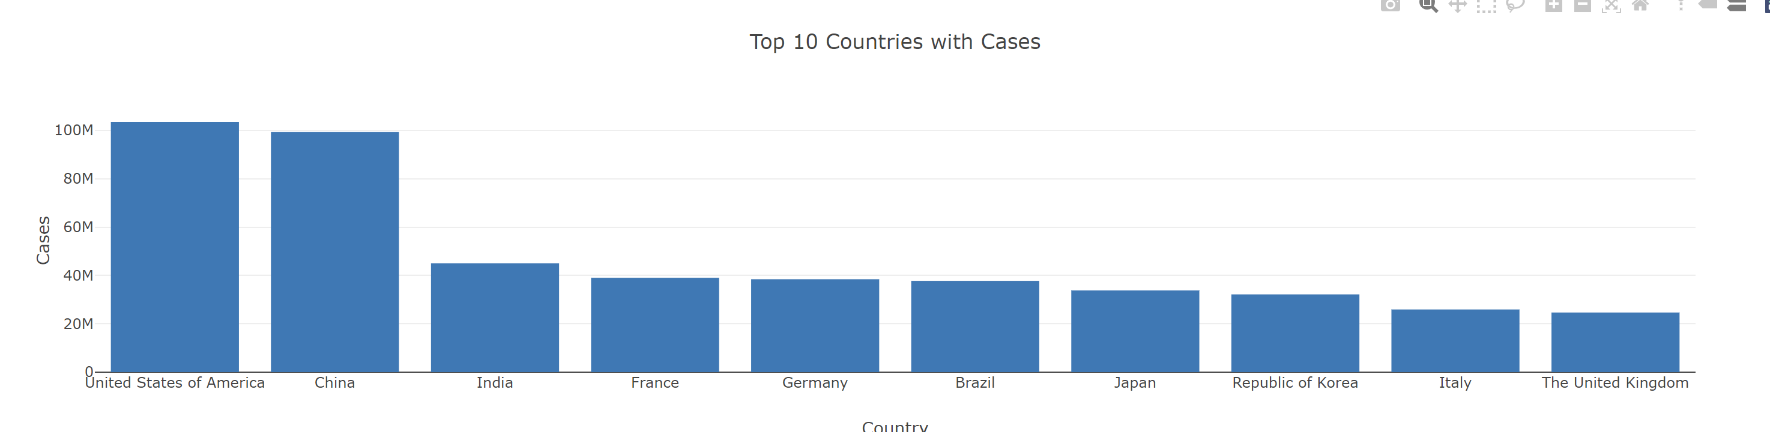
Top 10 countries by cumulative cases

Slide 11
Total cases and deaths
New cases | 766339879
Cumulative cases | 405251721844
New deaths | 6939172
Cumulative deaths | 5196529330

Slide 12
Top ten countries by number of Covid cases
Country | Cumulative cases
United States of America | 64496325842
India | 34068533022
Brazil | 25258981152
China | 20054618619
France | 19560844190
Germany | 17892944570
The United Kingdom | 14829767085
Russian Federation | 13260421559
Italy | 12928081898
Republic of Korea | 11929505476

