Slide 1



COVID19
A Global Situational Analysis
Anuja
Bec Ngooi
Rebecca Butcher

Slide 2

Content
What is SARS-CoV-2
Data techniques
Project implementation
Project outcome

Slide 3

Coronavirus (COVID-2019)
On March 11 2020 the World Health Organisation (WHO) declared the novel coronavirus (COVID-19) a worldwide pandemic. This pandemic declaration for COVID-19 is still active.
February 2020 NSW Health responded to an outbreak of a coronavirus (COVID-2019), first reported in China in December 2019.
The project's primary goal is to analyse COVID-19 data and gain insights into the cumulative cases and deaths around the world.
Objective: Identify the Top 10 countries with cumulative cases and deaths

Slide 4

Project
We created three visualisations, choosing Option 1 using a combination of Leaflet and Plotly
Let’s explore how we went about this process…

Slide 5
Data Techniques
Python
SQLite
Flask
HTML
CSS
JavaScript

Slide 6

Project Implementation
Find a dataset for COVID-19. Data obtained from WHO
WHO-COVID-19-global-data.csv was read into Covid-19ETL.ipynb
Data exploration and cleaning was performed and unused columns dropped
Data was grouped by Country
Latitude and Longitude was added to the dataset using an API
Cleaned data was loaded into an SQLite Database
app.py
Pulled in dataset from SQL
A flask app was developed with the following endpoints:
/ - landing page with rendered index html (‘/api/covid’) - returns covid data in GeoJSON format

Slide 7
Project Implementation cont.
Index.html - accesses all the libraries being used in the dashboard and displays the page contents
Logic.js
Pulled in dataset from ‘/api/covid’ using D3
Leaflet to draw a map of the world and hold the cases and deaths data
Click on country (pop ups) to identify the number of cases and deaths per country
Drop down menu to select on either cases or deaths
Plotly to develop a bar chart of cumulative cases and deaths
Style.css - applying style to the html page contents

Slide 8
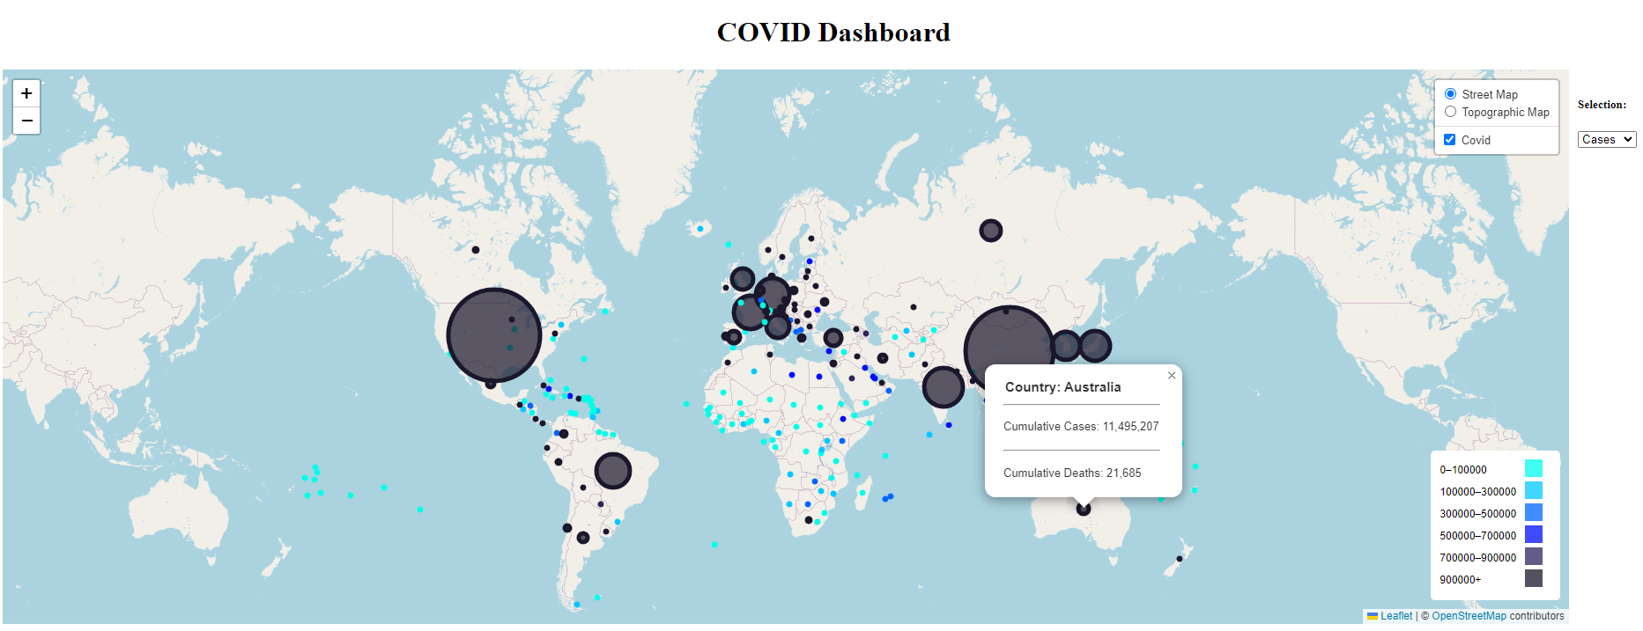

Slide 9
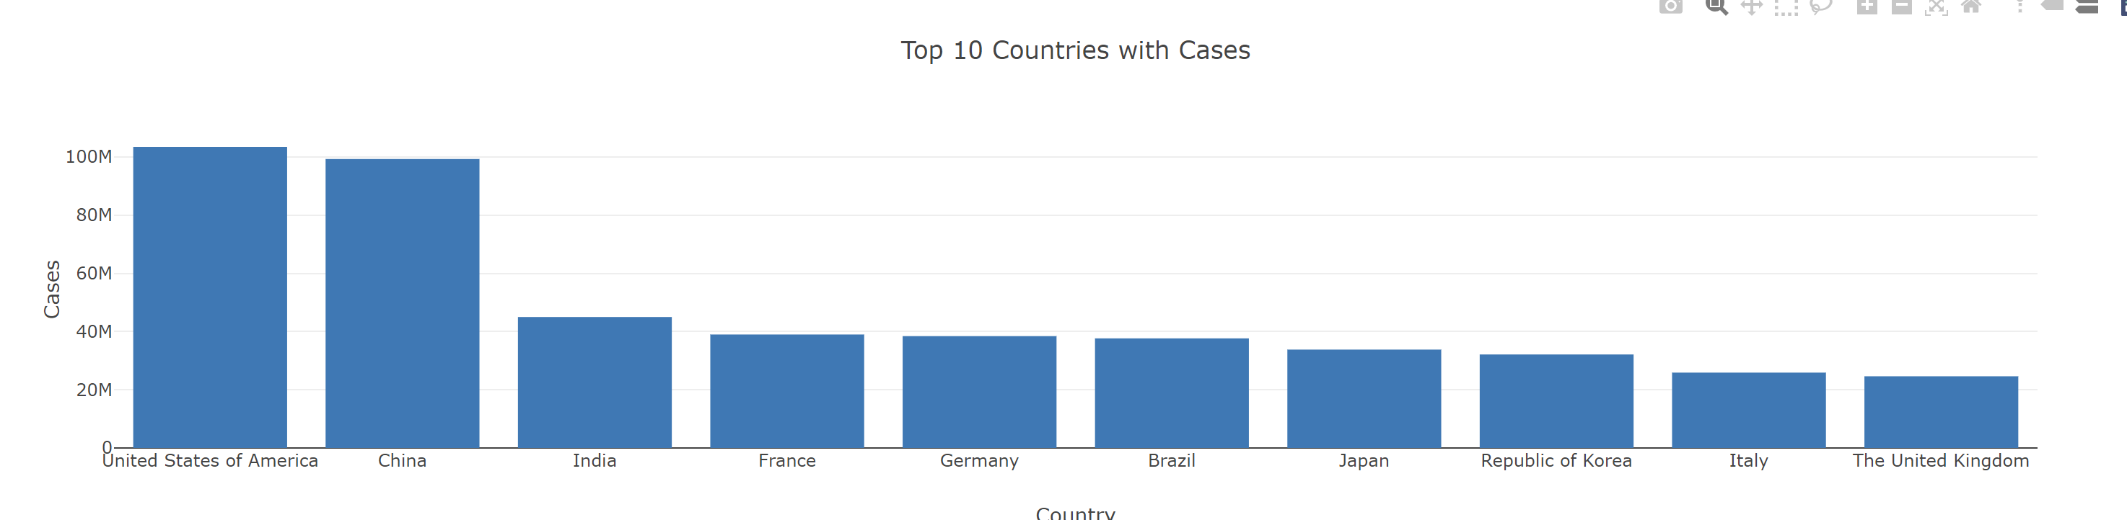
Top 10 countries by Cumulative Cases

Slide 10
Total cases and deaths
New cases | 766339879
Cumulative cases | 405251721844
New deaths | 6939172
Cumulative deaths | 5196529330

Slide 11
Top ten countries by number of Covid cases
Country | Cumulative cases
United States of America | 64496325842
India | 34068533022
Brazil | 25258981152
China | 20054618619
France | 19560844190
Germany | 17892944570
The United Kingdom | 14829767085
Russian Federation | 13260421559
Italy | 12928081898
Republic of Korea | 11929505476

