Slide 1
Tutorial 1

Slide 2
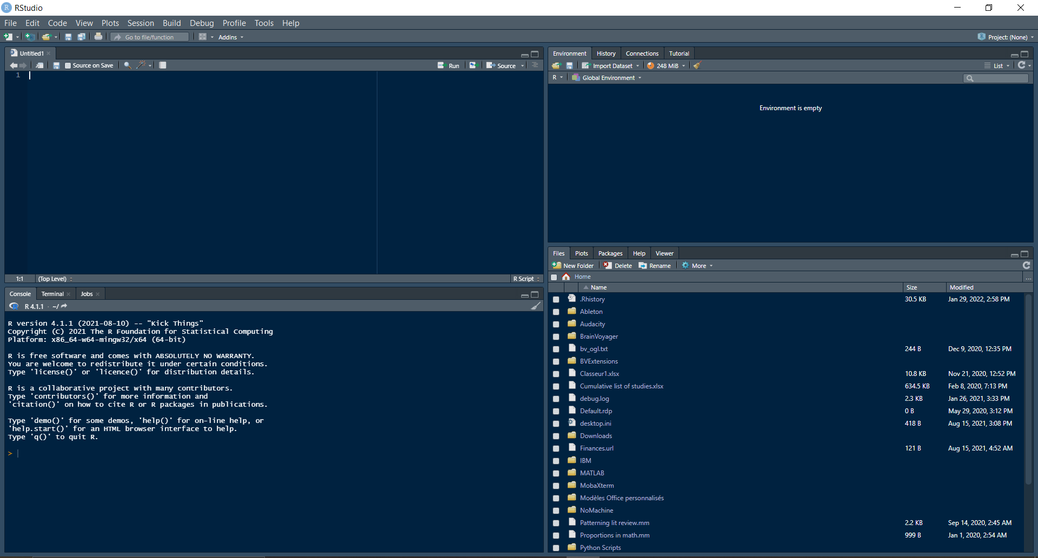
Script
Global Environment
Console
Resource/display

Slide 3
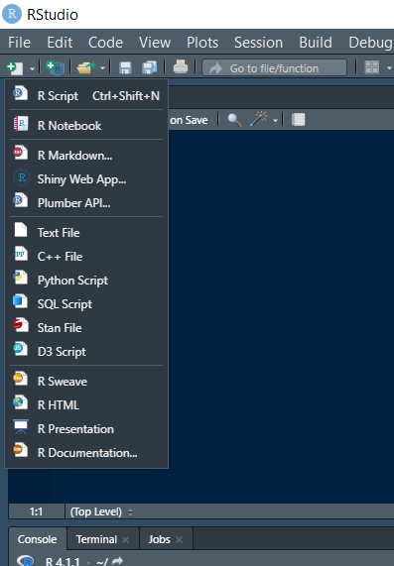
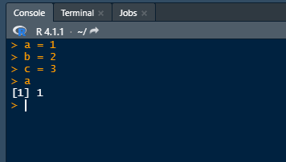
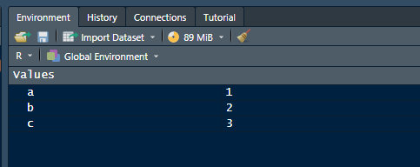
Name of object
Content of object
Objects
Content

Slide 4
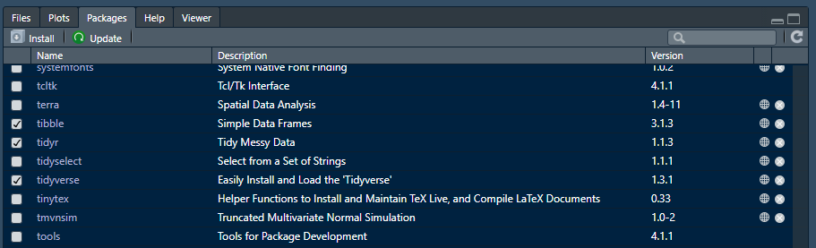

Slide 5
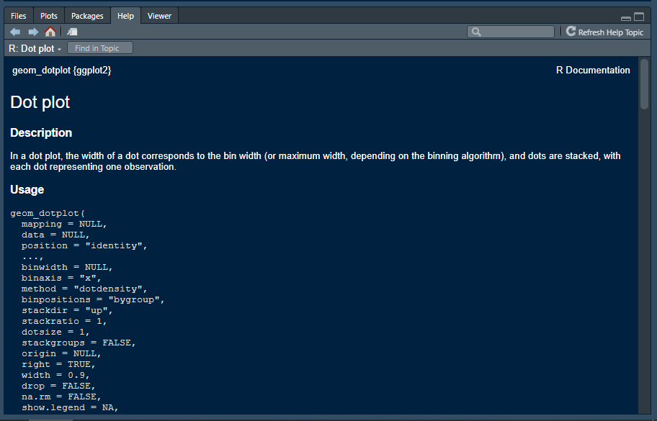

Slide 6
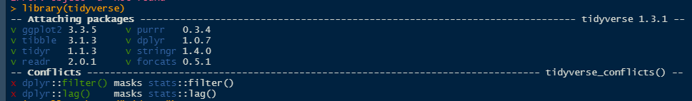

Slide 7
Tutorial 2

Slide 8
 | Item 1 | Item 2 | …
Subject 1 | Score…
Subject 2
Subject 3
One line per subject
Individual dataframes
Combined dataframe
Subject | Item | Score
Subject 1 | Item 1
Subject 1 | Item 2
Subject 1 | Item 3
Subject | Item | Score
Subject 1 | Item 1
Subject 1 | Item 2
Subject 1 | Item 3
Subject 2 | Item 1
Subject 2 | Item 2
Subject 2 | Item 3
Subject | Item | Score
Subject 2 | Item 1
Subject 2 | Item 2
Subject 2 | Item 3
Multiple lines per subject

