Slide 1
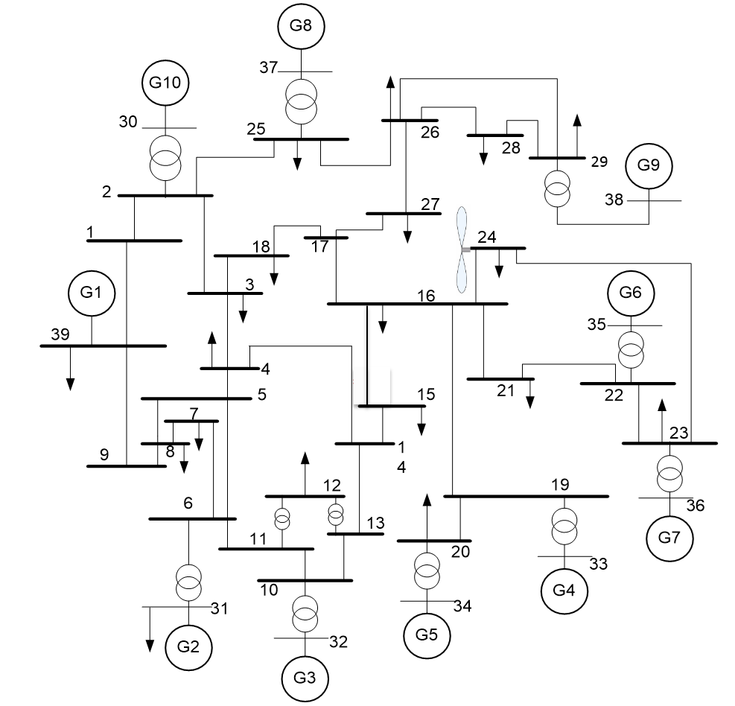
Optimal PMU placement and cascading analysis in IEEE 10 machine 39 bus system

