Slide 1
PHP Microservices

Slide 2
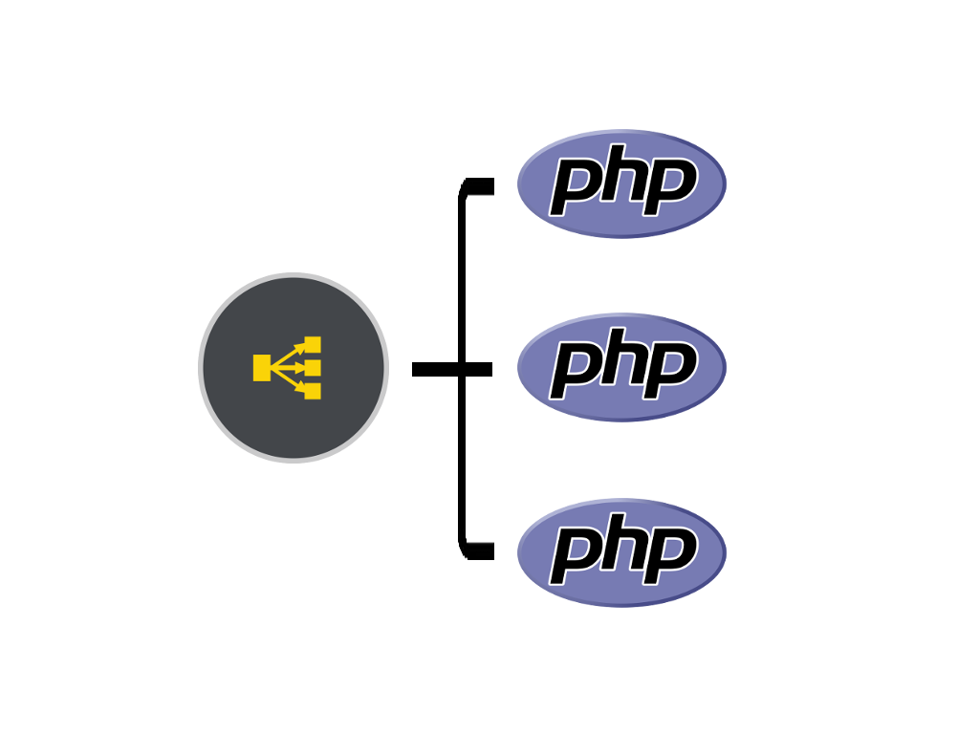
What we are going to do
Learn what a microservice is
Learn some pitfalls of microservices
Compare the speed of microservice vs full MVC
Implement a microservice

Slide 3
What is a Microservice?
From Wikipedia (https://en.wikipedia.org/wiki/Microservices ):
There is no industry consensus yet regarding the properties of microservices, and an official definition is missing as well. Some of the defining characteristics that are frequently cited include…

Slide 4
Microservice characteristics
Services in a microservice architecture (MSA)are often processes that communicate over a network to fulfill a goal using technology-agnostic protocols such as HTTP.^{[5][6][7]} However, services might also use other kinds of inter-process communication mechanisms such as shared memory.^{[8]} Services might also run within the same process as, for example, OSGI bundles.
Services in a microservice architecture are independently deployable.^{[9][1]}
The services are easy to replace.
Services are organized around capabilities, e.g., user interface front-end, recommendation, logistics, billing, etc.

Slide 5
Microservice characteristics Cont.
Services can be implemented using different programming languages, databases, hardware and software environment, depending on what fits best.^{[1]}Services in a microservice architecture are independently deployable.^{[9][1]}
Services are small in size, messaging enabled, bounded by contexts, autonomously developed, independently deployable, decentralized and built and released with automated processes.^{[9]}Services are organized around capabilities, e.g., user interface front-end, recommendation, logistics, billing, etc.
Service all share a common security model.

Slide 6
Microservice Philosophy
The philosophy of the microservices architecture essentially equates to the Unix philosophy of "Do one thing and do it well". It is described as follows:^{[21][22][23]}
The services are small - fine-grained to perform single functionality.
The organization culture must embrace automation of testing and deployment. This eases the burden on management and operations and allows for different development teams to work on independently deployable units of code.^{[24]}
The culture and design principles must embrace failure and faults, similar to anti-fragile systems.
Each service is elastic, resilient, composable, minimal, and complete.^{[23]}

Slide 7

It’s Not all Rainbows and Unicorns

Slide 8
The microservices approach is subject to a number of tradeoffs:
Services form information barriers^{[31]}
Inter-service calls over a network have a higher cost in terms of network latency and message processing time than in-process calls within a monolithic service process^{[5]}
Testing and deployment are more complicated^{[32]}
Moving responsibilities between services is more difficult.^{[1]} It may involve communication between different teams, rewriting the functionality in another language or fitting it into a different infrastructure^{[5]}
Viewing the size of services as the primary structuring mechanism can lead to too many services when the alternative of internal modularization may lead to a simpler design.^{[33]}

Slide 9

Enough Theory

Slide 10
PHP’s approach to Microservices:
A PHP Microservice preforms as much pre-processing as possible. That is to say as many constructors as possible should have been called before the request comes in.
PHP Microservices are usually asynchronous.
The Expressive Framework 3 or better can be used to build Microservices. But a framework is not required.
Common transports include HTTP (RESTful), WebSocket, and Message Queues, but can be anything.
Swoole is the preferred method of building Microservices as it supports Asynchronous PHP.
You do not use any webserver like Apache or NGINX.

Slide 11
Swoole a quick overview
Swoole in 5 minutes or less
Some things Swoole can do
Can by Sync or Async
Provides low level support for many Unix primitives
Millisecond task scheduling
Provides PHP programmer with access to C level primitives
Mmap, pool, mallac
Unix Sockets, udp
Ssl
Shell out to other scripts like python, exec
http/2

Slide 12
More Swoole
Swoole should not be used when running under Apache or other webserver.
Swoole will kill any process that uses too much memory.
You MUST restart the service for the changes to take effect. (more on this later).
Many frameworks are now embracing Swoole for building microservices
Zend Expressive microservices are being built around Swoole

Slide 13
Cool Swoole Examples
https://mwop.net/blog/2018-10-16-swoole.html
https://github.com/swoole/swoole-src/tree/master/examples
Calling Python script from PHP
https://github.com/swoole/swoole-src/tree/master/examples/process
Classic C/Unix Process Management
https://github.com/swoole/swoole-src/blob/master/examples/process/worker.php
Classic C/Unix Message Queue
https://github.com/swoole/swoole-src/blob/master/examples/process/msgqueue.php
Classic C/Unix Map a file into memory
https://github.com/swoole/swoole-src/blob/master/examples/mmap/mmap.php

Slide 14
The Example Code
https://github.com/jstormes/microservices

Slide 15
System requirements for running the Examples
Make sure you have Docker and Docker-Compose installed on your workstation.
[https://www.docker.com/community-edition](https://www.docker.com/community-edition)
Disable any existing web server/service running on ports 443 and 80, 8080, 8081, 8082
Disable any MySQL or MariaDB server running on port 3306
Make sure you have a git client on your workstation.
Make sure you have access to the Internet

Slide 16
Clone the example from GitHub
`git clone https://github.com/jstormes/microservices.git`
`cd microservices`
`git submodule init`
`git submodule update`
Or use a GUI git tool like SourceTree

Slide 17
Running the example
`docker-compose run --service-ports lamp bash`
`cd SpeedTest`
`composer install`
`composer development-enable`
`php public/index.php start >>/dev/null 2>&1 & `
To see the running web processes
`ps –ef`
To see the listening services
`netstat -tulpn`

Slide 18
Running the Example (cont.)
Open your browser to:
http://speedtest.loopback.world/test.php

Slide 19

How it works
https://github.com/zendframework/zend-expressive-swoole/blob/master/docs/book/v1/how-it-works.md

Slide 20
To make it even faster
Preload as many resources as possible, don’t use lazy loading.
This implies that you service should be small. Imagine trying to preload a large application. You would probably run the process out of memory. Thus the term microservice.
Open the Database connections before you start accepting request.
Open connections to other webservices/sockets before you start accepting request. (Redis, Queues, etc.…)
Use HTTP/2 and keep the HTTP connection open to the browser/client.
Use Async calls inside the service.
Using all of these techniques, I have seen this example run in low teens to single digits.

Slide 21
Writing your own Microservice

Slide 22
Pulling the Zend Expressive Framework
From the Docker container running Bash:
`cd ..` you should be in “/var/www”
`composer create-project zendframework/zend-expressive-skeleton <project-path>`
Use the defaults

Slide 23
Adding Swoole
`cd <project-path>`
`composer require zendframework/zend-expressive-swoole`
Copy “SpeedTest/config/autoload/swool.global.php” to your project. Change the port number to 8081.
`cp ../SpeedTest/config/autoload/swool.global.php config/autoload/`
Edit <project-path>/config/autoload/swool.global.php

Slide 24
Launching your new webservice
`php public/index.php start`
Open “http://myproject.loopback.world:8081”

Slide 25

What we did
Copied the skeletion Expressive framework.
Add Swoole support to it
Launched an instance of the service

Slide 26
Behind the covers
The Docker image we are using provides us a standard environment that simulates a lot of the infrastructure of a common production environment. This lets us concentrate on just he PHP code.
If we look at the running processes we can see both Apache and PHP processes. We have Apache running on ports 443 and 80, PHP running on 8080 and perhaps 8081. (`ps –ef` and `netstat –an` or `netstat –tulpn`)
Stopping and starting the related services and seeing what stops.
In production environments there would only be one service per docker container.

Slide 27
Adding our own logic to the microservice

Slide 28
Lazy new controller
Copy the HomePageHandler.php and HomePageHandlerFactory.php to your new service name.
` cp src/App/Handler/HomePageHandler.php src/App/Handler/UuidPageHandler.php`
`cp src/App/Handler/HomePageHandlerFactory.php src/App/Handler/UuidPageHandlerFactory.php`
Edit the files, remove all the stuff you don’t need.
Connect a route to your new controller in the routes.php file.
Restart the PHP server.
Test your new service at the URL: http://myservice.loopback.world:8081/<route>

Slide 29
New logic review
What happens when you don’t restart the PHP server?
How do we change the route to the controller?
What is loaded before the PHP server starts accepting requests?
Enable developer mode. (Why did we do this…)
Open the same site in Apache.
What is loaded before Apache starts accepting requests.
Open Chrome’s Developer Tools. What is the load speed of Apache? PHP Server?

Slide 30
More Review
What impact does lazy loading have on a PHP Microservice?
Does it violate the Microservice Philosophy?
Why would you want to open connections to Databases, Redis etc. before you start accepting requests?
Why are we using Zend Expressive, rather than direct PHP?
Can you do a full MVC in a PHP Microservice?
If so would it violate the Microservice Philosophy?
All MVC Microservices should be

Slide 31
Even More Review
Microservices “must embrace failure and faults” what does this mean.
If a single microservice completely fails should your application be down?
If a write only microservice cannot reach a database, how should it respond?
Can/should a Microservice be connected to another Microservice?
Can/should a Microservice service a Web-Socket a TCP-Socket a UDP-Socket?
Can/should a Microservice be connected to a Enterprise Queue like Tibco?
Can/should a PHP Microservice call a Java service over an Enterprise Queue?
Can/should a PHP Microservice listen for a Java call over an Enterprise Queue?

Slide 32
Final thoughts
Microservices lend themselves to enterprise architecture, not application architecture.
Microservices are more of a philosophy than a coding standard.
Why should microservices “Service all share a common security model”?
How would this tie into enterprise architecture?

Slide 34
Quiz
https://www.flexiquiz.com/SC/N/28353066-9d81-4d18-a628-cb51db5e4c26

