Slide 1
Ultra Challenge
Experimental uses of NASA EMIT data for location surface characterisation
By Robert Lambert

Slide 2
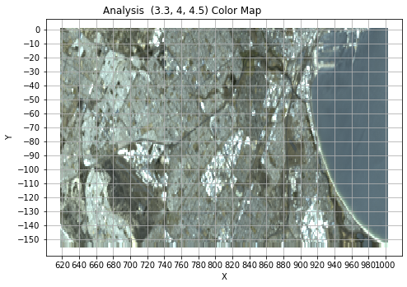
Color interpretation
Color map using varied width normal distributions over multiple channels to simulate human color perception, using NASA EMIT data for Cape Town, South Africa. Note how industrial areas appear to create to create very white colors, caused by high collective R, G, and B wavelengths output by this specific color perception algorithm. Suburban areas shown as grey, vegetation in green. Water and rivers as mostly appear as black.

Slide 3
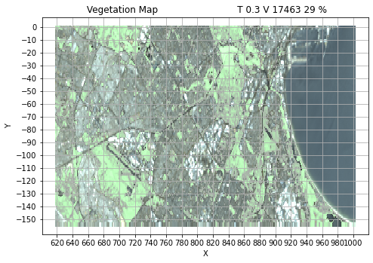
Vegetation Interpretation
NDVI Calculation using specific red and infrared channels, threshold of 0.3, counting 17463 pixels (29 % percent of the image) – Color image is used and then the amount of NDVI over the threshold is applied to a function to show NDVI intensity as a color

Slide 4
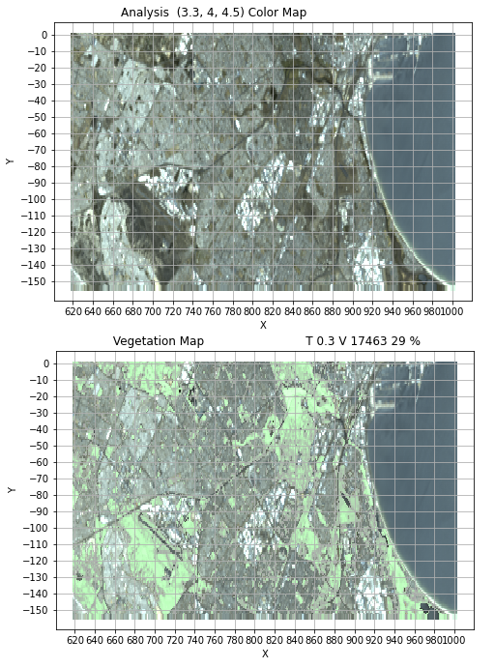
Comparison of Color map to Vegetation map on the same slide

Slide 5
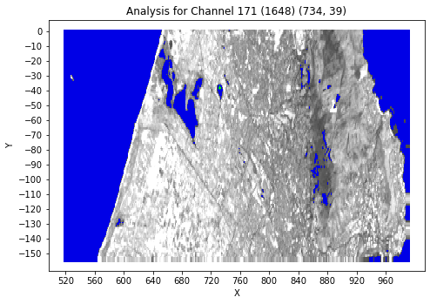
Location of the Pixel 734, 39 marked with green marker which while will be used for plot of water wavelength profile in the next slide. Image is of channel 171, blue is being marked with an experimental algorithm to attempt to characterise where water is. (This water detection algorithm was an early experimental test which was not highly reliable, so not all blue marked areas are in fact be water).

Slide 6
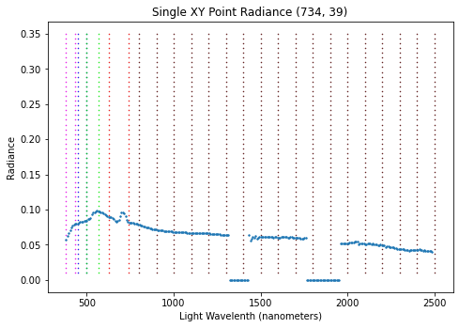
Plot of Pixel data of water at pixel (734, 39) in image in the preceding slide, violet, green and red wavelengths marked with dotted line, darker red lines show infrared bands.

Slide 7
About this project
More about this project
This project was started at 2023/09/04 when I first downloaded the first EMIT file, and began learning about how to display it and thinking about the various applications of EMIT data in surface characterisation.
This project is suggested as a template project for the the Space Apps Ultra Challenge.

Slide 8
What is a Space Apps Ultra Challenge?
A SpaceApps Ultra Challenge is a challenge that is made known weeks in advance of the project submission deadline, but is allowed to be started from the moment the challenges are released.
This allows for participants to participate and build more advanced solutions and showcase their creativity and skills, and learn more deeply about using NASA data in a manner that 48 hours doesn’t allow.

