Slide 1
R Tutorial
RMarkdown and the Tidyverse
library(dplyr)
rladies_global %>%
filter(city == 'Charlottesville')

Slide 2

Welcome!
You’re in the right place.
Whether you’re an R novice or R expert, this group is for you!

Slide 3





Thank you to our sponsors!
Notes:
Ask about experience
Fix hand

Slide 4
Agenda for today:
Introductions
What is R-Ladies?
R Tutorial: Intro to RMarkdown & the Tidyverse
What next?

Slide 5

1.
What is R-Ladies?

Slide 6

Worldwide organization
...that promotes gender diversity in the R community
...via meetups and mentorship
...in a friendly and safe environment
Notes:
More women/ non-binary coders, developers, speakers, leaders

Slide 7
Charlottesville
Connect with us on:
Website: rladies.org
Twitter: @RLadiesCville
Meetup: meetup.com/rladies-charlottesville/
GitHub: github.com/rladies-Charlottesville
Email: charlottesville@rladies.org
Notes:
Goals
Teach and learn R
Expand professional network
Meet amazing women
Get involved in the wider R community
Get involved in local tech community

Slide 8

2.
Intro to RMarkdown & the tidyverse

Slide 9
Tutorial Outline:
Why this tutorial?
Intro to RMarkdown
Tidy data and the tidyverse
Data wrangling with the tidyverse
Notes:
think a review of the main dplyr verbs plus some lesser known ones like case_when() and magrittr's pipe would be really valuable takeaways. I'm happy to do an overview of purrr or forcats,
Data Wrangling and Transformation
dplyr
tidyr
stringr
forcats

Slide 10
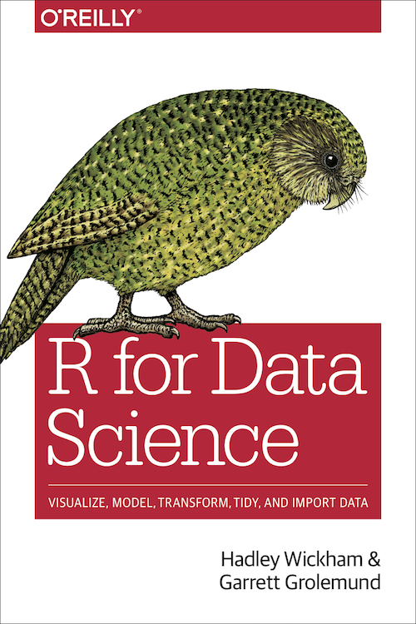
SYS 6018 Data Mining
The R for Data Science book (https://r4ds.had.co.nz/) chapters 1-21. The “tidyverse” is the style of R that we will use in class. It can be quite different than the “traditional” R, so it’s worth reviewing.
Using RMarkdown to create pdf documents (this will be the format for HW submission). An introduction is provided in Chapter 27 of the R4DS book (https://r4ds.had.co.nz/r-markdown.html).

Slide 11
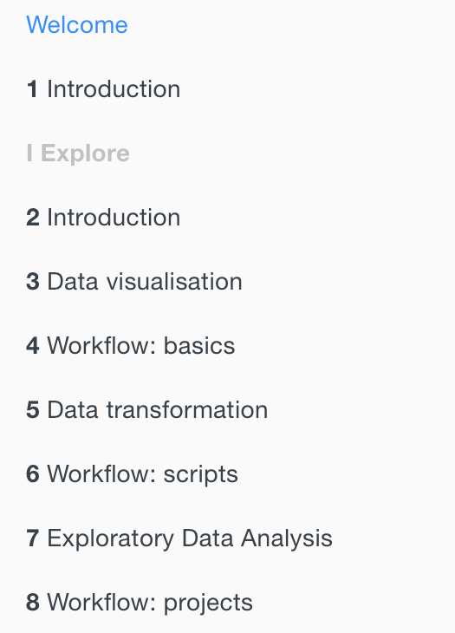
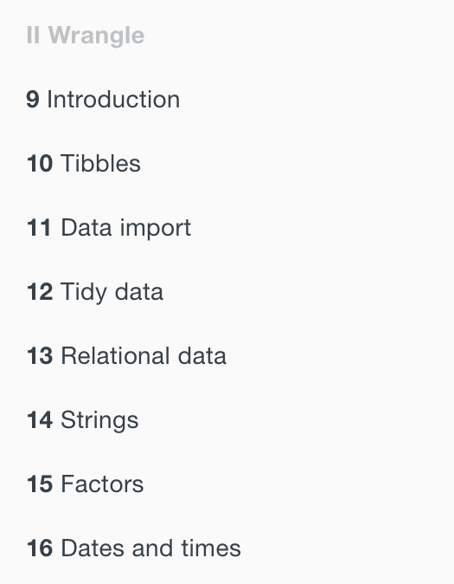
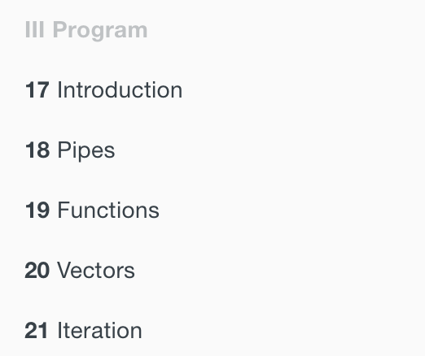
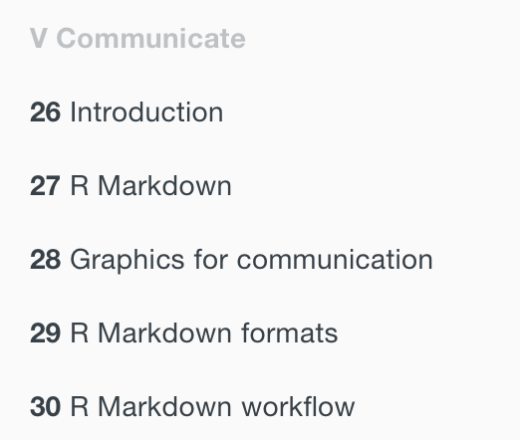
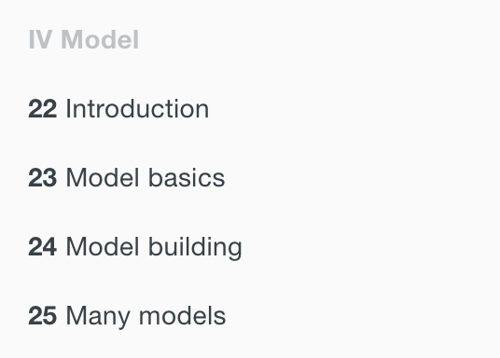
R4DS https://r4ds.had.co.nz

Slide 12

Intro to
RMarkdown

Slide 13

RMarkdown
Three main uses
Communication with decision makers who want to focus on conclusions, not code
Collaboration with other data scientists who are interested in both conclusions and code
An environment in which to do data science that captures both code and thought process
Notes:
R Markdown files are designed to be used in three ways:
For communicating to decision makers, who want to focus on the conclusions, not the code behind the analysis.
For collaborating with other data scientists (including future you!), who are interested in both your conclusions, and how you reached them ( i.e. the code).
As an environment in which to do data science, as a modern day lab notebook where you can capture not only what you did, but also what you were thinking.
It contains three important types of content:
An (optional) YAML header surrounded by ---s.
Chunks of R code surrounded by ```.
Text mixed with simple text formatting like # heading and _italics_.

Slide 14
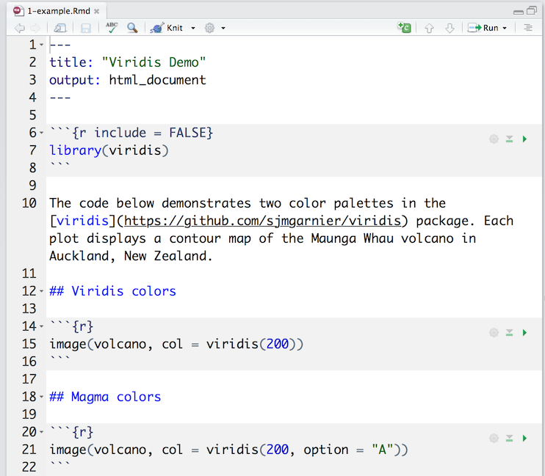
RMarkdown
Three types of content
(optional) YAML header surrounded by ---
Chunks of R code surrounded by ```
Text mixed with simple text formatting # heading _italics_
Notes:
It contains three important types of content:
An (optional) YAML header surrounded by ---s.
Chunks of R code surrounded by ```.
Text mixed with simple text formatting like # heading and _italics_.

Slide 15


RMarkdown
Run each code chunk by clicking
executes code and displays results inline with file
Render the file by clicking
generates a new file containing text, code, and results from .Rmd file
file types: web page, PDF, MS Word, HTML5 slides, books, dashboards, and others
Notes:
you can run each code chunk by clicking the icon.
RStudio executes the code and display the results inline with your file
use the “Knit” button in the RStudio IDE to render the file and preview the output ((⇧⌘K).
R Markdown generates a new file that contains selected text, code, and results from the .Rmd file.
Pandoc document conversion
The new file can be a finished web page ⧉, PDF ⧉, MS Word ⧉ document, slide show ⧉, notebook ⧉, handout ⧉, book ⧉, dashboard, package vignette ⧉ or other format.

Slide 16
RMarkdown – Code Chunks
Insert code chunks by
Keyboard shortcut Ctrl + Alt + I (OS X: Cmd + Option + I)
Add Chunk command in editor toolbar
Typing chunk delimiters ```{r} and ```.
Common Options
include = FALSE prevents code and results from appearing (figure embedding)
Echo = FALSE prevents code, but not results, from appearing
Message = FALSE suppresses messages generated from code
Warning = FALSE suppresses warnings generated from code
Notes:
Chunk output can be customized with knitr options ⧉,
arguments set in the {} of a chunk header.
include = FALSE prevents code and results from appearing in the finished file. R Markdown still runs the code in the chunk, and the results can be used by other chunks.
echo = FALSE prevents code, but not the results from appearing in the finished file. This is a useful way to embed figures.
message = FALSE prevents messages that are generated by code from appearing in the finished file.
warning = FALSE prevents warnings that are generated by code from appearing in the finished.
fig.cap = "..." adds a caption to graphical results.

Slide 17
RMarkdown – Inline Code
insert directly into the text enclosing the code with `r `
RMarkdown will always
display the results of inline code, but not the code
apply relevant text formatting to the results
As a result, inline output is indistinguishable from the surrounding text and does not take knitr options
Notes:
the available language engines include:
Python
SQL
Bash
Rcpp
Stan
JavaScript
CSS
To process a code chunk using an alternate language engine, replace the r at the start of your chunk declaration with the name of the language:

Slide 18

RMarkdown – Code Languages
Available language engines
Python
Bash
SQL
Rcpp
Replace r at the start of the code chunk declaration with the name of the language
Chunk options like echo and results are still valid
JavaScript
CSS
Stan
Notes:
the available language engines include:
Python Rcpp CSS
SQL Stan
Bash JavaScript
To process a code chunk using an alternate language engine, replace the r at the start of your chunk declaration with the name of the language:
Note that chunk options like echo and results are all valid when using a language engine like python.

Slide 19

RMarkdown – Pandoc Markdown
a set of markup annotations for plain text files
Transforms marked up text into formatted text in final file format
Types of formatted text
Headers
Lists
Italics
Bold
Superscript
Subscript
Strikethrough
Block quote
Links
Equations
Tables
Images
Tables
Images
Footnotes
Bibliography
Notes:
with Pandoc’s Markdown, a set of markup annotations for plain text files.
When you render your file, Pandoc transforms the marked up text into formatted text in your final file format,
You can use Pandoc’s Markdown to make:
Headers Block quotes Images Italicized text
Lists Latex equations Tables Bold text
Links Horizontal rules Footnotes Superscripts
Subscripts Slide Breaks Bibliography Strikethrough text

Slide 20
RMarkdown – Output Formats
Setting format
Set the output field of YAML header for default
Manually set the output_format argument of render()
Click the dropdown menu beside the knit button
Documents
html_notebook
html_document
pdf_document
word_document
md_document
Presentations
ioslides_presentation
revealjs_presentation
slidy_presentation
beamer_presentation
powerpoint_presentation
Other
flex_dashboard
html_vignette
github_document
books
websites
Notes:
Documents
html_notebook ⧉ - Interactive R Notebooks
html_document ⧉ - HTML document w/ Bootstrap CSS
pdf_document ⧉ - PDF document (via LaTeX template)
word_document ⧉ - Microsoft Word document (docx)
odt_document ⧉ - OpenDocument Text document
rtf_document ⧉ - Rich Text Format document
md_document ⧉ - Markdown document (various flavors)
Presentations (slides)
ioslides_presentation ⧉ - HTML presentation with ioslides
revealjs::revealjs_presentation ⧉ - HTML presentation with reveal.js
slidy_presentation ⧉ - HTML presentation with W3C Slidy
beamer_presentation ⧉ - PDF presentation with LaTeX Beamer
powerpoint_presentation ⧉: PowerPoint presentation
More
flexdashboard::flex_dashboard - Interactive dashboards
tufte::tufte_handout ⧉ - PDF handouts in the style of Edward Tufte
tufte::tufte_html ⧉ - HTML handouts in the style of Edward Tufte
tufte::tufte_book ⧉ - PDF books in the style of Edward Tufte
html_vignette ⧉ - R package vignette (HTML)
github_document - GitHub Flavored Markdown document
You can also build books ⧉, websites ⧉, and interactive documents ⧉ with R Markdown.

Slide 21
RMarkdown – PDF Format
PDF documents are created via LaTeX template
PDF output (including Beamer slides) requires an installation of LaTeX
TinyTex is recommended if you have not previously installed LaTeX
install.packages("tinytex")
tinytex::install_tinytex() # install TinyTeX
TinyTeX (https://yihui.name/tinytex/)
lightweight, portable, cross-platform, easy-to-maintain LaTeX distribution
Automatically installs missing LaTeX packages during compilation
Ensures document is compiled correct number of times to resolve cross-references
Notes:
pdf_document ⧉ - PDF document (via LaTeX template)
For R Markdown users who have not installed LaTeX before, we recommend that you install TinyTeX (https://yihui.name/tinytex/):
TinyTeX is a lightweight, portable, cross-platform, and easy-to-maintain LaTeX distribution
The R companion package tinytex (Xie 2019e) can help you automatically install missing LaTeX packages when compiling LaTeX or R Markdown documents to PDF, and also ensures a LaTeX document is compiled for the correct number of times to resolve all cross-references. If you do not understand what these two things mean, you should probably follow our recommendation to install TinyTeX, because these details are often not worth your time or attention.

Slide 22
RMarkdown – PDF Format
YAML Header
Figure options
fig_width and fig_height control default figure width and height
fig_caption controls whether figures are rendered with captions (default = FALSE)
dev controls graphics device used to render figure (default = pdf)
---
title: "Homework 1"
author: Brigitte Hogan
date: August 27, 2019
output: pdf_document
---
Notes:
fig_width and fig_height can be used to control the default figure width and height (6x4.5 is used by default).
fig_crop controls whether the pdfcrop utility, if available in your system, is automatically applied to PDF figures (this is true by default).
If you are using TinyTeX as your LaTeX distribution, we recommend that you run tinytex::tlmgr_install("pdfcrop") to install the LaTeX package pdfcrop. You also have to make sure the system package ghostscript is available in your system for pdfcrop to work. For macOS users who have installed Homebrew, ghostscript can be installed via brew install ghostscript.
If your graphics device is postscript, we recommend that you disable this feature (see more info in the knitr issue #1365).
fig_caption controls whether figures are rendered with captions (this is false by default).
dev controls the graphics device used to render figures (defaults to pdf).

Slide 23
RMarkdown – PDF Format
Customizing using top-level YAML metadata (not under output section)
YAML Header
---
title: Homework 2
output: pdf_document
fontsize: 11 pt
geometry: margin=1in
---
Notes:
can be customized using top-level YAML metadata (note that these options do not appear underneath the output section,
fontsize: 11pt geometry: margin=1in

Slide 24
What is tidy data?

Slide 25
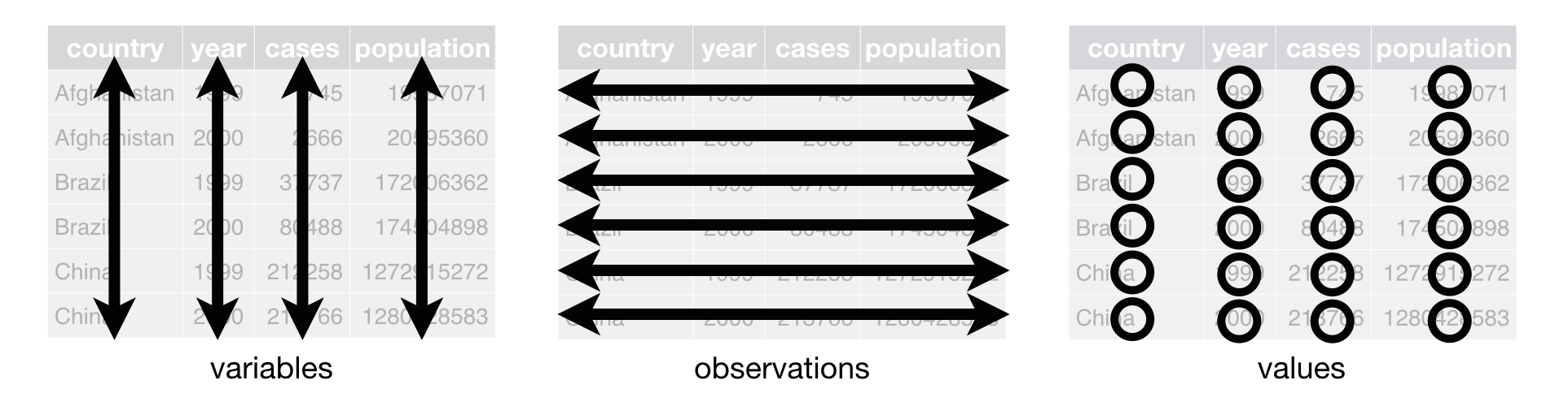
Tidy data
A standardized approach to structuring datasets
Core principles
Variables make up the columns
Observations make up the rows
Values go into cells
Notes:
“Tidy data” is a term that describes a standardized approach to structuring datasets to make analyses and visualizations easier
If you’ve worked with SQL and relational databases, you’ll recognize most of these concepts

Slide 26
Tidy data
Advantages
Consistent data structure
Variables in columns makes it easy to use R’s vectorized functions
country | 1999 | 2000
Afghanistan | 745 | 2666
Brazil | 37737 | 80488
China | 212258 | 213766
country | Year | cases
Afghanistan | 1999 | 745
Afghanistan | 2000 | 2666
Brazil | 1999 | 37737
Brazil | 2000 | 80488
China | 1999 | 212258
China | 2000 | 213766
Notes:
If you have a consistent data structure, it’s easier to learn the tools that work with it because they have an underlying uniformity.
There’s a specific advantage to placing variables in columns because it allows R’s vectorized nature to shine; most built-in R functions work with vectors of values

Slide 27



Slide 28
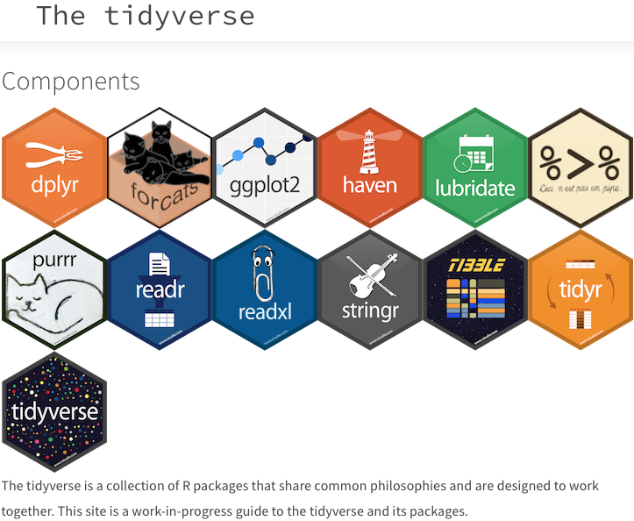
The tidyverse is a collection of R packages that share common philosophies and are designed to work together.
—Harvard Chan Bioinformatics Core
(from “Introduction to R”) https://hbctraining.github.io/Intro-to-R/lessons/tidyverse_data_wrangling.html
Notes:
https://hbctraining.github.io/Intro-to-R/lessons/tidyverse_data_wrangling.html

Slide 29

Tidyverse basics
The two most basic changes tidyverse implements are:
Pipes
Tibbles

Slide 30

1. Pipes
The pipe, %>%, comes from the ‘magrittr’ package
Installed automatically with the tidyverse
Makes R code more human-readable
Eliminates need for (most) nested functions
Allows the output of a previous command to be used as the input to another command
Note: The keyboard shortcut for a pipe is shift + command + M

Slide 31
Pipes
Take the square root of 83, round to two decimal places, and check that there are four characters
Before pipes:
> nchar(round(sqrt(83), digit=2))
[1] 4
With pipes:
> sqrt(83) %>% round(digit=2) %>% nchar()
[1] 4

Slide 32

2. Tibbles
Tibbles are a rework of the standard data.frame
Tibbles are data frames that follow different rules
You can create a tibble directly using tibble() or convert a data frame using as_tibble()
as_tibble() ignores row names (use rownames_to_column)
as_tibble() does not coerce chars to factors by default

Slide 33
Tibbles - printing
Default for print() shows only first 10 rows & columns that fit screen
Change rows & columns displayed by adjusting n and width in print():
> print(n = 20, width = Inf)
Data.frames
> iris
Sepal.Length Sepal.Width
1 5.1 3.5
2 4.9 3.0
3 4.7 3.2
4 4.6 3.1
5 5.0 3.6
Tibbles
> as_tibble(iris)
# A tibble: 150 x 5
Sepal.Length Sepal.Width
<dbl> <dbl>
1 5.1 3.5
2 4.9 3
3 4.7 3.2

Slide 34
Tibbles - subsetting
Base R simplifies a subset to the simplest data structure
Subsetting a column of a tibble returns another tibble
Some older functions will not work with tibbles
When piping to subset a data frame, use the placeholder . prior to [ ] or $
Data.frames
> seplen <- iris[,1]
> class(seplen)
[1] “numeric”
Tibbles
> irisTib <- as_tibble(iris)
> Seplen <- irisTib[,1]
> class(seplen)
[1] “tbl_df” “tbl” “data.frame”

Slide 35
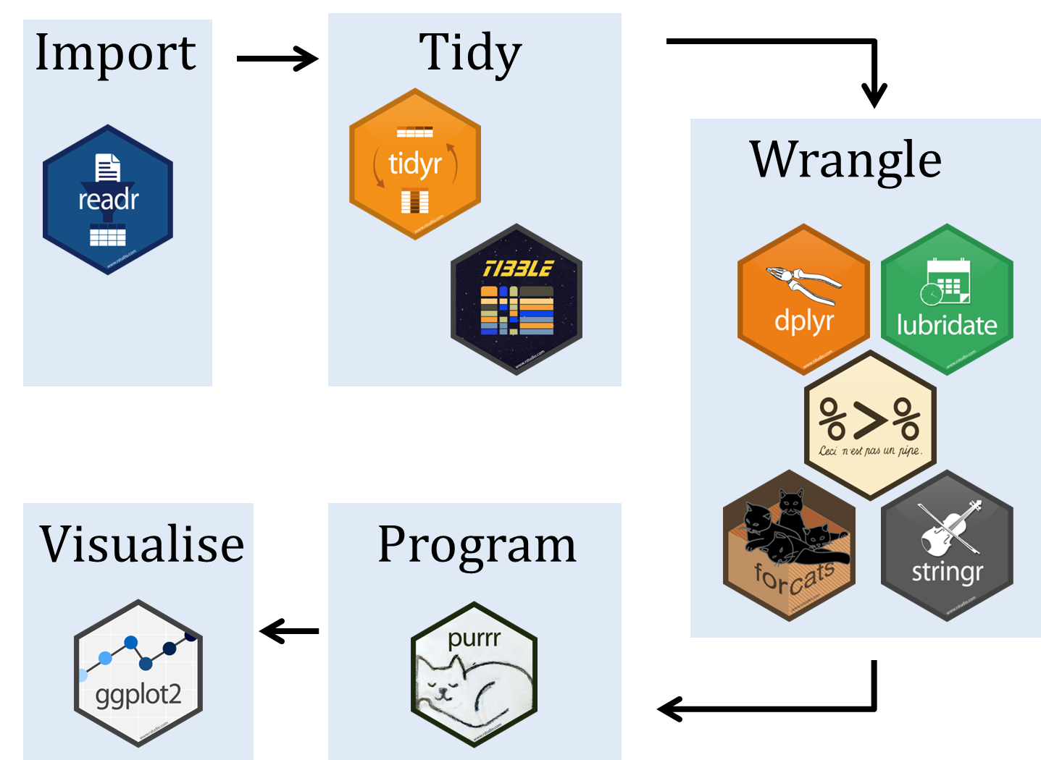
Tidyverse Workflow
Notes:
http://www.seec.uct.ac.za/r-tidyverse

Slide 36

Data Wrangling - dplyr
select(): select columns from dataset
filter(): filter out certain rows that meet criteria(s)
group_by(): group different observations together without changing original dataset
summarise(): summarize any of above functions
arrange(): arrange cols in ascend-/descending order
_join(): perform left, right, full, and inner joins
rename(): easily change col name
mutate(): create new cols, but keep existing variables
Notes:
most useful package in R for data manipulation.

Slide 37

Data Wrangling - tidyr
gather(): “gathers” multiple cols and convert into key-value pairs
spread(): take two cols and “spread” into multiple
separate(): helps separate single col into many
unite(): helps combine two or more cols into one
Notes:
boosts the power of dplyr for data manipulation and pre-processing.

Slide 38

Data Wrangling - stringr
str_sub(): extract substrings from a char vector
str_trim(): trim whitespace
str_length(): check length of the string
str_to_upper: converts the string into upper case
str_to_lower: converts the string into lower case

Slide 39

Data Wrangling - forcats
fct_reorder(): reorder a factor by another variable
fct_infreq(): reorder by the frequency of values
fct_relevel(): change order of a factor by hand
fct_lump(): collapse least/ most frequent values of a factor into “other”
Notes:
The forcats package is dedicated to dealing with categorical variables or factors.

Slide 40

Data Wrangling - lubridate
Types of date/time data
date <date>
time <time>
date-time <dttm>: date + time (aka POSIXct)
Time span classes
duration: exact amount of time between two points
period: tracks clock times despite leap years/seconds and DST
interval: protean summary of time information between two points
Notes:
There are three types of date/time data that refer to an instant in time:
A date. Tibbles print this as <date>.
A time within a day. Tibbles print this as <time>.
A date-time is a date plus a time: it uniquely identifies an instant in time (typically to the nearest second). Tibbles print this as <dttm>. Elsewhere in R these are called POSIXct,
It introduces three new time span classes borrowed from http://joda.org.
- durations, which measure the exact amount of time between two points
- periods, which accurately track clock times despite leap years, leap seconds, and day light savings time
- intervals, a protean summary of the time information between two points

Slide 41
Data Wrangling - lubridate
Parsing
Date-times ymd(), dmy(), myd(), …
Get and set components year(), month(), mday() hour(), minute(), second()
Helper functions for time zones with_tz(), force_tz()

Slide 42

Data Wrangling - purrr
map() functions replace for loops
Remember the apply function from base?
Pro tip: safely() for errors
transpose() reverses index order
Good for working with nested data frames and list columns

Slide 43

3.
What’s next?

Slide 44
Get involved
Learn
Join our Meetup page and attend events
Follow us on Twitter @RLadiesCville
Contribute
Join our GitHub page
Ask questions
Organize
Lead a workshop
Give a talk
Ask your company to sponsor us
Be a co-organizer!

