Slide 1
How to Build a Shiny App
Tatjana Kecojević
R-Ladies Manchester
08 March 2017

Slide 2

Shiny Showcase
https://www.rstudio.com/products/shiny/shiny-user-showcase/
TUTORIAL: Teach yourself Shiny
https://shiny.rstudio.com/tutorial/

Slide 3
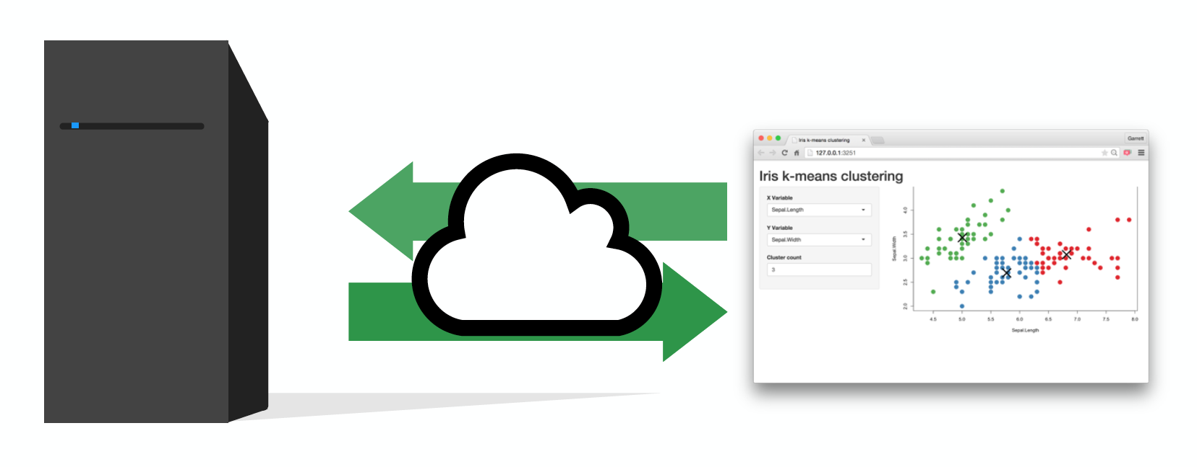
Every Shiny app is maintained by a computer running R

Slide 4
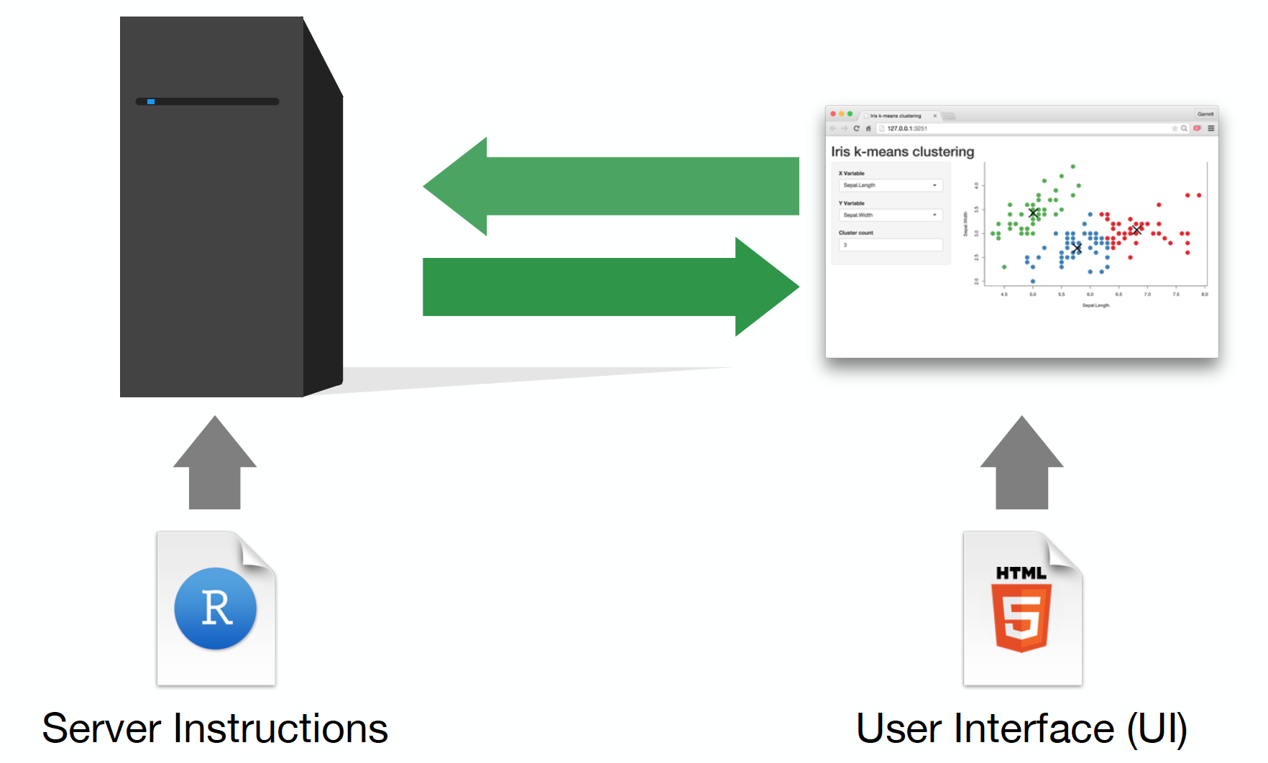

Slide 5
App template
library(shiny)
ui <- fluidPage()
server <- function(input, output) {}
# Run the application
shinyApp(ui = ui, server = server)

Slide 6
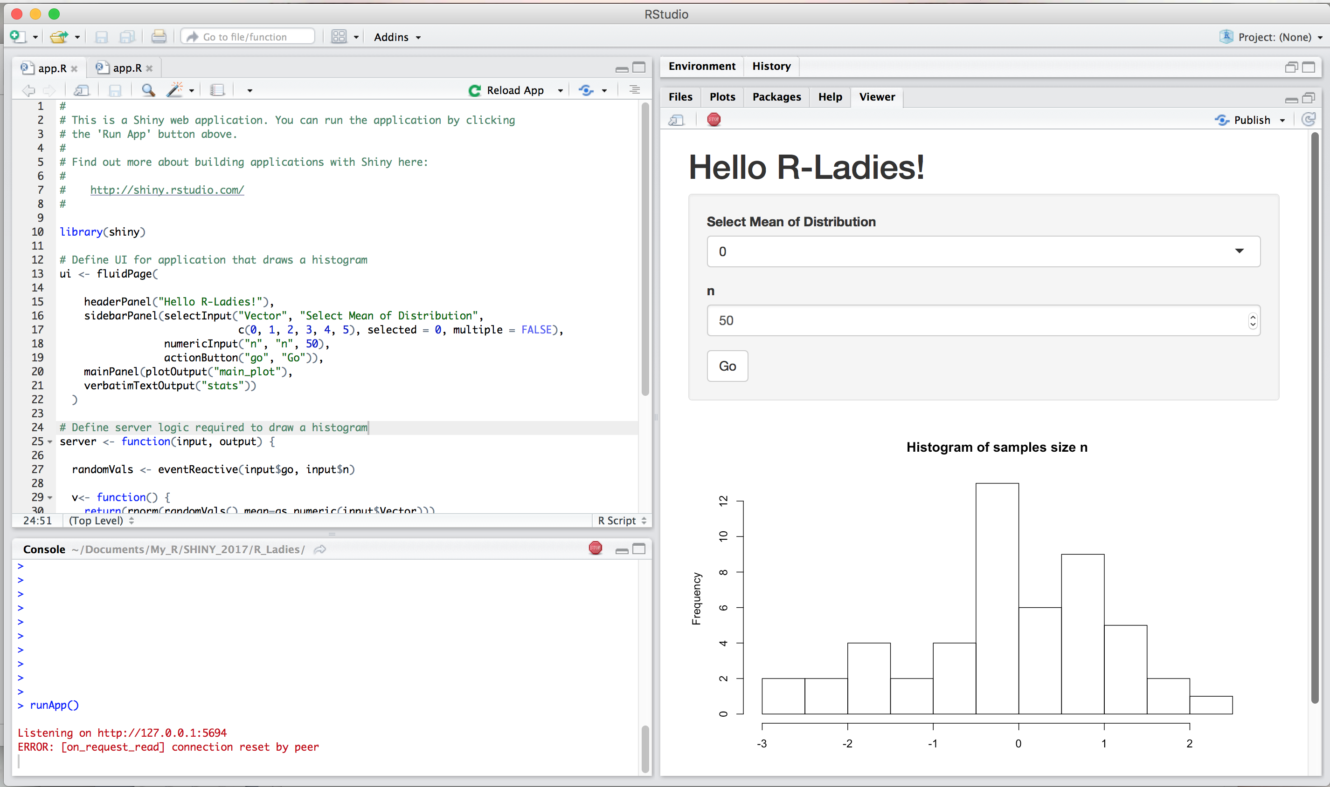
Reload/Run and Close an app

Slide 7
Add elements to your app as arguments to fluidPage()
library(shiny)
ui <- fluidPage("Hello R-Ladies!")
server <- function(input, output) {}
# Run the application
shinyApp(ui = ui, server = server)

Slide 8
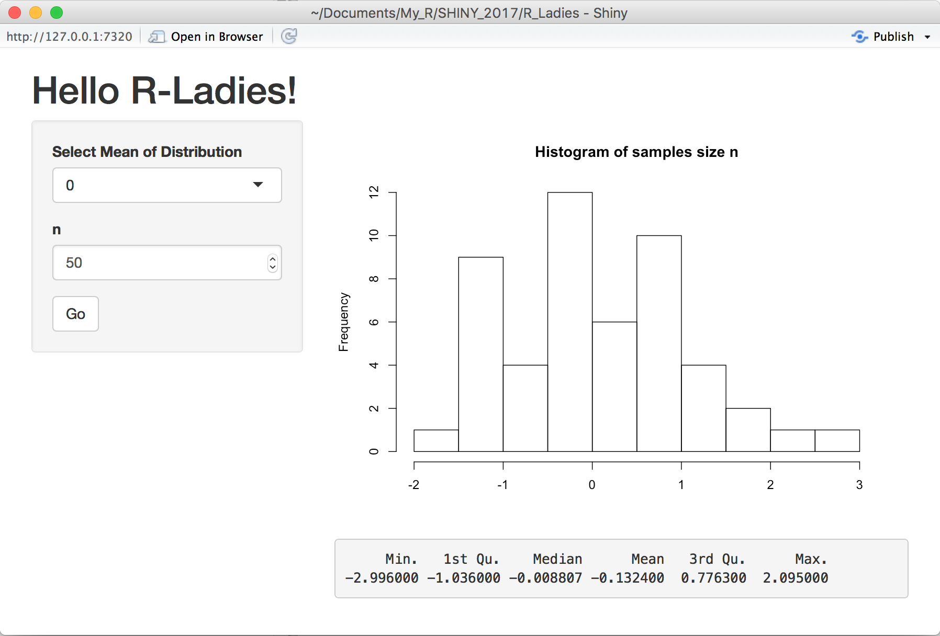
Inputs and Outputs

Slide 9
Add elements to your app as arguments to fluidPage()
ui <- fluidPage(
# *Input() functions,
# *Output() functions
)

Slide 10
Create an input with an *Input() function
selectInput("Vector", "Select Mean of Distribution”, c(0, 1, 2, 3, 4, 5), selected = 0, multiple = FALSE)

Slide 11
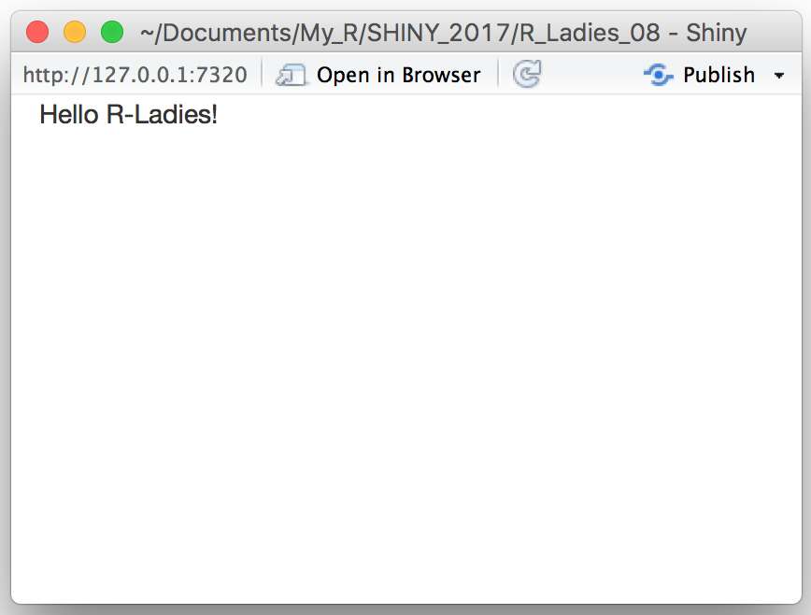
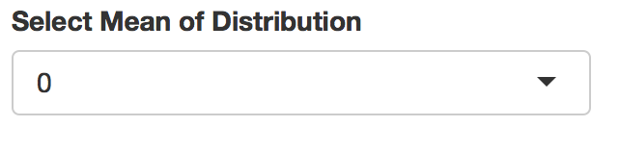
Create an input with an input function
library(shiny)
ui <- fluidPage("Hello R-Ladies!” ,
server <- function(input, output) {}
# Run the application
shinyApp(ui = ui, server = server)
selectInput("Vector",
"Select Mean of Distribution",
c(0, 1, 2, 3, 4, 5),
selected = 0,
multiple = FALSE)
)

Slide 12
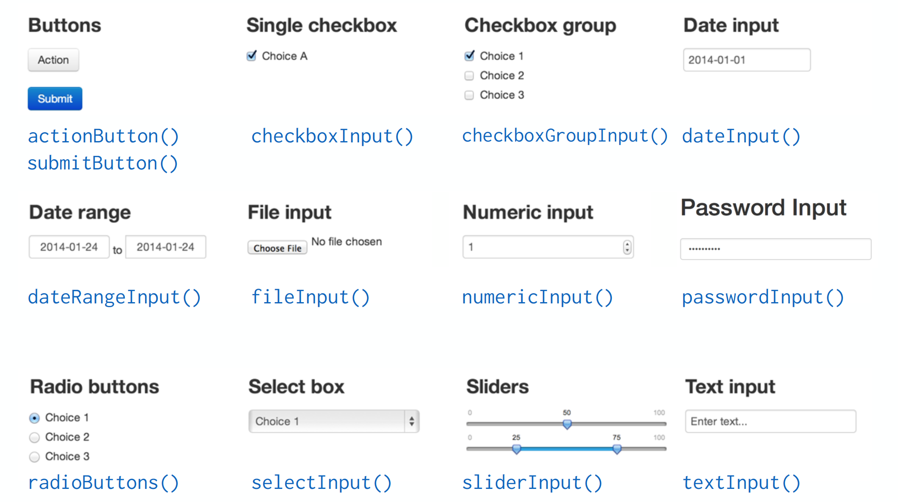
Input Objects

Slide 13
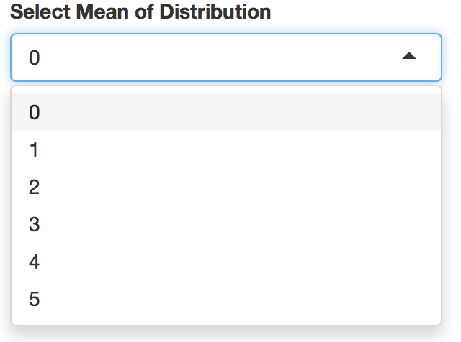
Syntax
selectInput("Vector",
"Select Mean of Distribution",
c(0, 1, 2, 3, 4, 5),
selected = 0,
multiple = FALSE)
Arguments
inputId The input slot that will be used to access the value (“Vector”).
label Display label for the control, or NULL for no label
("Select Mean of Distribution”).
choices List of values to select from… (0, 1, 2, 3, 4, 5) .
selected The initially selected value (or multiple values if multiple = TRUE
https://shiny.rstudio.com/reference/shiny/latest/selectInput.html

Slide 14
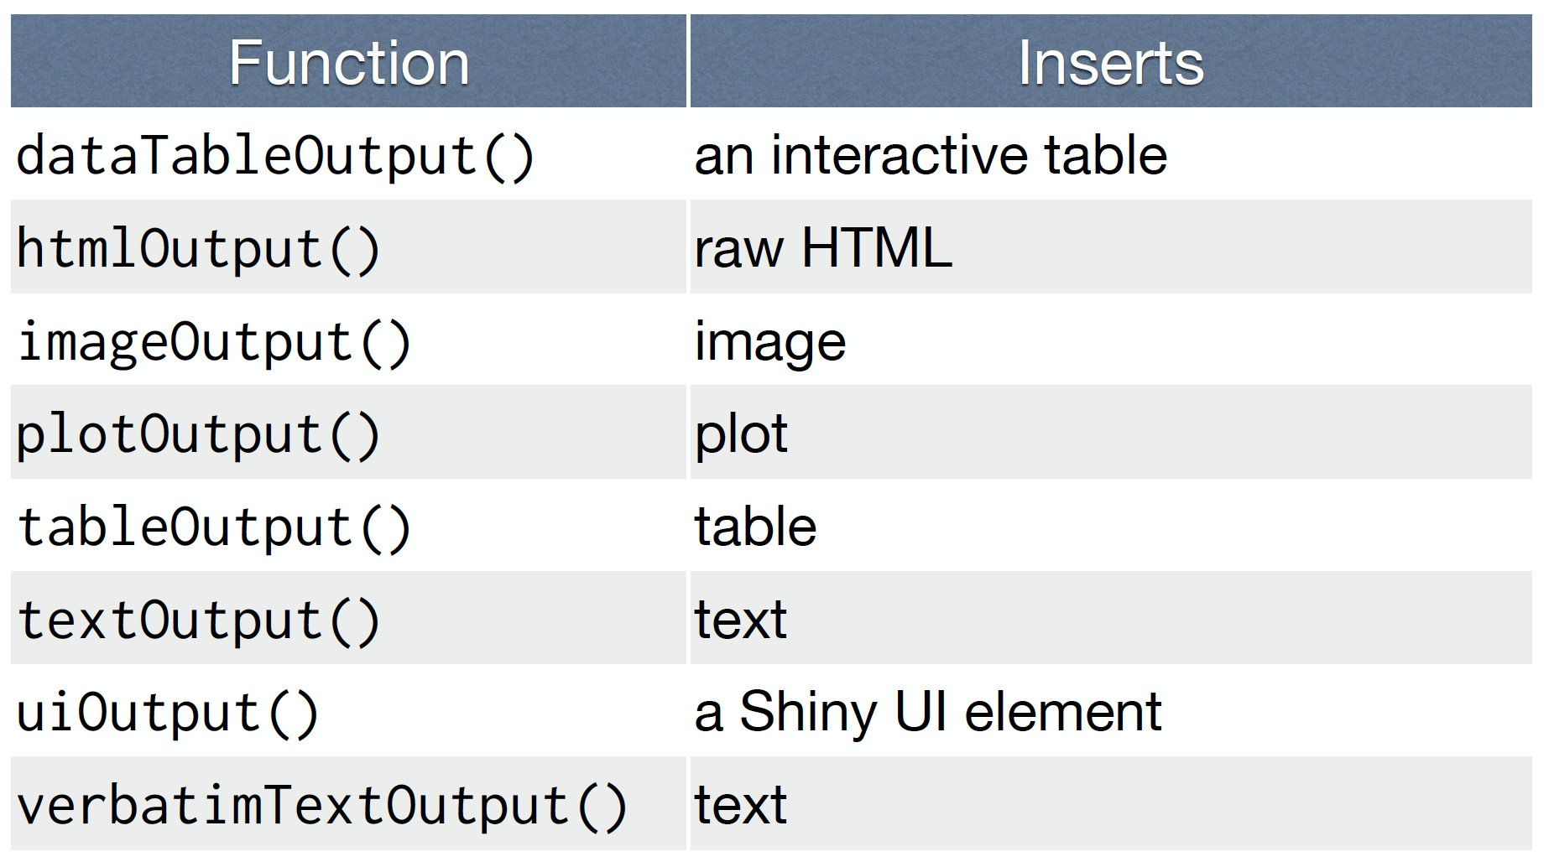
Output Objects

Slide 15
*Output()
To display output, add it to fluidPage()with an *Output()function
The type of output
to display
Name to give to the output object
plotOutput(”main_plot")

Slide 16
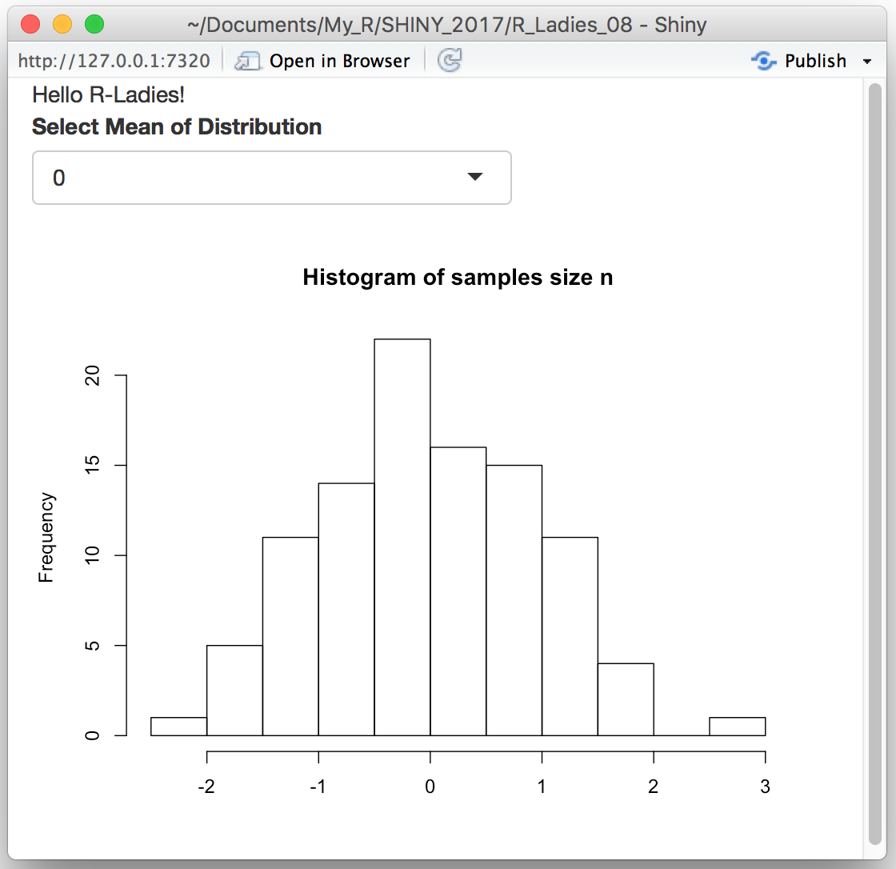
library(shiny)
ui <- fluidPage("Hello R-Ladies!” ,
selectInput("Vector",
"Select Mean of Distribution",
c(0, 1, 2, 3, 4, 5),
selected = 0,
multiple = FALSE),
plotOutput("main_plot”)
)
server <- function(input, output) {}
# Run the application
shinyApp(ui = ui, server = server)
You must build the object in the server function!

Slide 17
library(shiny)
ui <- fluidPage()
server <- function(input, output) {}
# Run the application
shinyApp(ui = ui, server = server)
- Start with Template:
- Add elements to your app as arguments to fluidPage()
- Create reactive inputs with an *Input()function
- To display output, add it to fluidPage()with an *Output()function
- Assemble outputs from inputs in the server function

Slide 18
3 rules to write the server function
server <- function(input, output) {
Output$main_plot <- # code
}
output$main_plot
plotOutput(”main_plot")
1) Save objects to display to output$
2) Build objects to display with render*()
server <- function(input, output) {
Output$main_plot <- renderPlot({
})
}

Slide 19
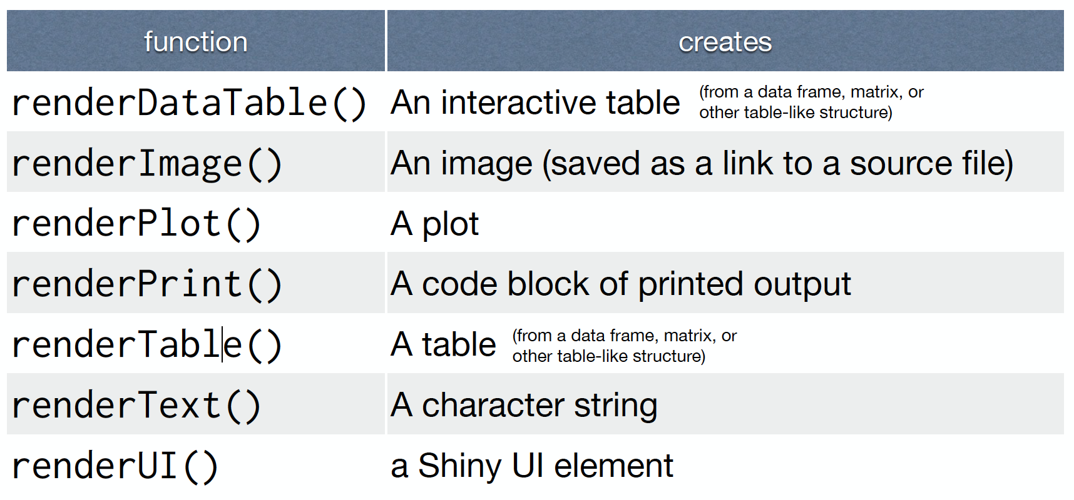
You can render*()different types of output you wish to make.

Slide 20
render*()
Builds reactive output to display in UI
The type of the object to build
to display
Code that build the object
renderPlot({hist(rnorm(100)})

Slide 21
Rule no 3) Access input values with input$
server <- function(input, output) {
v <- function() {return(rnorm(100, mean=as.numeric(input$Vector)))
}
output$main_plot <- renderPlot(
hist(v(), breaks=15, xlab="",
main="Histogram of samples size n"))
}
selectInput("Vector", "Select Mean of Distribution",
c(0, 1, 2, 3, 4, 5), selected = 0,
multiple = FALSE),
plotOutput("main_plot")
Reactivity automatically occurs whenever you use an input value to render an output object.

Slide 22
library(shiny)
# Define UI for application that draws a histogram
ui <- fluidPage(
headerPanel("Hello R-Ladies!"),
sidebarPanel(selectInput("Vector", "Select Mean of Distribution",
c(0, 1, 2, 3, 4, 5), selected = 0, multiple = FALSE),
numericInput("n", "n", 50),
actionButton("go", "Go")),
mainPanel(plotOutput("main_plot"),
verbatimTextOutput("stats"))
)
# Define server logic required to draw a histogram
server <- function(input, output) {
randomVals <- eventReactive(input$go, input$n)
v <- function() {
return(rnorm(randomVals(),mean=as.numeric(input$Vector)))
}
output$main_plot <- renderPlot(
hist(v(), breaks=15, xlab="",
main="Histogram of samples size n"))
output$stats <- renderPrint({summary(v())})
}
# Run the application
shinyApp(ui = ui, server = server)

Slide 23
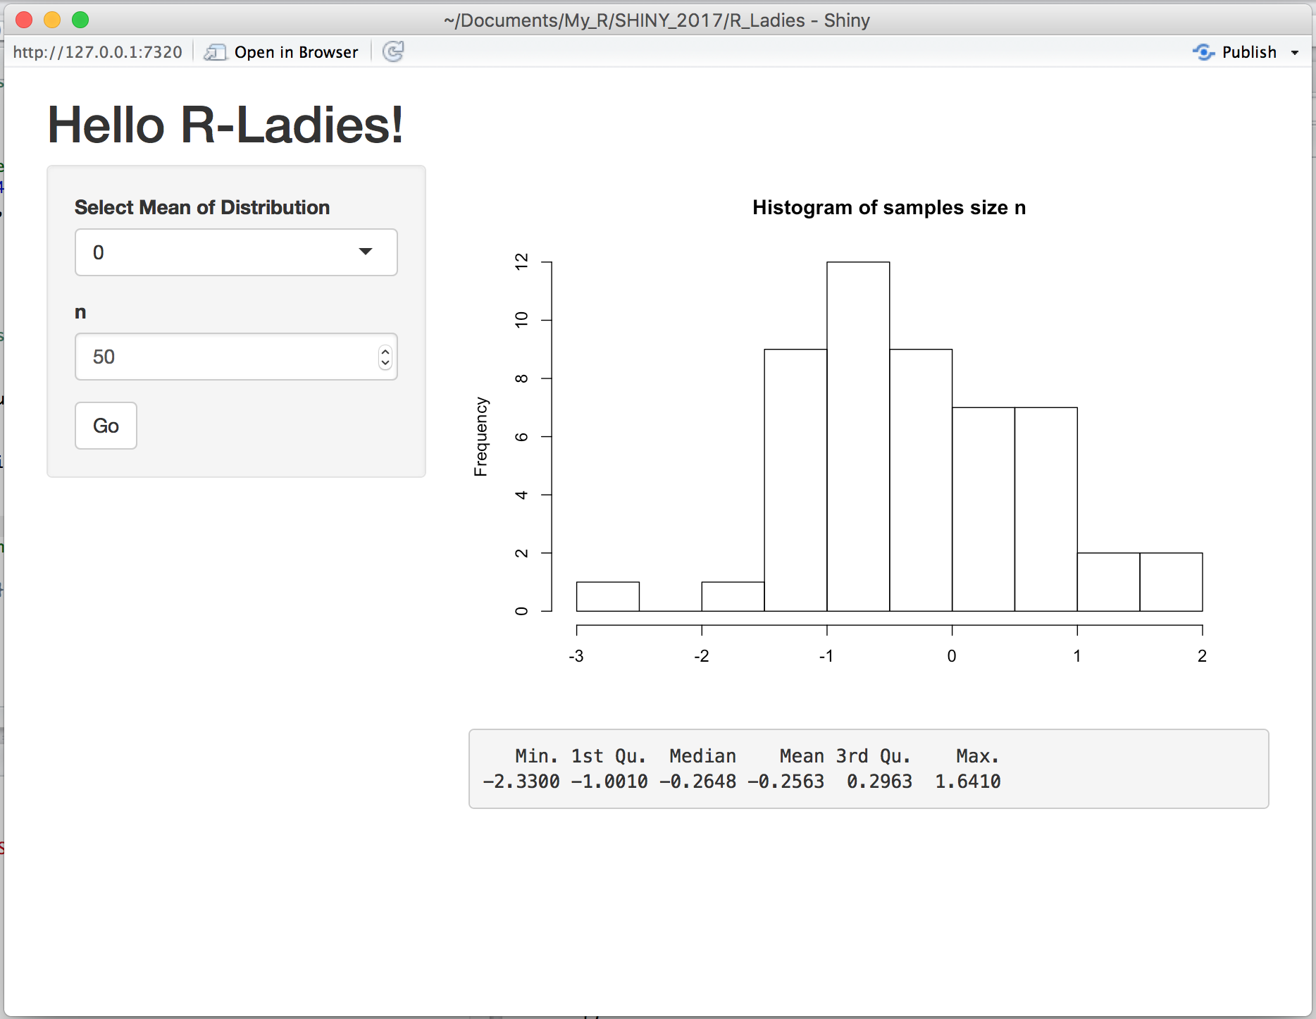

Slide 24
