Slide 1


Welcome to
Learning to drive R at Autotrader
@rladiesMCR
Notes:
Follow us on twitter, tweet any pictures from tonights event using the hashtag

Slide 2




Thanks to our hosts, sponsors and caterers

Slide 3
The things they don’t teach you at school
Keyboard shortcuts
Quirks
Cheat-sheets
Useless but nice
Notes:
Let’s assume that you’re good to go, you’ve got R and Rstudio downloaded, and you want to do some code.
For those that don’t we should have time at the end of this talk or in the intervals to help get you started with that too.

Slide 4
Keyboard shortcuts
For writing code
Win Mac Use
Tab attempt completion
Ctrl+Shift+M Cmd+Shift+M insert the %>%
Ctrl+Shift+C Cmd+Shift+C comment or uncomment lines
For running code
Ctrl+Enter Cmd+Enter run lines
Console
Esc Esc quit that thing you didn’t mean to do
Ctrl+2 Cmd+2 move cursor to console
Notes:
Why keyboard shortcuts are helpful, run through each one, give an example of why theyre good.

Slide 5
But if you only remember one….
Alt+Shift+K
(That brings up the keyboard shortcuts!)

Slide 6
Quirks
Packages
Packages contain functions
Installing package
install.packages(“tidyverse”) or install.packages(c(“tidyverse”, “lubridate”))
Once a package is installed, it’s ready for you to use it’s functions
Occasional use - use packagename::function
Intensive use - load into memory with library(“tidyverse”)
These have to be done one at a time, or with a workaround, unlike installing them.

Slide 7
Functions
The search( ) function will show you what order your packages are stored in your global environment.
The environment() function will tell you what package the function is taken from
environment(summarize)
<environment: namespace:Hmisc>
The conflicts() function will flag all functions with conflicts
If you need both packages loaded then you can differentiate using
The :: operator - E.g. dplyr::summarize()
Notes:
Example: both Hmisc and dplyr have a summarize function
Search () - This order is important as it will show you which package gets first dibs
To call a function, R first has to find it. R does this by first looking in the global environment. If R doesn’t find it there, it looks in the search path, the list of all the packages you have attached. You can see this list by running search()

Slide 8
Syntax
It’s <- not =
But = works too…just pick one and stick to it, consistency is key to readable code!
C is for concatenate. Or combine.
This c – install.packages(c(“tidyverse”, “lubridate”)
Or my_vector <- c(1, 5, “rladies”, TRUE)
For more:
https://ironholds.org/projects/rbitrary/#why-do-we-use---for-assignment
https://www.computerworld.com/article/2497143/business-intelligence-beginner-s-guide-to-r-introduction.html
Notes:
It’s a hangover from the days of S, which was built using APL, which used a machine with a literal arrow button on it
There are varieties of this, so for example, where you want to create a vector of multiple data types, c can stand for coerce – as in coerce all this things into the same data type. So you get a vector of all one data type. If you want a list of four objects with different datatypes, then use the list function

Slide 9
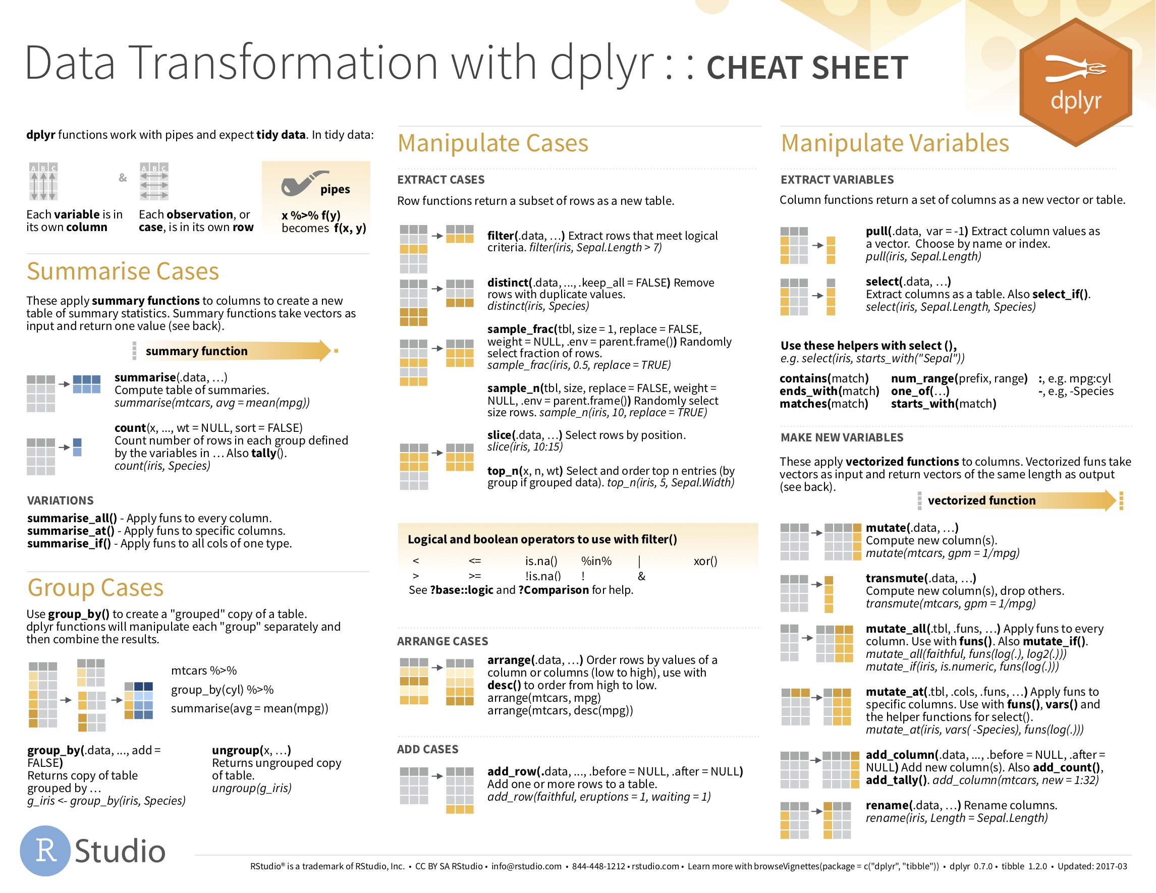

Slide 10
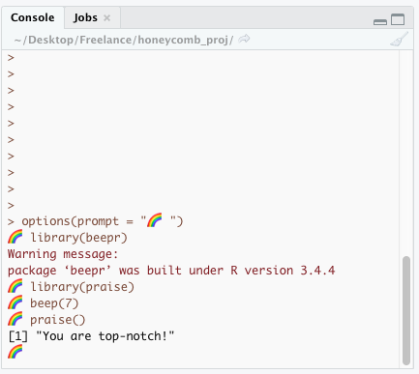
Cool things you absolutely don’t need to know but that’ll definitely make your code more fun
options(prompt = “🐶 ”)
More puppies/kittens/rainbows in your code
install.packages(“beepr”)
beep(8)
this one is the Mario sound but there are less annoying ones too…
install.packages(“praise”)
praise( )
For when you deserve to be told great stuff (always!)

