Slide 1
Shiny App-y People
Building your first interactive dashboard
Naomi ball

Slide 2
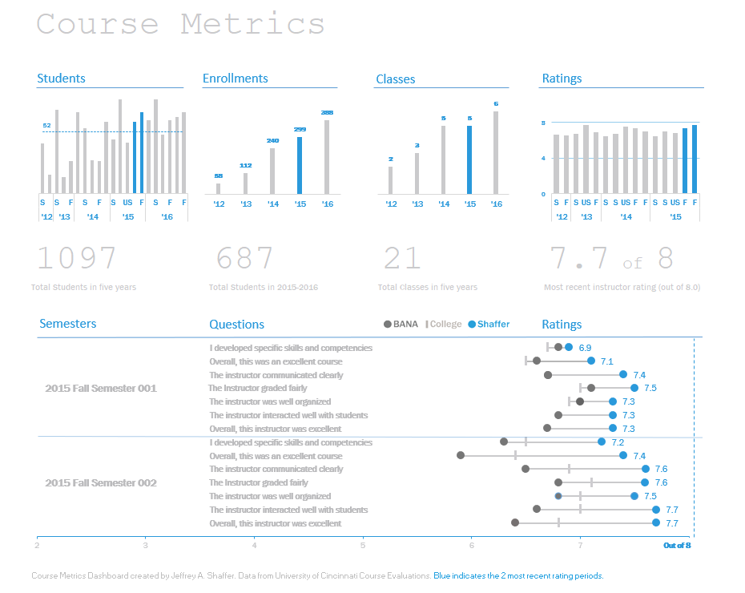
Source: https://www.bigbookofdashboards.com
Notes:
WHY DASHBOARDS ARE GREAT
They provide an overview of all the necessary information to drive user to take action – eg FITBIT
Let’s your (non-technical) user explore what’s important to them
Save yourself time

Slide 3



Source: https://dev.to/rly
Notes:
In the past you’d have had to use proprietary software or learn javascript to build a web app
But R and associated tools have changed all that
(Book covers generated with https://dev.to/rly )

Slide 4
html
Content
and structure
browser
appearance
css
Webpage
javascript
programmatically change behaviour
Notes:
In order to understand what Shiny is, it’s helpful to know a little about how the web works.
Ingredients
JavaScript – interactivity, calculations, data processed
R tools like Shiny and Markdown help you avoid the learning curve of these three languages
What’s not there? R. Browsers don’t understand how to process R code.

Slide 5
User Interface (UI)
Also known as client interface
Server
Inputs sent to server
html file opened in a browser
an environment that can run R
Outputs returned to UI
Inputs processed via JavaScript and returned as outputs
Inputs processed via R and returned as outputs
Notes:
Interactive webpages depend on Javascript to process inputs and return outputs.
What if you want to write the code for that processing in R? Browsers don’t understand R.
You need to send those inputs to somewhere that’s running an R session. It will process the R code and send outputs back.
Might seem technical, but important to remember these two concepts – UI is everything the user sees and interacts with (input boxes). Server is where the R processing is carried out.

Slide 6
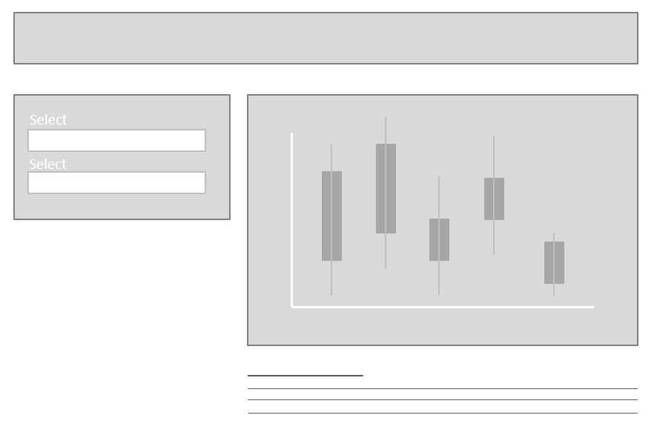
Write R code
Design layout
#Setup
#UI
#Server
#Run App
Notes:
App design process:
Get R code that works
Simultaneously, design layout
Shiny template to create the layout – make sure it works and things are in the right place
Slot your R code into the right part of the Shiny template

Slide 7
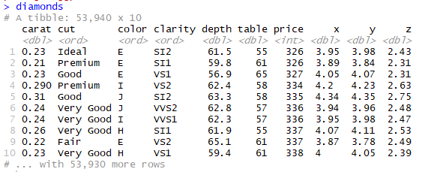
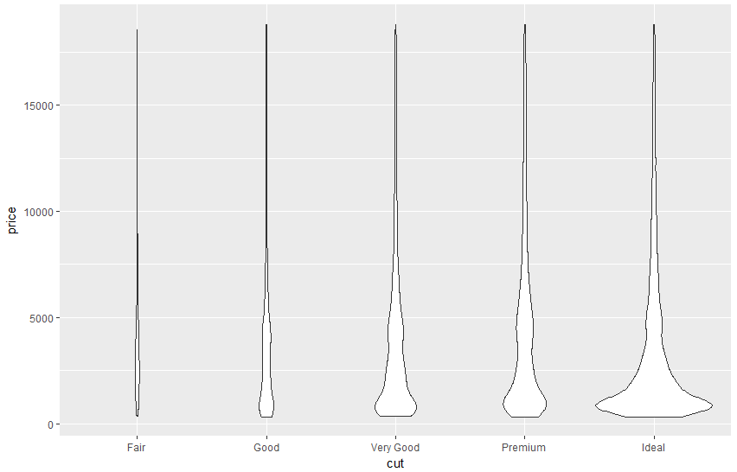
Notes:
We’ll be building an app to help you explore a dataset.
We’ll be using the diamonds dataset that comes with the ggplot2 package
I often need to visualise the distribution of data, so I built an app to do that.

Slide 8
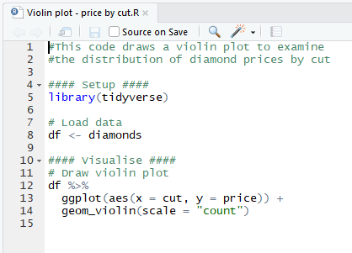
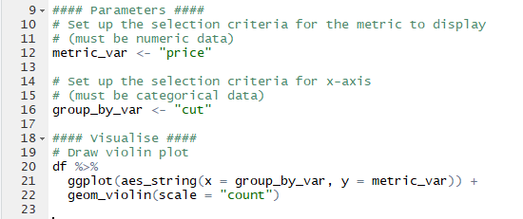
Notes:
Before we try to build an app, let’s get ‘inputs’ working in the R code…
Explain changes
Demo R code

Slide 9
titlePanel
Select
mainPanel
Select
sidebarPanel
sidebarLayout
fluidPage

Slide 10
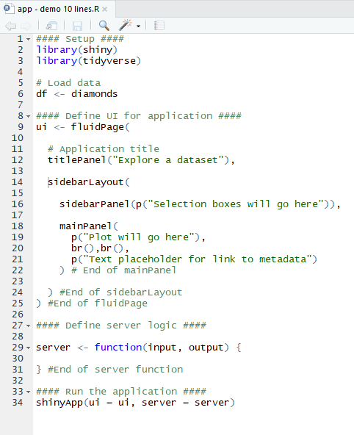
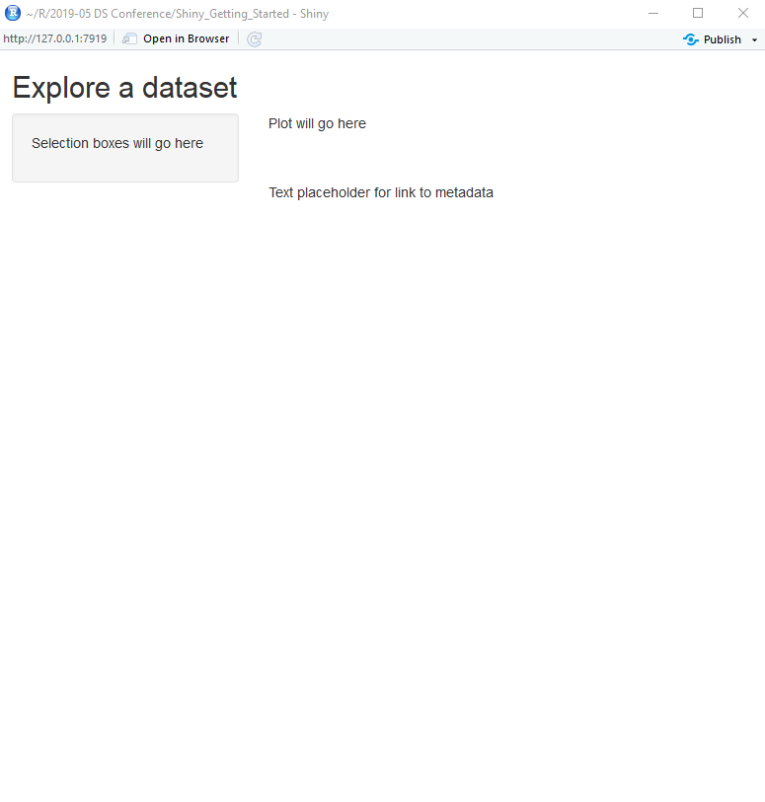
User Interface (UI)
Server
Notes:
10 lines
Simple – but it tells us our layout works.
Wanted to show you how simple, so that the basic structure makes sense to you if you want to read through someone else’s app code
Step through – notice there’s nothing in the server function, because we’re not asking the app to calculate anything yet

Slide 11
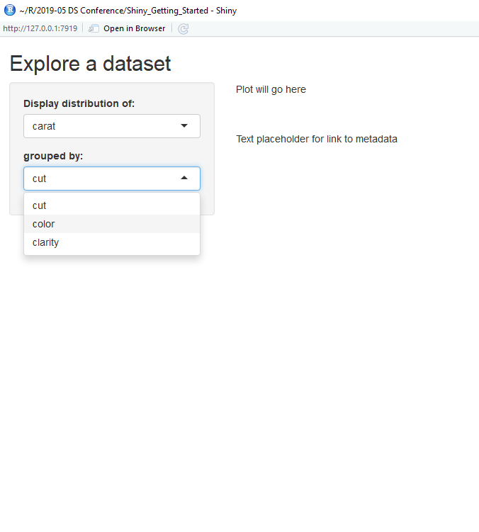
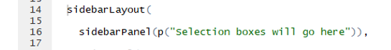
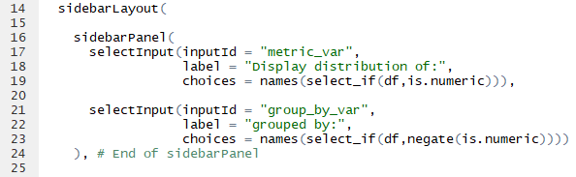

Slide 12
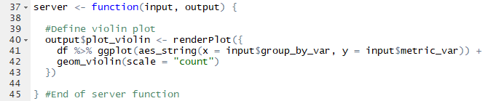
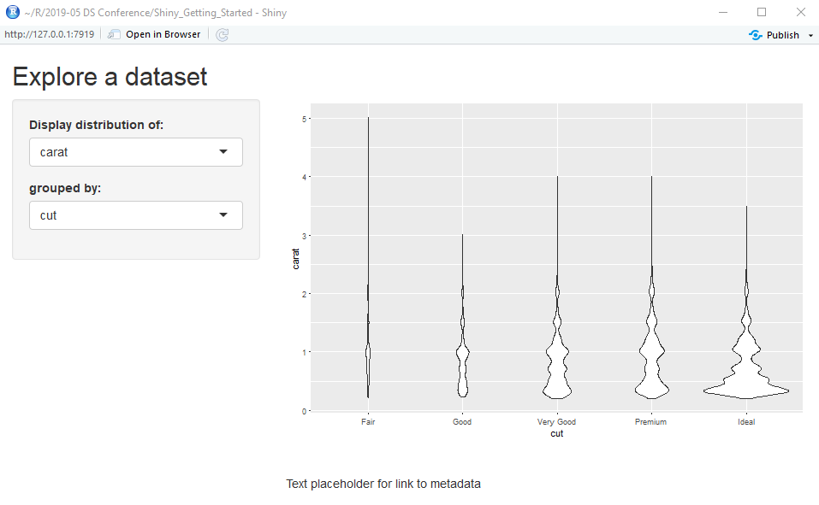


Slide 13
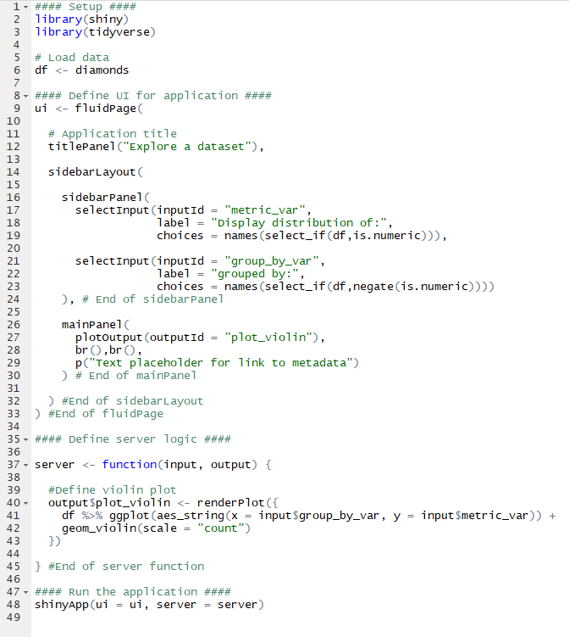
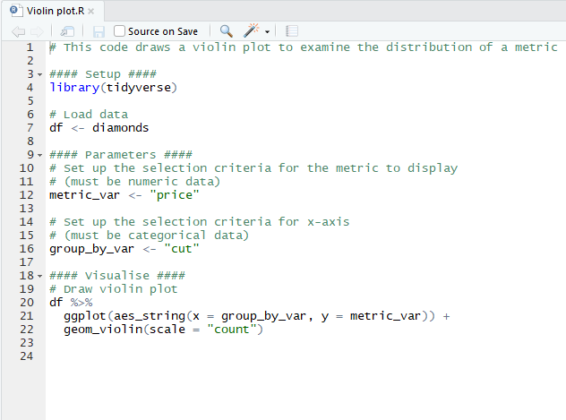
Notes:
Still less than 50 lines of code, for a functioning, useful app.
Hope as well as giving you some useful code, I’ve given you enough explanation for you to be able to adapt any of your R scripts to Shiny apps

Slide 14
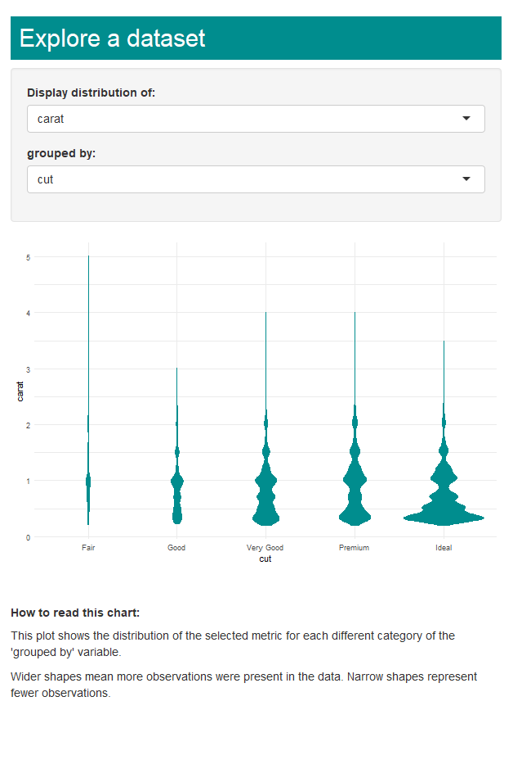
Notes:
And here’s some simple design principles applied to the app we built earlier in this presentation.
It wasn’t a lot of extra work, I edited maybe 3-4 lines of code.
The value comes from paying attention, not from putting in hours of extra work.

Slide 15
Speed-apping
Iris
Starwars
ChickWeight
Sleeping mammals (msleep)
Warp Breaks
CO2
Notes:
The nice thing about the app we’ve built, is that it will work for any dataset, as long as the data has both categorical and numeric data in it.
You could easily swap ‘diamonds’ for your own data, that you’ve read in as a csv file, or you’ve created in R and quickly be able to explore your data.
And when I say quickly, I mean quickly… let’s see how fast we can go from a completely blank R file to exploring one of these datasets…
(my personal best is 15 seconds!)

Slide 16

@NaomiJBall
https://njball.github.io/Portfolio/

Slide 17
Slides that may be useful in Q&A

Slide 18
Options for hosting your Shiny app
At work
At home
Employer’s
server
RStudio
on your PC
Commercial
server
Makes using your app as simple as using the Internet
Access controls
Business case required!
You already have this
Anyone with R on their machine can use your app – they don’t even have to open Rstudio
Hard to support non-analytical customers
Makes using your app as simple as using the Internet
Share with the wider world
DO NOT USE FOR WORK PURPOSES
Notes:
Pros and cons

Slide 19
User Interface (UI)
Also known as client interface
Server
Inputs sent to server
html file opened in a browser
an environment that can run R
Outputs returned to UI
Inputs processed via JavaScript and returned as outputs
Inputs processed via R and returned as outputs
DT
formattable
plotly
htmlwidgets
+ …
r2d3
dygraphs
DiagrammeR
leaflet
Notes:
Rmarkdown + Widgets are a great option if you really have to avoid using a server.
Widgets translate R into Javascript
Why bother with Shiny?
If there isn’t a suitable htmlwidget
Complicated processing task
Your outputs need you to aggregate or otherwise perform calculations on your data

