Slide 1
WOXSEN | SMART INDIA HACKATHON 2026
SIH Command Center
One place to track every hackathon team, mentor and deliverable
Team register · Problem statements · Mentor load · Deliverable deadlines
Woxsen University | B.Tech CSE SEM 5 | Full Stack Development (24TU05MJC1)
Team of 4 — Lead & Integration · Frontend · Backend · QA & Documentation

Slide 2
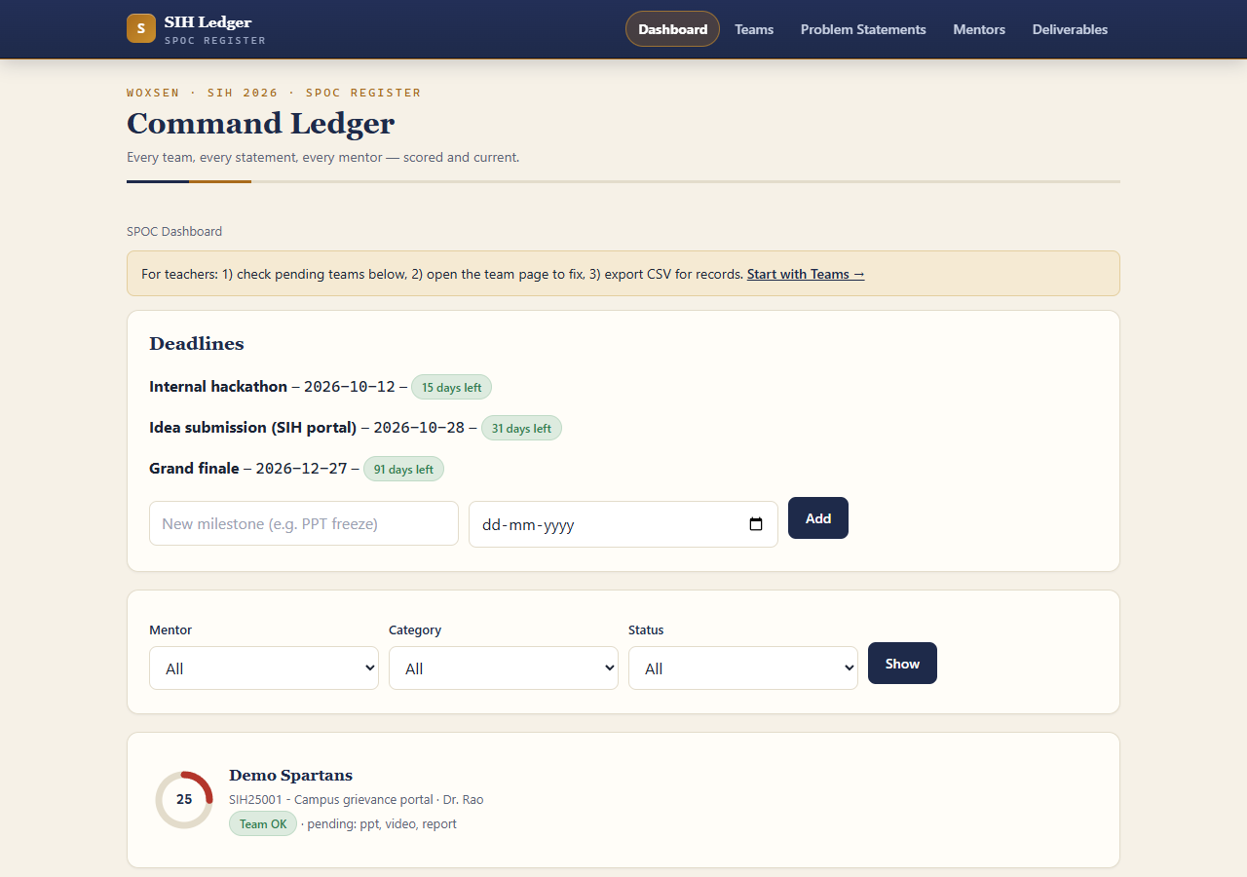
WHAT WE BUILT
The whole hackathon register in one web app
- One web app for the SPOC — five screens, no installation, works offline
- Register a team and the rules check themselves, instantly
- Pick a problem statement from the official list — held by one team only
- See every mentor's load and assign a team in one click
- Track 4 deliverables per team with a live readiness score out of 100
- Export the whole register as Excel or a printable report in one click

Slide 3
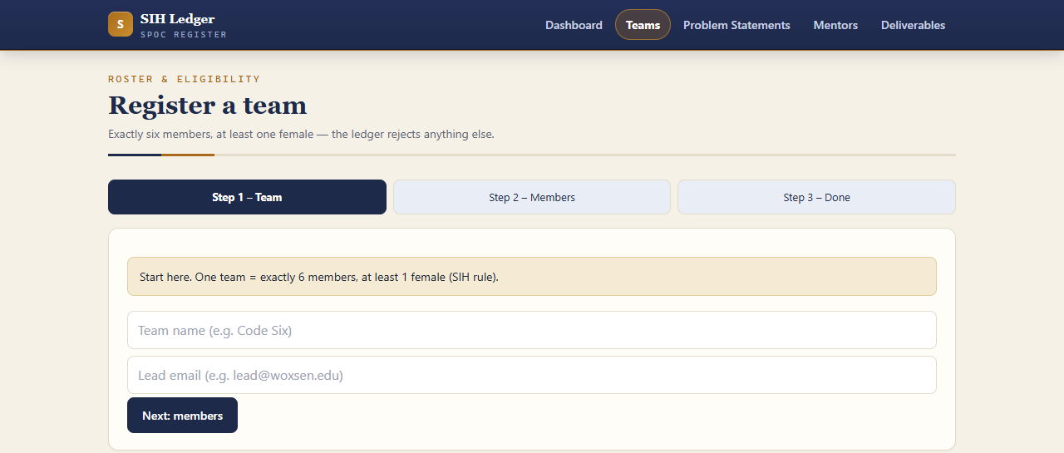
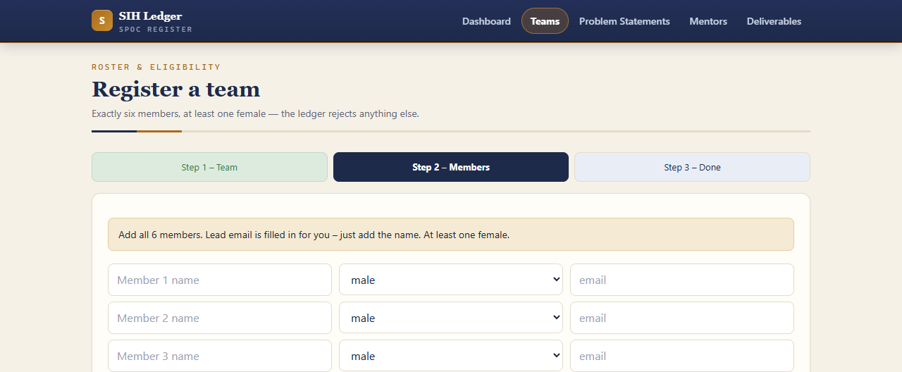
HOW WE SOLVE IT - 1
Team rules that check themselves
- Exactly 6 members required — a team of 5 is rejected instantly
- At least 1 female member — mandatory SIH rule, also rejected if missing
- A valid team is saved in one step and automatically gets its 4 deliverable slots
- The rule is checked before anything is stored, so bad entries cannot slip in
- The SPOC sees the exact reason in plain words, right on the screen

Slide 4
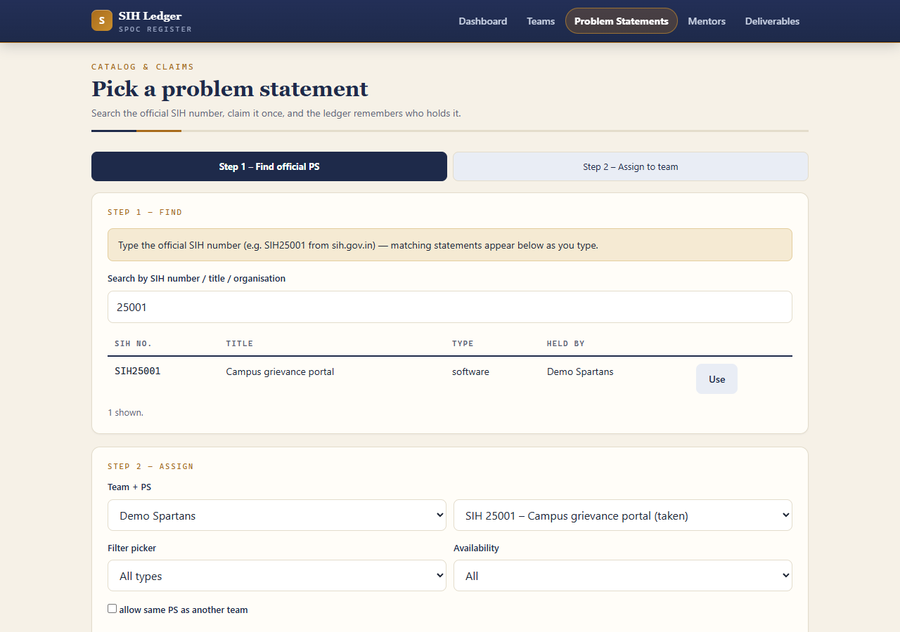
HOW WE SOLVE IT - 2
Finding the right problem statement
- One click pulls the official list from sih.gov.in — 242 statements, no typing
- Search by the SIH number or a keyword — matching rows appear as you type
- Claim a statement; if another team already holds it, the app says who
- The SPOC can still allow a shared statement deliberately, when needed
- Works without internet too — paste the rows once and the list is saved

Slide 5
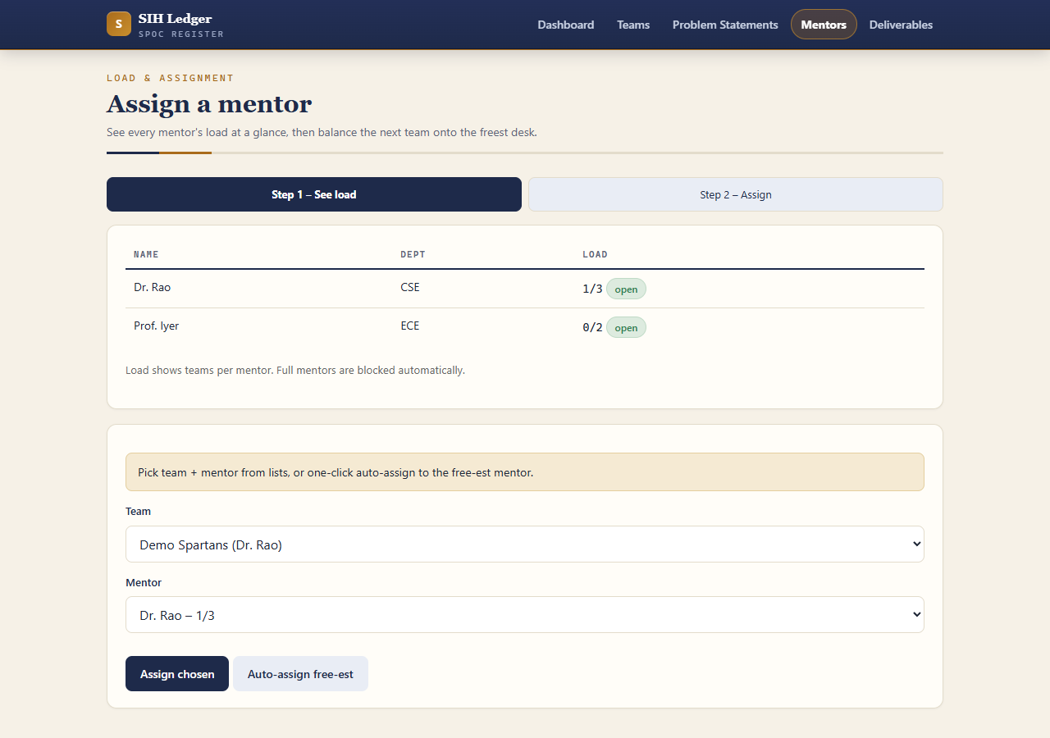
HOW WE SOLVE IT - 3
Mentors without the guesswork
- A load table shows each mentor's current teams against their limit
- A full mentor is clearly marked — the app refuses to overload them
- One click assigns a team to whichever mentor is freest at that moment
- The dashboard updates immediately, so the SPOC always sees the truth
- No more asking around: fairness is visible in a single screen

Slide 6
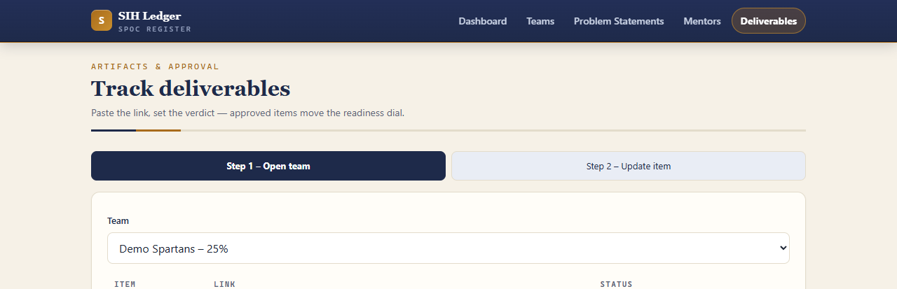
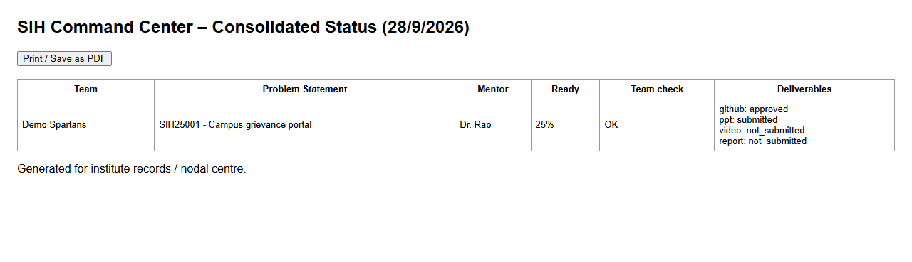
HOW WE SOLVE IT - 4
Progress you can actually see
- Four deliverables per team: GitHub repo, presentation, demo video, report
- Each item has a link and a status — submitted, needs revision, or approved
- Every approval adds 25% to that team's readiness score
- An invalid team or a missing mentor costs 25% — problems stay visible
- One click exports the register as Excel or a printable report for records

Slide 7
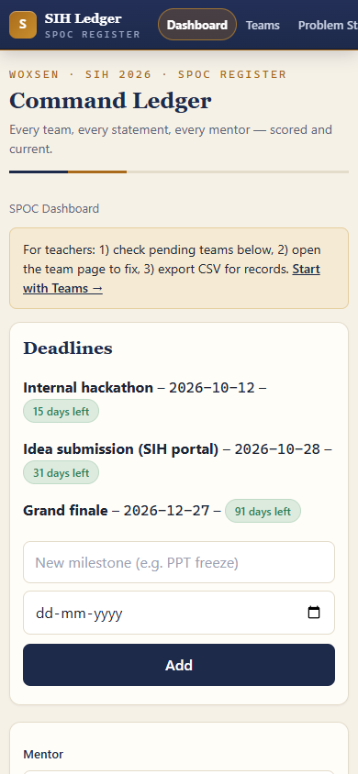
WHAT WE CHECKED
How we proved it works
- 105 automated checks cover every rule, screen and export
- Every rule was tested with wrong input first — the app blocks it
- Fast and stable: about 450 requests handled per second under load
- Tested on both phone-size and desktop screens — no broken layouts
- Security reviewed and hardened: fake entries cannot damage the app
- Runs on any college PC with no database — the demo can never fail
105 checks · 242 statements
450 req/sec · phone + desktop

Slide 8
WHAT'S NEXT
Future plan and who did what
Next steps
Team of 4
- Logins for SPOC, mentors and students — each sees only their own work
- Automatic reminders by email and WhatsApp as deadlines approach
- Online hosting plus a permanent database for the whole institute
- Direct verification of submitted GitHub links and files
Lead / Integration
overall build, wiring the screens to the rules, live demo
Frontend
the five screens, forms and phone-friendly layout
Backend
the rules, official list import, Excel and report exports
QA & Documentation
105 checks, security review, report and this presentation
SIH Command Center — register it right, track it till the finale.

