Slide 1


gPPI: The Tutorial
Donald G. McLaren, PhD
Department of Neurology, MGH/HMS
GRECC, ENRM Veteran’s Hospital
04/12/2013

Slide 2
Financial Disclosures
None.

Slide 3
Overview
MATLAB
SPM8
gPPI (first level analysis -- PPPI)
gPPI (second level analysis – SPM/GLM Flex)
Clustering and labeling peaks (peak_nii)
Plotting results (peak_extract_nii)

Slide 5
MATLAB Basics
Column Major (rows then columns)
* versus .* (. Can be used with many functions)
(),[],{}
Strings versus numbers versus arrays versus structures
Variable Names are: a, a1, a3 not a(1) a(2) a{2}
= versus ==
try statements
for loops
4D data versus 2D processing
SPM
Nifti files

Slide 6
Launch MATLAB

Slide 7
Prepare To Use SPM8
Add SPM8 to the MATLAB path
addpath(‘/Applications/MATLAB_SV74/toolbox/spm8’)
Add available scripts to the MATLAB path
addpath /Applications/MATLAB_SV74/toolbox/spm8/toolbox/PPPI
addpath /Applications/MATLAB_SV74/toolbox/spm8/toolbox/OrthoView
spm fmri would launch spm now.
Notes:
The paths will be different for each user. In the tutorial instructions, it is important to follow the install locations so that the commands will work as they are typed in the tutorial. Users can adjust the paths as they feel comfortable.

Slide 8
The SPM.mat
SPM.xX
.X -- The design matrix
.name – Labels for each column of the design matrix
SPM.xY
.P – The input files
.xY – The headers of the input files, modified pinfo
SPM.xBF – Information about the HRF
SPM.xCon – Information about the contrasts
SPM.Sess – Information about event timings
Notes:
Key fields in the SPM.mat file.

Slide 9
Steps for gPPI
First Level SPM Model of Task Activity
Identify and create a seed region
Create a parameter file
Run PPPI, will do: - Create PPI regressors - Estimate PPI model - Create PPI contrasts for group analysis
Create a wrapper for multiple regions/subjects
Run the wrapper
Notes:
Instructions are described briefly in this presentation, but detailed in the tutorial.

Slide 10
Implementation MATLAB/SPM
(for gPPI)

Slide 11
Class Dataset – Testing gPPI
Does running_gPPI_generic run properly?
This will determine if gPPI is installed correctly and your Matlab search path is setup correctly.

Slide 12
Step 1: First-Level Model
Hopefully you already have the first level task activity model completed as PPI is a secondary analysis of the data.
Notes:
See the tutorial for full details about the commands that will be used as they are not noted in the presentation.

Slide 13
Step 2: The Seed Region
VOI Button
create_sphere_image
create_sphere_image(SPMmatfile,spherecenter,{‘VOIname’},radius)
create_sphere_image('/Users/mclaren/Downloads/glm_ppi_analysis/attention/GLM/SPM.mat',[15 -78 -9],{'VOI_V2c_15_-78_-9'},6)

Slide 14
Step 3: Creating the Parameter File
This is a file that stores the parameters of PPI

Slide 15
parameter fields (required)
subject -- A string with the subject number.
directory -- Either a string with the path to the first-level SPM.mat directory, or if you are only estimating a PPI model, then path to the the first-level PPI directory.
VOI -- Either a string with a filename and path OR a structure variable defining the seed region
Region -- A string containing the basename of output file(s), if doing physiophysiological interaction, then two names separated by a space are needed.
analysis -- Specifies psychophysiological interaction ('psy'); physiophysiological interaction('phys'); or psychophysiophysiological interactions ('psyphy’). This is a string.
method -- Specifies traditional SPM PPI ('trad') or generalized context-dependent PPI ('cond'). This is a string.

Slide 16
parameter fields (optional)
contrast -- Contrast to adjust for. Adjustments remove the effect of the null space of the contrast. Set to 0 for no adjustment. Set to a number, if you know the contrast number. Set to a contrast name, if you know the name. The default is: 'Omnibus F-test for PPI Analyses’.
extract -- Specifies the method of ROI extraction, eigenvariate ('eig') or mean ('mean'). The default is: ‘eig’.
equalroi -- Specifies the ROIs must be the same size in all subjects. This is a number. The default is1 (true). Use 0 to lift the restriction.
FLmask -- Specifies that the ROI should be restricted using the mask.img from the first-level statistics. This is a number. The default is 0.
VOI2 -- Either a string with a filename and path OR a structure variable defining the second seed region for physiophysiological interactions.
outdir – This is the name of the output directory if you want to store the PPI analysis in a different location than the first-level SPM.mat file.
maskdir – location to store VOI file if input VOI was a mat-file.

Slide 17
parameter fields
Weighted -- Default is not to weight tasks by number of trials (0); to change this, specify which tasks should be weighted by trials. If you want to weight trials, then specify a duration longer than your events. If you have a mixed block event related design, then you can average your events based on number of trials and the blocks won't be averaged if Weighted is set to be a number that is shorter than the block duration and longer than your events. This is a number.
GroupDir – This is the location you want to copy the con_ files to for easier group analyses.
ConcatR – Under development, but can be used to concat sessions to reduce collineaity between task and PPI regressors.
preservevarcorr – preserves the variance correction estimated from the first level model. This will save time and also means all regions will have the same correction applied.
correct -- Set by the program to 1 if it has passed error checking.

Slide 18
parameter fields
Tasks -- In the generalized context-dependent PPI, you need specify the tasks to include in the analyses, but put a ‘0’ or ‘1’ in front of them to specify if they must exist in all sessions. For the traditional approach the task must appear in all runs, thus no number is needed. For the traditional approach, the task order must match the order of the weights. For the conditional approach the task has to occur in at least 1 run, which is why you have the option. The default is that it does not have to occur in each run. This is a cell array.
Weights -- For traditional PPI, you must specify weight vector for each task. This is a row vector.
Estimate -- Specifies whether or not to estimate the PPI design. 1 means to estimate the design, 2 means to estimate the design from already created regressors (must be of the OUT structure), 0 means not to estimate. This is a number. Default is set to 1, so it will estimate.

Slide 19
parameter fields
CompContrasts -- 0 not to estimate any contrasts; 1 to estimate contrasts; 2 to only use PPI txt file for 1st level (not recommended); 3 to only use PPI txt file for 1st level and estimate contrasts (not recommended); 2&3 are not recommended as they potentially do not include all tasks effects in the mode. Use them at your own risk. 3 cannot weight the contrasts based on the number of trials. Default is 0. This is a number. 1 is the most common setting.
Contrasts -- A cell array of tasks to create contrasts to evaluate OR it is a structure variable. If left blank and CompContrasts=1, then it defines all possible T contrasts for task components and across runs. This is only feasible with less than four tasks.

Slide 20
Contrasts

Slide 21
Contrasts fields
left -- A cell array with tasks on left side of equation or 'none'**
right -- A cell array with tasks on right side of equation or 'none’
Weighted -- From Weighted above, default is 0. This is a number.
STAT -- A string that is either: 'T' or 'F’
c -- A contrast vector from createVec. This will be generated automatically.
name -- Name of the contrast, will be defined from left and right fields if left blank. If not left blank, then this is a string.
Prefix -- Prefix to the task name (optional), can be used to select each run. This is a string.
Contrail -- Suffix after task name (e.g. parametric modulators, different basis function). This is a string.
MinEvents -- The minimum number of events needed to compute the contrast. This is required. This is a number.
MinEventsPer -- The minimum number of events per task needed to compute the contrast. This is a number. Default is MinEvents/NumberOfTasks.

Slide 22
VOI Structure
VOI -- Filename and path of the VOI file ('.nii', '.img')
masks -- A cell array of statistic images ('.nii', '.img') to threshold to define subject specific ROI. Must be NxM array, where N is either 1 or the number of sessions and M is the number of statistical images to use to define subject specific ROI.
thresh -- An NxM matrix of thresholds (e.g. use []) where N is either 1 or the number of sessions and M is the number of statistical images to threshold; thresholds should be the statistic value (e.g. 3) and not the significance (e.g. .05). These correspond to the images in the masks field up with the image names in the masks field.
exact -- If set to 1, will find a cluster of size VOImin. The default is 0. This is a number. If set to 1, then peak_nii.m must be in the MATLAB path.
VOImin -- The minimum VOI size required. This is a number.

Slide 23
Let’s Open MATLAB: Create Parameter file
Notes:
See tutorial for details on creating the parameter file.

Slide 24
Step 4: Running PPPI
PPPI(parameterfile)
PPPI(parameterfile,structurefile)
PPPI(parameterfile,structurefile,tsdata)
PPPI(parameterfile,[],tsdata)

Slide 25
Step 5: Creating a Wrapper

Slide 26
Automation
ppi_R01_v1(1,1,60)
Preconfigured file with ROI list and subject list
Can add regions or subjects at anytime
Uses a master template of gPPI settings, which are study specific (matlab structure with ~15 fields)
Output is con_ and spmT_ images for group level analyses
Tutorial and manuals are available online

Slide 27
Let’s automate the process

Slide 28
By creating a wrapper
%Setup the PPPI Toolbox
addpath(‘PPPIdirectory’)
%Replace PPPIdirectory with the location of the PPPI directory that was downloaded
%Setup SPM8
addpath('spm8directory')
%Replace spm8directory with the location of spm8 (can be found by typing which spm)
%Select the subjects
Subjects={'subject1' 'subject2'};
%Put your subjects in ’’ inside the {}. This is a cell array.
%Set the VOI
regionfile={'region1.nii'... 'region2.nii'};
%These are the VOIs files (.nii, .img, .mat) with full paths to use for PPI. This is a cell array.
%Set the region names
region={'region1'... 'region2'};
%These are the VOIs names. They must match the order of the VOIs in the regionfile variable. This is a cell array.

Slide 29
%Load PPI parameters that don’t change between regions or subjects (e.g. a master parameter file)
load('ppi_master_template.mat');
%Replace ppi_master_template.mat with the name of your master parameter file. If you have not made one yet, save this m-file and make your master parameter file now.
%Set the location to save the region specific mat-files
save(['directory' region{regionnumber} '.mat'],'P');
%Replace directory with the location you want to save the parameter structure that has the region and VOI information added to it.
%Make a loop – first subjects, then regions
for ii=1:numel(subjects)
For jj=1:numel(regions)
%Set the subject directory
Directory=['subjectdirectory'];
%Replace subjectdirectory with the location of 1st level statistics. Can include variables (e.g. [‘/Data/’ Subjects{i} ‘/model/’])
%Set the parameter file to be loaded for PPI analysis
load(['directory' region{regionnumber} '.mat']);
%must match the location where you saved the file above.
%Set an identifier for this analysis
save([Subjects{i} '_analysis_' region{regionnumber} '.mat'],'P');
PPPI([Subjects{i} '_analysis_' region{regionnumber} '.mat']);
%Replace analysis with an identifier that you can use to identify what you did for this PPI analysis.
end
end

Slide 31
Class Dataset
Is there any psychophysiological interactions with repetion or familiarity with the posterior cingulate cortex?
Repetition Dataset
Sphere centered at [0 -28 37]

Slide 32
GLM_Flex

Slide 33
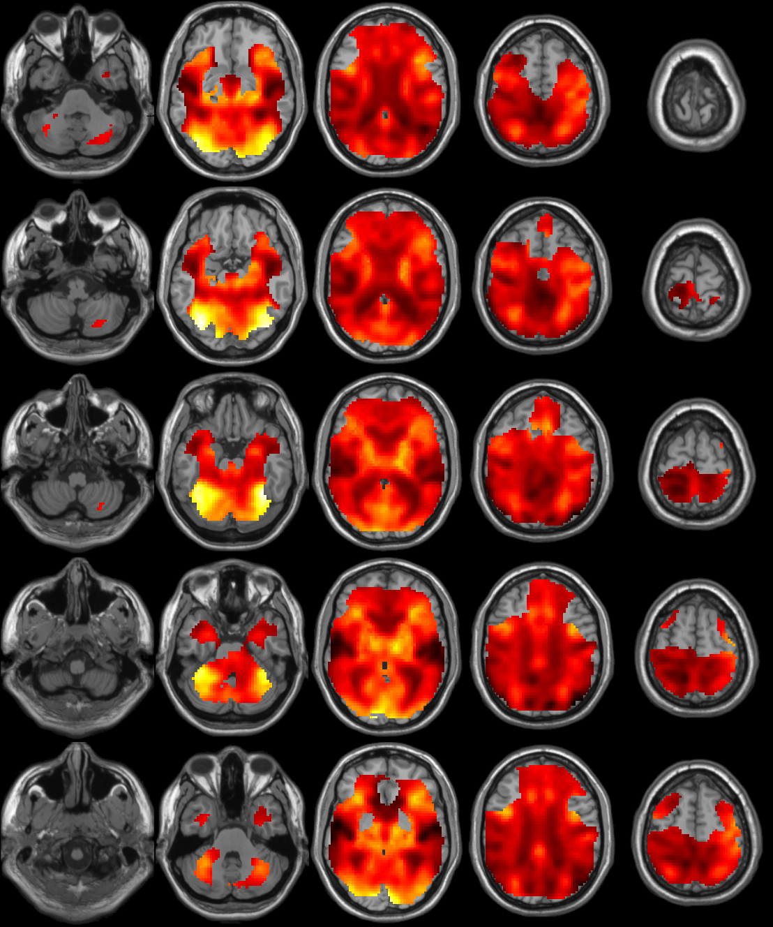
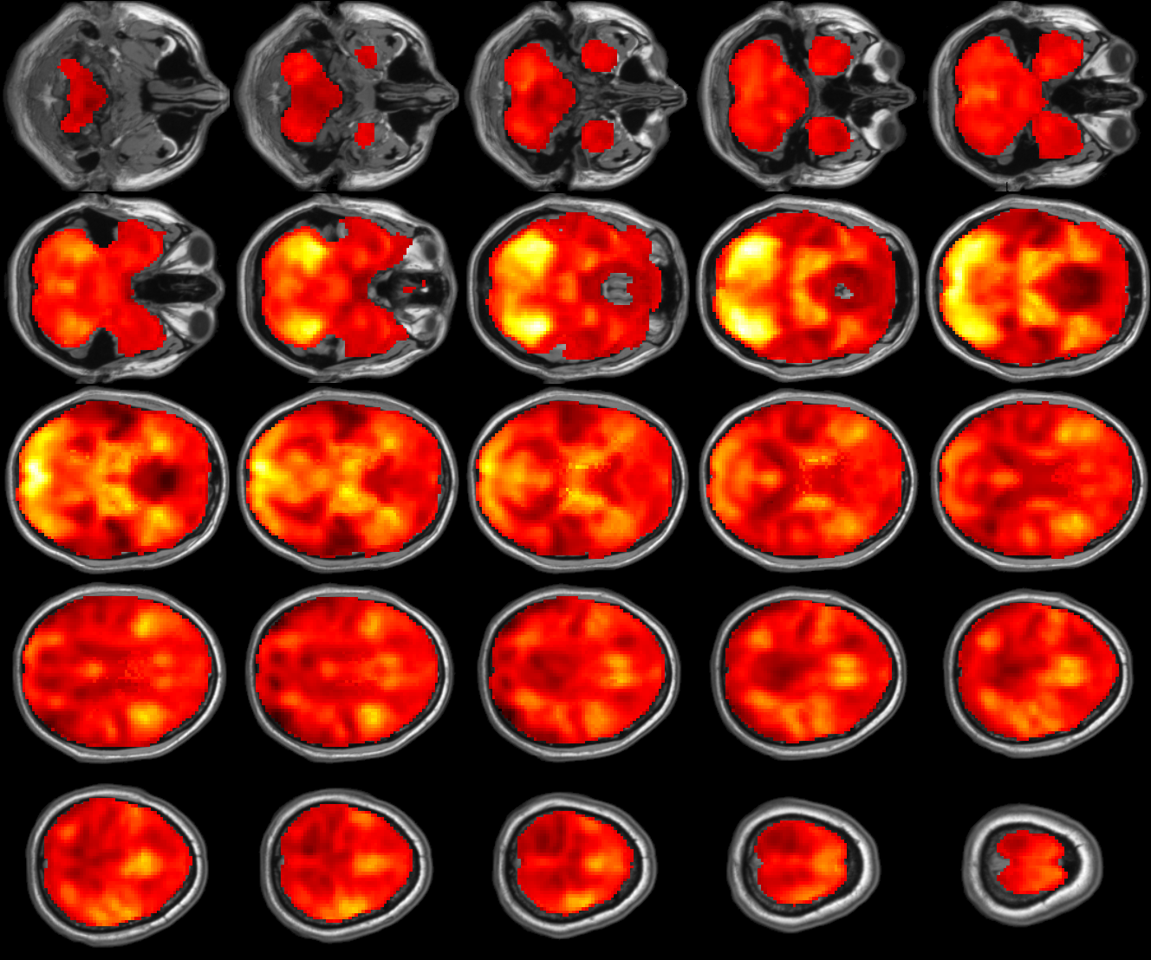
Analysis Package Differences
Notes:
In SPM/FSL, only voxels with data from all subjects are analyzed. Thus, its important to look at your mask. GLM_Flex can expand the mask and analysis voxels with data from fewer subjects.

Slide 34
Finding Clusters and Peaks
[voxels XX XX regions mapparameters UID] =peak_nii(‘myimage.nii’,mapparameters)
UID -- This was added to allow the user to add a unique ID to the analysis. If this field is not specified, then the default will be a timestamp (e.g. _20111108T150137). To avoid the using a timestamp, set this field to ‘’.
sign -- This can either be ‘pos’ or ‘neg. This specifies the direction of the contrast to test. If not specified, the program will default to ‘pos’. NOTE: F-contrasts can only be positive.
thresh -- This specifies the voxel threshold for finding clusters. This is only optional because the program will default to a value of 0. The threshold has to be a number and can either be the T/F statistic, a p-value, or any other number. This should almost always be specified.
type -- This specifies the statistic type, 'T', 'F', ‘Z’, or 'none'. cluster -- This specifies the minimum cluster size required to keep a cluster in the results. The default is 0. This is BAD!!!.
df1 --The numerator degrees of freedom for T/F-test
df2 --The denominator degrees of freedom for F-test.
label-- This specifies which labeling scheme to use.

Slide 35
Results Table
Cluster Size | Peak T-statistic | Peak X,Y,Z | Region
256 | 4.5923 | 18,56,6 | R. Superior Frontal Gyrus
 | 3.1503 | 26,44,2 | R. Middle Frontal Gyrus
145 | 3.4918 | 26,-32,40 | R. Postcentral Gyrus
594 | 3.4741 | 40,-56,-20 | R. Fusiform
 | 3.4027 | 20,-84,-16 | R. Cerebellum
 | 2.9215 | 32,-68,-18 | R. Fusiform
 | 2.5887 | 16,-96,-6 | R. Calcarine Sulcus
149 | 3.4199 | 18,-8,52 | R. Supplemental Motor Area
 | 3.0916 | 22,-16,62 | R. Precentral Gyrus
211 | 3.3672 | -2,-8,62 | L. Supplemental Motor Area
113 | 3.341 | -14,28,26 | L. Anterior Cingulate
288 | 3.3201 | 30,14,26 | R. Inferior Frontal Gyrus - Pars Triangularis
 | 3.0813 | 34,22,22 | R. Middle Frontal Gyrus
 | 3.0031 | 18,20,18 | R. Caudate
 | 2.4654 | 20,30,16 | R. Anterior Cingulate Cortex
109 | 3.2134 | -22,-84,-12 | L. Fusiform
60 | 3.1279 | 4,-20,14 | R. Thalamus
184 | 3.0597 | -32,-18,44 | L. Precentral Gyrus
 | 3.0011 | -30,-20,60 | L. Precentral Gyrus
 | 2.9813 | -18,-16,64 | L. Paracentral Lobule
221 | 3.01 | 48,-76,10 | R. Middle Temporal Gyrus
 | 3.0074 | 40,-72,12 | R. Middle Occipital Gyrus
 | 2.6437 | 28,-68,22 | R. Superior Occipital Gyrus
67 | 2.9583 | 30,-88,16 | R. Middle Occipital Gyrus
61 | 2.9485 | 44,-30,-6 | R. Superior Temporal Gyrus
139 | 2.8433 | 28,-48,40 | R. Angular Gyrus

Slide 36
peak_extract_nii
[resultsvoxels columnlistvoxels resultscluster columnlistcluster clusters mapparams subjparams UID] = peak_extract_nii(subjectparameters,mapparameters)
[resultsvoxels columnlistvoxels resultscluster columnlistcluster clusters mapparams subjparams UID] = peak_extract_nii([],mapparameters)

Slide 37
Acknowledgements
Harvard Aging Brain Project
Dr. Reisa Sperling
Dr. Alireza Atri
Dr. Aaron Schultz
Aishwarya Sreenivasan
Andrew Ward
Dr. Koene Van Dijk
Dr. Willem Huijbers
Dr. Dorene Rentz
Dr. Trey Hedden
Dr. Darren Gitelman
Justin Vincent
Dr. Bob Spunt
Wisconsin Alzheimer’s Disease Research Center
Imaging Core (Dr. Sterling Johnson, Dr. Michele Ries, Dr. Guofan Xu, Elisa Canu, Erik Kastman)
Dr. Mark Sager
Dr. Sanjay Asthana

