Slide 1
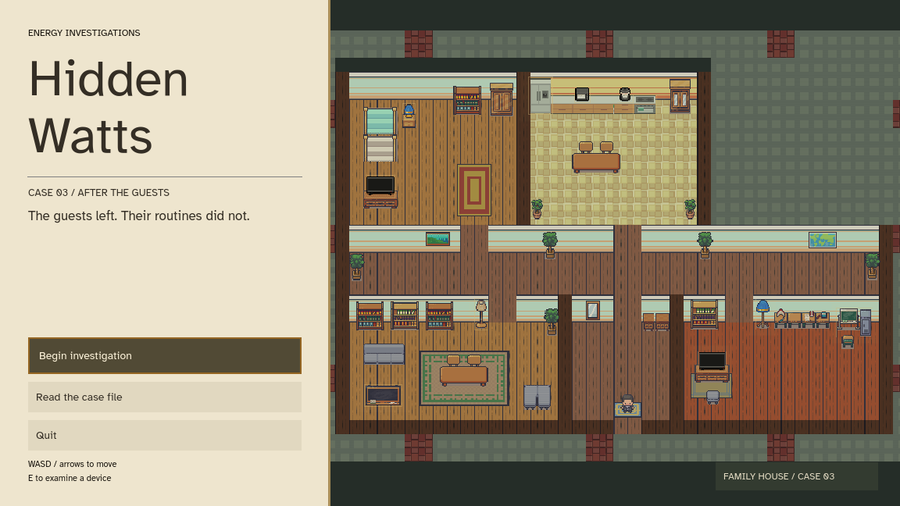
Hidden Watts
Prototype I
A single-player detective game about finding avoidable household electricity use.
Notes:
Developer identity and concept: supplied game proposal. Screenshot captured from the running local Godot project. This is a solo project with AI-assisted implementation, disclosed on slide 7.

Slide 2
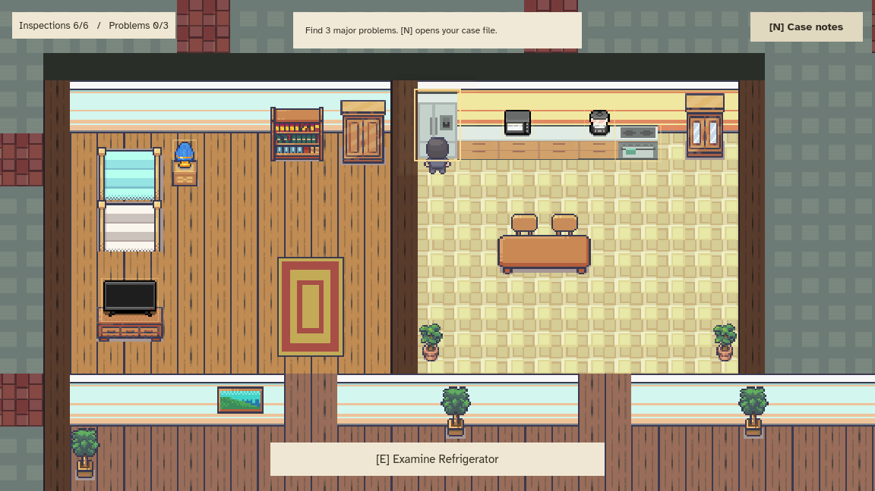
Implemented features
Explore a furnished house with an animated character and furniture collisions.
Approach 11 electrical devices and press E to examine them.
Three complete cases load from JSON. Returning to the menu chooses another case.
Notes:
Implemented features checked against Player.cs, Investigation.cs, MainMenu.cs, house.tscn and scenarios.json. Screenshot shows the current playable household.

Slide 3
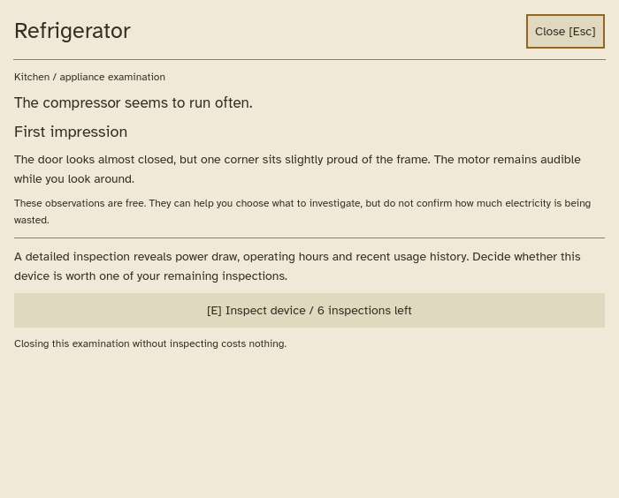
Choosing what to inspect
First impressions are free to read on every device.
Visible details and household habits suggest where to investigate.
Each case gives six detailed inspections to find three major problems.
Notes:
The free PreInspectionHint comes from scenarios.json and appears before the Inspect button. Reading it does not reduce the inspection budget. The hint guides a decision without displaying a good/bad label.

Slide 4
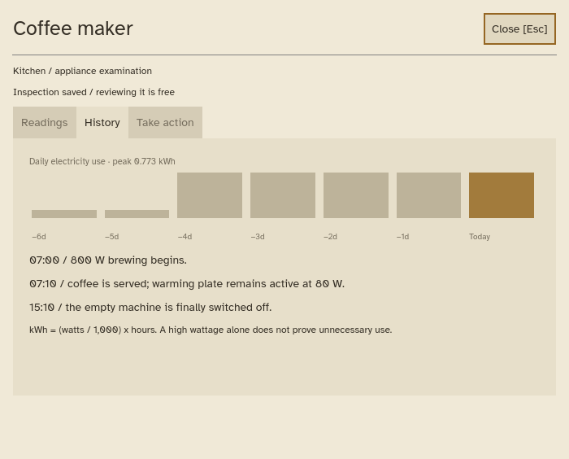
Evidence and corrective actions
An inspection reveals watts, operating time and recent usage history.
The player compares the readings with the household routine, then chooses an action.
Saved readings and case notes can be revisited without spending another inspection.
Notes:
The Readings, History and Take action tabs are implemented in GameHud.cs. A correct action resolves a major problem or clears a normal device. Incorrect actions reduce the score.

Slide 5
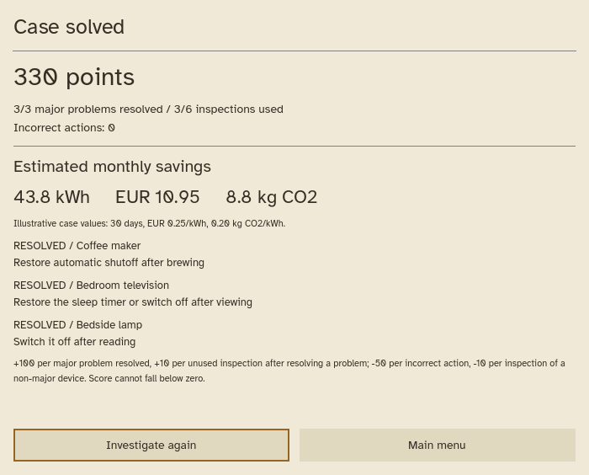
Social good in the gameplay
SDG 7: efficient electricity use
The player identifies avoidable use and chooses a practical correction.
SDG 13: climate action
Results connect electricity savings with estimated emissions avoided.
The game teaches that power draw and operating time both matter.
Notes:
SDG 7 and SDG 13 are the themes selected in the supplied proposal. The result screen implements energy, money and emissions savings. Values are illustrative scenario estimates, not measurements or verified learning outcomes. Calculations use 30 days, EUR 0.25/kWh and 0.20 kg CO2/kWh, stored per case in JSON. Scoring: +100 per major problem, +10 per unused inspection after a finding, -50 per incorrect action, -10 per non-major inspection, minimum zero.

Slide 6
Prototype II plan
Planned next steps
Add household layouts and more varied cases.
Show clearer changes after a fix and add saved case progress.
UI improvements
Notes:
Proposed Prototype II priorities based on the current implementation. These are future work, not claims of working features. The prototype currently has one house, three data-driven cases, static result feedback and no persistence system.

Slide 7
AI usage
OpenAI Codex
Assisted with C# scripting, debugging, and code refactoring
Generated scenarios, device clues, and case data.
Documentation (README.md)
HUD
Notes:
AI disclosure based on the development conversation: Codex assisted implementation, scenarios, UI, collision fixes, refactoring, documentation and presentation preparation. Human contributions reflect the supplied concept and the developer scene edits, testing and design direction. Sprite artwork comes from the supplied game assets. Other tools used for earlier proposal illustrations were not confirmed and are not attributed here.

