Slide 1


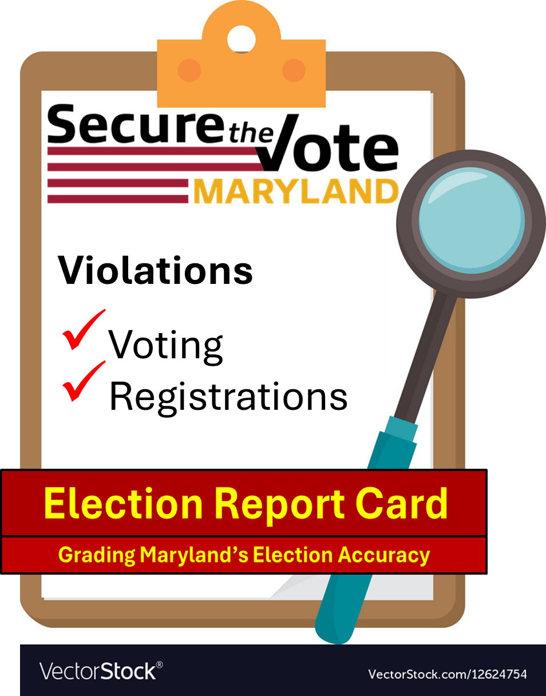
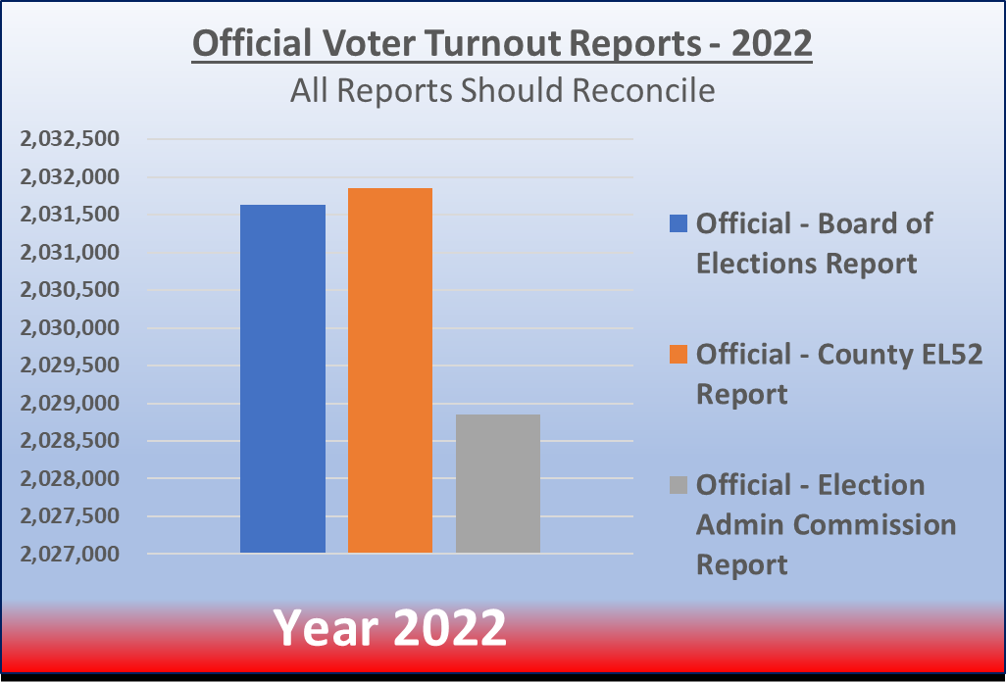
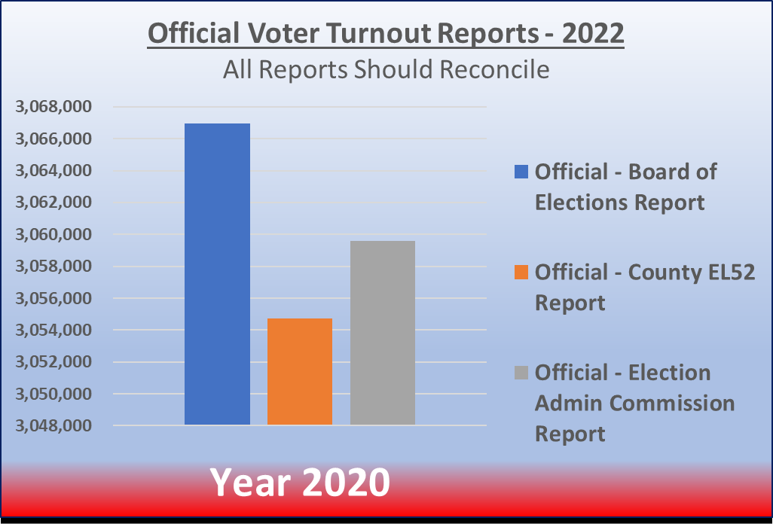



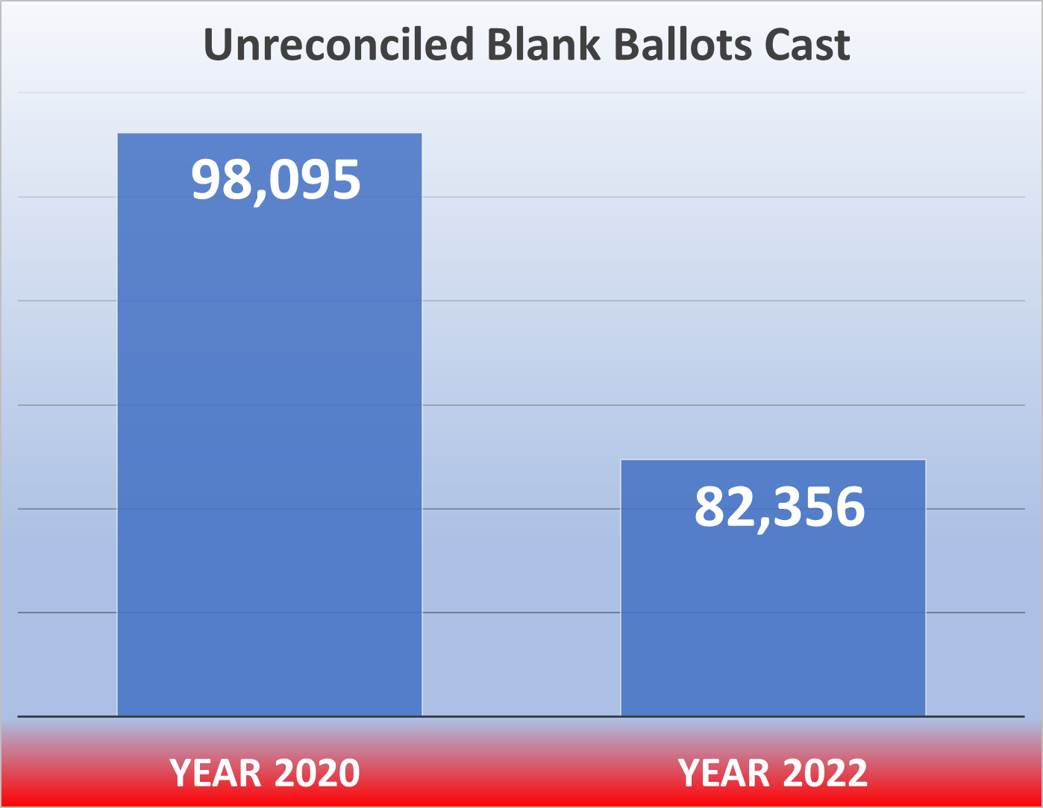

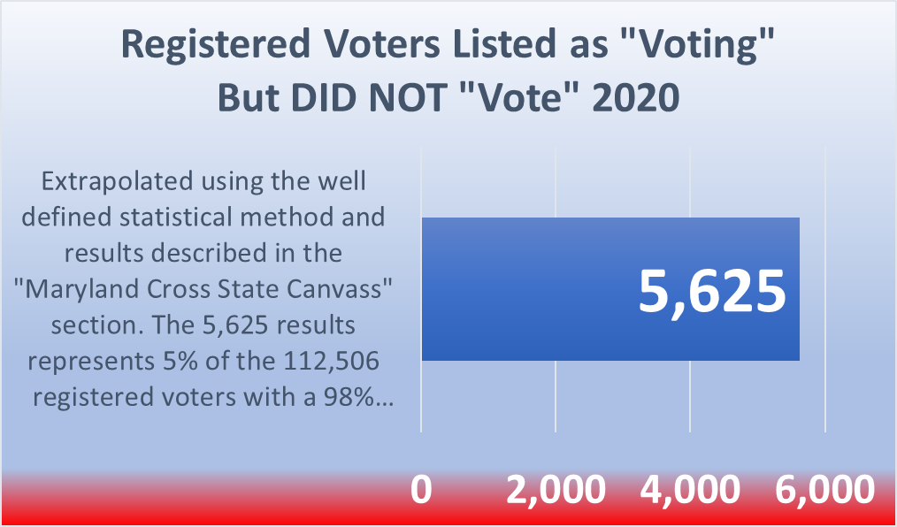
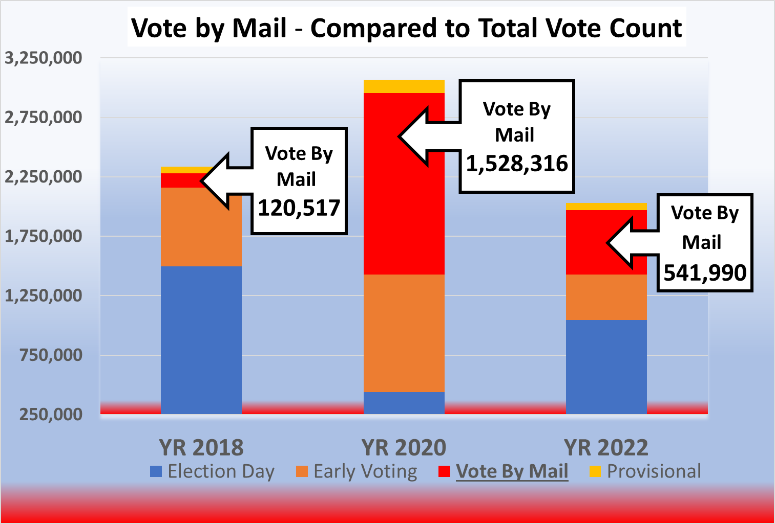
Additional Inaccuracies, Discrepancies and Concerns
Marylanders deserve accurate elections This report card provides citizens with scientifically developed data illustrating Maryland Voter Registration Database and other voting irregularities.
It objectively shows that the Maryland Board of Elections has failed to properly manage the electoral process and related voting systems.
This “failing” report card is a clarion call for Maryland citizens to take immediate action by going to SecuretheVoteMD.com and signing our petition, which will be presented to state legislators, to fix our elections process.
Confidence in our elections can only be achieved when the voting process accurately reflects the will of the people.
Maryland Election Integrity LLC
Election Season
2020 / 2022

Slide 2




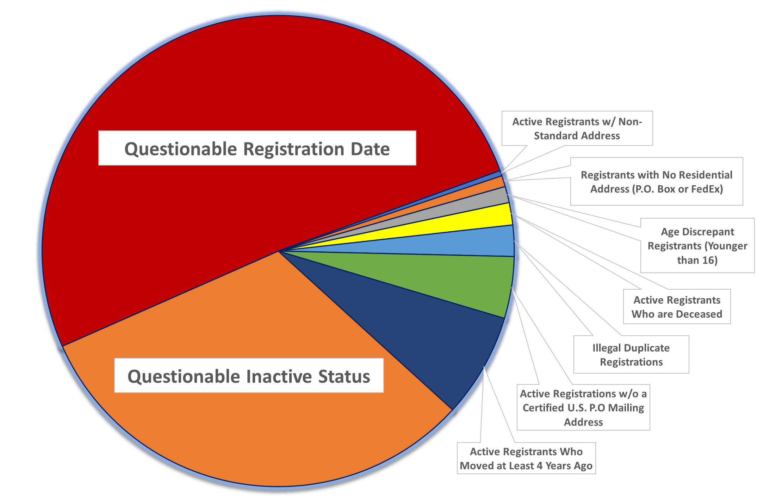
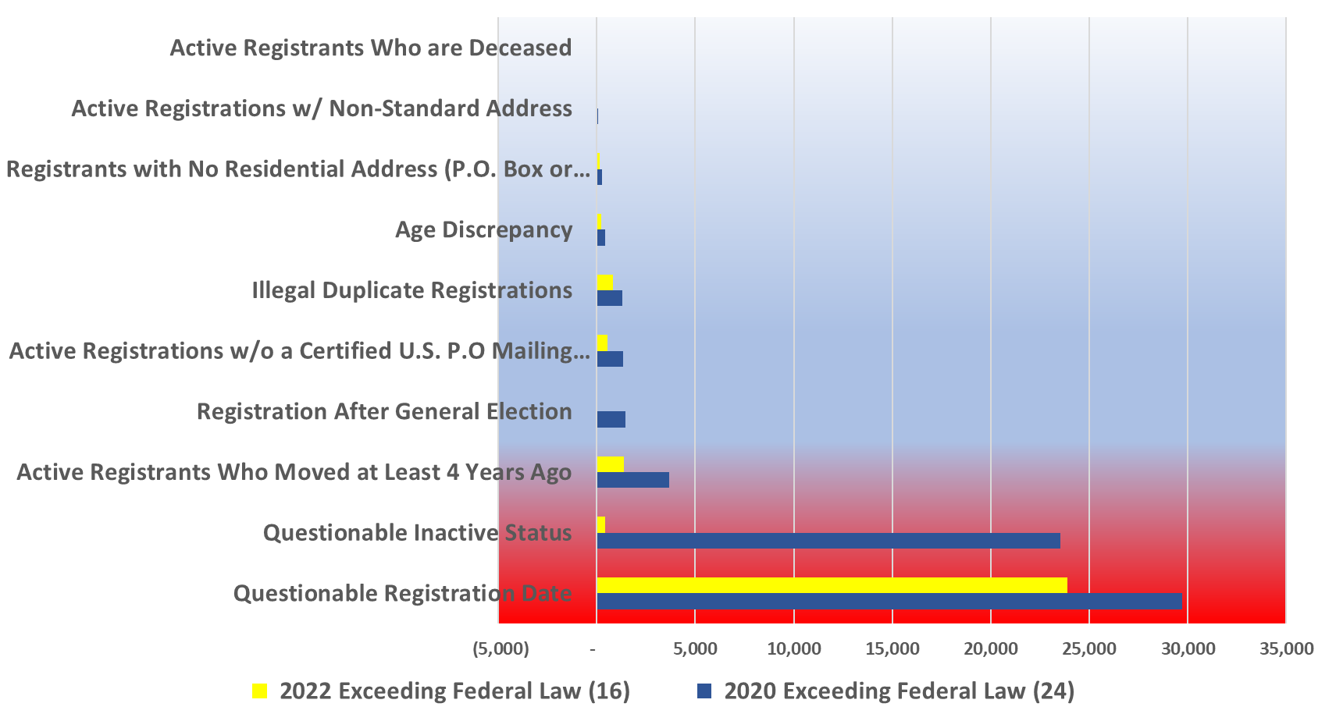


Report Card
Name of Student: Board of Elections
Grading Period: 2020 / 2022 Election Cycle
Passing Grade: Less than Federal Law Allowance
Class Advisor: Maryland Election Integrity LLC
Passing Grade: Violations = Zero or Less
Report Card
Voting Violations
Registration Violations

