Slide 1
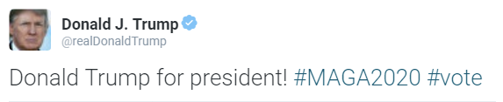












Softmax Probabilities
Dense Layer
0
1
Backward context
Forward context
Follower Features
Text context features
Bidirectional RNN
(Bi-GRU)
$$g^{(5)}$$
$$g^{(4)}$$
$$g^{(3)}$$
$$g^{(2)}$$
$$g^{(1)}$$
$$g^{(0)}$$
$$h^{(0)}$$
$$h^{(1)}$$
$$h^{(2)}$$
$$h^{(3)}$$
$$h^{(4)}$$
$$h^{(5)}$$
Embedding layer
(pre-trained with word2vec)
Clean and tokenize
Donald
Trump
for
president
#MAGA2020
vote
Input

