Slide 1
GreenLoop
By
Ramasamy Ramanathan
@ SF Hacks

Slide 2
Why are greener habits over looked upon or not valued?
Common people don’t see immediate impact
Assume they cannot make any big difference
Not incentivised in the near term
No active immediate peer groups or communities that actively participate or discuss about greener moves.

Slide 3

One person at a time
Chain effect
Move the needle

Slide 4
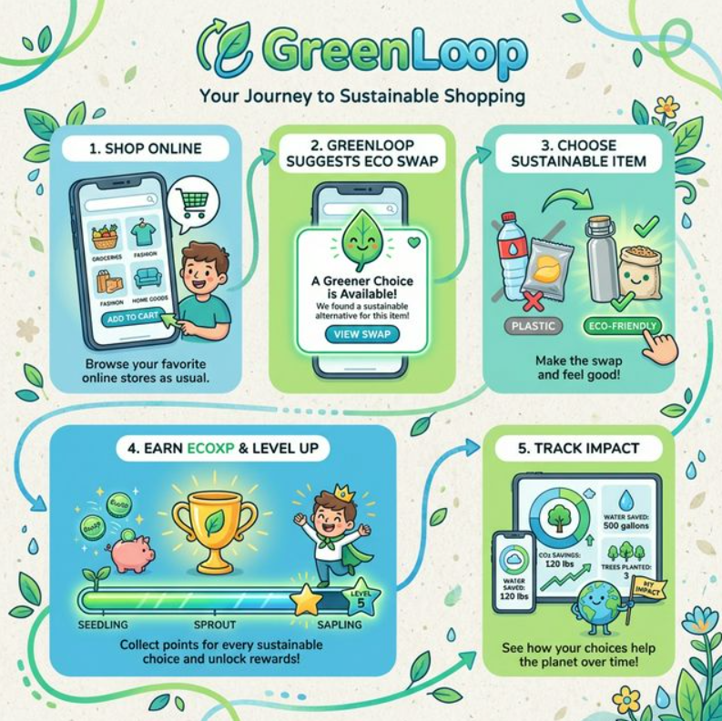
Proposition:

Slide 5
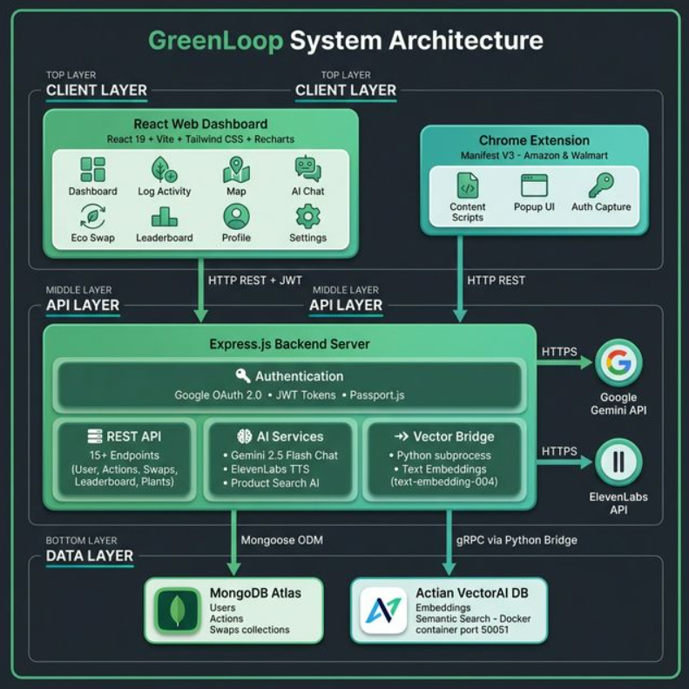
Architecture

Slide 6
To the demo

