Slide 1

Personalized News Recommendation System via LLM Embedding and Co-Occurrence Patterns
Short Story Assignment By
Ramasamy Ramanathan

Slide 2
Gist
Traditionals Models for News Recommendation Systems
Their limitations
Co-Occurrence Patterns
Large language models (LLM)
Semantic Understanding
Contrastive Learning
Context
Advantages Over the Traditional Models
Architecture
Background
Related work
Large language models (LLMs) enhance news recommendation by leveraging fine-tuned embeddings and co-occurrence patterns to better understand user preferences and capture collaborative information, outperforming traditional models.
Content

Slide 3
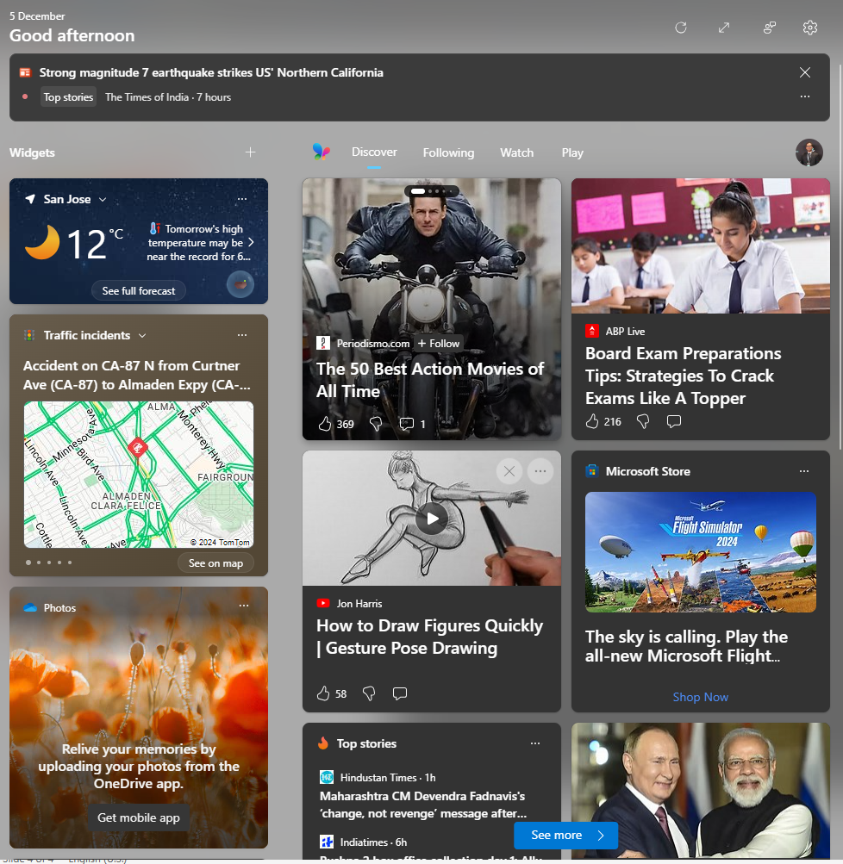
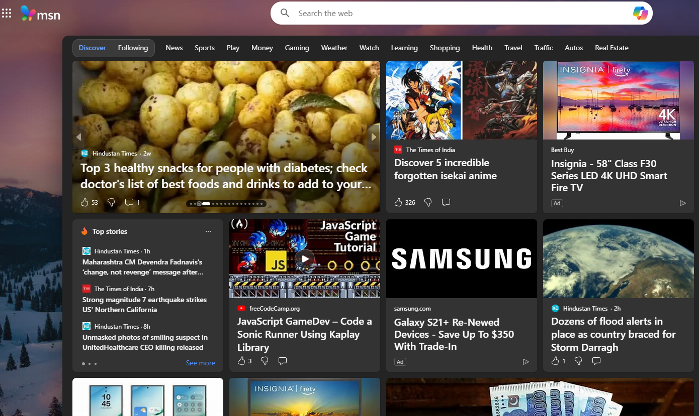
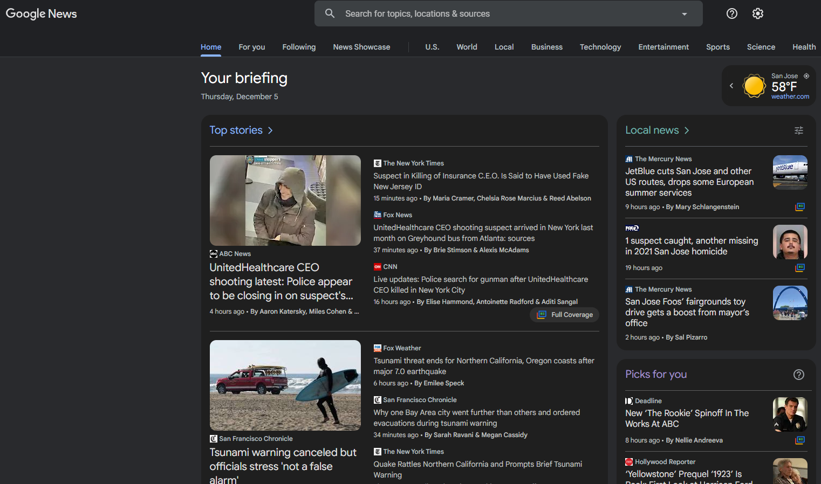
Traditionals Models for News Recommendation Systems
Traditional news recommendation systems match news articles to users based on their past reading habits, similar user behaviors, and article content. They analyze what users have read before and suggest similar or related news stories.

Slide 4
Contrastive Learning

Slide 5

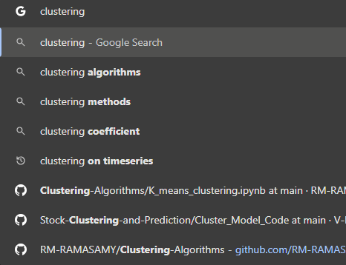

co-occurrence pattern
A measure of how similar two words or phrases are based on their co-occurrence patterns within a specific text or corpus.

Slide 6
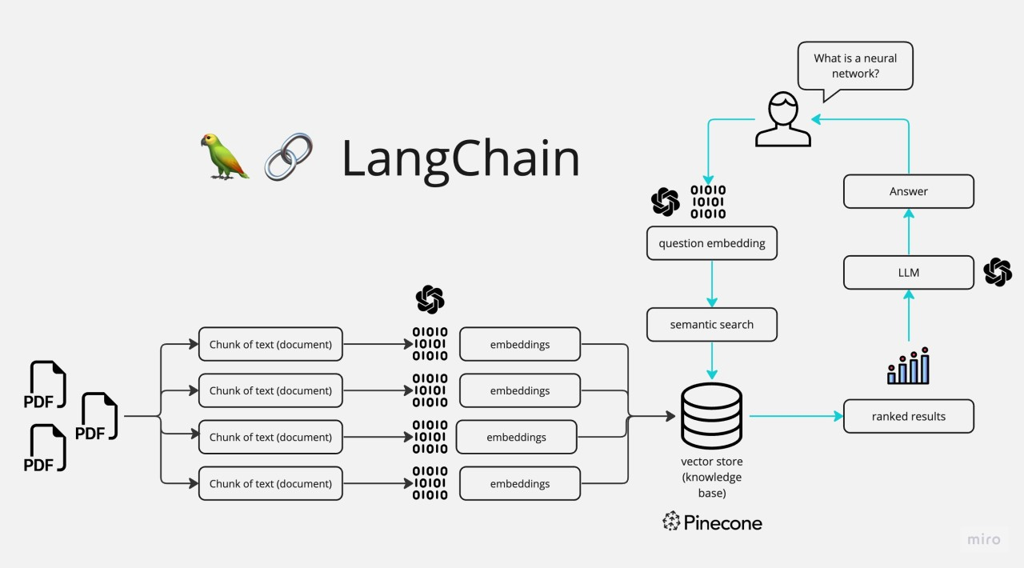
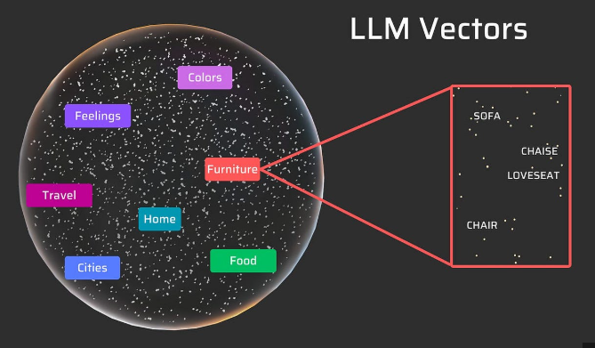
Large language models (LLM)
excel in understanding and processing large-scale text data. Trained on vast corpora, LLMs can generate rich contextual embeddings that represent the semantic essence of text. This capability allows them to analyze both the user’s click history and candidate news articles with a high degree of semantic understanding. Consequently, LLMs can align user preferences more accurately with potential recommendations, making them a natural fit for modern NR systems.

