Slide 1

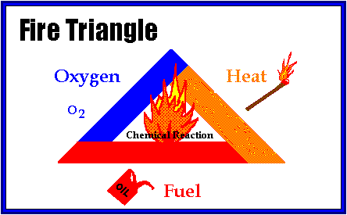
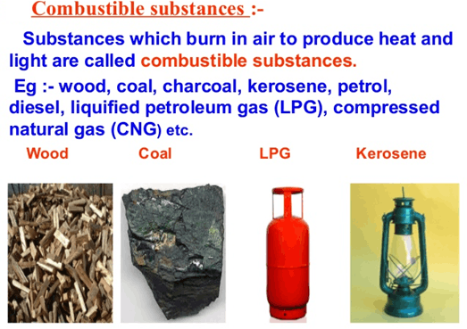
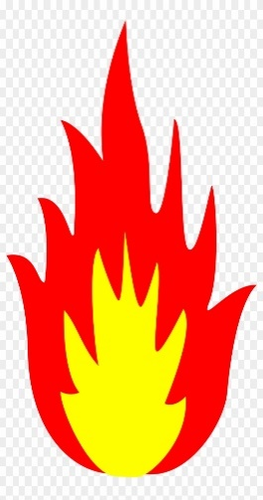
HSE TRAINING RECORD
Plant/Site/Location | : | Musaffah Batching Plant @Maintenance Rest Room | Date & Time | : | 02-02-2022 @14:30 hours
Topic/Subject | : | Basic Fire Fighting | Instructor | : | Ronald Valencia
The Elements of Fire
A fire needs three elements to exist: oxygen, heat and fuel. Fuel is anything that will burn when exposed to heat. It can be a solid, liquid or gas. Fuel sources include paper, wood, oil, grease, chemicals, and flammable liquids. The leading heat sources that could cause these fuel sources to burn include electricity, cigarettes, cutting and welding, sparks from tools, and friction. To prevent a fire from occurring, you need to eliminate any of the elements needed for a fire to exist.

Slide 2
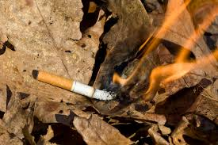
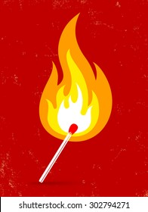
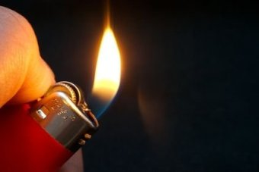
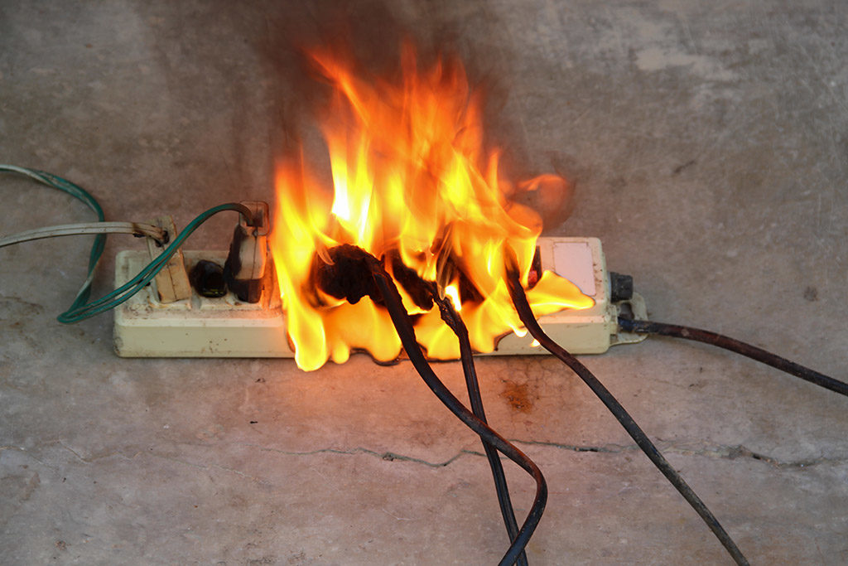
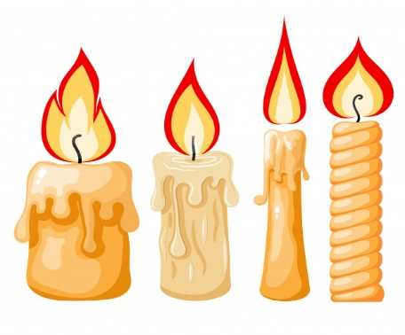
HSE TRAINING RECORD
Plant/Site/Location | : | Musaffah Batching Plant @Maintenance Rest Room | Date & Time | : | 02-02-2022 @14:30 hours
Topic/Subject | : | Basic Fire Fighting | Instructor | : | Ronald Valencia
FUEL CAN BE:
HEAT:
Solid.
Liquid.
Gas.
Throwing cigarettes that are still burning.
Matchsticks & lighters
Candles
Electrical fires due to overloading & short circuits.
In order to combust the
right mixture of oxygen
and fuel must be present.
SOLID LIQUID GAS
OXYGEN:
The fuel air mixture must be right.
People need 19 percent to live.
Fire only needs 16 percent.
2

Slide 3
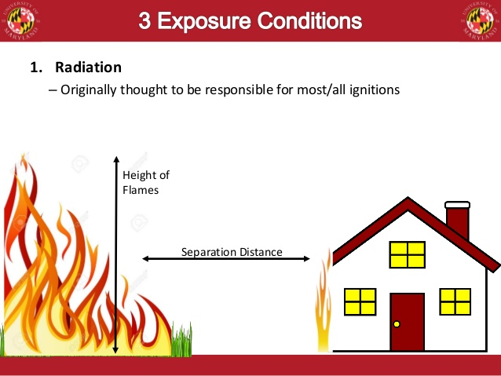
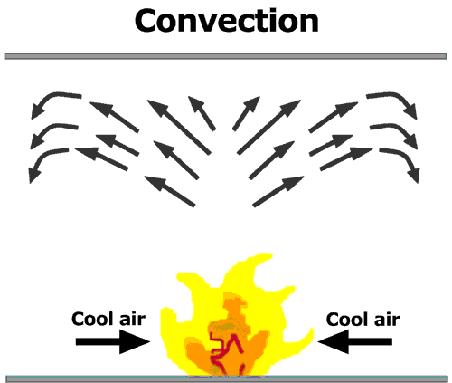
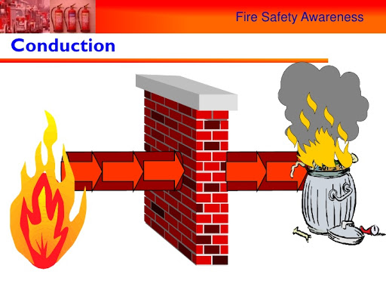
HSE TRAINING RECORD
Plant/Site/Location | : | Musaffah Batching Plant @Maintenance Rest Room | Date & Time | : | 02-02-2022 @14:30 hours
Topic/Subject | : | Basic Fire Fighting | Instructor | : | Ronald Valencia
How does fire spread or transfer the extreme heat?
Radiation refers to the emission of energy in rays or waves. Heat moves through space as energy waves. It is the type of heat one feels when sitting in front of a fireplace or around a campfire. It travels in straight lines at the speed of light. This is the reason that when facing the fire, only the front is warmed. The backside is not warmed until the person turns around. The earth is heated by the sun through radiation. Sunburns are a fact of life when people are exposed to the sun very long. Most of the preheating of fuels ahead of a fire is by radiation of heat from the fire. As the fire front gets closer, the amount of radiant heat received is increased.
Convection is the transfer of heat by the physical movement of hot masses of air. As air is heated, it expands (as do all objects). As it expands, it becomes lighter then the surrounding air and it rises. (This is why the air near the ceiling of a heated room is warmer than that near the floor.) The cooler air rushes in from the sides. It is heated in turn and it also rises. Soon a convection column is formed above the fire which can be seen by the smoke that is carried aloft in it. This in-draft of cooler air from the side helps to supply additional oxygen for the combustion process to continue.
Conduction is the transfer of heat within the material itself. Most metals are good heat conductors. Wood is a very poor conductor so it transmits heat very slowly. This can be illustrated by the fact that a wooden handle on a hot frying pan remains cool enough to be held by the bare hands. Conduction is not an important factor in the spread of forest fires.

Slide 4
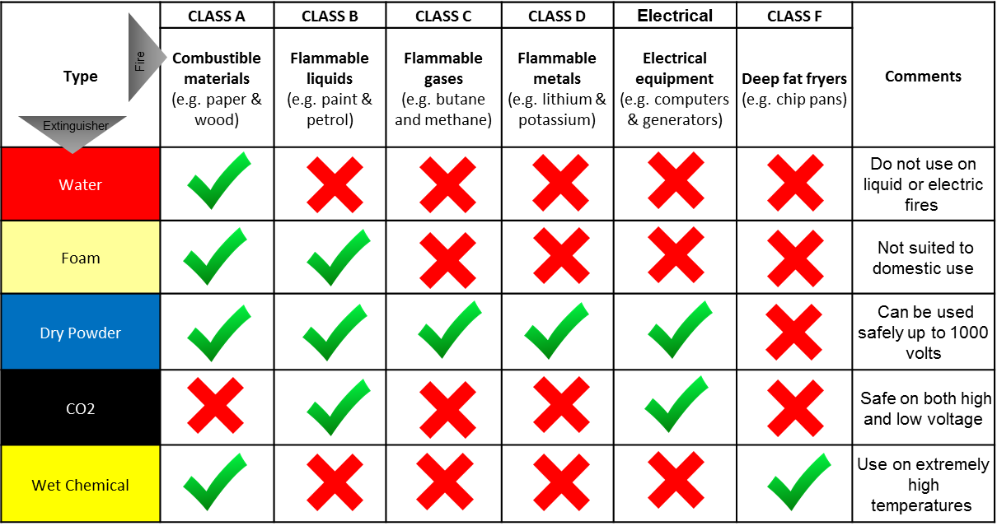
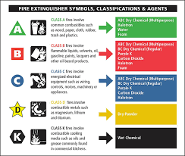
HSE TRAINING RECORD
Plant/Site/Location | : | Musaffah Batching Plant @Maintenance Rest Room | Date & Time | : | 02-02-2022 @14:30 hours
Topic/Subject | : | Basic Fire Fighting | Instructor | : | Ronald Valencia
Fire Extinguishers
Fire extinguishers are classified according the type of fire they are effective against. The type of fuel that a fire is composed of determines it classification.
Class A fires are composed of dry combustibles like paper, wood, and plastics Class A extinguishers contain water to remove the heat from the fire. Class A fires form embers that continue to smolder in the fire is not totally extinguished. The burned material must be moved away from the building after the fire is extinguished.
Class B fires are usually fueled by grease, oil, paint, or flammable liquids. Class B extinguishers contain dry chemicals, carbon dioxide, or other agents. Dry chemical shoots out a powdery cloud that smothers fire. Carbon dioxide eliminates the oxygen element of the fire.
Class C fires are electrical. An extinguisher is rated for class C fires if it contains an agent that is nonconductive.
Class D extinguishers are used on exotic metals such as magnesium, sodium, and potassium. No other fire extinguisher is effective against these combustible metal fires. Using an extinguisher that is not properly rated for the fire could actually spread the fire and make it worse. Extinguishers with multiple classifications life the ABC extinguisher eliminate your chances of choosing the wrong extinguisher because they are effective for Class A,B, and C fires, and fries that have more than one fuel involved.

Slide 5
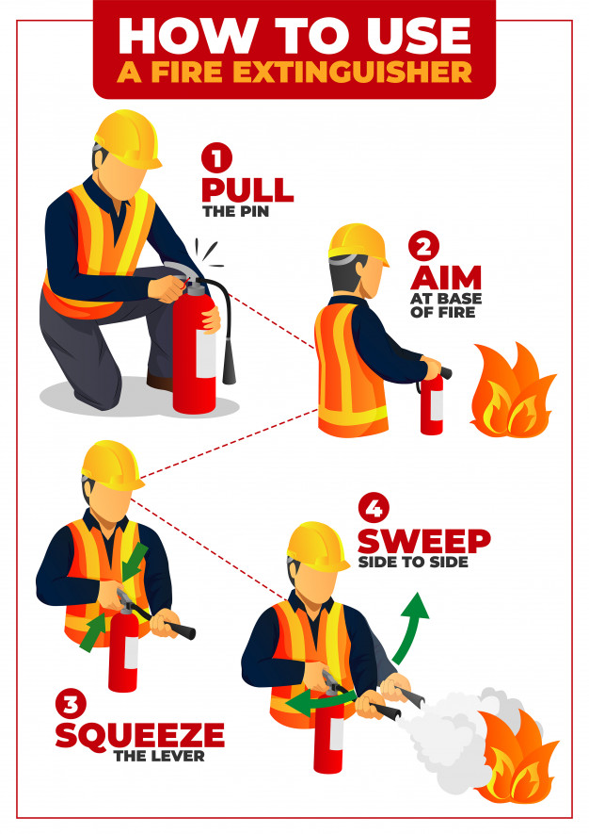
HSE TRAINING RECORD
Plant/Site/Location | : | Musaffah Batching Plant @Maintenance Rest Room | Date & Time | : | 02-02-2022 @14:30 hours
Topic/Subject | : | Basic Fire Fighting | Instructor | : | Ronald Valencia
Use of Fire Extinguishers
When using a fire extinguisher remember the acronym P.A.S.S.
Pull the pin.
Aim low, at the base of the fire.
Squeeze the handle to release the extinguisher agent.
Sweep from side to side to keep the fire from spreading.
Remember that fire extinguishers have a limited range and limited amount of extinguishing agent. They are effective against small fires and should not be used in any of the following situations:
You have not been properly trained to use the fire extinguisher.
The fire spreads beyond its immediate area.
The fire could block your escape route.

Slide 6
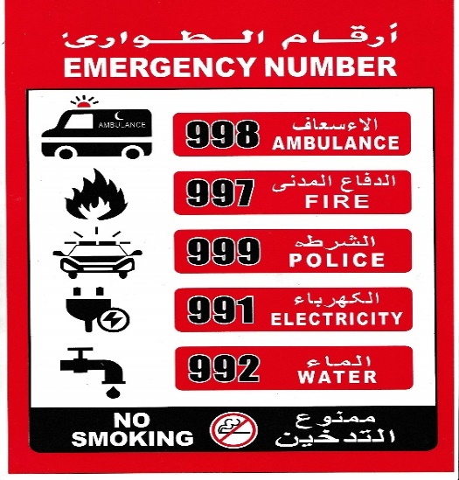
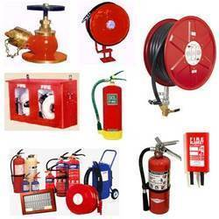

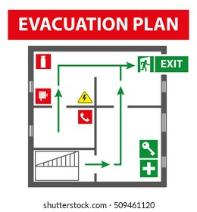
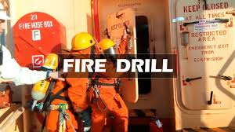
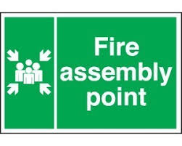
HSE TRAINING RECORD
Plant/Site/Location | : | Musaffah Batching Plant @Maintenance Rest Room | Date & Time | : | 02-02-2022 @14:30 hours
Topic/Subject | : | Basic Fire Fighting | Instructor | : | Ronald Valencia
FIRE PREVENTION & CONTROL
Don’t hang clothing over or near heating equipment.
Don’t let paper, oily rags or other rubbish accumulate.
Don’t smoke in prohibited areas.
Use proper, sealed containers for flammable liquids, not open tins or buckets.
Don’t overload electric sockets – ‘one socket, one plug’.
Handle flammable liquids at a safe distance from possible sources of ignition.
Ensure there are no adjacent flammable materials before using blowlamps, welding and cutting equipment.
Make sure you know what to do in case of fire.
Make certain you know your escape route, especially at construction sites and industrial companies.
Keep fire doors clear and unobstructed.
Don’t obstruct access to fire extinguishers.
Ensure you know how to operate the fire extinguishers in your area.
Fire fighting equipment’s must be installed as per building code requirements.
Fire safety signages, including emergency evacuation plan layout, emergency contact numbers, fire fighters should be posted at all areas in the workplace.
Provide general housekeeping in your workplace areas.
Conduct emergency fire drills.

Slide 7
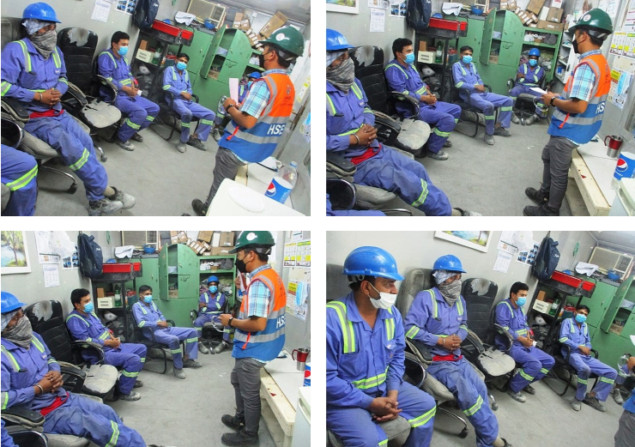
HSE TRAINING RECORD
Plant/Site/Location | : | Musaffah Batching Plant @Maintenance Rest Room | Date & Time | : | 02-02-2022 @14:30 hours
Topic/Subject | : | Basic Fire Fighting | Instructor | : | Ronald Valencia

Slide 8
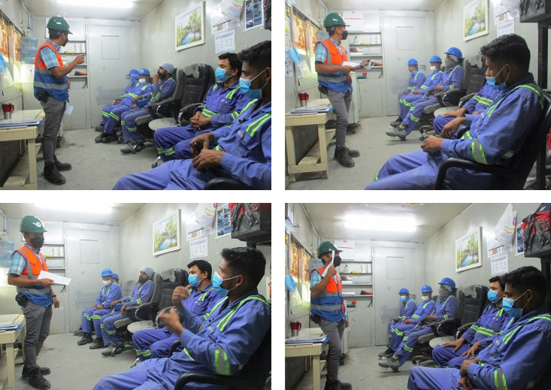
HSE TRAINING RECORD
Plant/Site/Location | : | Musaffah Batching Plant @Maintenance Rest Room | Date & Time | : | 02-02-2022 @14:30 hours
Topic/Subject | : | Basic Fire Fighting | Instructor | : | Ronald Valencia

Slide 9
