Slide 1
ECE 571 Final Project
Design Verification of DDR3 Memory Controller
Ajna Bindu R
Jyothsna K
Rithvik M B
Vadiraja M N

Slide 2
INTRODUCTION
Verification of a Memory Controller interfaced with a DDR3 Memory Model
Object Oriented approach
Verification Environment
SystemVerilog Assertions
Emulation of DDR3 Memory Controller

Slide 3
PROJECT GOALS
Protocol verification
Timing parameters
Emulation in TBX Mode

Slide 4
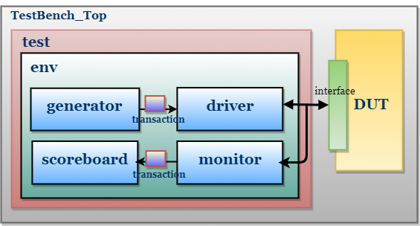
VERIFICATION ENVIRONMENT

Slide 5
VERIFICATION STRATEGY
Directed Testcases
Reset – Garbage Data
Verify single write and read
Overwrite data on the same address and read
Write to same row, different column and read
Write to different row, same bank
Write to consecutive rows
Single write to every bank
Generated random testcases

Slide 6
VERIFICATION STRATEGY
Assertions
Concurrent Assertions
Write Assertions: Verified the timing parameters T_RCD,T_WL, T_RC
Read Assertions: Verified the timing parameters T_CL,T_RP
Immediate assertions

Slide 7
VERIFICATION STRATEGY
INPUT COVERAGE
To check the tested and untested portion of the design
Coverage model is defined using covergroup construct
Implemented for signals at interface and top level
FUNCTIONAL COVERAGE
Implemented to verify the state transitions of FSM (DUT)

Slide 8
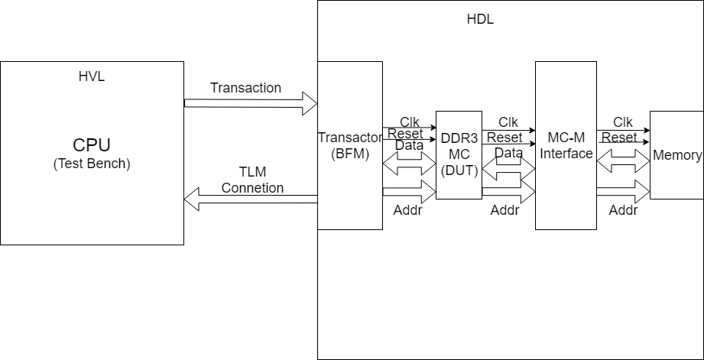
EMULATION
Implemented Emulation on Veloce using TBX Mode

Slide 9
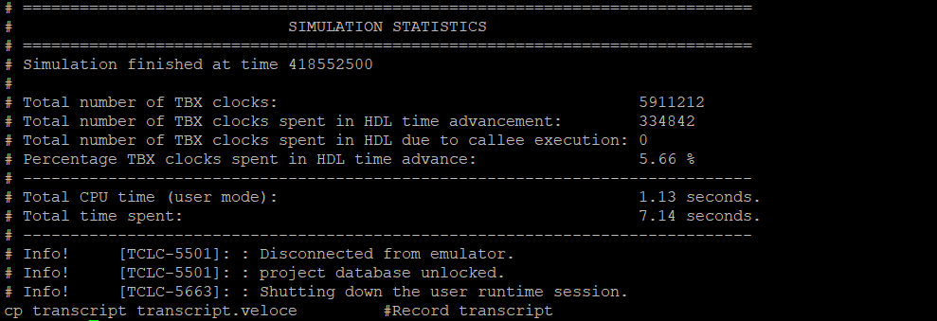
STATISTICS

Slide 10
CONCLUSION
Results: Effective testcases- improved functional coverage
Efficient usage of System Verilog constructs
Bottlenecks:
Implementation of interfaces between DUT & Testbench
Emulating the DUT

Slide 11
REFERENCES
1GB Automotive DDR3L SDRAM Micron datasheet
http://www.verificationguide.com/p/systemverilog-tutorial.html
http://www.testbench.in/
Emulation: PSU Veloce Examples

