Slide 1

Intro to Git and GitHub
Rory Crean
Researcher
Department of Chemistry - BMC
Uppsala University
18th December 2023

Slide 2
Part 1: Git

Slide 3

Git is a version control system used to track changes
Example local version control diagram,
Taken from: Pro Git book
Advantages over “manual” version control:
More automated and easier to use.
More space efficient.
Much less likely for user error.
No need to write files like: ”final_version3_draft_V3.py”
Notes:
Git is a version control system used to track changes in source code (or other files).
It enables multiple people to work on the same project simultaneously and (somewhat) independently.
That means it keeps records of versions for files.
For a single file, normal version control fine, but quickly becomes a mess.
Each time you make a change are you going to save every version.

Slide 4
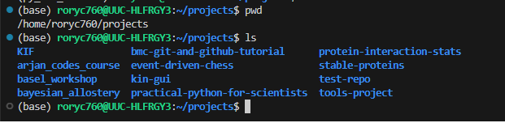
You start by defining a folder for Git to Monitor
New project, new folder.
Store each project/folder in the same general place.
Don’t have spaces in the file path.
If you use dropbox/onedrive, don’t track this location.
My Setup
Each folder above has it’s own git repository

Slide 5
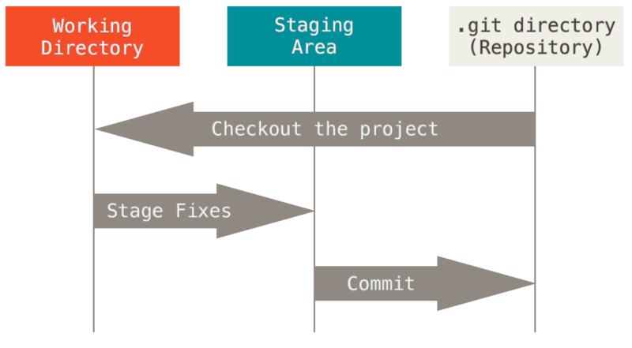
The three states of a file in Git
Modified
Staged
Committed
Git has no record of this file, if you remove it now, Git will never know.
Image taken from: Pro Git book
Notes:
Modified means that you have changed the file (or created it) but have not committed it to your database yet.
Staged means that you have marked a modified file in its current version to go into your next commit snapshot.
Committed means that the data is safely stored in your local database.

Slide 6
The three states of a file in Git
Modified
Staged
Committed
Use ”git add [file_name]” to move a file to the staging area.
Image taken from: Pro Git book
Notes:
Modified means that you have changed the file but have not committed it to your database yet.
Staged means that you have marked a modified file in its current version to go into your next commit snapshot.
Committed means that the data is safely stored in your local database.

Slide 7
The three states of a file in Git
Modified
Staged
Committed
Use “git commit” to store a new version of the project. Changes in the staging area are used in this commit.
Image taken from: Pro Git book
Notes:
Modified means that you have changed the file but have not committed it to your database yet.
Staged means that you have marked a modified file in its current version to go into your next commit snapshot.
Committed means that the data is safely stored in your local database.

Slide 8
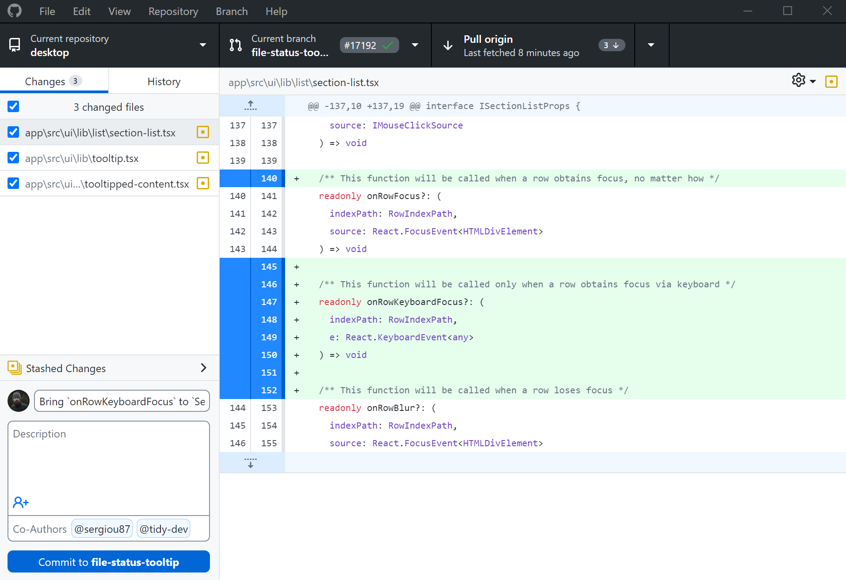
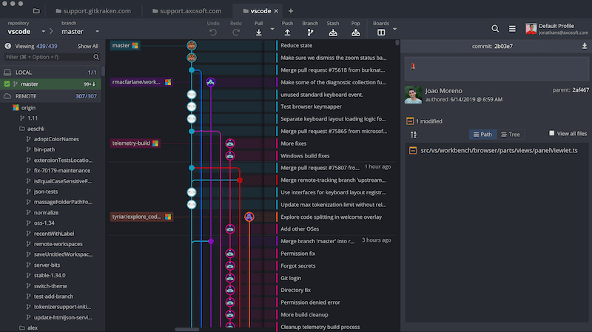
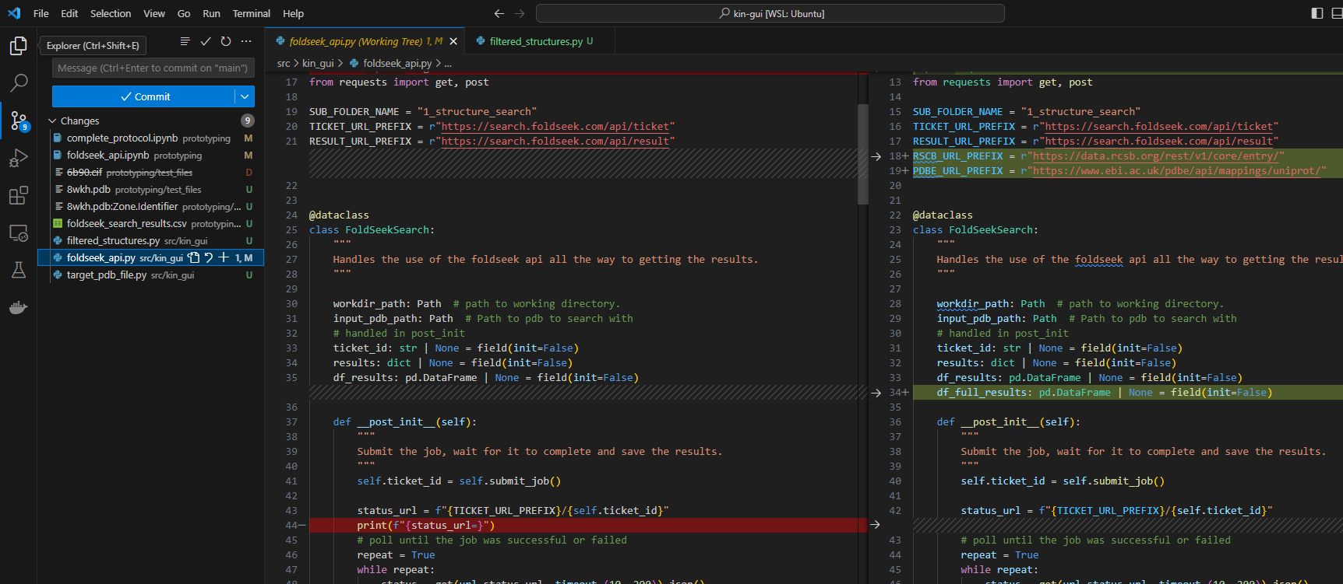
Tools/IDEs Can Help You Make Use of Git
GitHub Desktop
GitKraken
Image taken from: desktop.github.com
Image taken from: gitkraken.com
VSCode
Notes:
It’s possible to do everything with the terminal but both IDEs and dedicated tools can help you make use of Git.
Two tools (GitHub Desktop and GitKraken) to be used directly with Git.
VSCode and other IDES help you use Git/GitHub.
That said, we’ll start in the terminal.

Slide 9
Hands on Session 1: Please go to: https://rmcrean.github.io/bmc-git-and-github-tutorial/ or: https://github.com/RMCrean/bmc-git-and-github-tutorial (and then click on the link on the left handside.)

Slide 10
Part 2: GitHub and Git Combined

Slide 11
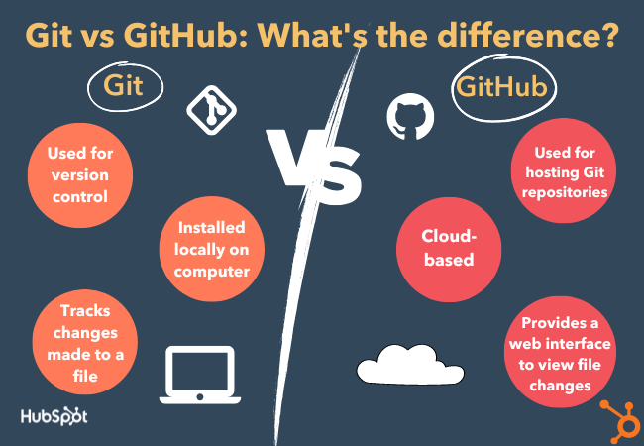
The difference between Git and GitHub
Image taken from: https://blog.hubspot.com/website/git-vs-github
Notes:
GitHub is a place to store Git repositories (among other things).
You don't need to use GitHub to use Git
For example bitbucket and GitLab offer very similar functionality. That said, we will use.

Slide 12
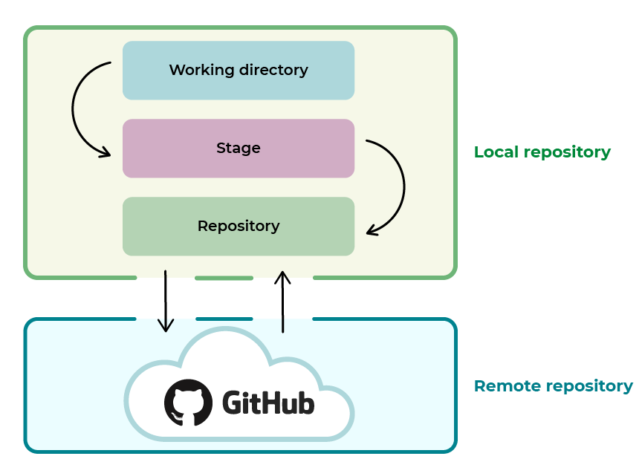
GitHub is a place to store/host remote Repositories
You can have several versions of the same project, this can be useful both working alone or in a team.
Local means it’s on your pc (or someone else’s pc, in which case that version is local for them).
Remote means you need to connect to it (e.g. hosted on a server).
Image taken from openclassrooms
Why Use a Remote:
Back up your own work.
To collaborate with other people.
Share your work.

Slide 13
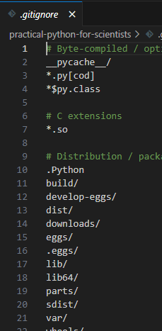
Not everything should be uploaded to GitHub
Example of things you should not add:
Large datasets.
Sensitive/Personal data.
Passwords/usernames.
System-specific files, e.g. .DS_Store on a Mac.
How to do this:
Use a “.gitignore” file and add to it as you need.
You should commit your .gitignore file.
Use a “.gitignore” template file designed for your programming language.
Be careful about using “git add .”

Slide 14
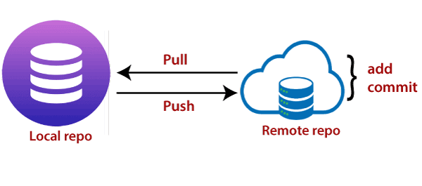
More Git Vocabulary: Push and Pull
Image taken from: https://www.javatpoint.com/git-push
“git push” – Update local commits to the remote repo.
“git pull” – Get remote commits from your pc to remote repo
And one more:
“git clone” – Make a local copy of a remote repo.

Slide 15
Hands on Session 2: Please go to: https://rmcrean.github.io/bmc-git-and-github-tutorial/ or: https://github.com/RMCrean/bmc-git-and-github-tutorial (and then click on the link on the left handside.)

Slide 16
Part 3: Branches and Merging

Slide 17
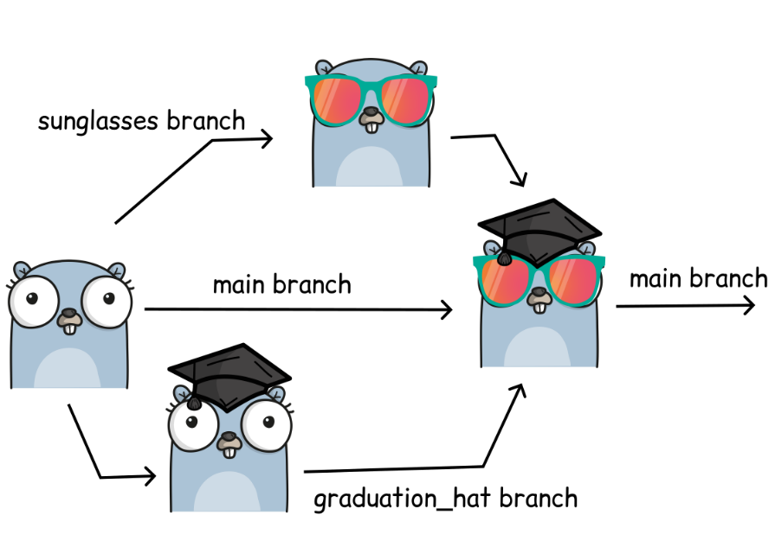
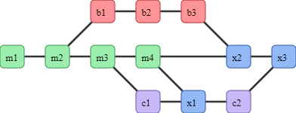
Branches in Git
Image taken from: https://coderefinery.github.io/git-intro/branches/
Image taken from: https://coderefinery.github.io/git-intro/branches/
Branches allow us to separate out different blocks of work.
Once we’re happy with the changes on the branch, we want to merge the changes (commits) back onto the main branch.
If working alone, you can probably get away with not using branches.

Slide 18
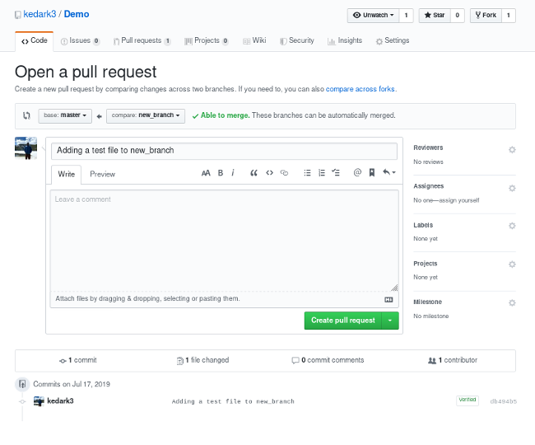
Merging two branches can be done with either Git or GitHub
Rough Protocol:
1. Make new branch.
2. Add changes to branch
3. Push changes to GitHub
4. Follow Instructions on GitHub
Notes:
On GitHub we can perform a pull request in order to merge two branches.

Slide 19
Hands on Session 3: Please go to: https://rmcrean.github.io/bmc-git-and-github-tutorial/ or: https://github.com/RMCrean/bmc-git-and-github-tutorial (and then click on the link on the left handside.)

Slide 20
Summary
Image taken from openclassrooms
It’s easier to keep things simple, especially while learning in the beginning.

Slide 22
BELOW ARE SLIDES I CONSIDERED USING BUT DIDN’T DUE TO TIME CONSTRAINTS

Slide 23
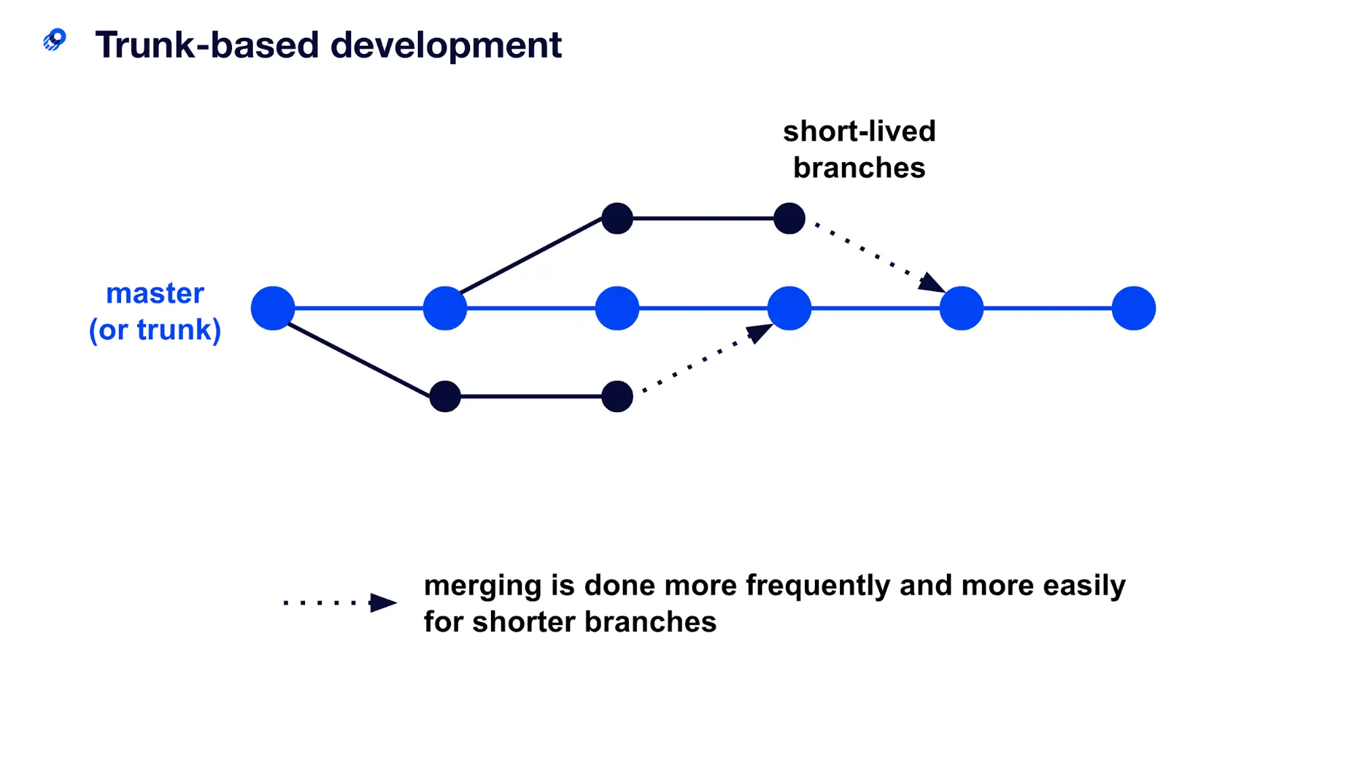
Trunk based development can be a good strategy for small groups
There are a lot of branching strategies…
Most are inappropriate for small scientific projects involving you and a few colleagues.
Trunk based development can be a good idea…
main/
Image taken from: https://www.optimizely.com/optimization-glossary/trunk-based-development/

Slide 24
Practicing trunk based development
main/
Image taken from: https://www.optimizely.com/optimization-glossary/trunk-based-development/
You have one main branch which holds code you’re all happy with.
New features/ideas get implemented on a different branch.
Once happy with the new feature, it is merged onto the main branch.
Don’t take too long to merge the new feature.
Discuss and plan with co-workers who will do what. Working on different aspects of a project can make the merging process much much much easier

