Slide 1
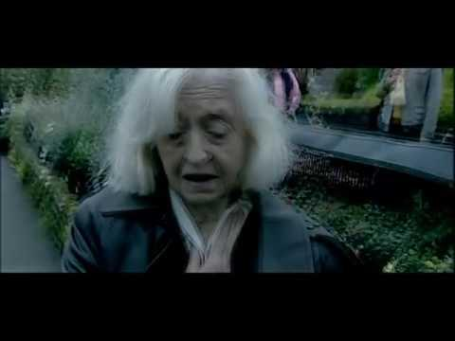

Slide 2
Practical Demo

Slide 3
CPR + AED MANAGING THE UNCONSCIOUS, NON-BREATHING CASUALTY
Notes:
initial heart-rhythm analysis, about 25–50% of SCA victims have ventricular fibrillation (VF), a percentage that has declined over the last 20 years.7–13 Itis likely that many more victims have VF or rapid ventricular tachycardia (VT) at the time of collapse, but by the time the first electrocardiogram (ECG) is recorded by emergency medical service personnel their rhythm has deteriorated to asystole.14,15 When the rhythm is recorded soon after collapse, in particular by an on-site AED,the proportion of victims in VF can be as high as 76%.16,17 More victims of SCA survive if bystanders act immediately while VF is still present. Successful resuscitation is less likely once the rhythm has deteriorated to asystole.

Slide 4
OBJECTIVES
At the end of this course participants should be able to demonstrate:
How to assess the collapsed victim
How to perform chest compression and rescue breathing (CPR)
How to operate an automated external defibrillator safely

Slide 5
BACKGROUND
700,000 individuals a year are affected by sudden cardiac arrest in Europe (one cardiac arrest every 45 seconds)¹
Bystander CPR is a vital intervention before arrival of emergency services
Early resuscitation and prompt defibrillation (within 3-5 minutes) can result in survival rates as high as 50-75%¹
Perkins GD, Handley AJ, Koster RW. European Resuscitation Council Guidelines for Resuscitation 2015 Section 2. Adult basic life support and automated external defibrillation. Resuscitation 2015;91:81-99
Notes:
Every minute of delay to defibrillation reduces the probability of survival to discharge by 10–12%. Bystander CPR is provided, the decline in survival is more gradual and averages 3–4% per minute delay to defibrillation
In most communities, the median time from emergency call to emergency medical service arrival (response interval) is 5–8 min,16,36–38 or 8–11 min to a first shock.13,27

Slide 6
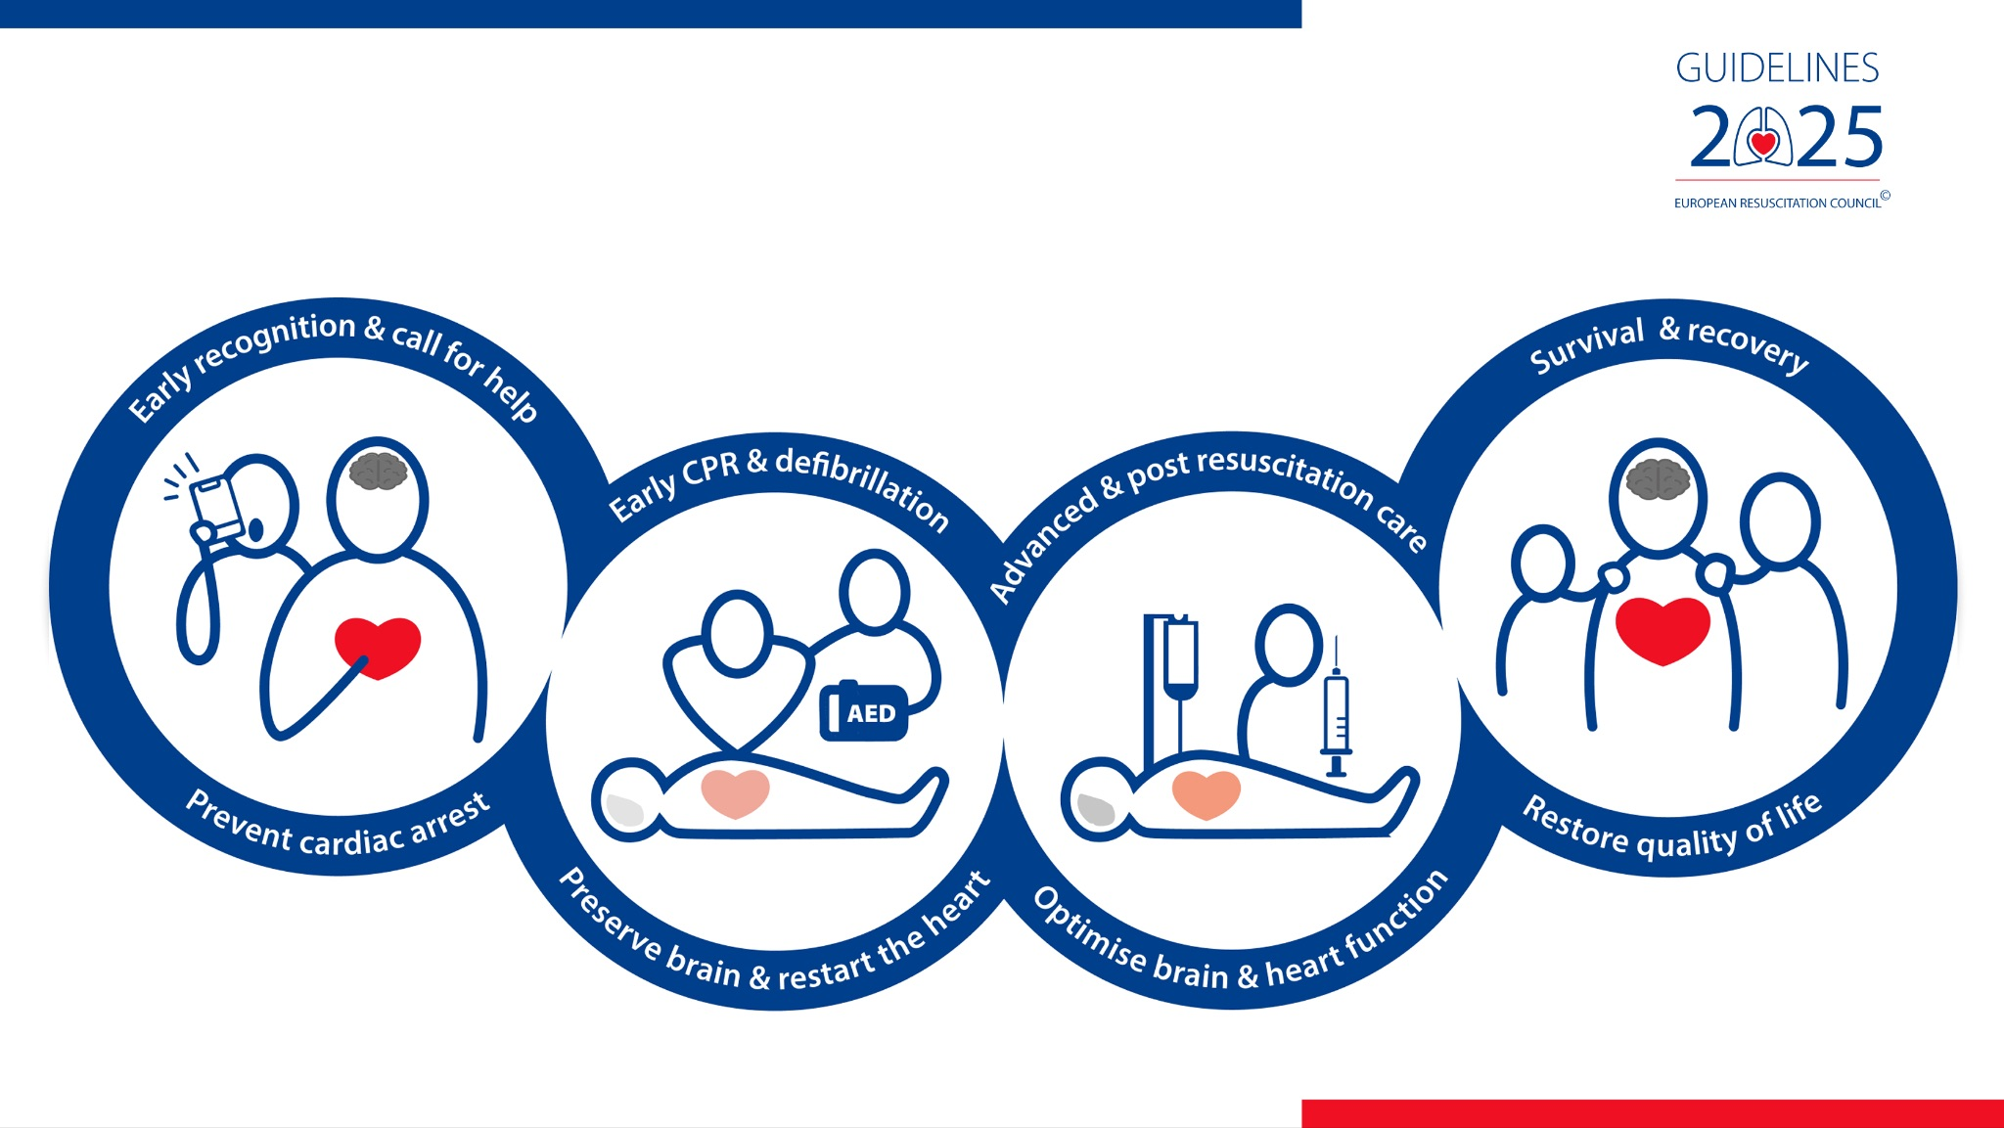
CHAIN OF SURVIVAL

Slide 7
CHECK
CALL
CPR

Slide 8
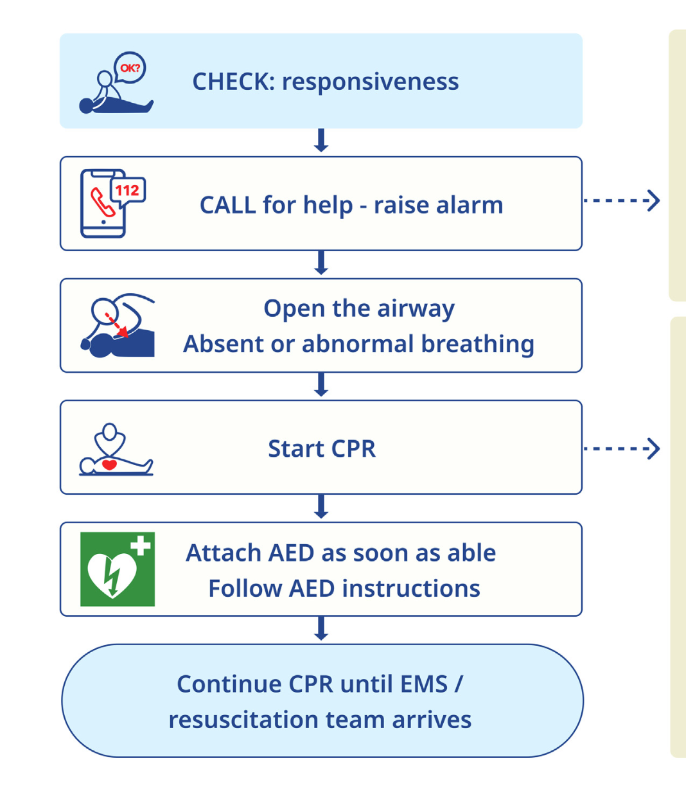

Slide 9
CHECK
SAFE TO APPROACH
IS PERSON CONSCIOUS

Slide 10
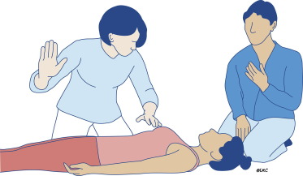
SAFETY

Slide 11
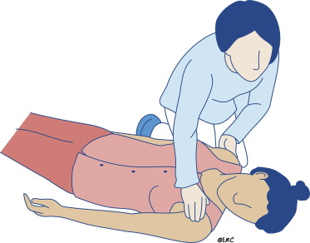
Shake shoulders gently
Ask “Are you alright?”
If he responds, leave him as you found him
Find out what is wrong
Reassess regularly

Slide 12
WHAT DOES CARDIAC ARREST LOOK LIKE?
People in cardiac arrest are often not completely still & unmoving
- Seizures are common soon after the initial collapse
- Agonal (‘heavy, noisy or gasping’) breathing
Notes:
Especially if cardiac arrest has just happened…
Seizures (up to approximately 10% of cardiac arrests): Seizure-like activity is a major sign/symptom of the onset of “sudden” cardiac arrest of presumed cardiac etiology, particularly in patients with shockable initial rhythms. Such activity Is significantly associated with neurologically favorable outcomes.
Agonal breathing suggests at a degree of brain perfusion / early phase of cardiac arrest & is associated with more favourable outcomes

Slide 13
CALL
999
ANYONE NEARBY WHO CAN HELP

Slide 14
CALL
999
ANYONE NEARBY WHO CAN HELP
ASSESS BREATHING

Slide 15
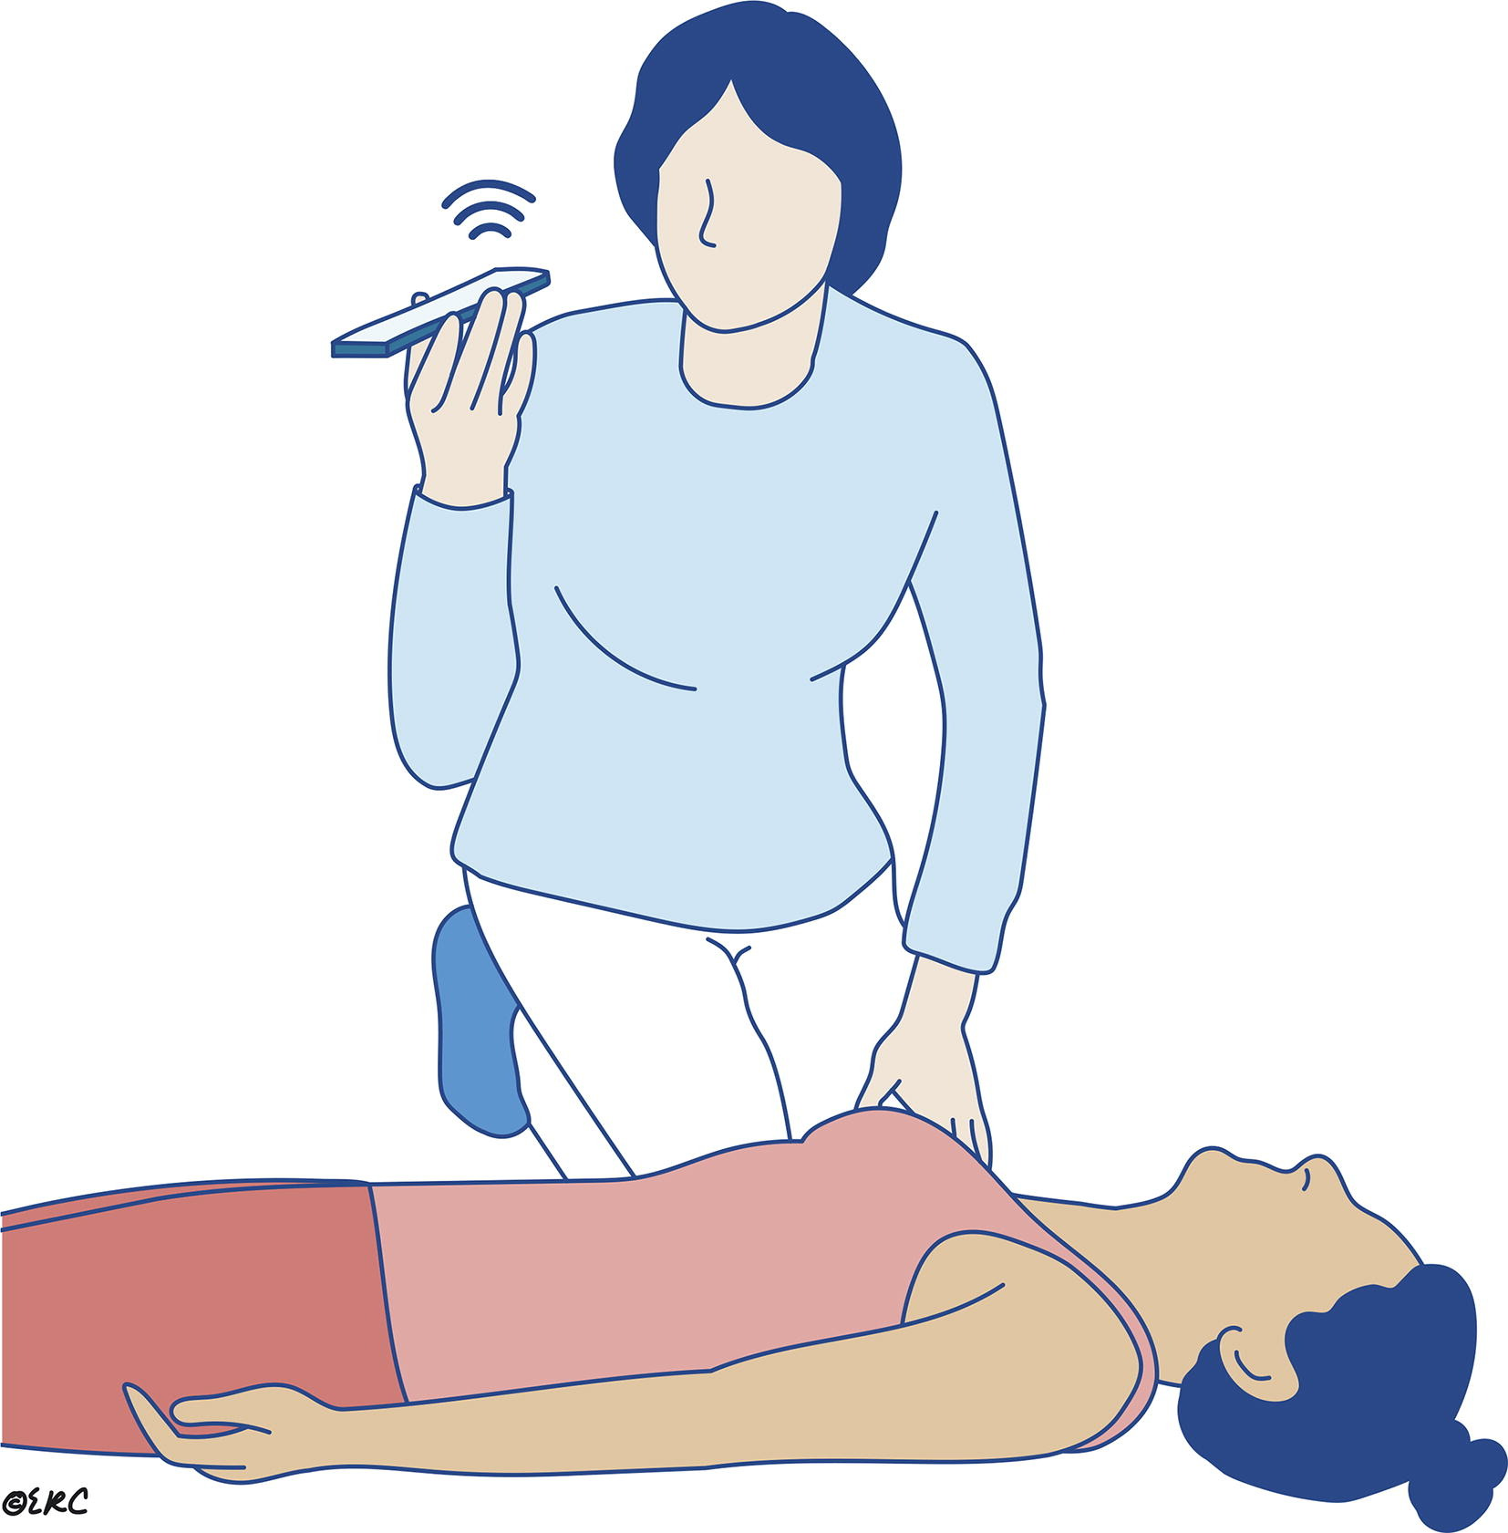

Slide 16
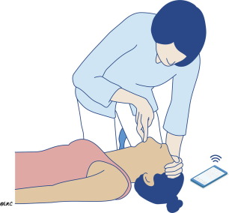
OPEN THE AIRWAY
Notes:
If there is no response, position them on their back & open the airway using this method whilst waiting for 999 call to be answered

Slide 17
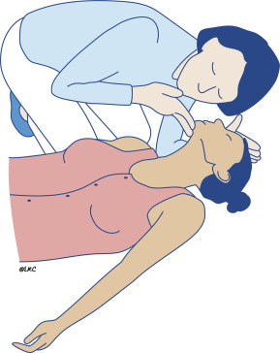
ASSESS BREATHING
Look
Listen
Feel
For no more than 10 seconds
Is there absent or abnormal breathing?

Slide 18
Any person who is unresponsive with abnormal breathing
Absent breathing
Abnormal pattern of breathing
If there is any doubt, assume cardiac arrest
If you are uncertain, the 999 call taker will help you

Slide 19
AGONAL BREATHING
Occurs shortly after loss of brain perfusion in up to 40% of cardiac arrests.
Heavy, noisy or gasping breathing: abnormal
Commence CPR
Agonal breathing can continue for a prolonged period with effective CPR
Notes:
Agonal breaths are slow and deep breaths,
frequently with a characteristic snoring sound.
They originate from the brain stem, the part of the brain that remains functioning for some minutes even when deprived of oxygen.
The presence of agonal breathing can be erroneously interpreted as evidence that there is a circulation and CPR is not needed.
Agonal breathing may be present in up to 40% of victims in the first minutes after cardiac arrest, and if responded to as a sign of cardiac arrest, is associated with higher survival rates.48 The significance of agonal breathing should be emphasised during basic life support training.49,50
SEIZURE LIKE ACTIVITY also.

Slide 20


Slide 21
CPR
START IMMEDIATELY
USE AN AED

Slide 22
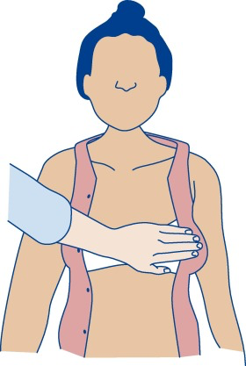
START CHEST COMPRESSIONS
Hands in the centre of the chest

Slide 23
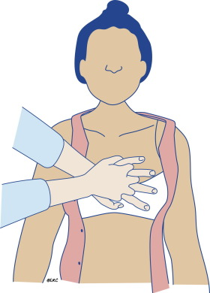
START CHEST COMPRESSIONS
Hands in the centre of the chest

Slide 24
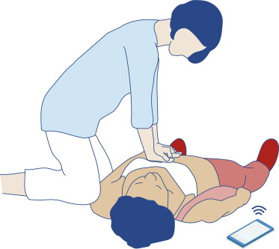
START CHEST COMPRESSIONS
Arms straight
Vertical above the victim

Slide 25
START CHEST COMPRESSIONS

Slide 26
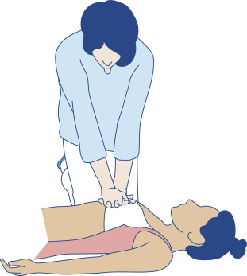
START CHEST COMPRESSIONS
Compress the chest
Rate 100-120 min⁻¹
Depth 5-6cm
Equal compression and relaxation
30 chest compressions

Slide 27
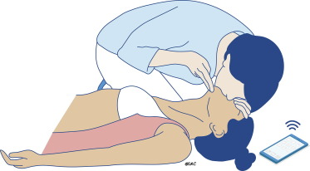
RESCUE BREATHS
2 rescue breaths
1 second each
Make the chest rise

Slide 28
30
:
2

Slide 29
RESCUER INABILITY TO PERFORM RESUSCITATION
Lack of knowledge
Cognitive overload
Physical
Too small for adequate chest compressions (eg child rescuer)
Unable to get into position for effective resuscitation
Physical problem preventing basic life support delivery

Slide 30
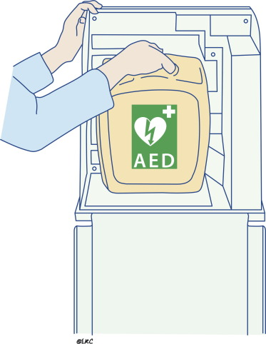
AUTOMATED EXTERNAL DEFIBRILLATOR
Use AED as soon as it arrives
Notes:
After defibrillation, if the heart is still viable, its pacemaker activity resumes and produces an organised rhythm followed by mechanical contraction.
Community AEDs are They are accurate and will deliver a shock only when VF (or rapid VT) is present.41,42
This week we’re focusing on early on defibrillation - which aims to shock the heart back into a normal sinus rhythm.

Slide 31
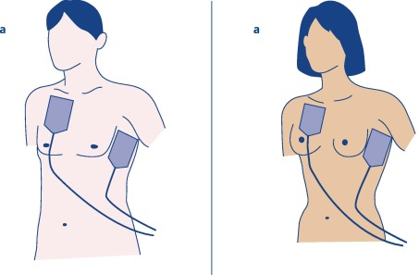
ATTACH AED PADS
Attach the pads to the person’s bare chest
Move (or cut / unfasten) a bra if needed for correct position
Prioritise life saving interventions over concerns for modesty

Slide 32
ATTACH AED PADS
Attach the pads to the person’s bare chest
Move (or cut / unfasten) a bra if needed for correct position
Prioritise life saving interventions over concerns for modesty

Slide 33
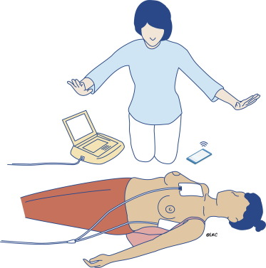
FOLLOW THE INSTRUCTIONS OF THE AED
Spoken & visual directions

Slide 34
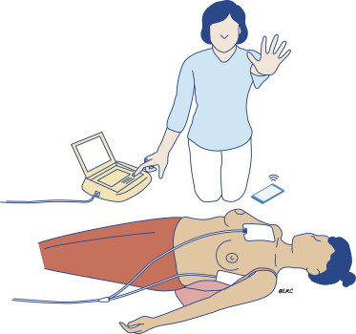
FOLLOW THE INSTRUCTIONS OF THE AED
If shock is advised
Make sure you and no-one else is touching the victim
Puch shock button
Resume CPR immediately

Slide 35
FOLLOW THE INSTRUCTIONS OF THE AED
If no shock is advised
Resume CPR immediately

Slide 37
ANY QUESTIONS?

Slide 38
In summary...
Early resuscitation and prompt defibrillation saves lives
Chest compressions and rescue breaths should be cycled in a ratio of 30:2 until further help or an AED arrives
CHECK
CALL
CPR

