Slide 1
LEARNING
Notes:
initial heart-rhythm analysis, about 25–50% of SCA victims have ventricular fibrillation (VF), a percentage that has declined over the last 20 years.7–13 Itis likely that many more victims have VF or rapid ventricular tachycardia (VT) at the time of collapse, but by the time the first electrocardiogram (ECG) is recorded by emergency medical service personnel their rhythm has deteriorated to asystole.14,15 When the rhythm is recorded soon after collapse, in particular by an on-site AED,the proportion of victims in VF can be as high as 76%.16,17 More victims of SCA survive if bystanders act immediately while VF is still present. Successful resuscitation is less likely once the rhythm has deteriorated to asystole.

Slide 2
OBJECTIVES
How do people learn?
How can you help people learn?
Prepare - Open - Facilitate - Close
Teach it - Facilitate it - Assess it
Learning conversations

Slide 3
LEARNING STYLES
Models describing range of types of learners
Teaching to a learner’s style does not improve outcome
You can be an effective teacher to most people using similar techniques
Think about yesterday
What teaching techniques did you learn that you managed to implement well?
What was difficult?

Slide 4
BEING EFFECTIVE
Notes:
Remind them of the structure of a lecture, to which they will have been introduced in the Teaching Adults session.

Slide 5
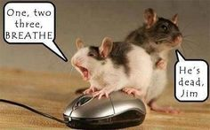
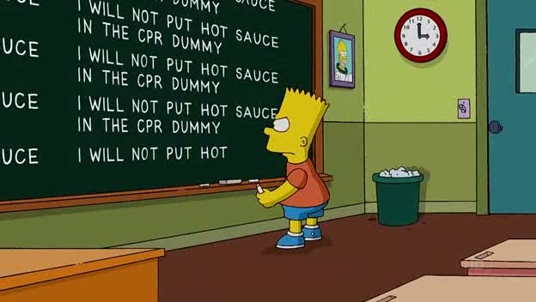
Notes:
Used carefully and sensitively, humour can enhance a lecture a great deal. Be aware that cultural differences, even within a continent such as Europe, can mean that what is funny to one person, is not to another or, even worse, is offensive. Cartoons without words are probably the best.

Slide 6
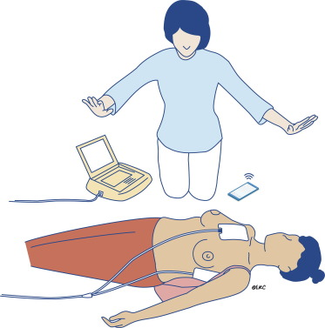
Defibrillation
Notes:
A picture relevant to the talk helps to focus attention but needs to be correct
what is wrong with this picture?
Answer = we won’t use / teach manual paddles on this course

Slide 7
PREPARE - OPEN - FACILITATE - CLOSE
Notes:
Remind them of the structure of a lecture, to which they will have been introduced in the Teaching Adults session.
Prepare: Set out the room. Tell them what you are going to teach them
Open: Tell them about it (‘teach it’)
Facilitate: enable ongoing teaching with practice and teacher/candidate demonstrations
Closure: Tell them what you have told them

Slide 8
LEARNING CONVERSATION
Notes:
Remind them of the structure of a lecture, to which they will have been introduced in the Teaching Adults session.
The opening gambit
Exploring issues
Group contributions
Sharing your thoughts
Final comments
Summary

Slide 9
ANY QUESTIONS?

Slide 10
SUMMARY
You can teach many people effectively
Joining their experiences with your teaching is important
Facilitating a group is an active experience
Structure is transferable
Notes:
Summarise...

