Slide 1

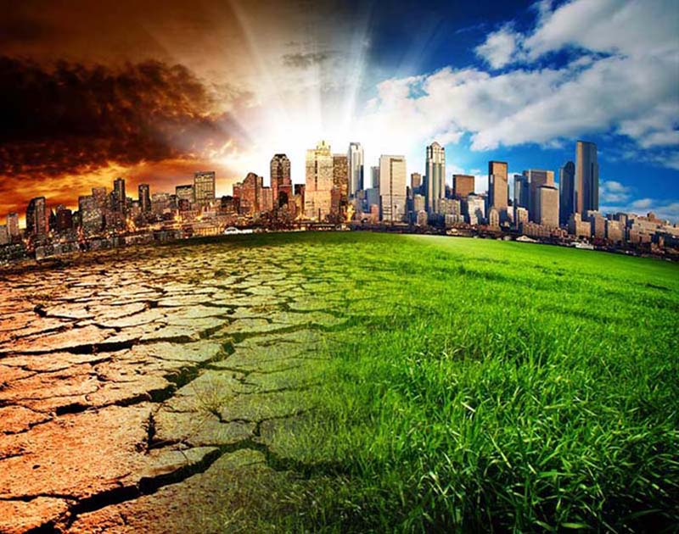
Environmental Pollution
R.M.Dewmini
322512689

Slide 2
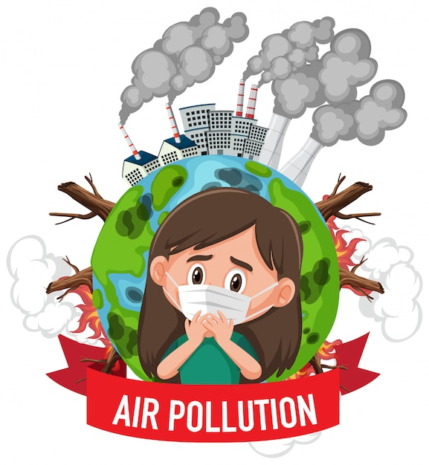
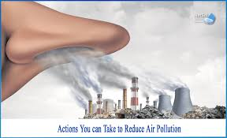
Air Pollution
What is Air Pollution ?
Air pollution refers to the presence of harmful substances in the air, released from various sources, which can negatively impact human health and the environment.

Slide 3
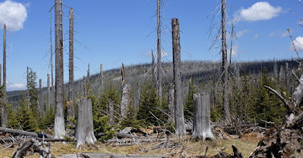
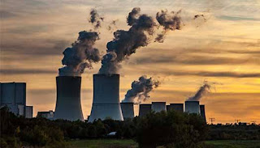
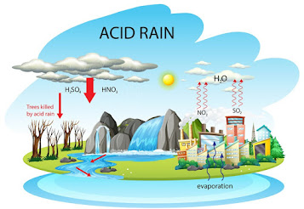
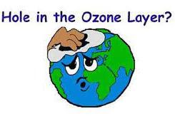
Types Of Air Pollution
There are several types of air pollution, mainly Indoor Air Pollution and Outdoor Air Pollution. These include smog, acid rain, the green house effect and hole in ozone layer.
One type of air pollution is the release of particles into the air.
Another type of air pollution is the release of poisonous gases.

Slide 4
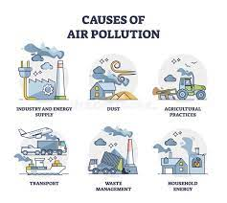
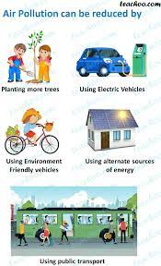
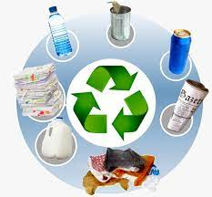
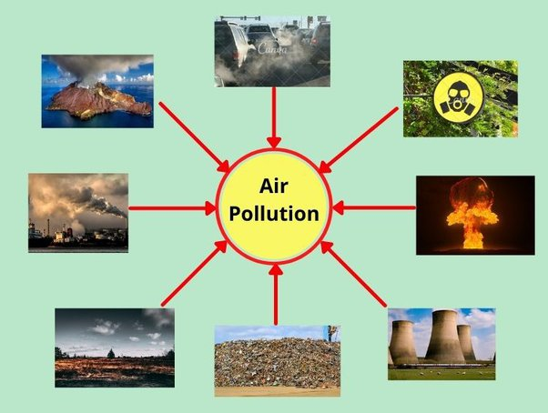
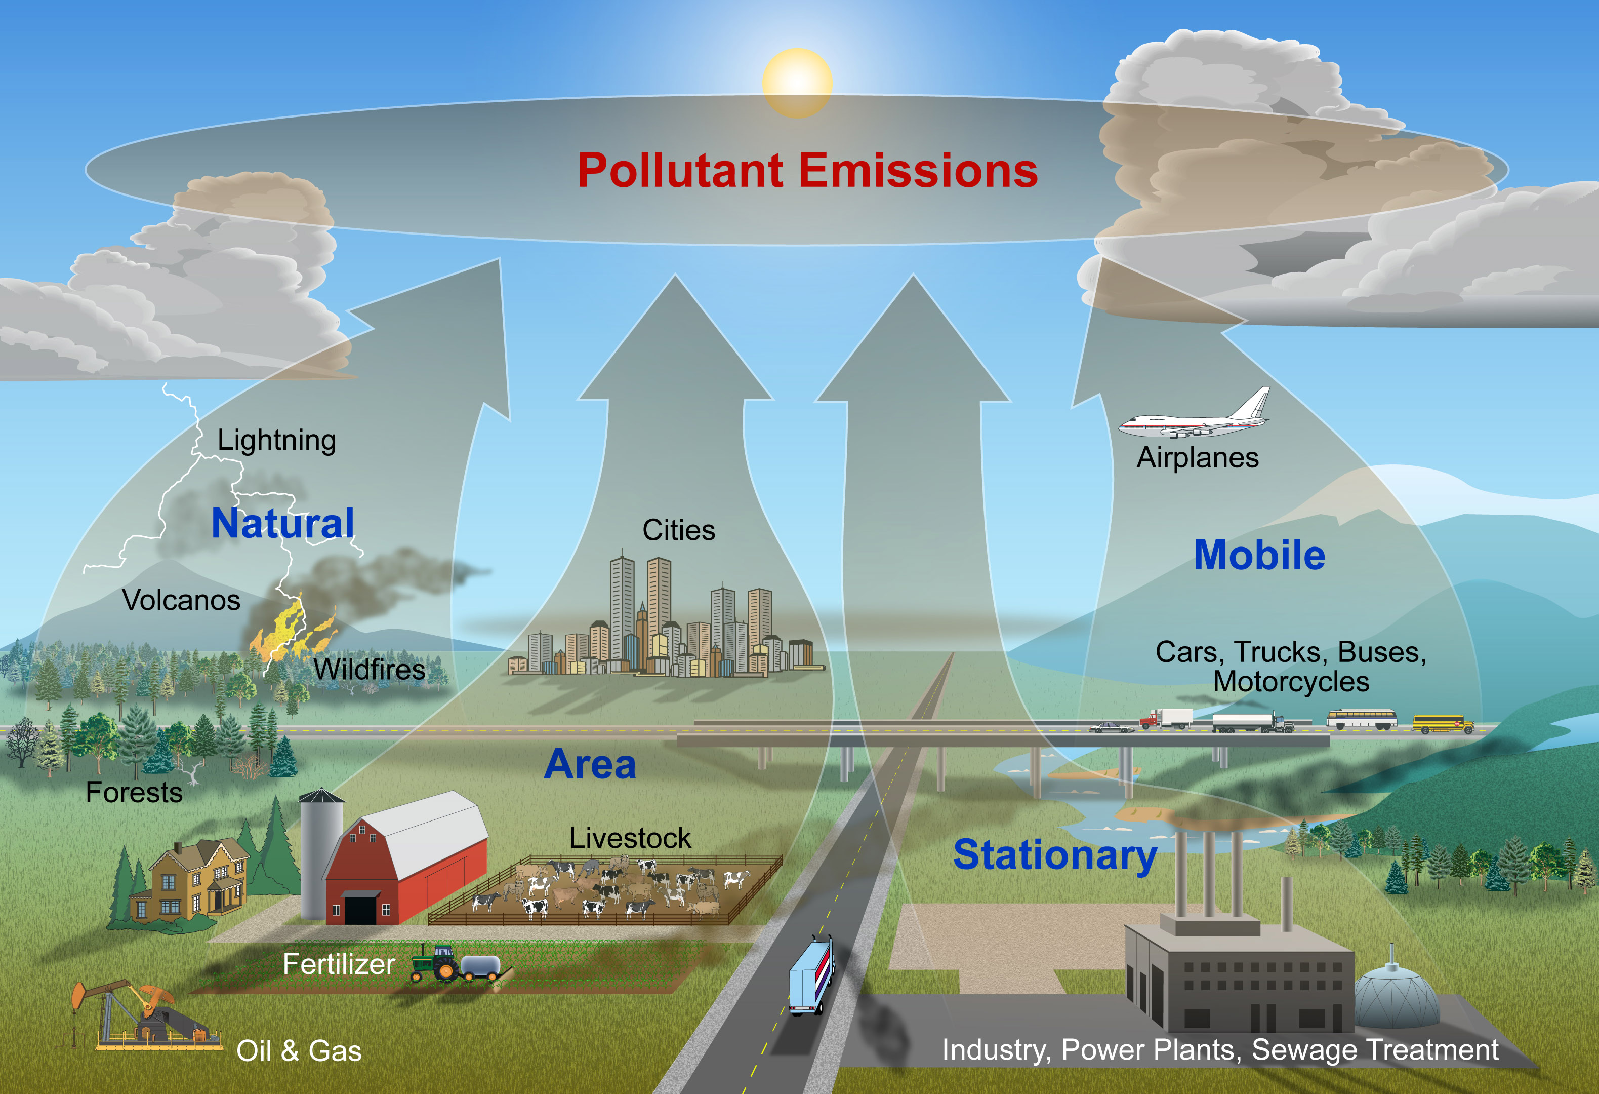
Causes Of Air Pollution
Preventions
Dust raised on the ground during dust storms.
Stone dust raised by crushing of stones in quarries.
Smoke emitted by vehicles.
Smoke from forest fires.
Smoke raised by burning of coal in powerhouses.
Burning of wood, cow dung cakes, garbage etc.
Vehicle care
Public transport
Alternative energy sources
Saving energy
Minimize Air Pollution
Recyclable materials

Slide 5
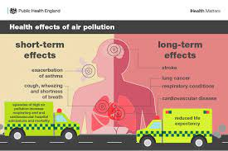
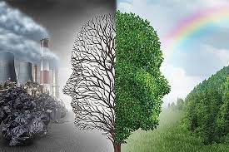

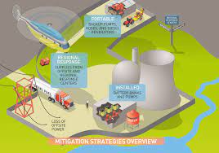
The take-home message regarding air pollution:
Environmental effects:
Air pollution contributes to climate change, smog formation, acid rain, and the degradation of ecosystems. Taking measures to reduce pollution helps preserve biodiversity and maintain the balance of our natural environment.
Health impacts:
Air pollution can lead to respiratory problems, cardiovascular diseases, allergies, and other serious health issues. By reducing air pollution, we can protect and improve public health.
Awareness and education:
Raising awareness about the causes and consequences of air pollution is essential. Educating communities and fostering a sense of responsibility can encourage individuals to make conscious choices that contribute to cleaner air.
Mitigation strategies:
Implementing cleaner
technologies, transitioning to renewable energy sources, promoting energy efficiency, improving public transportation, and adopting eco-friendly practices are crucial steps in mitigating air pollution.

Slide 6
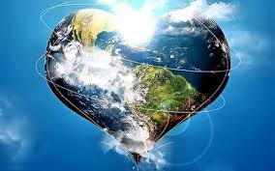

Together, let's strive for cleaner air and a better world.
THANK YOU !

