Slide 1

Kaggle challenge: Real estate prices prediction
Jorren
Roel
Foivos

Slide 2

Our method
Feature Selection
Most important and obvious features for a baseline model
# of bedrooms & bathrooms, latitude, longtitude
Model
Best score: Scikit learn linear regression model
Effort with Random forest regression did not help to improve results

Slide 3



Visualization

Slide 4
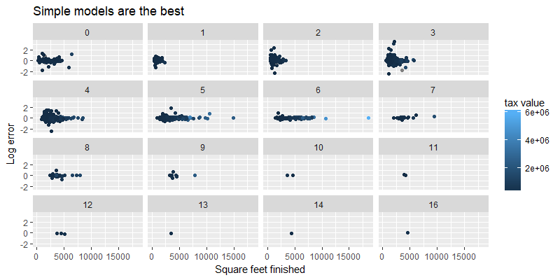
Visualization

