Slide 1
Arduino-PWM

Slide 2
Analog and Digital
All Arduino signals are either Analog or Digital
All computers including Arduino, only understand Digital
It is important to understand the difference between Analog and Digital signals for producing a PWM signal.

Slide 3
Remember?

Slide 4
Output
“Output in pwm is always Digital”
To Output a Digital signal (On or Off) use this code:
digitalWrite ( pinNumber , value );
Where value is HIGH or LOW
To output a signal that pretends to be Analog use this code:
analogWrite ( pinNumber, value );
Where value is a number 0 - 255

Slide 5
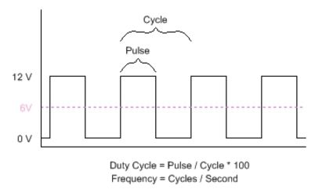

Duty cycle
Pulse Width Modulation, or PWM, is a technique for getting analog results with digital means.
It is commonly used to control the power fed to an electrical device, like, motors, LEDs, speakers etc.

Slide 6
.
1. Using a Digital signal that pretends to be an Analog signal is called Pulse Width Modulation
2. Use Pulse Width Modulation, or P.W.M., for anything that requires a signal between HIGH and LOW
3. P.W.M. is available on Arduino pins # 3, 5, 6, 9, 10, and 11
4. Arduino's PWM frequency is about 490Hz for pins #3,9,10,11 and about 980Hz for pins #5, 6.

Slide 7
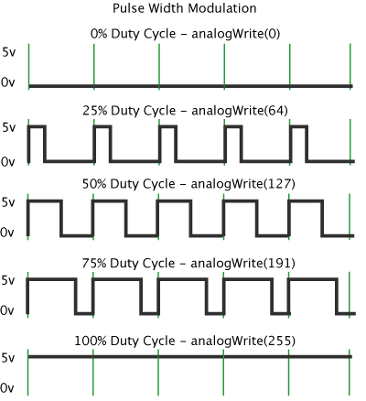
analogWrite():
analogWrite() is on a scale of 0 - 255,
1.analogWrite(3,255) requests a 100% duty cycle (always on) on pin 3,
2. analogWrite(3,127) is a 50% duty cycle (on half the time) on pin 3

Slide 8
Let’s do a task!!
Vary the brightness of LED corresponding to value (0 to 255) in any PWM pin.

Slide 9
Solution
int i;
void setup() {
// put your setup code here, to run once:
pinMode(5,OUTPUT);
}
void loop() {
// put your main code here, to run repeatedly:
for(i=0;i<=255;i++){
analogWrite(5,i); //Gradually increase the voltage supplied to LED
delay(10);
}
}

Slide 10
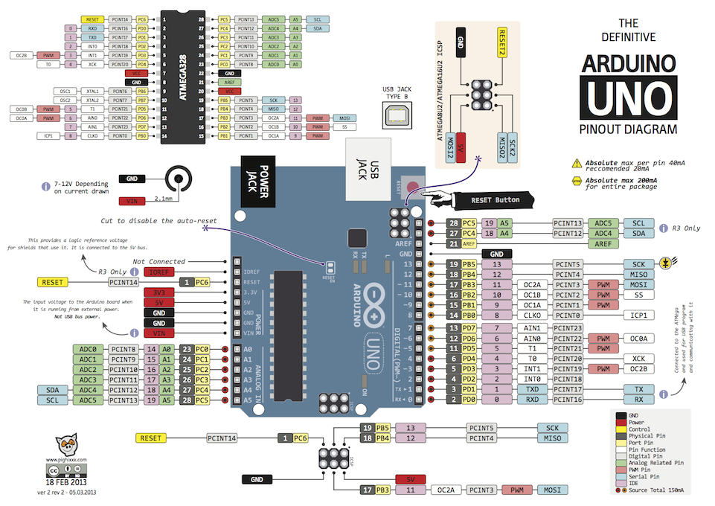
PWM PINS
Timer 0 – Pin 5, 6
Timer 1 – Pin 9, 10
Timer 2 – Pin 3, 11
This Photo by Unknown Author is licensed under CC BY-SA

Slide 11
NOTE:
Generally changing the counter overflow frequency of Timer0 & Timer2 can cause some of the inbuilt Arduino timer related functions not to work.
So it is recommended that we vary PWM period/frequency using Timer1 PWM pins (pin 9 & 10) and “TimerOne.h” library serves that purpose.

Slide 12
Timer1.pwm(pin, duty)
Generates a PWM waveform on the specified pin.
Output pins for Timer1 are pin 9 & 10, so you have to choose between these two, anything else is ignored.
The duty cycle is specified as a 10 bit value , so anything between 0 and 1023. (Remember, in analogWrite() we specified an 8 bit value which was from 0 to 255)
Note that you can change period/frequency with Timer1.setPeriod(period) function with as Time period’s value in microseconds as parameter .

Slide 13
Timer1.setPwmDuty(pin, duty)
A fast shortcut for setting the pwm duty for a given pin if you have already set it up by calling pwm() earlier.
Once you have already initialized PWM for a pin using Timer1.pwm() function and just want to change the duty cycle use this function.
Timer1.disablePwm(pin)
Turns PWM off for the specified pin so you can use that pin for something else.

Slide 14
NOTE:
analogWrite() will no longer work with Timer1 PWM pins (pin 9 & 10) if “TimerOne.h“ library functions are used, instead you have to use Timer1.pwm()
using this library we can simultaneously run 2 PWMs in pin 9 & 10 with same/different duty cycles & a timer interrupt function also, but all 3 of them can run with the same time period/frequency only (the period value is common for them).

Slide 15
Example:
Connect a LED to pin 9 & glow it at 1/4th brightness and 3/4th brightness after 1 second using Timer1 PWM , repeat this process.
#include<TimerOne.h>
void setup()
{
pinMode(9, OUTPUT);
Timer1.initialize(1000); // initialize Timer1, and set 1000 micro seconds as period
Timer1.pwm(9, 255); // initialize pwm on pin 9, 25% duty cycle (since max value is 1023)
}
void loop()
{Timer1.setPwmDuty(9, 767); //since initialization is already done, use this function to change dutycycle
delay(1000);
Timer1.setPwmDuty(9,255); //set dutycycle of PWM in pin 9, back to 25%
delay(1000);}

Slide 16
Let’s do a Task!!
Make an LED blink with the frequency sent through the serial monitor using Timer1 PWM.

Slide 17
Solution
#include <TimerOne.h>
float f,t;
void setup() {
pinMode(9,OUTPUT);
Timer1.initialize(1000000); //Initialize Timer1 and set period as 1 second
Timer1.pwm(9,511); //Initialize PWM in pin 9, set 50% dutyCycle
Serial.begin(9600); //Initialize Serial Communication
Serial.print("Enter frequency:");
}
void loop() {
if(Serial.available()>0) //Serial.available() returns the no. of characters received via Serial & stored in buffer memory & not yet read via any Serial function
{ delay(100);
f=Serial.parseFloat(); //Reads the characters received from Serial & returns the float values they repreresent to variable f
Serial.println(f);
t=1/f; //Convert received values of frequency from Hz to Time Period in seconds (and seconds is converted to microseconds in next line)
Timer1.setPeriod(t*1000000); //Since Timer1 is already initialized and just the period needs to be changed use this function
Timer1.setPwmDuty(9,511); //Whenever Time Period is changed using setPeriod() or initialize(), duty cycle of a PWM pin needs to be set again
Serial.print("Enter frequency:");
}}

