Slide 1
Servo Motors
Servos have integrated gears and a shaft that can be precisely controlled.
Standard servos allow the shaft to be positioned at various angles, usually between 0 and 180 degrees.
Standard library for servo functions is <Servo.h>

Slide 2
Servo Variable
Use the statement:
Servo servo_var
This statement creates a variable servo_var of type Servo that is used to control that servo.

Slide 3
attach()
Attaching a Servo variable to a pin.
Syntax
servo_var.attach(pin)
Parameters
servo_var: a variable of type Servo
pin: the number of the pin that the servo is attached to

Slide 4
write()
Writes a value to the servo, controlling the shaft accordingly.
On a standard servo, this will set the angle of the shaft (in degrees), moving the shaft to that orientation.
Syntax
servo_var.write(angle)
Parameters
servo_var: a variable of type Servo
angle: the value to write to the servo, from 0 to 180

Slide 5
read()
Description
Read the current angle of the servo (the value that you passed to the last call to write()).
Syntax
servo_var.read()
Parameters
servo_var: a variable of type Servo
Returns
The angle of the servo, from 0 to 180 degrees.

Slide 6
Note:
If "Servo.attach()" function is executed, then "analogWrite()" & "TimerOne.h functions" won't work with Timer1 pins (i.e. pin 9 & 10) anymore.
This is because the "Servo.h" library uses Timer1 as base to generate signal pulses for servos.
"Servo.h" works with any pin (digital/analog) configured as output irrespective of weather it has PWM feature or not.

Slide 7
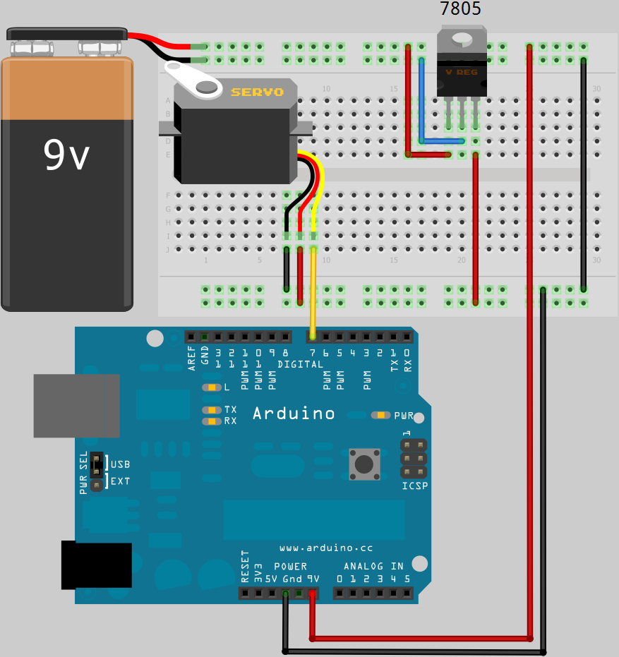
circuitdiagram
This Photo by Unknown Author is licensed under CC BY-SA

Slide 8
Example vary the angle of servo
#include <Servo.h> int pos = 0; // variable to store the servo position int servoPin= 9; int servoDelay=25; Servo myPointer; //Creates an object myPointer which can control a Servo void setup() { Serial.begin(9600); //Initialize Serial Communication in Arduino myPointer.attach(servoPin); //Initializes and attaches Servo object “mypointer” to the pin where input of Servo is connected } void loop() { for (pos=15; pos<=170; pos=pos+1) { myPointer.write(pos); //Sets the new angle to which the Servo must turm to delay(servoDelay); //A small delay, so that you can physically see the gradual change in angle of Servo Shaft } for (pos=170; pos>=15; pos=pos-1) { myPointer.write(pos); delay(servoDelay); } }

Slide 9
map()
Re-maps a number from one range to another. That is a value within fromLow and fromHigh gets mapped propotionally within toLow and toHigh
Does not constrain values to within the range, because even the out-of-range values which are propotinal are sometimes intended and useful.
Syntax:
map(value, fromLow, fromHigh, toLow, toHigh)

Slide 10
Parameters:
value: the number to map
fromLow: the lower bound of the value’s current range
fromHigh: the upper bound of the value’s current range
toLow: the lower bound of the value’s target range
toHigh: the upper bound of the value’s target range
the "lower bounds" of either range may be larger or smaller than the "upper bounds"
so the map() function may be used to reverse a range of numbers, for example
y = map(x, 1, 50, 50, 1);
The function also handles negative numbers well, so that for example
y = map(x, 1, 50, 50, -100);

Slide 11
Let’s do a task :)
Get an integer value of 0 to 180 from the user via Serial monitor & instantly rotate the servo shaft to that angle (in degrees). And loop this process .

Slide 12
Solution
#include<Servo.h>
Servo myservo;
unsigned int angle;
void setup() {
myservo.attach(8);
Serial.begin(9600);
}
void loop() {
Serial.print("Enter angle:");
while(Serial.available()==0){
} /* Exits loop only if a Serial data is received */
delay(100);
angle=Serial.parseInt(); /*Capture integer entered by user and store it in variable “angle” */
Serial.println(angle);
angle=map(angle,0,180,0,151); /* We map the value since the particular Servo we use is a 210° & not an ideal 180° Servo. We experimentally found that it turns to 180° for a myservo.write() parameter value of 151 itself */
myservo.write(angle);
}

