Slide 1
ANALOG TO DIGITAL CONVERTER (ADC)

Slide 2
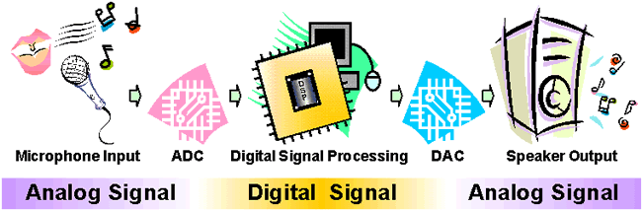
WHY SHOULD I LEARN ADC ??
What it does ?
It is a device which converts analog input to digital output
Everything that is present in the physical world is analog and continuous such as the temperature around us, light, humidity, velocity ,sound.
But the digital world comprising the microcontrollers and processors need binary data to process a given information.
What we get is analog but we need digital data to process it. Now, this is why we need an Analog-to-Digital Converter.

Slide 3

APPLICATIONS
Analog –to- digital Converters are among the most widely used devices used for data acquisition.
Proximity sensor.
Digital thermometers.
Microphone.

Slide 4
Characteristics of an ADC
Range
The smallest to largest value an instrument can measure
Eg – 0-5 V range voltmeter, 1.0 to 2.0 mA range ammeter
Resolution
The resolution of the converter indicates the number of discrete values it can produce over the range of analog values.
Higher the resolution , higher the precision.
If range is 0-5 V and has a resolution of 20 steps then it can detect changes greater than (5-0)/20=0.25V (this smallest difference is also called step size)

Slide 5
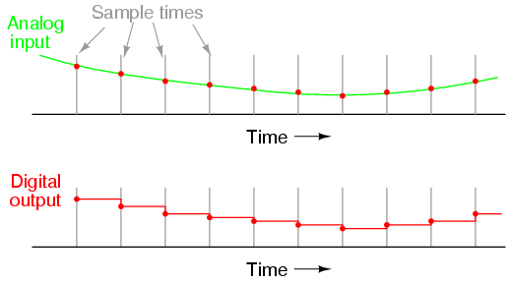
Resolution graph

Slide 6
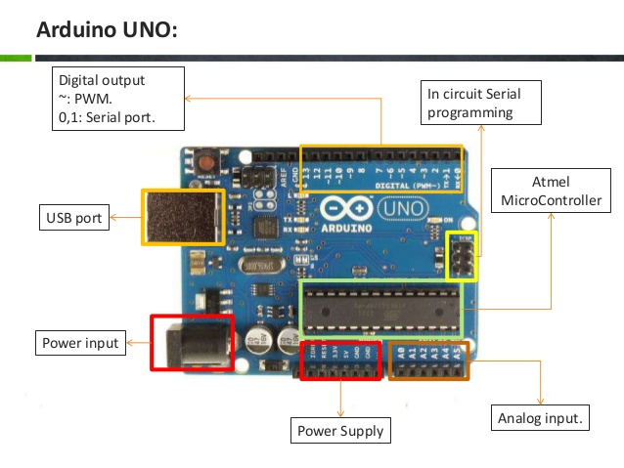
Reference Value
The reference voltage (V_{ref}) is the maximum value that the ADC can convert.
If AV_{ref} is unconnected, Arduino by default takes V_{ref} as 5v

Slide 7
TYPES OF ADC
SUCCESSIVE APPROXIMATION(used by Arduino)
COUNTER TYPE
INTEGRATING OR DUAL SLOPE
PARALLEL OR FLASH

Slide 8
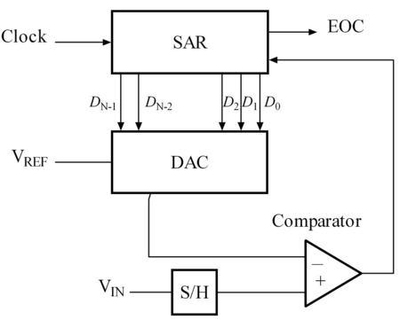
Successive Approximation ADC

Slide 9
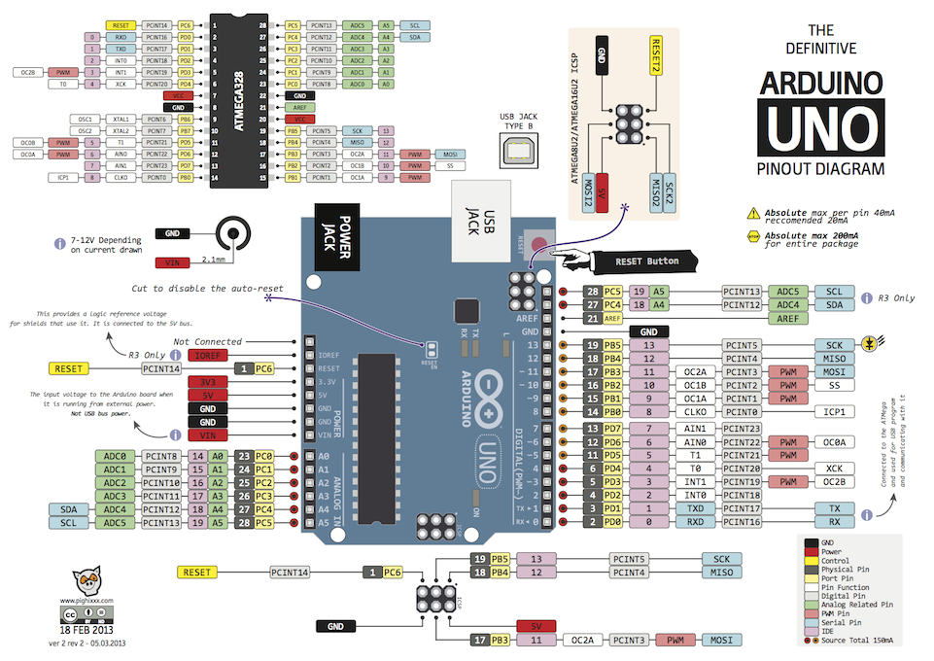
This Photo by Unknown Author is licensed under CC BY-SA

Slide 10
analogRead(pin)
To read the analog values
To read an analog Input to your Arduino use Analog Pins A0 - A5.
analogRead(pin) returns an integer value from 0 to 1023 .
The analog voltage can be calculated by ,
V= V_{ref} *(x /1023) , where x is the value returned by the function
SYNTAX:
analogRead ( pinNumber );

Slide 11
Hardware Connection
AVCC provides the power supply for the analog ADC circuitry. To get a better accuracy of AVR ADC we must provide a stable voltage source to the AVCC pin. This is done by connecting a capacitor (10 -20 pF) between AVCC and GND.
By connecting a capacitor (10 -20 pF) between AVREF and GND we can make the V_{ref} voltage more stable and increase the accuracy of the ADC.

Slide 12
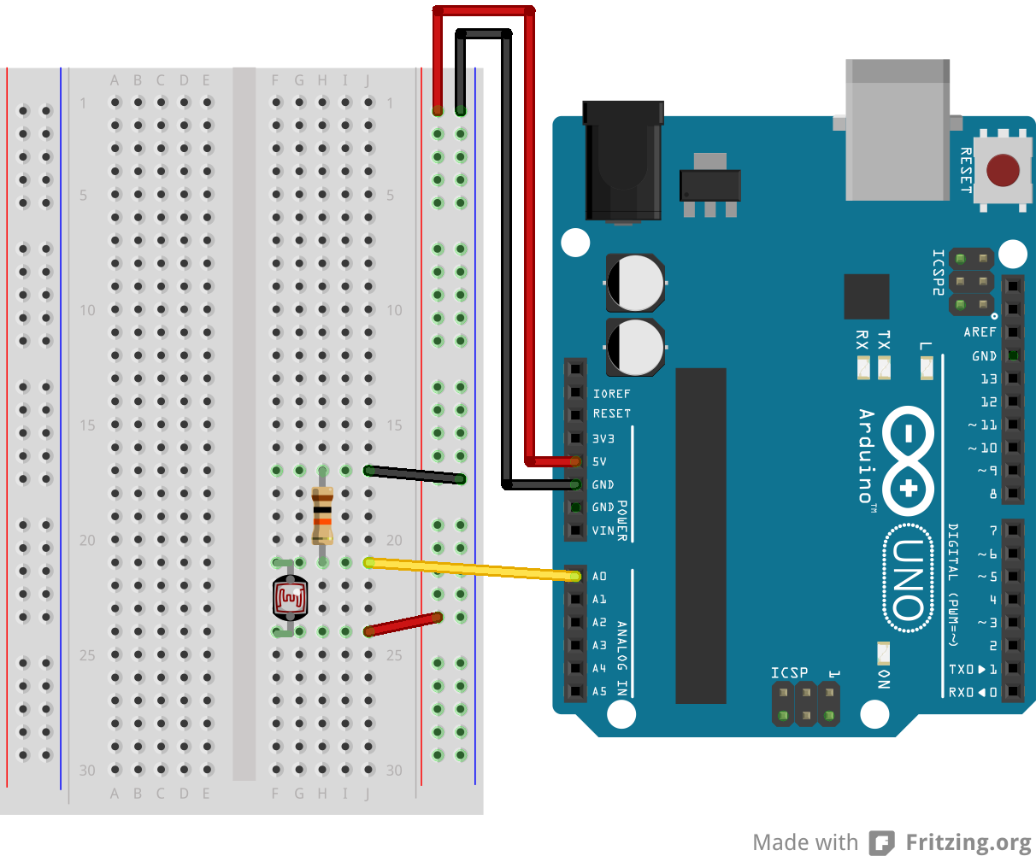
Example
Measure the Change in Voltage across an LDR using ADC, and print it in Serial monitor:
int analogvalue;
void setup() {
// put your setup code here, to run once:
pinMode(A0,INPUT);
Serial.begin(9600);
}
void loop() {
// put your main code here, to run repeatedly:
analogvalue=analogRead(A0);
Serial.println(analogvalue);
delay(500);
}

Slide 13
Task
Vary a led intensity according to variation of light falling on ldr

Slide 14
Solution
int a;
void setup() {
// put your setup code here, to run once:
pinMode(A3,INPUT);
pinMode(9,OUTPUT);
}
void loop() {
// put your main code here, to run repeatedly:
a=analogRead(A3);
a=a/4; //Scaling 0 to 1023 value to 0 to 255
analogWrite(9,a);
}

