Slide 1


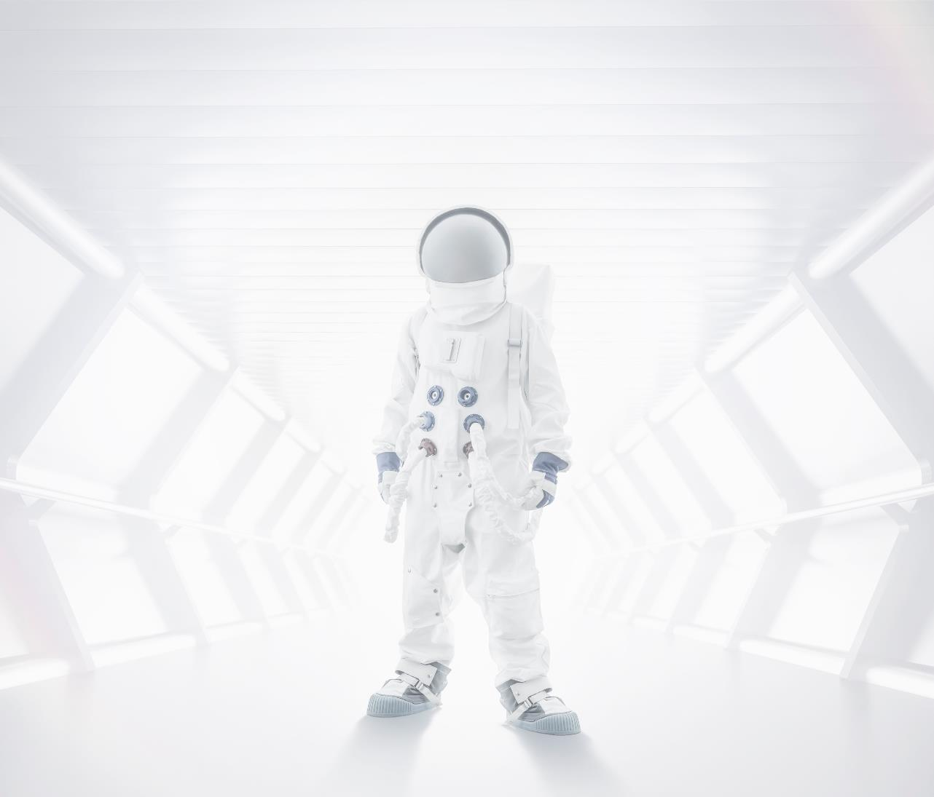
Introduction to OpenCV

Slide 2
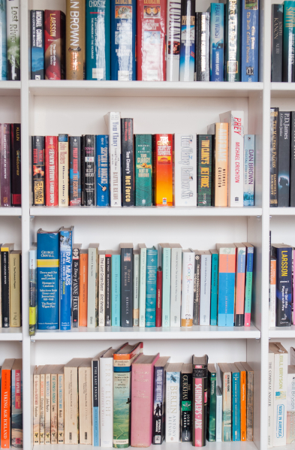
What Is OpenCV ?
OpenCV (Open Source Computer Vision) is a library of programming functions mainly aimed at real-time computer vision.
It helps in image processing which can be used in different fields like deep learning face detection etc.
One example of OpenCV can be effects produced by your phone camera.
I

Slide 3
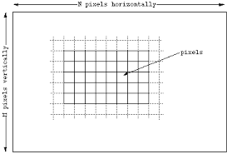
What is an Image
Images are made of picture elements called pixels. Typically, pixels are organized in an ordered rectangular array. The size of an image is determined by the dimensions of this pixel array.
Thus the pixel array is a matrix of M columns x N rows.
To refer to a specific pixel within the image matrix,
we define its coordinate at x and y.
The coordinate system of image matrices
defines x as increasing from left
to right and y as increasing from top to bottom.
Compared to normal mathematic
convention, the origin is in the top left corner
and the y coordinate is flipped.

Slide 4
MxN, only provides a rectangular shape for our image. One more parameter,
intensity, is needed to truly define an image. Each pixel has its own intensity
value, or brightness.
An 8-bit intensity range has 256 possible values, 0 to 255. For an 8-bit image, 2⁸ = 256 possible values. The standard digital photo uses an 8-bit range of values; RGB images use 8-bit intensity ranges for each color and B&W images have a single 8-bit intensity range. Since RGB images contain 3 x 8-bit intensities they are also referred to as 24-bit color images.
Here 8 bit refers to the depth of the image.
No of the colors of the image is known as it channel . For e.g. colored image i.e. RGB has 3 channels whereas grayscale image has only 1 channel

Slide 5

So now a days you see TVs saying FHD , FHD+ and UHD , 4k etc. so what's the difference

Slide 6
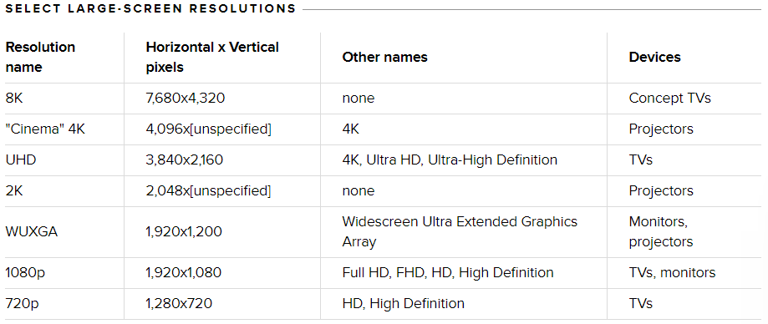
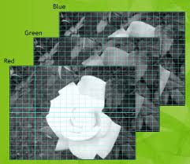
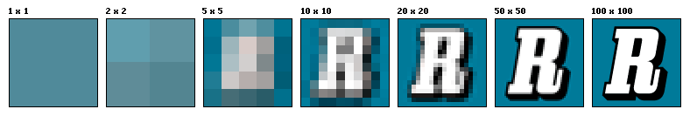
Well it’s the pixels basically more the number of pixels sharper is the image and better is the clarity.
RGB Image split into its channels
Well see this picture will make you clear the role pixel plays in images

Slide 7
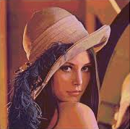

Basics of Image
Types of images :-
Grayscale image :- pixel value varies from 0 to 255,
here depth = 8
number of channels = 1
Grayscale conversion

Slide 8

Did you Lenna image is the most famous image for starting image processing …..
Basically there are 2 reasons
First, the Lenna image contains a nice mixture of detail, flat regions, shading, and texture that do a good job of testing various image processing algorithms. It is a good test image!
Second, the Lena image is a picture of an attractive woman. It is not surprising that the (mostly male) image processing research community gravitated toward an image that they found attractive.

Slide 9
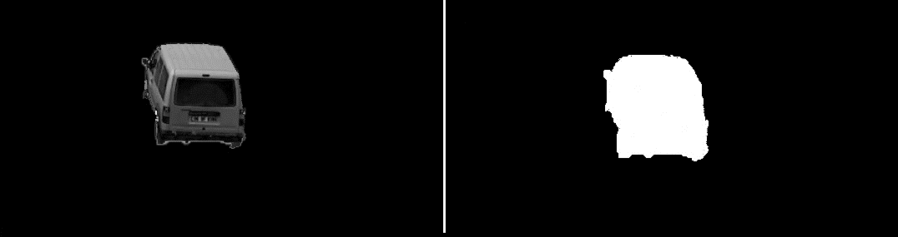
Binary image :- intensity values is either 0 or 1 ,
where 0 corresponds to black and 1 corresponds to white
here depth = 1
number of channels = 1
The binary image obtained from the grayscale image also depends how thresholding is done. We will get to know about just after few slides. We find binary images out of either HSV images or grayscale images.
Gray scaled version of original image
Binary image

Slide 10
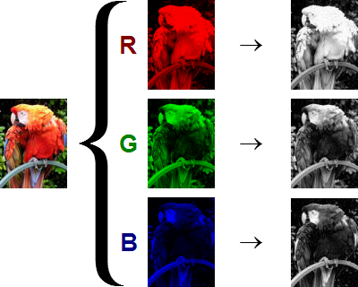
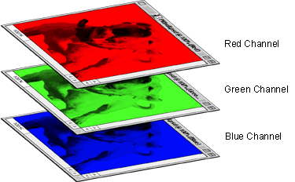
RGB image :- pixel value for each color varies from 0 to 255,
here depth = 8
number of channels = 3 ( The three channels are red , green and blue )
Which means any colored image has different intensities in these 3 channels

Slide 11
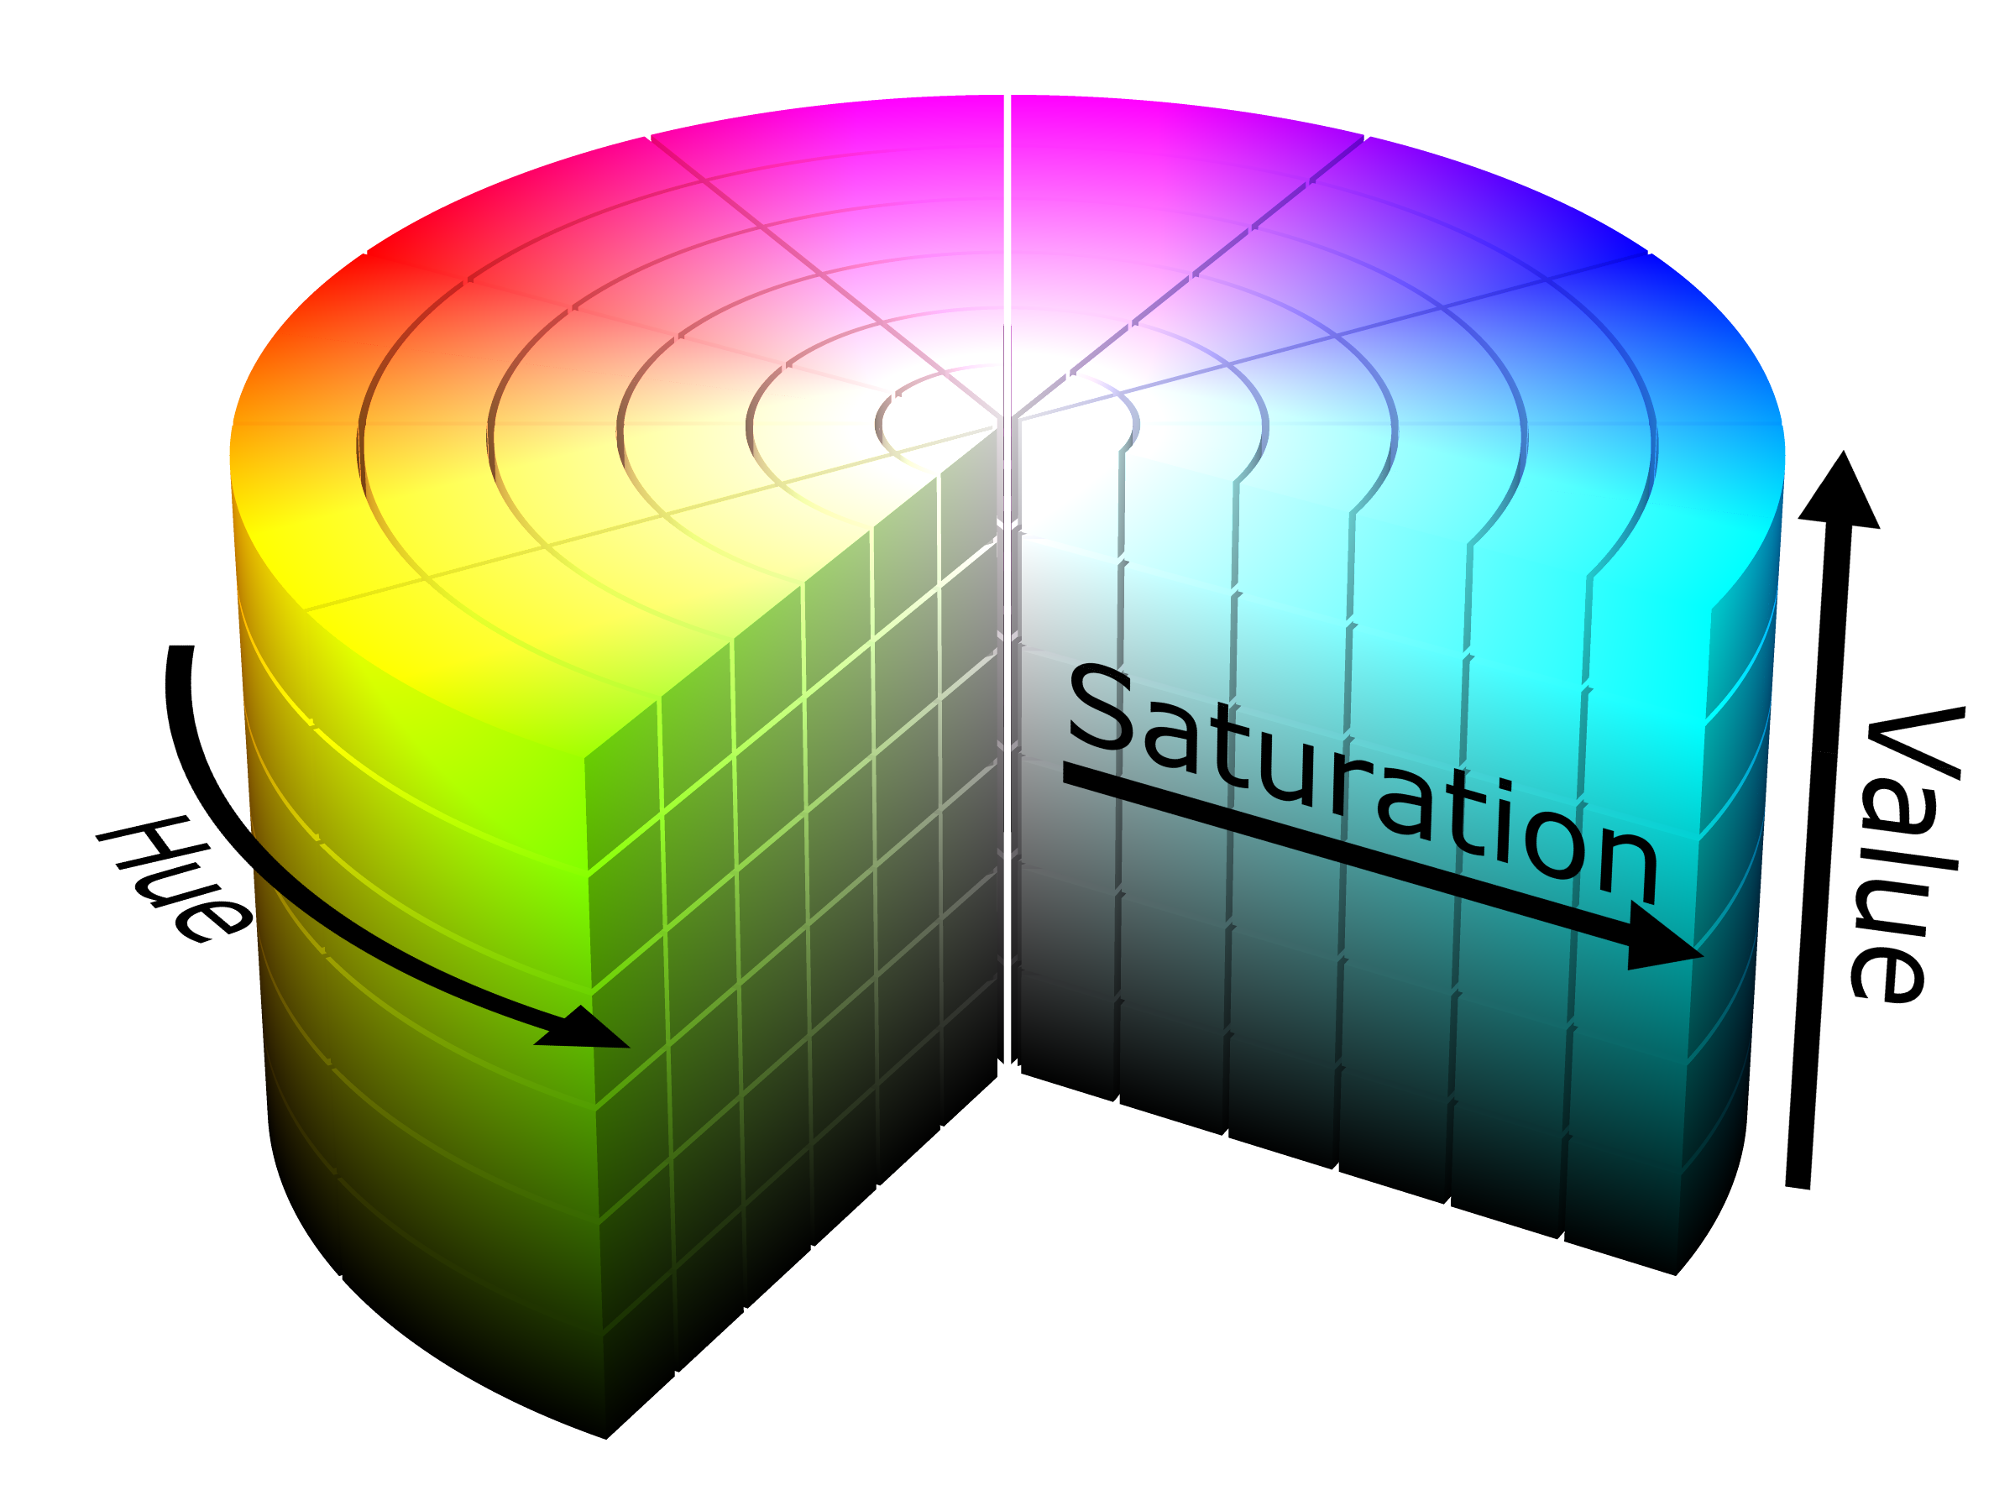
HSV image :- It is a format for the colored image other than RGB . In this colored image is represented in terms of hue , saturation and value.
We use this format for colored image as separation of colors becomes easy in this.

Slide 12
So why do we use HSV when we have a simplified format like RGB ???

Slide 13
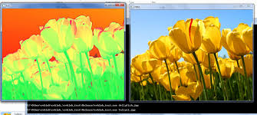
Well color segmentation is very easy in HSV
Similarly we have other formats like CMYK , HSL
And the best of OpenCV is that we can convert one format to another easily
HSV image
RGB image

Slide 14
Some Basic functions
cv2.imread() to read an image
syntax :- image = cv2.imread(‘ destination of the file ‘ , number)
Explanation : - destination of the file is the location of the image. Eg:- ‘C:\Users\Lenovo\Desktop\mypic.jpg’
Here 1 : Loads a color image
0 : Loads image in grayscale mode
cv2.imwrite() to save an image
syntax :- cv2.imwrite(‘location to be stored’, variable containing the image)
Explanation : - First argument is the location where we want to save the image.
Eg:- ‘C:\Users\Lenovo\Desktop\nameoftheimage.jpg’

Slide 15
To display an image and destroy the window
syntax : - cv2.imshow(‘ image ’, image)
cv2.waitKey(0)
cv2.destroyAllWindows()
Explanation : - Here the ‘image’ gives the name of the window you are creating it can be any name , and the other parameter is the variable containing the loaded image. You can use multiple imshow() to display different images
cv2.waitKey(0) will keep the pop up window unless any key is pressed . Here argument inside the parenthesis specifies the milliseconds it should wait before going to next line. 0 means it will wait there infinitely. If you put any other small value it will disappear very quickly as it goes to the next line
cv2.destroyAllWindows() is used to destroy the pop – up window it usually follows the waitKey() function so after the wait is over it destroys all the windows

Slide 16
To convert from one color space to another
syntax : - gray = cv2.cvtColor(frame , cv2.COLOR_BGR2GRAY)
Explanation : - Here the cv2.cvtColor converts the image stored in the frame with BGR color space to grayscale. Similarly we can easily convert BGR to any other color space. We use COLOR_BGR2HSV for converting BGR to HSV

Slide 17
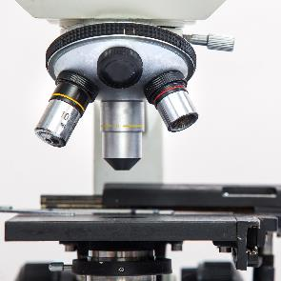

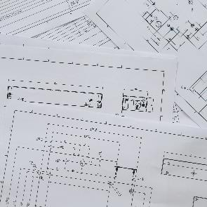
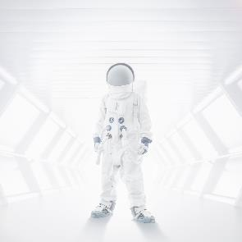
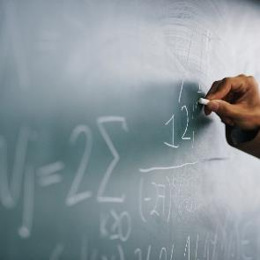
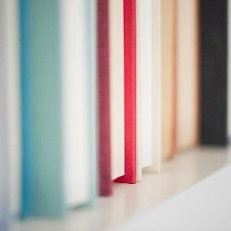
Lets Get Started
Our first program will be loading a simple image file from computer
import cv2
# loading the image as coloured image
image = cv2.imread(r‘C:\Users\Lenovo\Desktop\mypic.jpg’ , 1)
# displaying the image
cv2.imshow(‘ image ’, image)
cv2.waitKey(0)
cv2.destroyAllWindows()
!!! TASK 1:- LOAD A COLOURED IMAGE AND CONVERT IT TO GRAYSCALE AND THEN SAVE IT
1
2
3
4
5
6

Slide 18
Using Webcam for live video feed
import cv2
# To start the camera
cap = cv2.VideoCapture(0)
while (True) :
# to capture a frame since video is nothing but images one after another
_ , frame = cap.read()
# lets convert it to gray scale
gray = cv2.cvtColor(frame , cv2.COLOR_BGR2GRAY)
# displaying the video as images
cv2.imshow(‘ show video ‘ , gray)
if cv2.waitKey(1) & 0xFF == ord(‘q’):
break
cap.release()
cv2.destroyAllWindows()
!!! TASK 2:- FROM LIVE VIDEO FEED TRY AND CAPTURE AN IMAGE AT THE PRESS OF A KEYSTROKE
Here we insert 0 because we are using the inbuilt webcam instead if we want to use an external webcam we have to replace 0 by 1
To exit program at a specific key press can be any other key for keys like esc and spacebar we have number
For esc program will be
if cv2.waitKey(1) & 0xFF == 27:
To release the camera

Slide 19
Basic drawing functions
BGR format
To draw a line on an image
syntax :- line = cv2.line( image , (0,0) , (265 , 254) , (255 , 0 , 0) , 5)
Explanation : - Here the 1st argument is the image on which the line has to be drawn. 2nd and 3rd arguments are the initial and final coordinates of the line. 4th argument is the color of the line in this case it is blue and the 5th argument is the thickness of the line.
To draw a rectangle on an image
syntax :- rectangle = cv2.rectangle ( image , (0,0) , (265 , 254) , (255 , 0 , 0) , 5)
Explanation : - Here the 1st argument is the image on which the rectangle has to be drawn. 2nd and 3rd arguments are the coordinates of the bottom left corner and the top right corner. 4th argument is the color of the line in this case it is blue and the 5th argument is the thickness of the boundaries.
To draw a circle on an image
syntax :- circle = cv2.circle ( image , (0,0) , 5, (255 , 0 , 0) , 5)
Explanation : - Here the 1st argument is the image on which the rectangle has to be drawn. 2nd argument is the coordinate of the center , 3rd argument is the radius of the circle . 4th argument is the color of the line in this case it is blue and the 5th argument is the thickness of the boundaries.
Other drawing functions are also there like for ellipse , polygon.
If -1 circle will be filled from inside

Slide 20
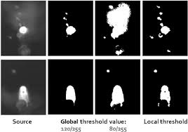
What is thresholding ??
Thresholding is the simplest method of image segmentation. From a grayscale image, thresholding can be used to create binary images. In simpler words if the pixel value is greater than a particular value set by the user then make all those pixels black or white .
Keep on adjusting this value for perfect thresholding
There are different types of thresholding
Simple Thresholding : - we use cv2.threshold() function for this
syntax : - ret , thresh1 = cv2.threshold( image ,127, 255, cv2.THRESH_BINARY )
Explanation : - S Here the 1st argument is the image which has to thresholded , 2nd is the pixel intensity above which you want to threshold the image i.e. it is the threshold value , 3rd argument represents the value to be given if pixel value is more than the threshold value , 4th argument is the type of thresholding we want to do .
IMPORTANCE OF PROPER THRESHOLDING VALUE

Slide 21
another example would be using
syntax : - ret , thresh2 = cv2.threshold( image,127, 255, cv2.THRESH_BINARY_INV )
So what's the difference ????
There are other types also but these two are the ones which are primarily used and serve all the main purposes
Adaptive thresholding : - It is used when the lighting conditions over the image are not uniform
Otsu binarization : - For images with uniform lighting conditions it gives almost the perfect thresholding value

Slide 22
Lets detect a colored object from the camera
import numpy as np
import cv2
cap = cv2.VideoCapture(0)
while (True) :
_ , frame = cap.read()
# converting BGR to HSV
hsv = cv2.cvtColor(frame , cv2.COLOR_BGR2HSV)
# now we need to define the blue color range in hsv
lower_blue = np.array( [ 110 , 50 , 50])
upper_blue = np.array( [ 130 , 255 , 255])
# now we will threshold the image to get blue colors only using lower_blue and upper_blue
mask = cv2.inRange( hsv , lower_blue , upper_blue)
Eg:-
Values of HSV depend a lot on lighting condition so we have to tweak them
If the hsv pixel value is within this range it will give one 1(white) otherwise it will give 0(black)
Hence we have a binary image

Slide 23
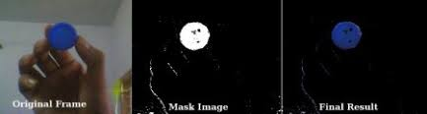
# now to only show the blue cap we perform bitwise and operation
final_result = cv2.bitwise_and( frame , frame , mask = mask )
cv2.imshow(‘ video ‘ , frame)
cv2.imshow(‘ masked image ‘ , mask)
cv2.imshow(‘ resultant ‘ , final_result)
if cv2.waitKey(1) & 0xFF == ord(‘q’):
break
cap.release()
cv2.destroyAllWindows()
Binary image hence pixel value of black 0 and white is 1
Since 0 AND anything is 0 whereas 1 AND anything is that thing itself
!!! TASK 3:- Try it with any other colour

Slide 24
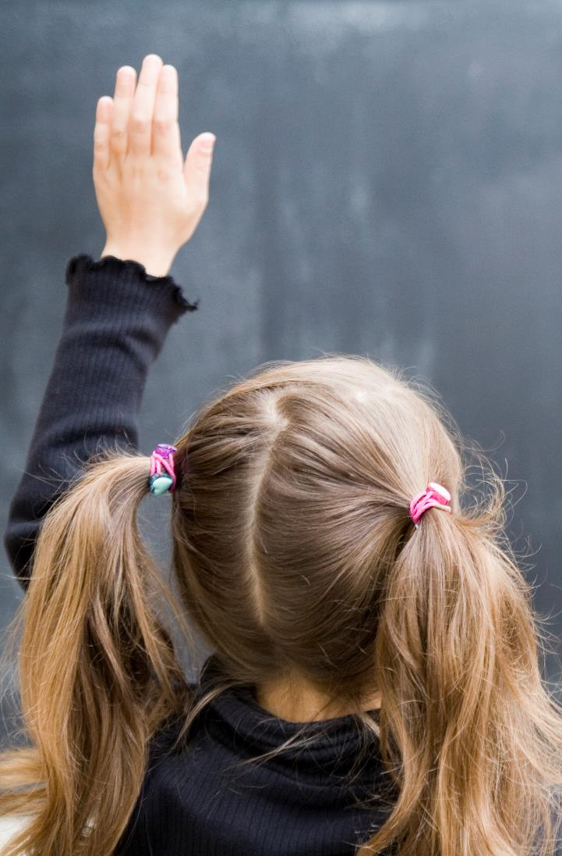
Thank You
BY: SARTHAK NARAYAN

