Slide 1
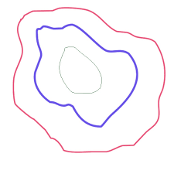
Contours
A Contour is a curve joining all the continuous points (along the boundary), having same colour or intensity. Contours are a useful tool for shape analysis and object detection and recognition.

Slide 2
cv2.findContours()
Contours are detected via the cv2.findContours() function
For better accuracy use binary images which can be obtained by thresholding.
In OpenCV, finding contours is like finding white object from black background. So remember, object to be found should be white and background should be black.

Slide 3
Syntax : - img , contours, hierarchy = cv2.findContours(thresh , cv2.RETR_TREE , cv2.CHAIN_APPROX_SIMPLE)
There are three arguments in cv2.findContours() function, first one is source image, second is contour retrieval mode, third is contour approximation method. And it outputs the image, contours and hierarchy. contours is a Python list of all the contours in the image. Each individual contour is a Numpy array of (x,y) coordinates of boundary points of the object.

Slide 4
cv2.findContours() params
Retrieval Modes:
RETR_LIST
Builds a hierarchy without any parent child relationships
RETR_EXTERNAL
Returns only extreme outer contours
RETR_CCOMP
Establishes two level hierarchy(Inner and Outer)
RETR_TREE
Returns all contours and establishes full family hierarchy
Approximation Methods:
CHAIN_APPROX_NONE
Returns all the points along the contour
CHAIN_APPROX_SIMPLE
compresses horizontal, vertical, and diagonal segments and leaves only their end points.

Slide 5
cv2.drawContours()
This function takes contours and draws them on an image.
Its first argument is source image , second argument is the contours which should be passed as a Python list, third argument is index of contours (useful when drawing individual contour. To draw all contours ,pass -1) and remaining arguments are color, thickness.
Syntax : -img = cv2.drawContours(img , contours , -1 , (0,255,0) , 3)

Slide 6
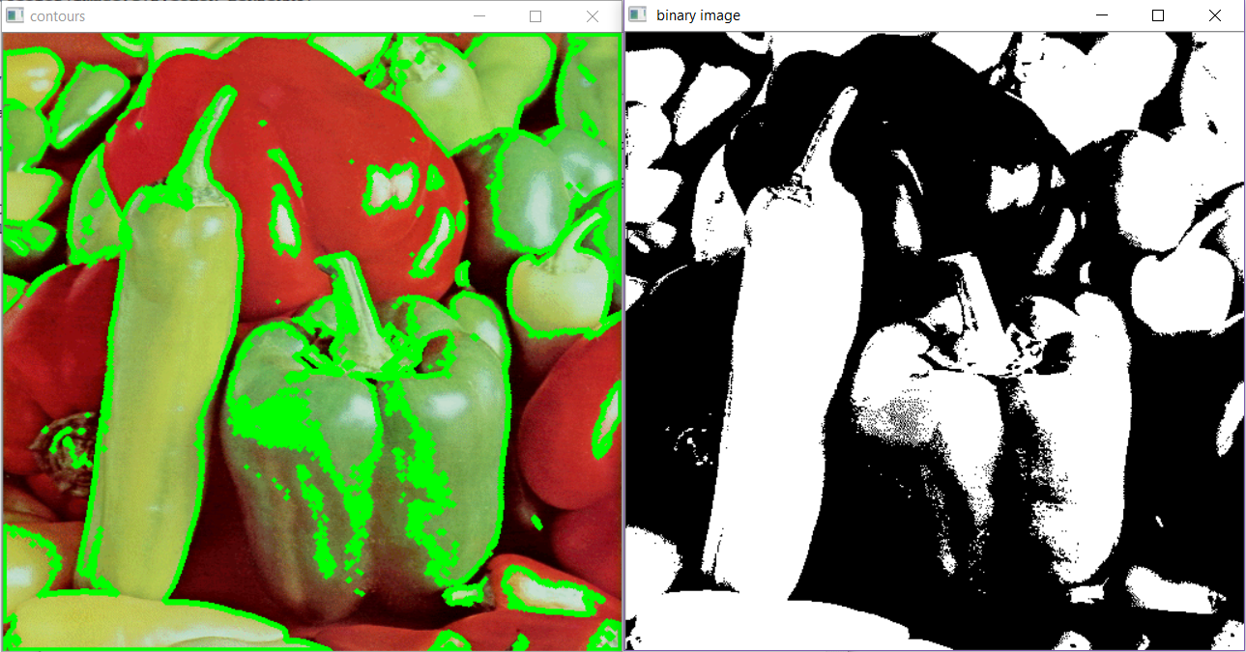
Example of a contour

Slide 7
Sample code
import cv2
image = cv2.imread('test.jpg‘ , 1 )
gray = cv2.cvtColor(image,cv2.COLOR_BGR2GRAY)
ret , thresh = cv2.threshold( gray, 127, 255, 0)
_ , contours, _ = cv2.findContours(thresh , cv2.RETR_TREE , cv2.CHAIN_APPROX_SIMPLE)
img = cv2.drawContours(img, contours , -1 , (0,255,0) , 3)
cv2.imshow( ‘ contours ‘ , img )
cv2.waitKey(0)
cv2.destroyAllWindows()

Slide 8
Contour Features
1. Area:
Syntax :- cnt = contours[0]
area = cv2.contourArea(cnt)
Returns Area of the 1st contour cnt if you want 2nd contour replace 0 by 1 and so on.
2. Perimeter:
Syntax :- perimeter = cv2.arcLength(cnt , True)
Returns perimeter. Second argument specify whether shape is a closed contour (if passed True), or just a curve.

Slide 9
3. Minimum enclosing circle :
Using this we find the circumcircle of an object using the function cv2.minEnclosingCircle(). It is a circle which completely covers the object with minimum area.
Syntax :- (x , y) , radius = cv2.minEnclosingCircle(cnt)
center = (int(x) , int(y))
radius = int(radius)
img = cv2.circle(img , center , radius , (0,255,0) , 2)
There are many other contour functions like for finding minimum bounding rectangle , for finding the centroid and etc.

Slide 10
Task - 1
Using Contour Properties, Find the area, perimeter and minimum enclosing circle of the image

Slide 11
Image Blurring
Image blurring is achieved by convolving the image with a low-pass filter kernel. It is useful for removing noise. It actually removes high frequency content (e.g. : noise, edges) from the image resulting in edges being blurred when this is filter is applied.
There are different types of blurring in OpenCV but we will be discussing Gaussian Blur.
Gaussian Blur :
We use cv2.GaussianBlur() function for this. A gaussian kernel is used for this. Gaussian filtering is highly effective in removing Gaussian noise from the image.
Syntax :- blur = cv2.GaussianBlur( img , (5,5) , 0)
Kernel

Slide 12
So what is a kernel
In image processing, a kernel or a convolution matrix, is a small matrix. It is used for blurring, sharpening, embossing, edge detection, and more. This is accomplished by doing a convolution between a kernel and an image.

Slide 13
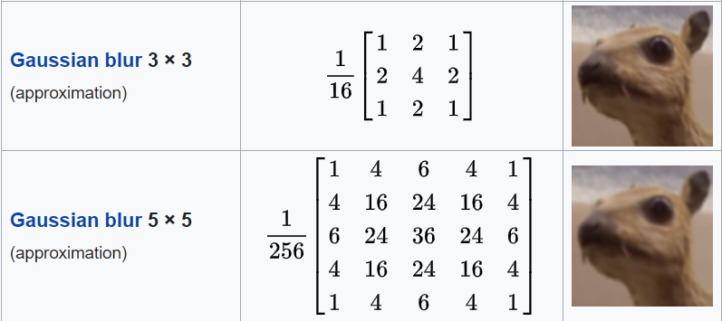

Slide 14

Morphological Transforms
Morphological Transforms are simple operations based on the shape of an image.
They are generally used to reduce noise.
These transforms need two inputs, the source image and the kernel.
A kernel is a filtering element that is slid over the image to produce a filtered image.
It is normally performed on binary images

Slide 15

Erosion
Syntax : - kernel = np.ones((5,5),np.uint8)
erosion=cv2.erode(img , kernel, iterations= 1)
The kernel slides through the image (as in 2D convolution). A pixel in the original image (either 1 or 0) will be considered 1 only if all the pixels under the kernel is 1, otherwise it is eroded (made to zero).
So the thickness or size of the foreground object decreases or simply white region decreases in the image.
Parameters:
Source Image
Kernel
Number of iterations : more the iterations thinner the image gets

Slide 16

Dilation
Syntax : - dilation = cv2.dilate(img , kernel, iterations = 1)
It is just opposite of erosion. Here, a pixel element is ‘1’ if at least one pixel under the kernel is ‘1’. So it increases the white region in the image or size of foreground object increases. Normally, in cases like noise removal, erosion is followed by dilation. Because, erosion removes white noises, but it also shrinks our object. So we dilate it. Since noise is gone, they won’t come back, but our object area increases.
The parameters are the same as erosion.

Slide 17


Opening and Closing
These are simply erosion followed by dilation and dilation followed by erosion respectively.
Opening:
Syntax :- cv2.morphologyEx(img, cv2.MORPH_OPEN , kernel)
Closing:
Syntax :- cv2.morphologyEx(img , cv2.MORPH_CLOSE , kernel)

Slide 18
Task - 2
Apply the morphological transforms to a Video Feed and see the results!

