Slide 1

BASICS OF CODING

Slide 2
INTRO TO BOOLEAN LOGIC
Boolean Logic is a form of algebra which is centred around three simple words known as Boolean Operators: “Or,” “And,” and “Not”. At the heart of Boolean Logic is the idea that all values are either true or false.
Instead of elementary algebra where the values of the variables are numbers, Boolean algebra is the branch of algebra in which the values of the variables are the truth values true and false, usually denoted 1 and 0 respectively.

Slide 3
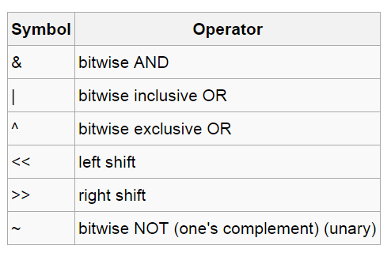
BOOLEAN OPERATORS

Slide 4
BITWISE AND, OR, COMPLEMENT
AND rules:
0&0=0
1&0=0 or 0&1=0
1&1=1
OR rules:
0|0=0
1|0=1 or 0|1=1
1| 1 =1

Slide 5
BITWISE AND, OR, COMPLEMENT
COMPLEMENT:
~0=1 and ~1=0
Basically changes all 1s to 0s and all 0s to 1s.
EXAMPLES: 0010 1111 & 1101 0001 = 0000 0001
0010 1110 | 1101 0001 = 1111 1111
~(0010 1010) = 1101 0101

Slide 6
Left Shift and Right Shift operators
Used to shift 1 to “n” positions to the left or right in a binary number.
Eg.(left shift operation): consider a binary no. 0000 0010
(2<<2)can also be represented as (0000 0010 << 2 ) gives (0000 1000)
Eg.(right shift operation): consider a binary no. 0000 0010
(0000 0010 >> 1 ) gives (0000 0001)

Slide 7
BASIC C
INCLUDING HEADERS
DATA TYPES
CONDITION STATEMENTS
LOOPING STATEMENTS

Slide 8
INCLUDING HEADER FILES
Header files are a compilation of long sets of code with basic functions.
Required to make our tasks easy

Slide 9
DATA TYPES
There are five basic data types associated with variables:
int - integer: a whole number. (Eg:- 15,-2,0)
float - floating point value: ie a number with a fractional part. (Eg:-12.2,15.2)
double - a double-precision floating point value.
char - a single character.(Eg:- A,e)
void - valueless special purpose type

Slide 10
The if-else – Condition Statement
Suppose your integer variable contains a value stored. For example 7 . How do you check that ? Examine this self explanatory sample code :
#include<stdio.h> void main() { int rmi=7; if(rmi==7) //check if it is equal to 7 { //do something } else if(rmi!=7) //check if it is not equal to 7 { //do nothing } }

Slide 11
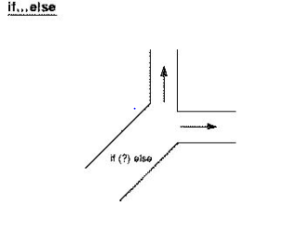

Slide 12
LOOPING STATEMENTS

Slide 13
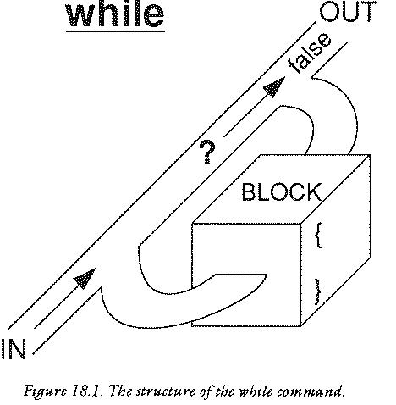

Slide 14
The while loop
As long as the condition is true , the while loop keeps executing the code it is given . This sample code illustrates how a variable's value is incremented until it reaches 100 . //assume headers and void main int rmi=1 ; while(rmi<101) { //do something rmi=rmi+1; }
So, as soon as the value stored by rmi reaches 101, the condition goes false and the loop ends .

Slide 15
For loop
I'm leaving it to you to findout why 'for loop' is used for . This program keeps incrementing a variable until the condition stays true and also runs a code you declare inside the for loop after the change each time . for(rmi=0 ;rmi<100; rmi=rmi+1)
{ //type your code you want to execute after the //value of rmi changes each time , here ! }

Slide 16
FUNCTIONS
A function is a group of statements that together perform a task.
You can divide up your code into separate functions.
the division usually is such that each function performs a specific task.

Slide 17
FUNCTION DEFINITION
Return Type − A function may return a value. The return_type is the data type of the value the function returns.
Function Name − This is the actual name of the function.
Parameters − A parameter is like a placeholder. When a function is invoked, you pass a value to the parameter. This value is referred to as actual parameter or argument.
Function Body − The function body contains a collection of statements that define what the function does.
THE GENERAL FORM OF FUNCTION DEFINITION
return_type function_name( parameter list )
{
body of the function
}

Slide 18
CALLING THE FUNCTION
While creating a function, you give a definition of what the function has to do. To use a function, you will have to call or invoke that function.
When a program calls a function, program control is transferred to the called function. A called function performs defined task and when it’s return statement is executed or when its function-ending closing brace is reached, it returns program control back to the main program.
To call a function, you simply need to pass the required parameters along with function name, and if function returns a value, then you can store returned value.

Slide 19
AN EXAMPLE IN C
#include<stdio.h>
int com(int a, int b) //to find the greatest number
{ if(a>b) //compares the number
ret a;
else
ret b;
}
void main()
{ int grt;
grt=com(50,100); //function call
}

