Slide 1

INTRO TO ARDUINO
Arduino Uno Board description
Input and output
Serial Communication

Slide 2
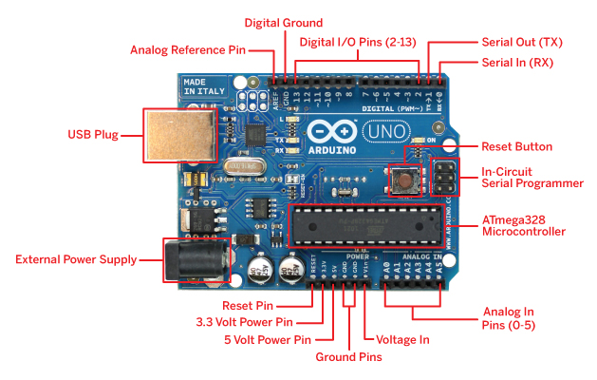
ARDUINO UNO BOARD DESCRIPTION
Arduino Uno board has 4 ports namely PORT A,B,C,D.
Arduino Uno board has 14 (0-13) digital pins and 6 analog pins (0-5).
Has power pins like V_{in} , 5V , 3.3V and two ground pins.
Has extra pins like Reset and A_{ref} .
Has extra ports for USB plugging and external power supply.

Slide 3
LEARNING ABOUT THE LOGIC STATES
Modern digital logic gates, IC’s and micro-controllers contain many inputs, called “pins” as well as one or more outputs, and these inputs and outputs need to be correctly set, either HIGH or LOW for the digital circuit to function correctly.
But being digital, these circuits can only have one of two logic states, called the logic “0” state or the logic “1” state.

Slide 4
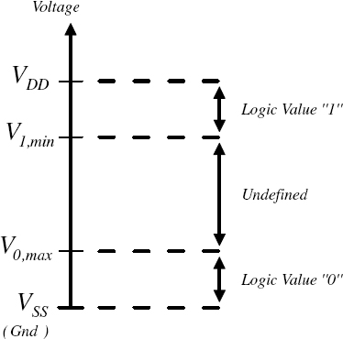
CONTINUED ……..
These logic states are represented by two different voltage levels with any voltage below one level regarded as a logic “0”, and any voltage above another level regarded as logic “1”.

Slide 5
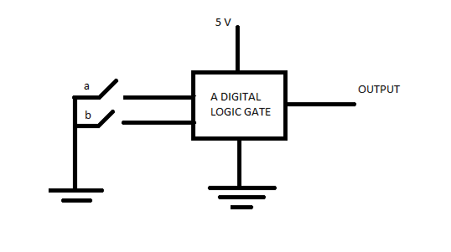
Consider the digital circuit , The two switches, “a”
and “b”, represent the inputs to a generic logic
gate. When switch “a” is closed (on), input “A” is
connected to ground, (0v) or logic level “0” (low)
and likewise, when switch “b” is closed (on), input
“B” is also connected to ground, logic level “0”.
SO THEN WHAT HAPPENS WHEN SWITCH IS OPEN?

Slide 6
FLOATING VALUE OF A PIN
As the input is now effectively unconnected from either a defined HIGH or LOW condition, it has the potential to “float” about between 0V and +5V (Vcc) allowing the input to self–bias at any voltage level whether that represents a HIGH or a LOW condition.
This uncertain situation may cause the digital input at “A” to stay at a logic level “0” (low) with the switch open, when we actually need a logic “1”, (high) causing the logic gate to falsely switch the output.
This floating and weak input signal could easily change value at the slightest of interference or noise from its neighbouring inputs or could even cause it to go into oscillation, rendering the gate practically unusable.

Slide 7
SO HOW DO WE AVOID THIS??
THIS IS WHEN PULL UP RESISTORS AND PULL DOWN RESISTORS COMES IN HANDY.

Slide 8
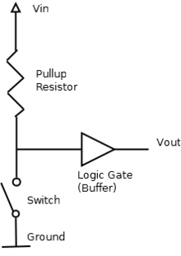
PULL UP RESISTOR
They are simple fixed-value resistors connected between the voltage supply (usually +5V) and the appropriate pin, which results in defining the input or output voltage in the absence of a driving signal.

Slide 9
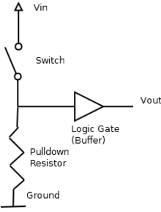
PULL DOWN RESISTOR
Pull-down resistors work in the same manner as pull-up resistors, except that they pull the pin to a logical low value. In such a circuit, when the switch is closed, the input is at a logical high value, but when the switch is open, the pull-down resistor pulls the input voltage down to ground (logical zero value), preventing an undefined state at the input.

Slide 10

INPUT AND OUPUT
The 14 digital pins and 6 analog pins can be configured either as input or output.
Arduino pins are by default configured as inputs.
BUT HOW TO DO IT IN ARDUINO CODE ?
In Arduino code , the function ‘pinMode’ helps us in
enabling a pin as input or output.
Syntax pinMode(pin Number, mode)
Pin Number is the number of the digital pin whose mode you are going
to set as input or output.

Slide 11

SO WHAT HAPPENS IF YOU LEAVE AN INPUT PIN UNCONNECTED? WHAT WILL BE THE LOGIC STATE OF IT?

Slide 12
MODE-INPUT_PULLUP
As we have seen before, if you leave an input pin unconnected , the read value of the pin starts to float between +5V and 0V, thereby producing an error in the read value.
Therefore , we can use the built-in pull-up resistors in our microcontroller. There are 20K pull-up resistors built into the Atmega chip that can be accessed from software.

Slide 13
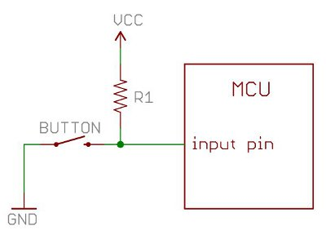
These built-in pull-up resistors are accessed by setting the pinMode() as INPUT_PULLUP. This effectively inverts the behaviour of the INPUT mode
When connecting a sensor to a pin configured with INPUT_PULLUP, the other end should be connected to ground. In the case of a simple switch, this causes the pin to read HIGH when the switch is open, and LOW when the switch is pressed.

Slide 14
READING AND WRITRING – DIGITAL PINS
digitalRead() function
SYNTAX digitalRead(pin)
Used when you set the pin as an input.
Returns whether the read value of the pin is HIGH or LOW.
digitalWrite() function
SYNTAX digitalWrite(pin,mode)
Used when you set the pin as output.
Helps to write the pin as HIGH or LOW with the help of mode parameter.

Slide 15
THE DELAY FUNCTION
SYNTAX delay(ms) ms: the number of milliseconds to pause (unsigned long)
Pauses the program for the amount of time (in milliseconds) specified as parameter. (There are 1000 milliseconds in a second.)
THERE IS AN ANOTHER FUNCTION – delayMicroseconds()
SYNTAX delayMicroseconds(us)
Pauses the program for the amount of time (in microseconds) specified as parameter. There are a thousand microseconds in a millisecond, and a million microseconds in a second.

Slide 16
SAMPLE CODE FOR I/O
int ledPin = 13; // LED connected to digital pin 13
void setup()
{
pinMode(ledPin, OUTPUT); // sets the digital pin 13 as output
}
void loop()
{
digitalWrite(ledPin,HIGH); // sets the LED to the button's value
delay(1000);
digitalWrite(ledPin,LOW);
}

Slide 17
LET’S DO A TASK
As we have learnt to get output from Arduino , let’s try to glow an led with switch control.
THINGS TO REMEMBER
ADD A RESISTOR IN SERIES WITH THE LED TO AVOID THE DAMAGE OF LED IN THE CIRCUIT.
GET THE INPUT FROM THE SWITCH AND USE THAT TO GLOW AN LED.

Slide 18
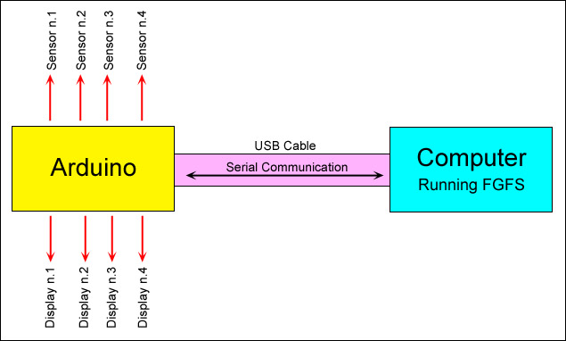
SERIAL COMMUNICATION
Used for communication between the Arduino board and a computer or other devices. It communicates on digital pins 0 (RX) and 1 (TX) as well as with the computer via USB.

Slide 19
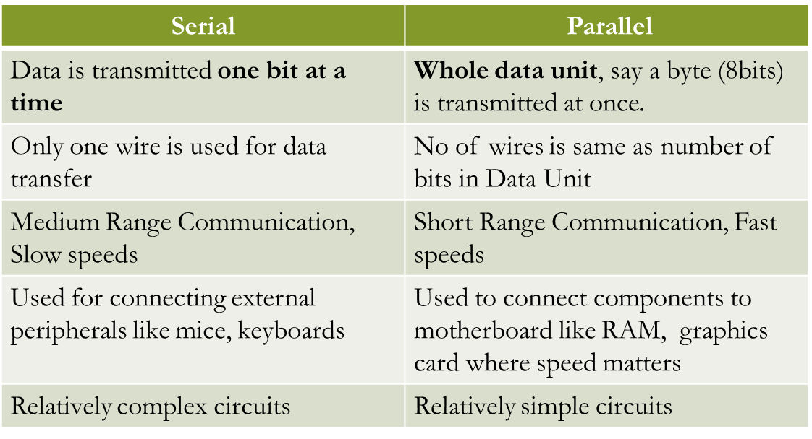
SERIAL AND PARALLEL COMMUNICATION

Slide 20
Serial Communication
Asynchronous
Synchronous

Slide 21
SYNCHRONOUS COMMUNICATION | ASYNCHRONOUS COMMUNICATION
Has a clock line which synchronizes reading and writing operations. | Has no clock line.
Transfers data as a block | Transfers data bit by bit.
 | Requires a start bit and a stop bit.
 | Also both sides have to agree on a common transmission rate.

Slide 22
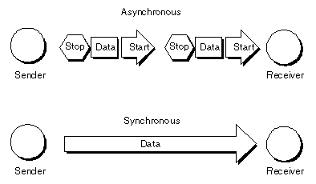
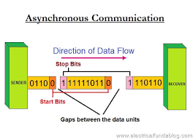
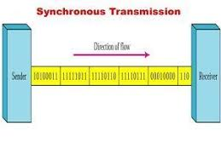

Slide 23

BASICS TO BEGIN WITH
BAUD RATE
Sets the data rate in bits per second (baud) for serial data transmission. For communicating with the computer, use one of these rates: 300, 600, 1200, 2400, 4800, 9600, 14400, 19200, 28800, 38400, 57600, or 115200.
QUICK TIP
You can use the Arduino environment’s built-in serial monitor to communicate with an Arduino board. Click the serial monitor button in the toolbar and select the same baud rate used in the call to begin().

Slide 24
CONTINUED…….
SETTING BAUD RATE
SYNTAX Serial.begin(speed) [speed: in bits per second (baud)]
Sets the serial data transmission speed as the value passed in the parameter.
FOR EG:- Serial.begin(9600); // opens serial port, sets data rate to 9600 bps.
PRINTING IN THE SERIAL MONITOR
SYNTAX Serial.print(val) [val:the value to print - any data type]
Prints data to the serial port as human-readable ASCII text. This command can take many forms. Numbers are printed using an ASCII character for each digit. Floats are similarly printed as ASCII digits, defaulting to two decimal places. Bytes are sent as a single character. Characters and strings are sent as it is.

Slide 25
WRITING BINARY DATA
Serial.write(val) SYNTAX Serial.write(str) Serial.write(buf, len) Writes binary data to the serial port. This data is sent as a byte or series of bytes. To send the characters representing the digits of a number use the print() function instead.
READING FROM SERIAL MONITOR
SYNTAX Serial.read()
RETURNS - The first byte of incoming serial data available (or -1 if no data is available)
OTHER FUNCTIONS
1.)println() 3.) parseInt() 5.)readBytesUntil()
2.)readString() 4.) flush() 6.)readStringUntil() THESE FUNCTIONS WILL BE USED LATER (NOT REQUIRED NOW) Let’s try a task! Try to acknowledge a message from the computer

Slide 26
SAMPLE CODE FOR SERIAL COM
int incomingByte = 0; // for incoming serial data
void setup()
{
Serial.begin(9600); // opens serial port, sets data rate to 9600 bps
}
void loop()
{
if (Serial.available() > 0) // send data only when you receive data
{
incomingByte = Serial.read(); // read the incoming byte
// say that you got:
Serial.print("I received: ");
}
}

Slide 27

LET’S TRY TO BLINK AN LED WITH EXTERNAL CONTROL
Let’s try to blink an led with any key press from the keypad of your laptop.
HINT
For simplicity , we can take ‘a’ as the key press.
Be careful , that the baud rates of the computer and the set value is same.
Use the function Serial.Read() and use comparison statements to check for the character entered.

