Slide 1
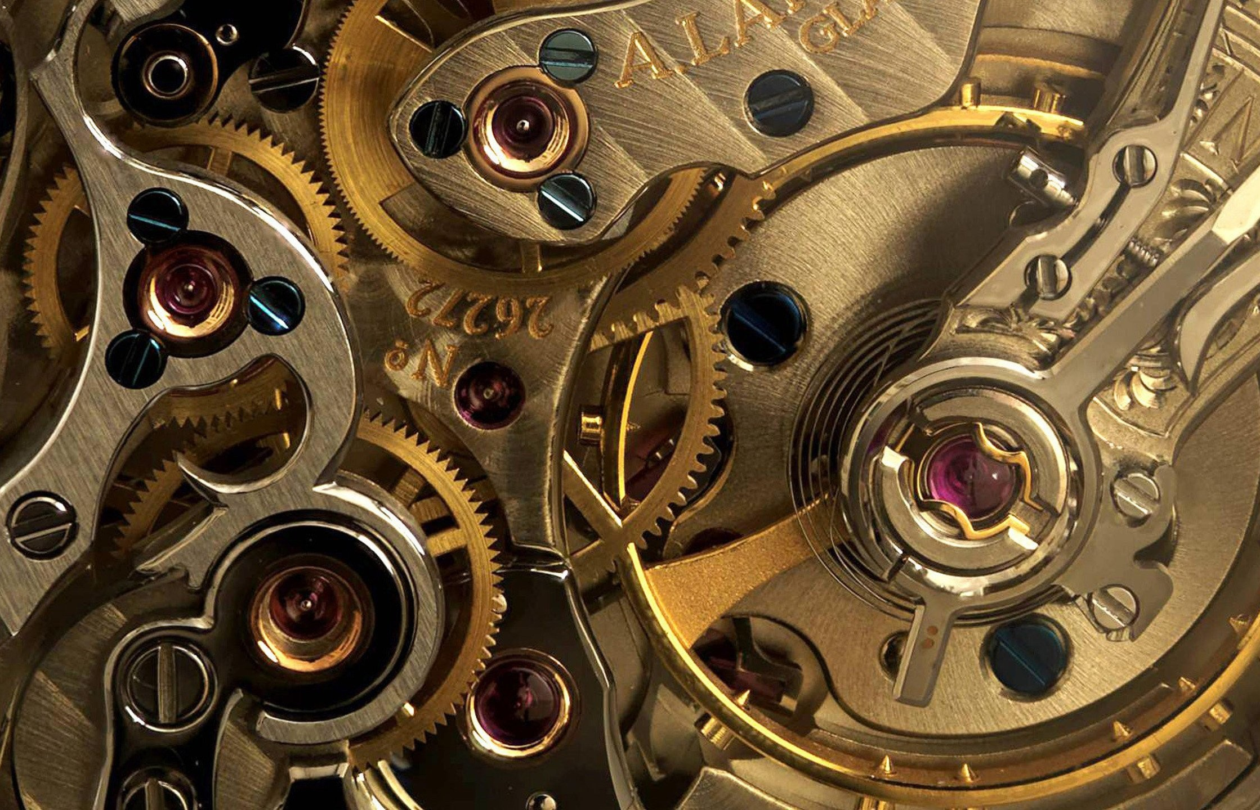
GEARS AND MOTORS

Slide 2
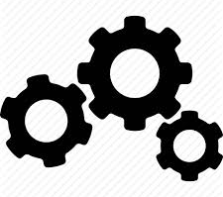
GEARS
A Gear is a rotating machine element which are used to transmit Torque. They have cut teeth which mesh with another gear
Gears have the ability to change the speed ,torque and the direction of power source ,thus creating a mechanical advantage through their gear ratio

Slide 3


GEAR RATIO
Gear ratio is the ratio of the number of turns the output shaft makes when the input shaft turns once.

Slide 4
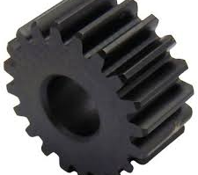
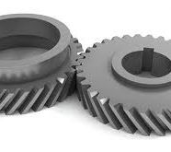
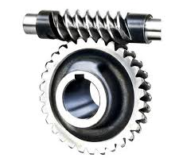
TYPES OF GEARS
SPUR GEAR Gears having cylindrical pitch surfaces are called cylindrical gears. It has a tooth line which is straight and parallel to the shaft.
HELICAL GEARS are used with parallel shafts similar to spur gears and are cylindrical gears with winding tooth lines. They have better teeth meshing than spur gears and have superior quietness and can transmit higher loads.
WORM GEAR A screw shape cut on a shaft is the worm, the mating gear is the worm wheel, and together on non-intersecting shafts is called a worm gear.

Slide 5
Now we will see how a worm gear works

Slide 6
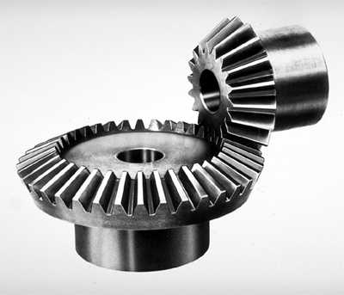
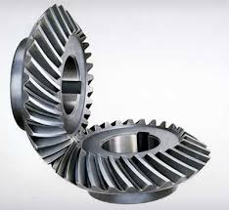
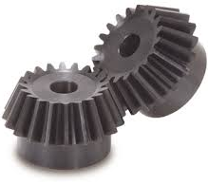
BEVEL GEARS have a cone shaped appearance and are used to transmit force between two shafts which intersect at one point
SPIRAL BEVEL GEARS are bevel gears with curved tooth lines. Due to higher tooth contact ratio, they are superior to straight bevel gears in efficiency, strength, vibration and noise
MITER GEARS are bevel gears with a speed ratio of 1. They are used to change the direction of power transmission without changing speed

Slide 7
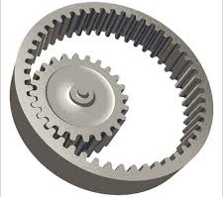
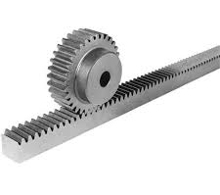
INTERNAL GEARS have teeth cut on the inside of cylinders or cones and are paired with external gears. The main use of internal gears are for planetary gear drives and gear type shaft couplings.
RACK AND PINION same sized and shaped teeth cut at equal distances along a flat surface or a straight rod is called a gear rack. By meshing with a cylindrical gear pinion, it converts rotational motion into linear motion.

Slide 8
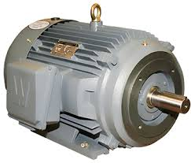
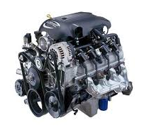
MOTORS
A motor or an engine is a device that converts any form of energy into mechanical energy, like IC engines, DC motors etc..

Slide 9
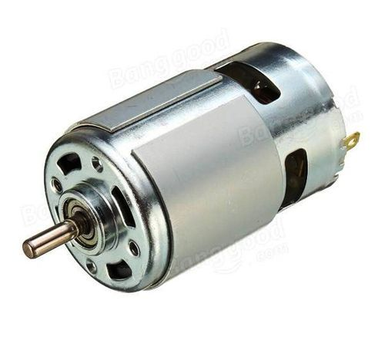
ELECTRICAL MOTORS
An electric motor is an electrical machine that converts electrical energy into mechanical energy. Most electric motors operate through the interaction between the motor's magnetic field and winding currents to generate force in the form of rotation

Slide 10
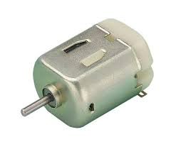
DC MOTORS
A dc motor is any of a class of rotary electrical machines that converts direct current electrical energy into mechanical energy. The most common types rely on the forces produced by magnetic fields.
Its operation is based on the principle that when a current-carrying conductor is placed in a magnetic field, it experiences a mechanical force.

Slide 11
Working of DC Motors

Slide 12
FEATURES –DC MOTOR
DC motor offers the wide range of speed control both above and below the rated speeds.
High starting torque. Therefore dc series motors are used in the applications such as in electric trains and cranes.
Quick starting, stopping, reversing and acceleration
Best choice for robotics applications

Slide 13
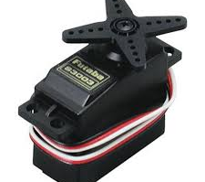
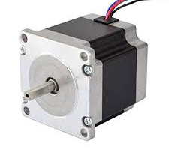
There are two special motors used in robotics
Servo Motors
Stepper Motors

Slide 14
SERVO MOTOR
A servomotor is a rotary actuator or linear actuator that allows for precise control of angular or linear position, velocity and acceleration.
A servomotor uses position feedback to control its motion and final position. The input to its control is a signal (either analog or digital) representing the position commanded for the output shaft.

Slide 15
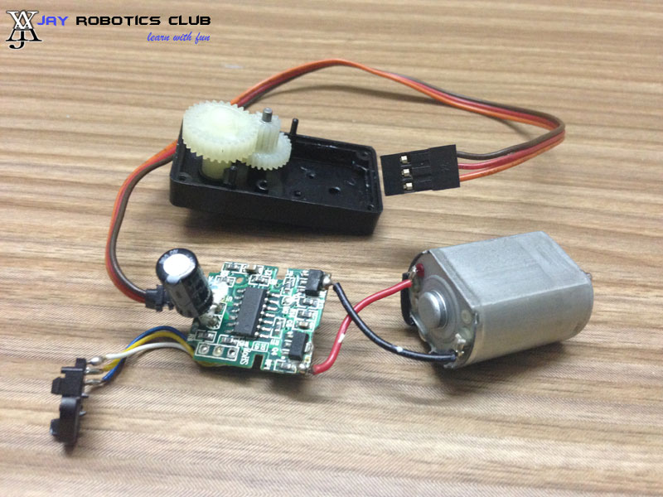
A DC servo motor is an assembly of four separate components , namely
DC motor
Gear assembly
Position sensing device
Control circuit

Slide 16
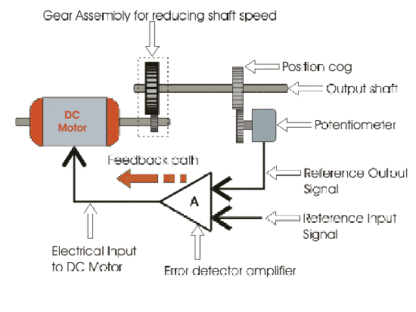

Slide 18
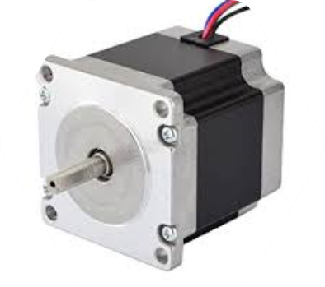
STEPPER MOTOR
A Stepper motor or step motor or stepping motor is a Brushless DC electric motor that divides a full rotation into a number of equal steps. The motor's position can then be commanded to move and hold at one of these steps without any position sensor for feedback

Slide 20
Servo motor vs Stepper motor
Servo motor
Stepper motor
OPERATE IN A CLOSED LOOP-IT HAS AN INTERNAL FEEDBACK
MAINTAINS THE TORQUE IN HIGH ROTATIONAL SPEEDS
HIGH POWER TO WEIGHT RATIO
TYPICALLY HAS 4 TO 12 POLES
EXPENSIVE
OPERATE IN AN OPEN LOOP-NO FEEDBACK AND THUS MORE PRONE TO ERROR
LOSES TORQUE IN HIGH ROTATIONAL SPEEDS
SMALL POWER TO WEIGHT RATIO
TYPICALLY HAS 50 TO 100 POLES
CHEAP COMPARED TO SERVOs

Slide 21
Lets do a task..
Design a mechanism to convert rotary motion to linear motion

