Slide 1

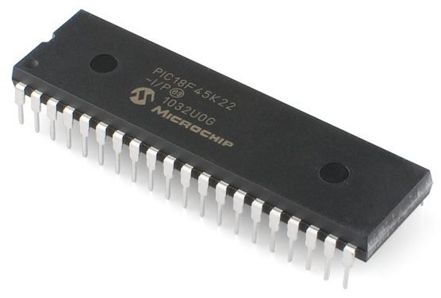
MICROCONTROLLERS
aND
MICROPROCESSORS

Slide 2
MICROPROCESSOR
A microprocessor is a controlling unit of a micro-computer, fabricated on a small chip capable of performing the functions of the cpu and communicating with the other devices connected to it.

Slide 3
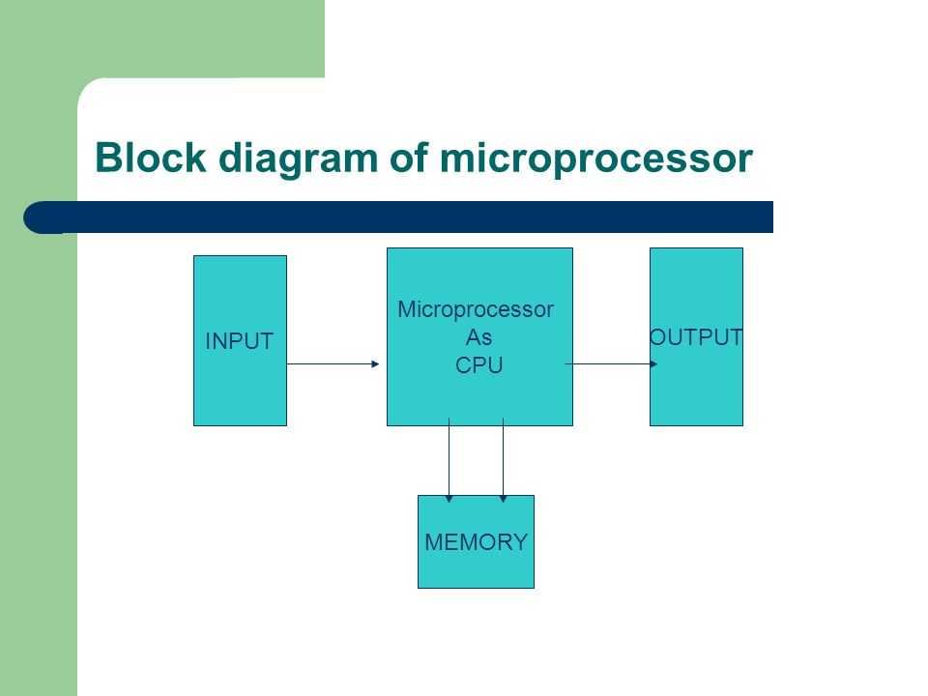

Slide 4
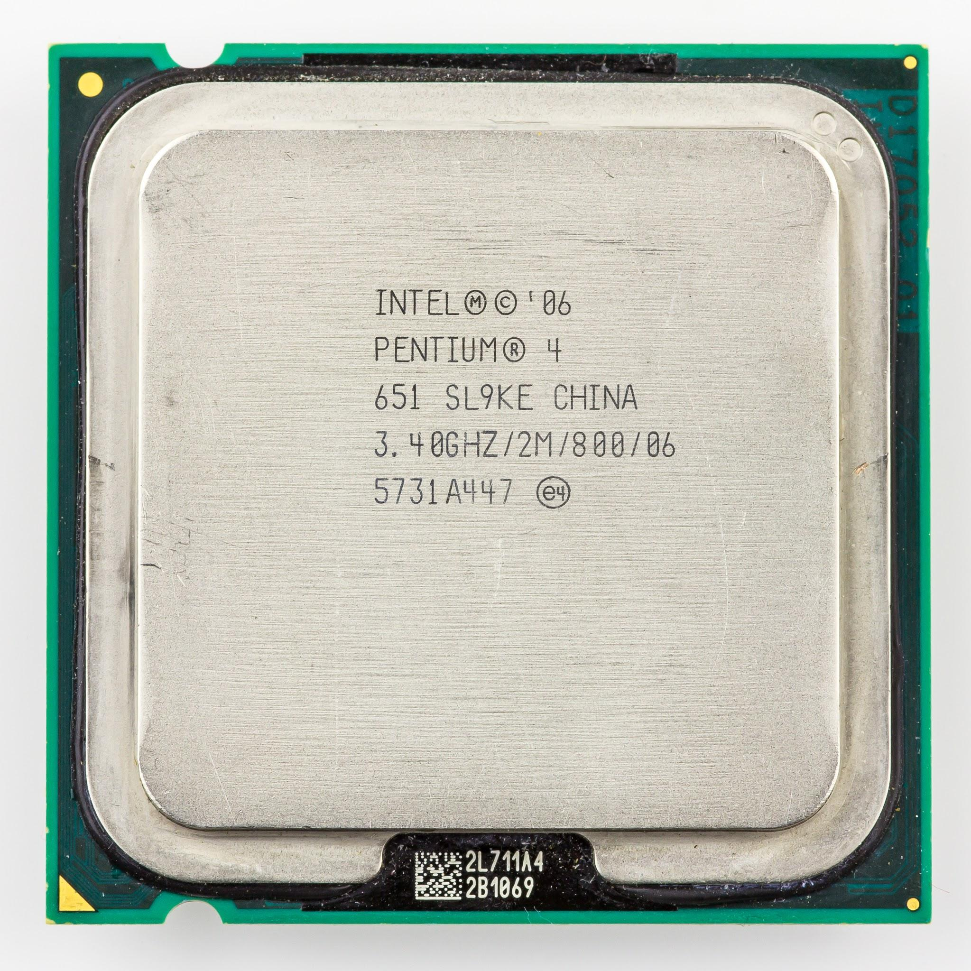
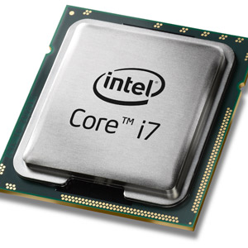
SOME MICROPROCESSORS

Slide 5
MICROCONTROLLERS
A microcontroller also called an embedded controller because the microcontroller and its support circuits are often built into, or embedded in, the devices they control.

Slide 6
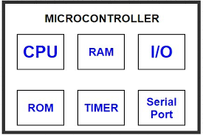
A microcontroller basically contains one or more following components:
Central processing unit(CPU)
Random Access Memory)(RAM)
Read Only Memory(ROM)
Input/output ports
Timers and Counters
Interrupt Controls
Analog to digital converters
Digital to analog converters
Serial interfacing ports

Slide 7
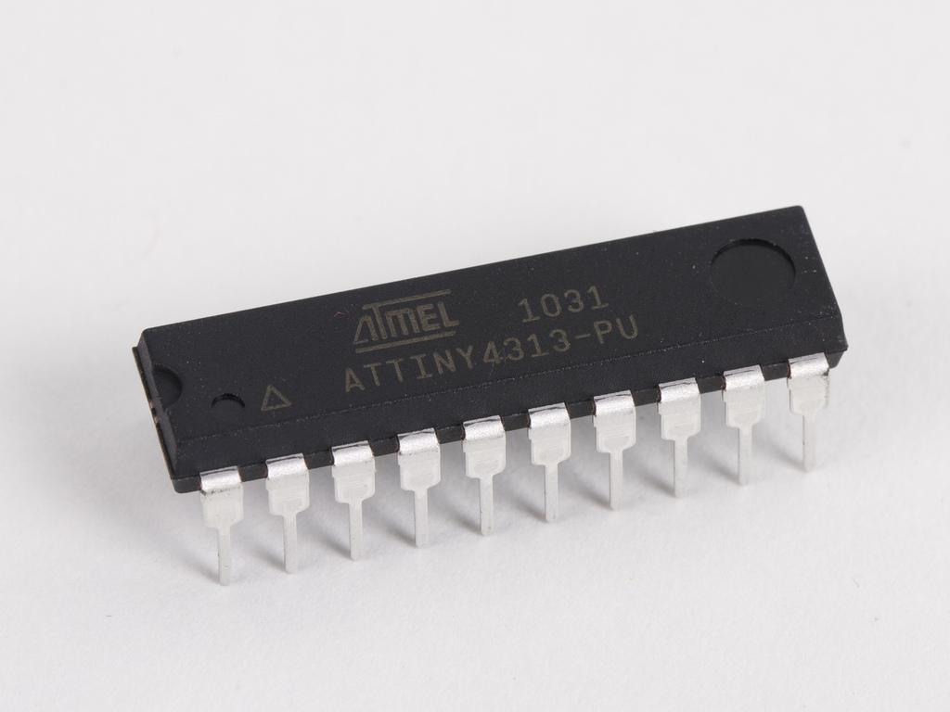
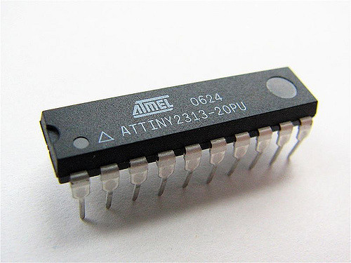
HOW DOES A MICROCONTROLLER LOOK LIKE ?
WHERE IS THE MCU IN YOUR ARDUINO UNO?

Slide 8
MICROCONTROLLER
MICROPROCESSOR
Memory and ports are inbuilt
Memory and i/o port access time is less
Most of the pins are multifunctional
It can be used for dedicated limited applications
Cant be used for tasks that require high processing power
Memory and ports are external.
Memory and i/o port access time is large
Very few pins are multifunctional
They can be used for various generic applications
Can be used for tasks that require high processing power

