Slide 1
timers

Slide 2
The clock and the timer/counter
• Timers are used to measure time elapsed in real world.
• This can be achieved by counting the clock ticks provided by a oscillator.
• The number of clock cycles are stored in memory blocks called registers.
• Events can be triggered if a particular value in the timer register is reached.

Slide 3
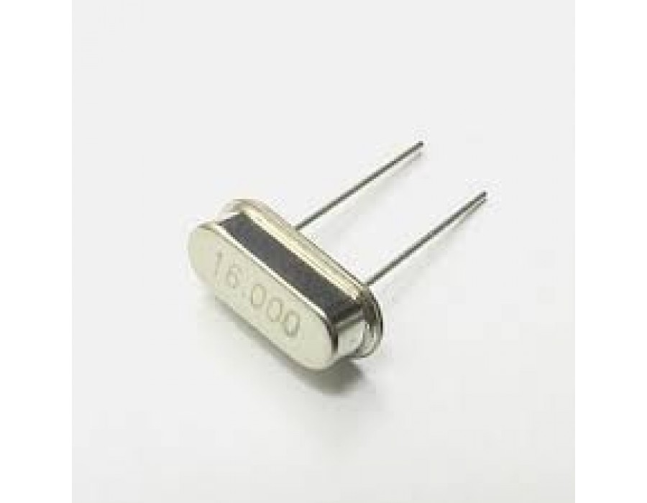
Crystal Oscillator
A crystal oscillator is an electronic oscillator circuit that uses the mechanical resonance of a vibrating crystal of piezoelectric material to create an electrical signal with a precise frequency
In Arduino we use 16MHz Crystal Oscillator.

Slide 4
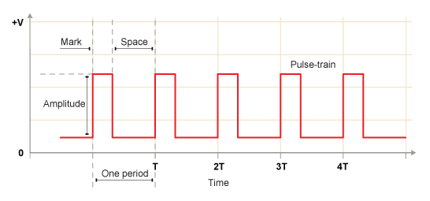
CLOCK PULSE
A clock is a device that alternates between 0 and 1, repeatedly.
The most important is the amount of time it takes before the signal repeats.
This time is called the period, which we call T.
If you've ever bought a computer, one of the more important features it the clock rate.
For example, you may buy a machine that's running at 2 GHz. Do you know what 2 GHz refers to? It refers to a clock!

Slide 5
Why clock signal?
• Used to synchronize different parts of circuitry.
• Sometimes more than one clock cycle is required to do a predicted task.
• for high accuracy requirements , a crystal oscillator is used.

Slide 6
Implementation of timer in an MCU
The timers are classified based on the number of bits used to store the timer count. Then ATMEGA328P offers two 8 bit timers and one 16 bit timer. They are named as shown below.
TIMER | RESOLUTION
Timer0 | 8 bit
Timer1 | 16 bit
Timer2 | 8 bit

Slide 7
Timer functions:
micros(),millis(),delay() & delayMicroseconds()
These functions work only by using Timer 0.

Slide 8
micros()
Returns the number of microseconds since the Arduino board began running the current program.
This number will overflow (go back to zero), after approximately 70 minutes.

Slide 9
millis()
Returns the number of milliseconds since the Arduino board began running the current program. This number will overflow (go back to zero), after approximately 50 days.
delay()
Pauses the program for the amount of time (in milliseconds) specified as parameter.
delayMicroseconds()
Pauses the program for the amount of time (in microseconds) specified as parameter
For delays longer than a few thousand microseconds, you should use delay() instead.

Slide 10
TASK……
Try to blink an LED without using delay function

Slide 11
Solution
unsigned long int t;
void setup() {
// put your setup code here, to run once:
pinMode(13,OUTPUT);
}
void loop() {
// put your main code here, to run repeatedly:
t=millis();
digitalWrite(13,HIGH);
while(millis()-t<1000){ //wait for 1 second
}
digitalWrite(13,LOW);
while(millis()-t<2000){ //wait for another 1 second
}
}

