Slide 1
Timer interrupts

Slide 2
Polling and Timer interrupts
IN POLLING:
The microcontroller constantly checks for a timer value to be reached inside a loop without continuing any other operation.
When the timer value is reached, the corresponding task is performed.
The disadvantage is that no other task can be done while the MCU is waiting for the timer value to be reached.
IN INTERRUPTS:
Interrupt is the signal sent to the microcontroller to mark the event that requires immediate attention
Upon receiving an interrupt signal, the microcontroller interrupts whatever it is doing and executes the assigned interrupt function.
This also allows MCU to perform other task until the interrupt is triggered

Slide 3
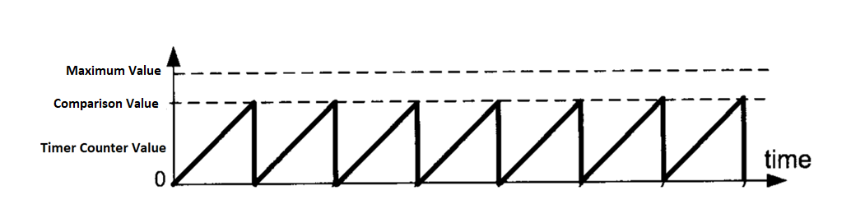
The Interrupt can be set to trigger at a comparison value that need not necessarily be the maximum value of the timer register
When the interrupt is triggered, the value of the timer resets to 0.

Slide 4
NOTE:
Generally generating timer interrupts using Timer0 & Timer2 can cause some of the inbuilt Arduino timer related functions not to work. So it is recommended that we use Timer1 to generate Timer interrupts with a desired Timer Period/Frequency.
We use a library called “TimerOne.h” to generate timer interrupts using Timer1 .

Slide 5
Functions for Timer Interrupts
void initialize(long microseconds)
To initialize Timer 1 with Period entered in microseconds
void setPeriod(long microseconds)
Assigns a time period in microseconds for all Timer functions under Timer1
void attachInterrupt(void (*isr)())
Attaches the function whose name is passed as parameter with Timer1 interrupt. It will run the function, periodically at Timer1`s period.
void detachInterrupt() Disables the attached interrupt.
void stop()
Stop Timer1
void restart()
Restart Timer1

Slide 6
Example: Using Timer1 Interrupt, blink inbuilt LED at 0.5 second period.
#include<TimerOne.h>
int x=0;
void setup()
{
pinMode(13,OUTPUT);
Timer1.initialize(500000); //Initialize & Set Period( of Timer1 with 0.5s (500000 Micro seconds)
Timer1.attachInterrupt(callback);} //Assign “callback” as the Timer Interrupt Function
void callback()
{ //This function simple toggles the inbuilt at 13th pin
if(x==0)
x=1;
else
x=0;
digitalWrite(13,x) ; }
void loop() {
// You have the freedom to put any code here now
}

Slide 7
Let’s do a task
Using Timer1 Interrupt, serial print 0,1,2…. Etc. Initially the rate of printing should be 1 per second. After each number is printed, the rate should be divided by 1.1.

Slide 8
Solution
#include<TimerOne.h>
int i=0;
unsigned long int period = 1000000;
void setup() {
pinMode(13,OUTPUT);
Timer1.initialize(period); //Initialize & set Timer1 period as 1 second (period= 1000000 us)
Timer1.attachInterrupt(callback); //Assign function “callback” as Timer Interrupt function
Serial.begin(9600);
}
void callback()
{
Serial.println(i);
i=i+1;
period = period/1.1; //Reduce “period” by a small factor everytime.
Timer1.setPeriod(period); //Update the period value of Timer1
}
void loop() {
// put your main code here, to run repeatedly:
}

