Slide 1
WED-16.30-6 Presentation
VERDOUW, Midori (s3575912)
PHAM, Van (s3788106)
TJIONG, Julian (s3786866)
CHEONG, Hon Khuin Jonathan (s3642842)
SONG, Jason (s3744335)

Slide 2
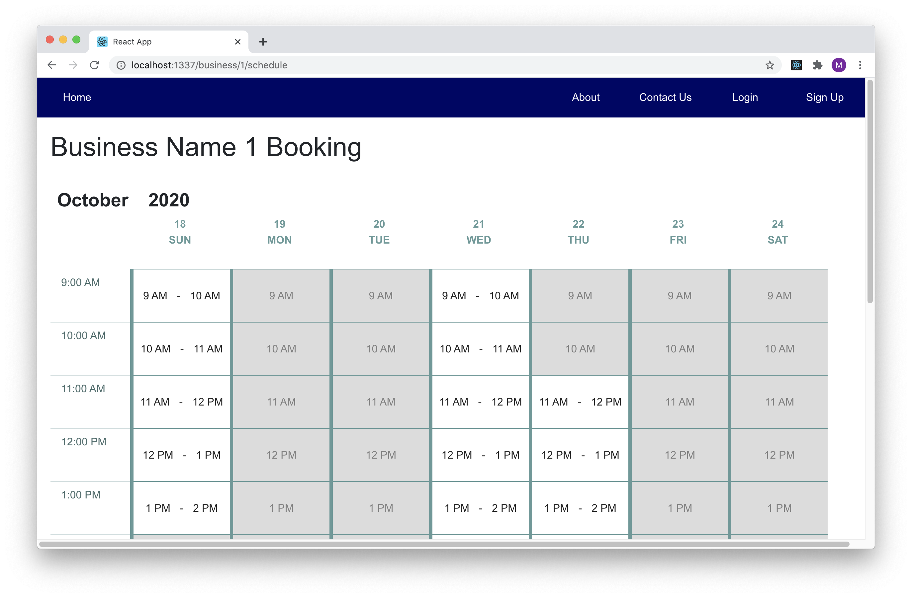
1. Making a Booking (Front End)
Business schedule page
Each timeslot must take the availability of all workers into account
Available & Unavailable timeslots

Slide 3
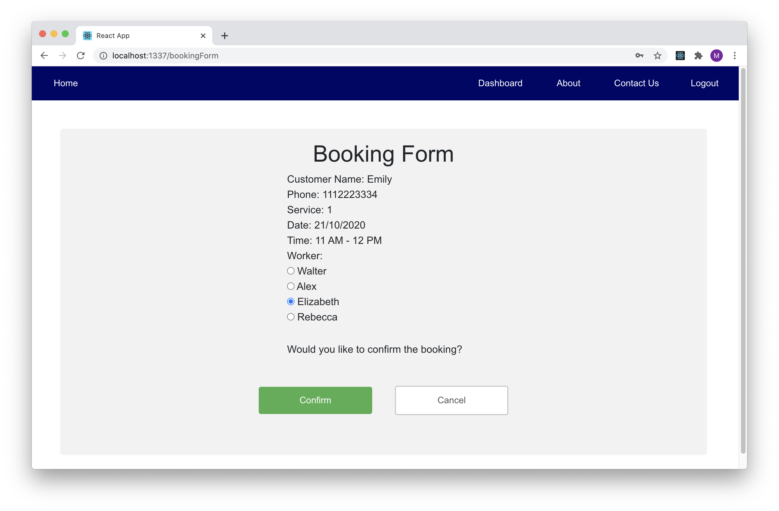
1. Making a Booking (Front End)
Booking form
Redux to keep user information
Use action to communicate with backend

Slide 4
2. Something interesting about what you did

Slide 5
3. Something interesting about what you did

Slide 6
Retrospective
What worked well?
Implementation of core functionalities
What could be improved?
More involvement in CI/CD
What “surprised” you?
Missing group members
What did you learn?
New platforms and tools

