Slide 1
WED-16.30-6 Presentation
VERDOUW, Midori (s3575912)
PHAM, Van (s3788106)
TJIONG, Julian (s3786866)
CHEONG, Hon Khuin Jonathan (s3642842)
SONG, Jason (s3744335)

Slide 2
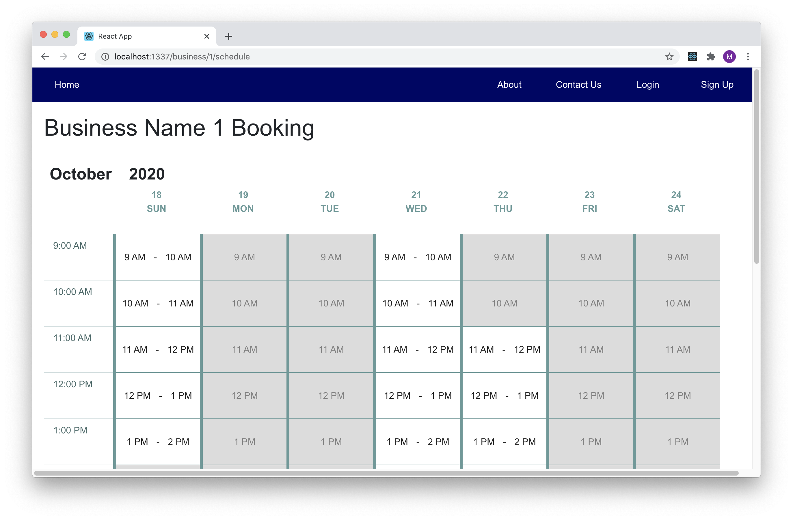
1. Making a Booking (Front End)
Business schedule page
Each timeslot must take the availability of all workers into account
Available & Unavailable timeslots

Slide 3
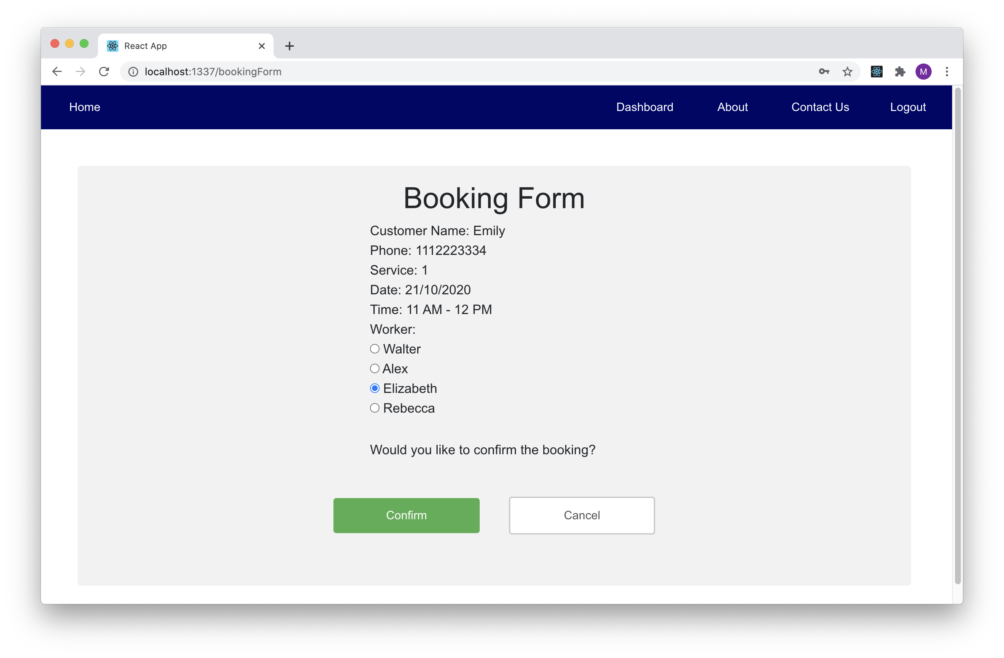
1. Making a Booking (Front End)
Booking form
Redux to keep user information
Use action to communicate with backend

Slide 4
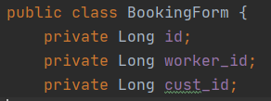
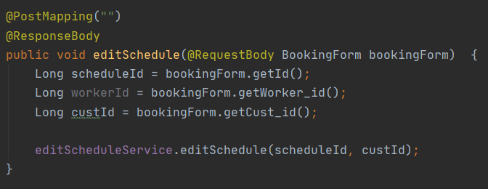
2. Making API for Make Booking (Back End)
BookingForm class for @RequestBody to receive Json from FrontEnd
Call the editScheduleService

Slide 5
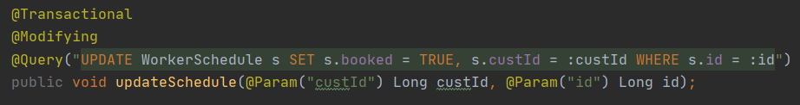
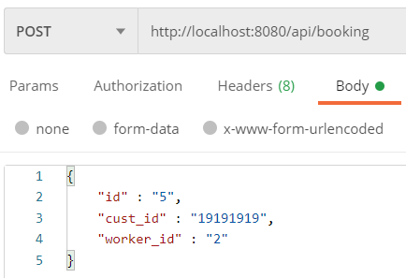
2. Making API for Make Booking (Back End)
Learnt things on @Query

Slide 6

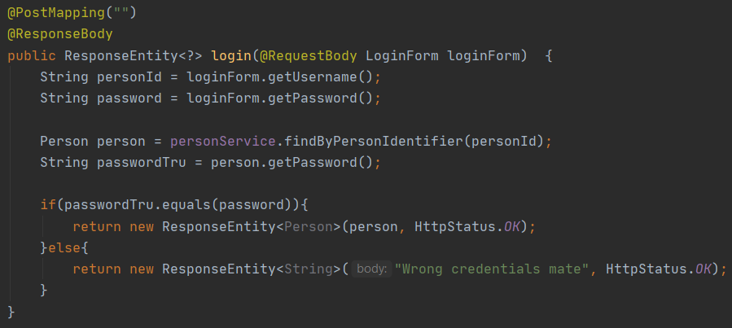
3. Login Functionality (Back End)
LoginForm for @RequestBody
Checks if credentials are correct

Slide 7
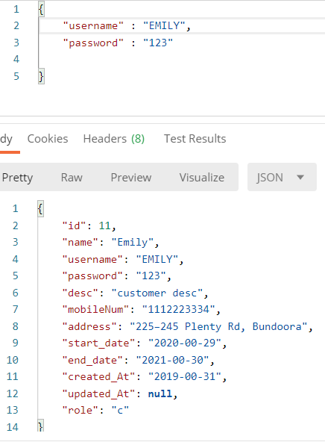
3. Login Functionality (Back End)
Retrieve user information if credentials are valid

Slide 8
Retrospective
What worked well?
Implementation of core functionalities
Sprints based development process
Independent coding task
What could be improved?
More involvement in CI/CD
Unit testing
Higher code quality
Implementation discussion
What “surprised” you?
Some members are inactive/missing
The amount to learn
What did you learn?
New platforms and tools
Spring Boot annotations
Scrum
AWS

