Slide 1
WED-16.30-6 Presentation
VERDOUW, Midori (s3575912)
PHAM, Van (s3788106)
TJIONG, Julian (s3786866)
CHEONG, Hon Khuin Jonathan (s3642842)
SONG, Jason (s3744335)

Slide 2
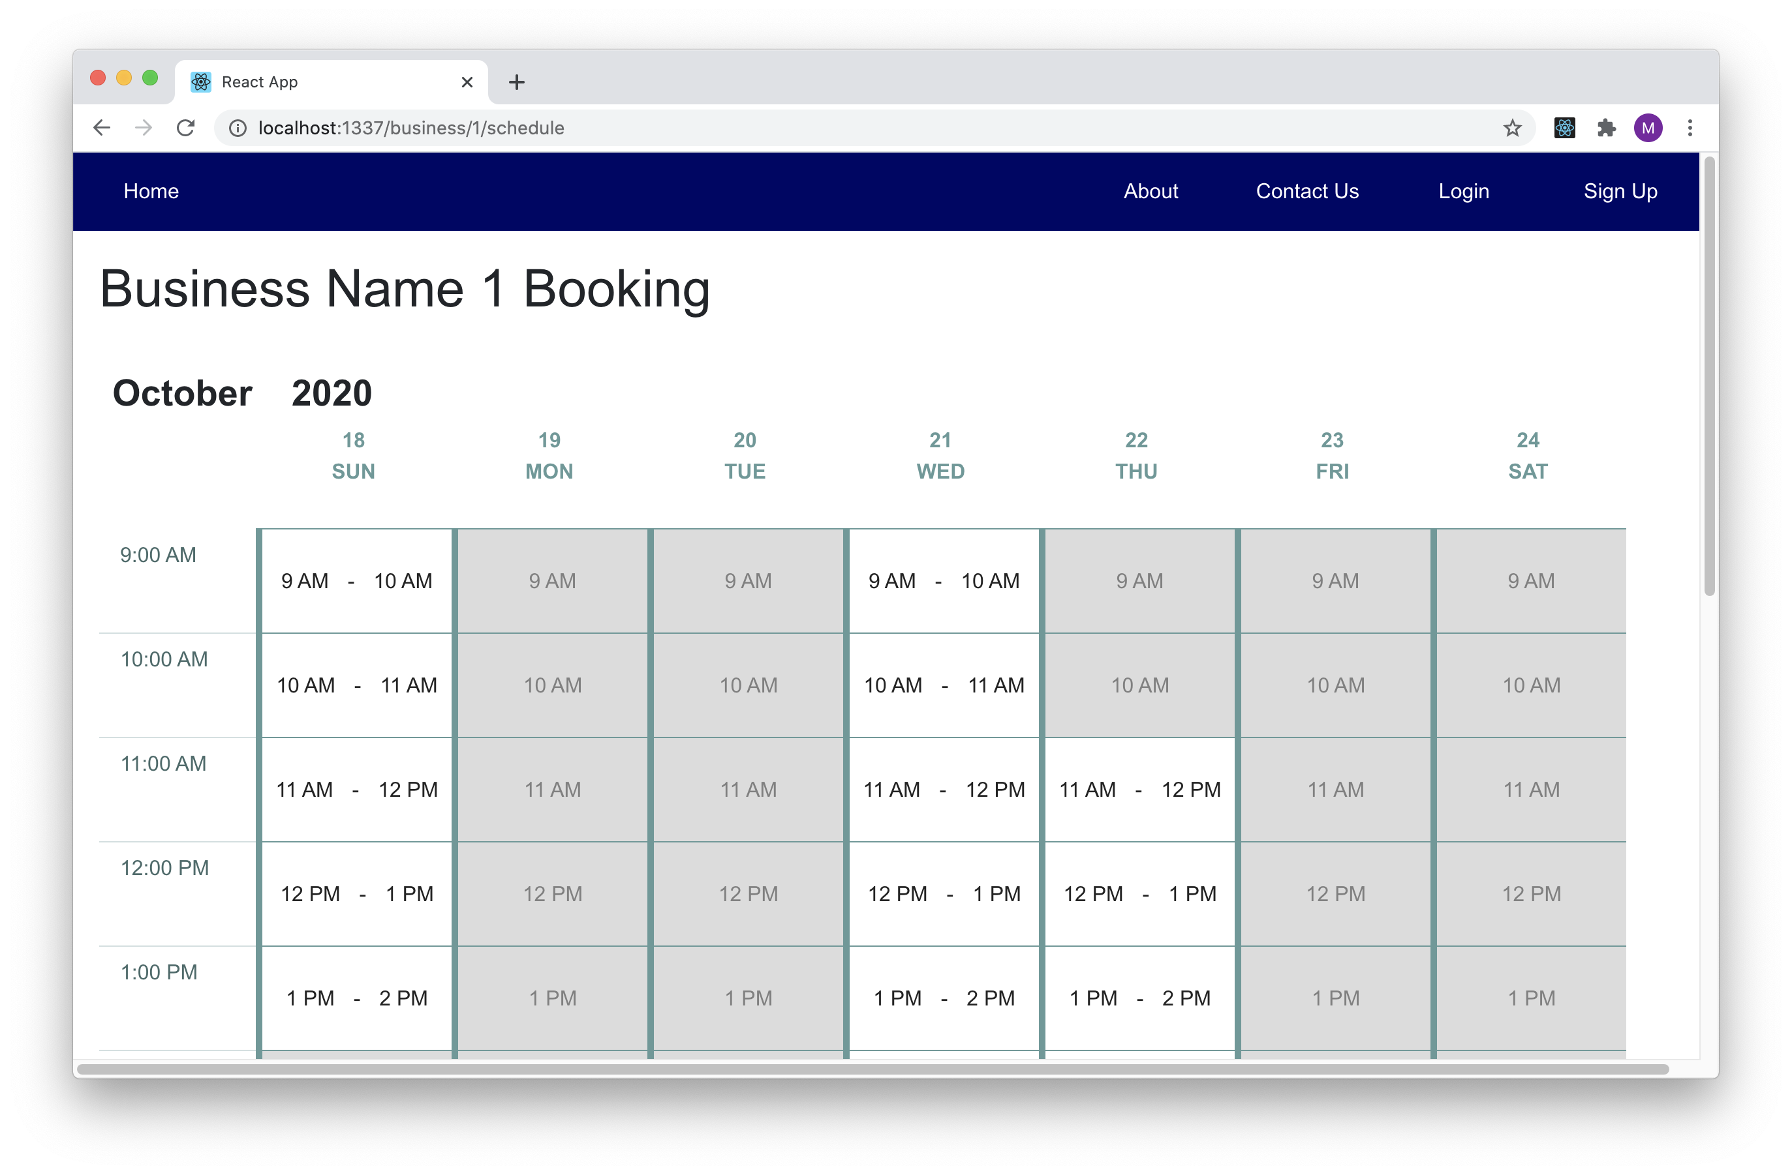
1. Making a Booking (Front End)
Business schedule page
Each timeslot must take the availability of all workers into account
Available & Unavailable timeslots

Slide 3
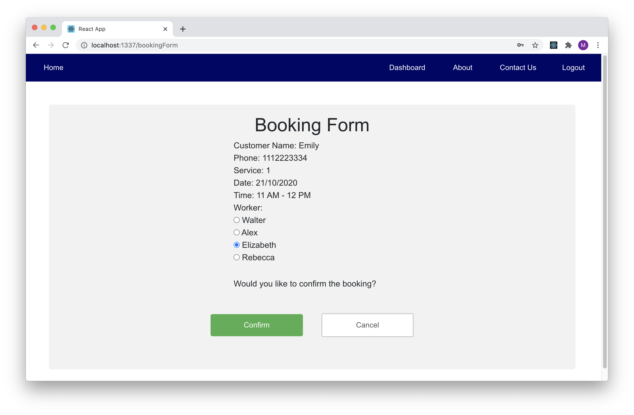
1. Making a Booking (Front End)
Booking form
Redux to keep user information
Use action to communicate with backend

Slide 4
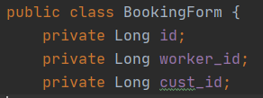
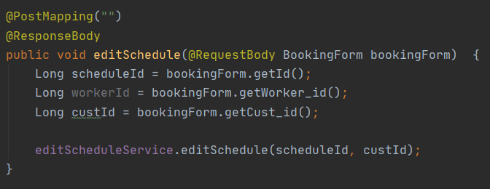
2. Making API for edit schedule (Back End)
BookingForm class for @RequestBody to receive Json from FrontEnd
Call the editScheduleService

Slide 5
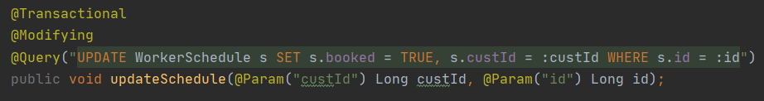
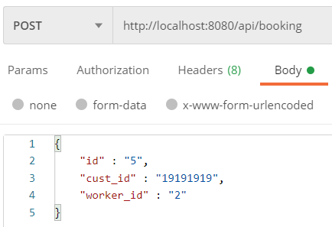
2. Making API for edit schedule (Back End)
Learnt things on @Query

Slide 6

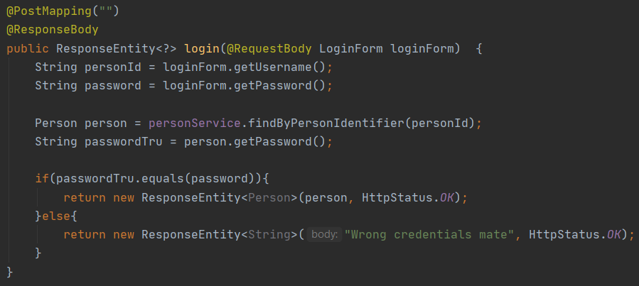
3. Login Functionality (Back End)
LoginForm for @RequestBody
Checks if credentials are correct

Slide 7
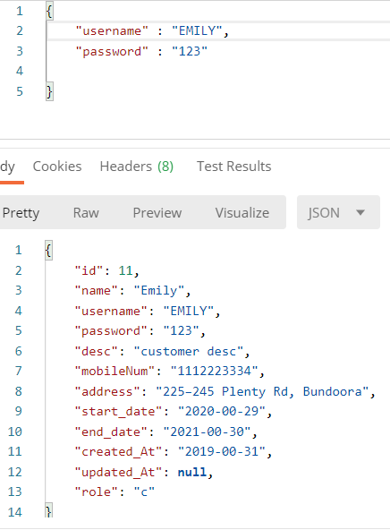
3. Login Functionality (Back End)
Retrieve user information if credentials are valid

Slide 8
Retrospective
What worked well?
Implementation of core functionalities
Sprints based development process
Independent coding task
What could be improved?
More involvement in CI/CD
Unit testing
Higher code quality
Implementation discussion
What “surprised” you?
Missing group members
Some members are inactive
The amount to learn
What did you learn?
New platforms and tools
Scrum
AWS

