Slide 1
CourseCode Course Name Referencing
Study and Learning Centre

Slide 2
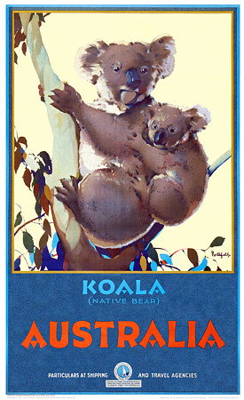
University culture
Universities are like another country.
They have their own unique culture, rules, customs and language.
When entering a new culture you need to understand what these are.
(Source: Google. Image by unknown)

Slide 3
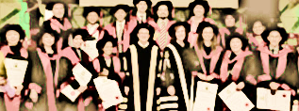
Becoming part of a ‘knowledge community’
University communities value knowledge creation
New knowledge builds on the work of many
University culture expects students to be respectful of this prior knowledge and of the people who generated it
(Hathaway 2015)
(Source: RMIT. Image by Graduation)

Slide 4

How? Reference!
Academic knowledge is about being ‘critical’
analysing, comparing and evaluating information
incorporating other voices (as well as your own)
builds on knowledge using previous contributions
need to acknowledge (reference & cite) these contributions
Source: Flickr. Image by Harmes
Notes:
‘Academic knowledge’ isn’t just recording and rewriting what information already exists.
It is about demonstrating your research, your analysis and evaluation of the information you have found.
You need to add other (credible and authoritative) voices to support your own by using citations and by referencing.

Slide 5
Why do I reference? Part 1
You need to reference all information taken from external sources to:
add credibility to your work
Acknowledgement of academic sources shows that you have undertaken research, rather than inventing information.
acknowledge the work of others
Credit should be given to authors whose work or ideas you have used.
show your ‘voice’
Your argument needs to be distinguished from the sources you have used.
protect against accusations of plagiarism
Without referencing, your original arguments and ideas may not be credited.

Slide 6
But I don’t need to reference …
the words I use to organise and add to the structure of the assignment restating themes that have been cited
common knowledge general or specific to my area of study
my original work – ideas, findings from research or experiments, designs or artworks (unless it has been published or exhibited already)
.

Slide 7
Referencing and plagiarism
Referencing
Acknowledging the ideas of experts in your own writing
Plagiarism
Using the work of others without acknowledgement (cheating)
Buying, stealing or borrowing and submitting others’ work as your own
Downloading, copying, cutting and pasting text without acknowledgement
Using significant ideas from someone else – concepts or theories need to be acknowledged
Violates copyright laws and trademark laws and is academically dishonest

Slide 8
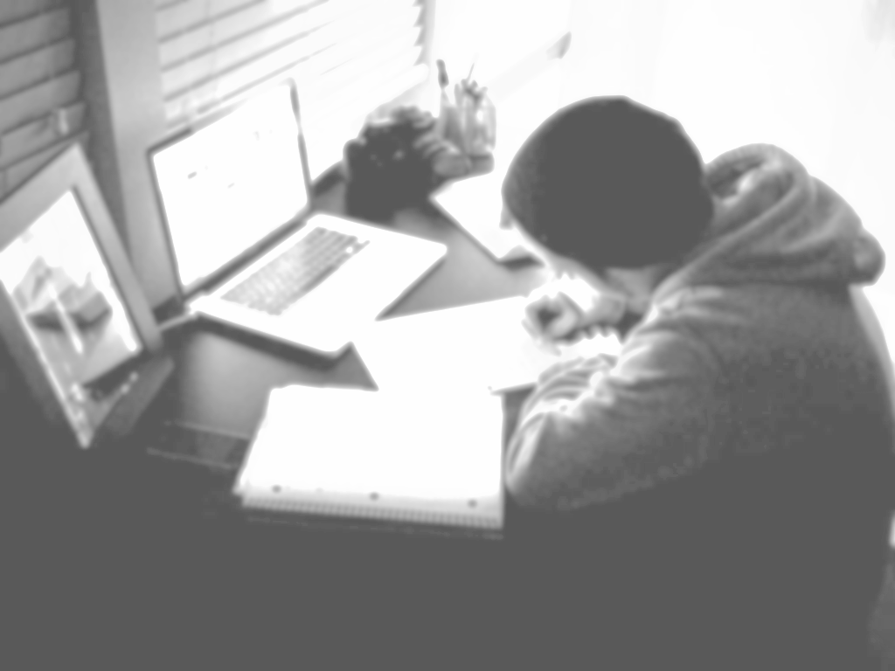

Referencing guides
All referencing systems require the same basic information:
author
year
title
publication details (publisher/place)
Library referencing guides - RMIT University
RMIT Learning Lab
(Source: flikr. Image by Bentley)

Slide 9
References
[Image 1]
Koala, n.d., poster, viewed 1 July 2015, <http://vintagevenus.com.au/vintage/reprints/travel/TV578.jpg>.
[Image 2]
Graduation 2012, RMIT PhD graduates, photograph, viewed 1 July 2015, <http://mams.rmit.edu.au/a05tuhw5pikt.jpg>.
[Image 3]
Harmes, S 2015, stairway to heaven, photograph, viewed 1 July 2015, <https://www.flickr.com/photos/stephanharmes/17056589311/in/photostream/>.
[Image 4]
Bentley, J n.d., Student at desk, photograph, viewed 2 July 2015, <https://www.flickr.com/photos/joshwachaos/5329756408/sizes/l/in/photostream/>.

Slide 10
Writing activity/exercise

Slide 11
Speaking/discussion activity/exercise

Slide 12
Reading activity/exercise

Slide 13
What have you learned?
Q
A
Q
A

