Slide 1
NXRP Maze
C++17 maze game with SFML 3.1.0
Project defense
01
Notes:
Introduce NXRP as a Windows maze game. The player chooses dimensions, follows passages and reaches the exit. Explain that the presentation covers the implemented version, including its test evidence and remaining checks. The maintained solution contains four standard Visual Studio projects.
Sources in this repository:
README.md
NXRP.slnx
ProjectDefaults.props

Slide 2
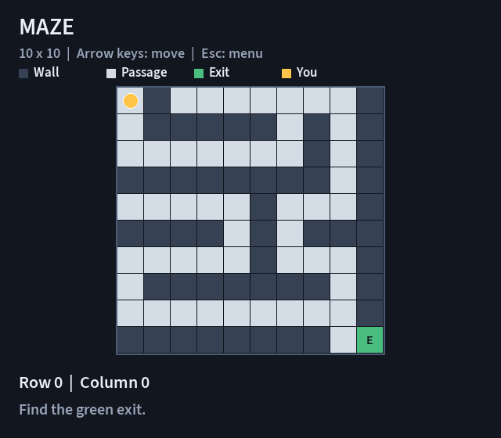
Rules and controls
Start at (0, 0)
Arrow keys move one cell.
Walls and boundaries block moves.
The green bottom-right cell is the exit.
Esc pauses. Continue keeps
the same maze and position.
02
Notes:
Explain the colors using the actual board render: dark walls, light passages, green exit and yellow player. Coordinates are zero-based. The arrow keys request one move per press. Show a blocked move before a legal one during the demo. The image is an archived controller render at the 640 by 560 minimum window size, not a newly executed manual test.
Sources in this repository:
Maze.Graphics/GameView.cpp
Maze.Graphics/main.cpp
Maze.Logic/Maze.Game.cpp
QA/Evidence/Board-10-minimum.png

Slide 3
Project architecture
Maze.Graphics
Application
Maze.Logic
Static library
Maze.Data
Static library
Maze.UnitTest
Native test DLL
Lines point to a dependency. Graphics also uses SFML.
Data and Logic contain no SFML code.
03
Notes:
Read dependency arrows from the consumer to the dependency. Graphics references Logic and Data. Native tests also reference Logic and Data. Logic references Data. Only Graphics depends on SFML. Data owns storage, Logic applies rules, and Graphics handles input and display. CMake builds SFML only. Explain that the diagram shows the four maintained projects, with the third-party dependency mentioned separately.
Sources in this repository:
NXRP.slnx
Maze.Graphics/Maze.Graphics.vcxproj
Maze.Logic/Maze.Logic.vcxproj
Maze.UnitTest/Maze.UnitTest.vcxproj
dependencies/CMakeLists.txt

Slide 4
Data and memory ownership
GameState
maze, player, phase, selectedSize
MazeGrid
size + unique_ptr<MazeCell[]>
One contiguous cell array
index = row * cols + col
Dimensions: 10–50 for each axis. Invalid access throws.
Copying is disabled. Moving transfers ownership.
Replacement and destruction release the previous array.
04
Notes:
MazeGrid uses a dynamic array through std::unique_ptr<MazeCell[]>. Show that row-major indexing gives constant-time cell access. The constructor validates before allocation and fills the array with walls. at checks both coordinates. Copying is disabled to prevent accidental ownership duplication. A move empties the source. Replacement releases the old array, and the destructor performs cleanup automatically. selectedSize is a future-game preference, while the actual maze keeps its own dimensions.
Sources in this repository:
Maze.Data/MazeGrid.h
Maze.Data/MazeGrid.cpp
Maze.Data/GameState.h
Maze.Data/MazeSize.h

Slide 5
Randomized depth-first generation
Allocate walls
Open and push (0, 0)
Stack empty?
Yes
Connect bottom-right
Mark Exit and return
No
Read top room
Find unused rooms
Pop room
to backtrack
No
Any candidates?
Yes
Choose a candidate
Carve wall and push room
Rooms are two cells apart. An even-size edge needs at most two extra cells.
05
Notes:
Walk through the diagram from the initialized wall grid. Rooms lie at even row and column indices. The current room examines unvisited rooms two cells away. A random choice opens both the wall between rooms and the destination, then pushes the destination. A dead end pops the stack. Every new room joins the connected carved area. When DFS ends, the last room connects to the bottom-right exit. For 10 by 10 the last room is (8, 8), and the extension reaches (9, 9). Time and stack space are O(rows * cols). The seeded API reproduces a layout on the same generator and toolchain.
Sources in this repository:
Maze.Logic/Maze.Generation.cpp
docs/ALGORITHMS.md
Maze.UnitTest/MazeGenerationTests.cpp

Slide 6
Movement and session lifecycle
tryMove checks phase, direction, bounds and walls before changing position.
Action | Effect
Blocked move | Keep position and phase
Legal move | Move one cell. Exit sets Won
Esc / Continue | Pause / resume the same unfinished maze
New Game / Exit | Replace the session / release its grid
A replacement layout validates before ownership moves.
A preparation failure preserves the old session.
06
Notes:
tryMove returns Blocked, Moved or Won. Rejected requests leave the game unchanged. The controller switches to the victory page when movement sets Won. Continue requires both a nonempty grid and an unfinished phase, so a completed grid cannot be resumed. New Game prepares a replacement before transferring it into GameState. startGame checks the start cell, the single exit and known cell values. It does not run a reachability search itself. The generator and independent tests establish reachability. Exit and window close call endGame before closing.
Sources in this repository:
Maze.Logic/Maze.Game.cpp
Maze.Graphics/MazeApplication.cpp
Maze.Data/GameState.h

Slide 7
Build and resources
1
Prepare SFML once
Run Prepare-Dependencies.ps1 from the checkout.
2
Open NXRP.slnx in Visual Studio 2026
Select Debug / x64 and build all four projects.
3
Run Maze.Graphics with F5
Build copies assets beside the executable.
The font path uses the executable directory.
07
Notes:
Use Windows with the Visual Studio 2026 C++ desktop workload, MSVC v145, a Windows SDK, Git and CMake 4.2 or later. The generated dependency property sheets belong under ignored build/dependencies. The four Maze projects remain normal Visual Studio projects. ProjectDefaults.props selects C++17. Read the exact Command Prompt commands in README for setup and VSTest. Build copies assets, including the bundled Source Sans 3 font and license. The Windows module path resolves the font even if the working directory changes. A font-load failure reports the path and exits cleanly.
Sources in this repository:
README.md
Prepare-Dependencies.ps1
ProjectDefaults.props
Maze.Graphics/main.cpp
Maze.Graphics/ExecutablePath.cpp
Maze.Graphics/Maze.Graphics.vcxproj

Slide 8
Tests and QA evidence
Local check | Result | Date
Debug rebuild + native tests | 63 / 63 Passed | 31 Oct 2026
Release rebuild + native tests | 63 / 63 Passed | 31 Oct 2026
63 tests across six classes
Independent BFS checks every allowed size pair: 1,681.
Fixed seeds check repeatability and playable routes.
Archived QA: 78 cases, 75 Passed, 0 Failed, 3 Not Run.
The workbook records native runs and UI/probe observations separately.
08
Notes:
The final documentation-stage rebuild ran on 31 October 2026 in both x64 configurations. Both VSTest console runs passed all 63 tests. Six test classes cover dimensions, array ownership, GameState, movement, generation and session lifecycle. The independent one-cell BFS checks all walkable cells and all 1,681 valid dimension pairs. The archived QA workbook describes the 29 October source run at baseline 44d251e and contains 78 distinct cases. Its count includes 63 native cases, each with separate configuration steps, plus 15 GUI/manual scenarios. A successful VSTest run does not confirm Test Explorer UI execution.
Sources in this repository:
docs/VALIDATION.md
Maze.UnitTest/MazeGenerationTests.cpp
QA/README.md
QA/Evidence/Native-Debug.trx
QA/Evidence/Native-Release.trx

Slide 9
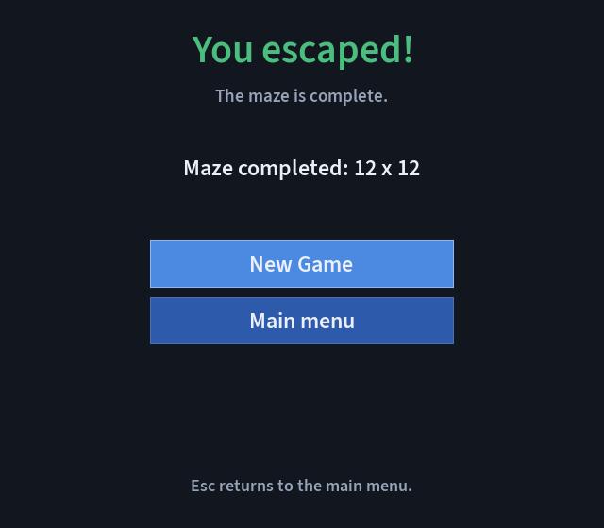
Demonstration and remaining checks
Demonstration
Choose size, start a maze and move.
Pause, change the next-game size,
then Continue the current maze.
Checks still pending
Complete hover/click sweep
Setup on a second clean machine
Execution in Test Explorer
Settings currently last for one launch.
09
Notes:
For a short live demo, show the five menu choices, enter Settings and save a rectangular size, then start a random maze. Show a boundary rejection and a legal move. Press Esc, change next-game dimensions, then Continue to demonstrate preservation of the current board. Start another game to apply the new size. Explain the victory controls using the archived victory render if a complete route would take too long. The pending QA items remain Not Run. The application currently stores preferences only in memory, and has no exposed seed input, timer, move counter, same-layout restart or zoom. The workbook and presentation passed engine checks, while native Excel and PowerPoint UI behavior has not been verified.
Sources in this repository:
QA/README.md
QA/Evidence/Victory-minimum.png
Maze.Graphics/MazeApplication.cpp
docs/VALIDATION.md

Slide 10
Team responsibilities
Participant | Development area
RMKolibarov24 | Solution setup, dependencies and documentation
HAMihaylov24 | Data, game rules, generation and lifecycle
PDKapralev24 | SFML menu, rendering and screen transitions
NKPeshev24 | Native test coverage and QA review
Questions
10
Notes:
Introduce the four confirmed usernames and explain the areas shown. These are responsibility areas, not claims that every commit or test execution came from the listed account. The QA workbook keeps its actual execution methods and metadata. Be ready to explain why unique_ptr owns the array, why Data and Logic are independent of SFML, how even dimensions connect to the exit, and how the BFS tests differ from the DFS generator.
Sources in this repository:
docs/TECHNICAL.md#team-responsibilities
QA/README.md

